Slide 1
Quantum Gates and Circuits
Rohini V
GiQ Indian Ambassador | IBM Qiskit Certified Associate Developer

Slide 2
In quantum computing and specifically the quantum circuit model of computation, a quantum logic gate (or simply quantum gate) is a basic quantum circuit operating on a small number of qubits.
They are the building blocks of quantum circuits, like classical logic gates are for conventional digital circuits.

Slide 3

I Gate
The identity gate is a single qubit operation that leaves the basis states |0> and |1> unchanged.

Slide 4

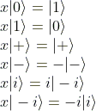

X Gate
X gate switches the amplitudes of the state |0> and |1>

Slide 5

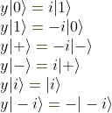
Y Gate
The effect of this gate is to flip a qubit’s |0> and |1> amplitudes and multiplies by an imaginary number (phase).
From a probabilities perspective, this gate has the same effect as the X gate.
However, the additional phase makes this gate very useful in creating certain constructive / deconstructive interferences.

Slide 6


Z Gate
The effect of this gate leaves a qubit’s |0> amplitude unchanged, while multiplying by -1 (phase) to a qubit’s |1> amplitude.
The power of this gate comes from the fact that it only affects the |1> component, which will be frequently used for picking out certain states in the system while leaving others unaltered.

Slide 7
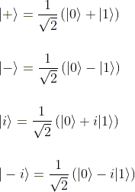





H or Hadamard Gate
Creates a superposition of |0> and |1>
=
=

Slide 8



S Gate and S Dagger Gate
Also known as Square root of Z Gate

Slide 9

T and T Dagger gate
T gate is also called as

Slide 10
Single Qubit Gates
qc.x(0) Performs a rotation of pi around x axis
qc.y(0) Performs a rotation of pi around y axis
qc.z(0) Performs a rotation of pi around z axis
qc.s(0) Performs a rotation of pi/2 around z axis
qc.sdg(0) Performs a rotation of -pi/2 around z axis
qc.t(0) Performs a rotation of pi/4 around z axis
qc.tdg(0) Performs a rotation of –pi/4 around z axis
qc.h(0) Performs a rotation of pi around an axis, located halfway between x and z axis

Slide 11
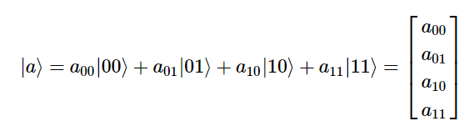

Multi Qubit Gates
Single qubit has two possible states, and a qubit state has two complex amplitudes
Two qubits have four possible states 00, 01, 10, 11
State of two qubits requires four complex amplitudes

Slide 12
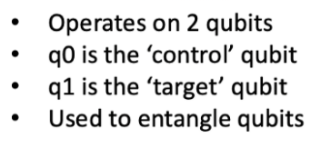
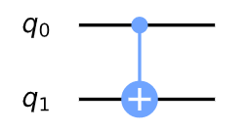
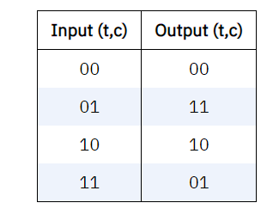
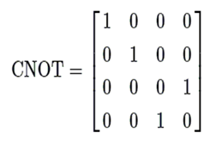
The CNOT gate/Feynman Gate

Slide 13
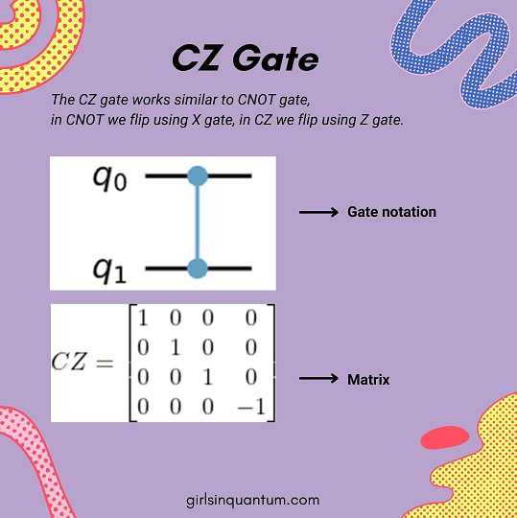

Slide 14
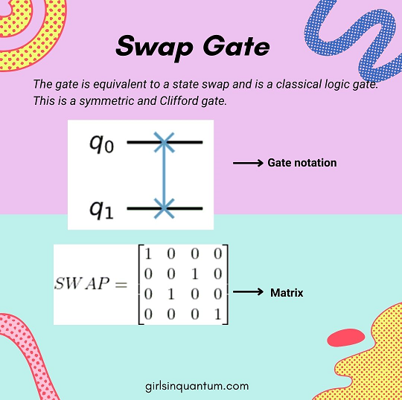

Slide 15
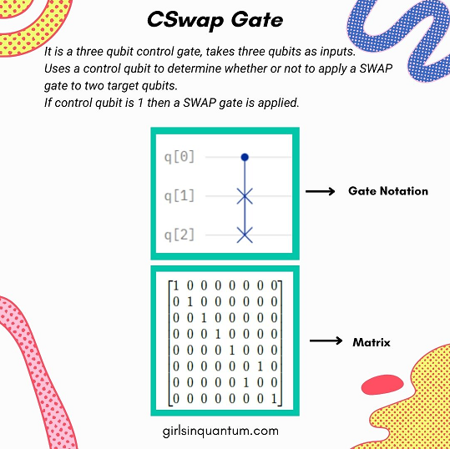

Slide 16
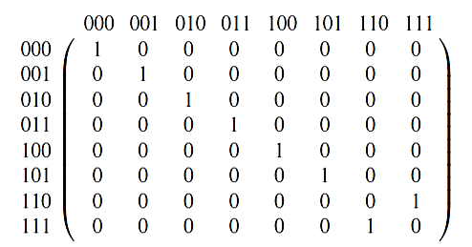
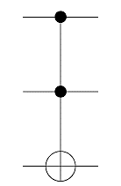
CCNOT Gate/TOFFOLI Gate
It is a three qubit control gate, takes three qubits as inputs.
ccx(q0,q1,q2)

Slide 17
Quantum Hardware
What actually happens when you run a circuit?
Transpilation: Classical computers at IBM convert the gates in your circuit to gates that can be implemented on the quantum computer you want to use
Gates as Pulses: These gates get converted into a series of microwave pulses, which get sent to the qubits on the QC. The state changes due to these signals
Readout: Classical computers measures the final state of the qubits.
Display: The final state gets sent back to your computer and is displayed as counts or histogram

Slide 18
Qubits can be many different things
There are many competing ways to make qubits.
Different applications may require different qubits.
Examples:
Superconducting
Trapped Ions
Diamond NV Centres
Photonics

Slide 19
Components of a Quantum Computer
Quantum Chip: Where the qubits are located
Others parts: Protect and house the chip and also to keep it functioning as well as to provide connection to the external world
The quantum processor needs to be at almost absolute zero
But the other components needs to be at room temperature

Slide 20
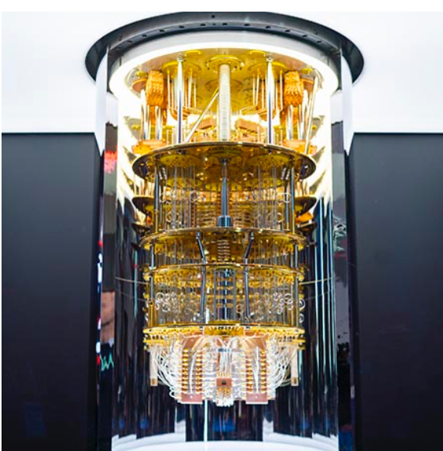
How does the chandelier keep the chip cool?
Tubes carry liquid helium to the chip
Liquid helium is at -450 Fahrenheit(about 4K)
A technique called Dilution Refrigeration reduces the temperature further to around 20mK

Slide 21


