Slide 1
MediCare – Smart Health Record & Medicine Management System
By: Riya Gandhi (Enrollment No: [ADT23SOCB1548])
Guide: [Rohini Bhosale]
Department of Information Technology
[MIT-ADT UNIVERSITY]
Date: 3 November 2025

Slide 2
Project Overview and Introduction
Introduction:
MediCare is a ReactJS-based web application that allows users to securely upload and store their medical reports, schedule medicine reminders, and track remaining medicine quantities.
Problem Statement:
People often misplace medical documents and forget to take medicines on time.
Motivation:
  To simplify daily medicine tracking and report management digitally.
Proposed Solution:
A full-stack system providing secure login, report upload, alerts, and medicine tracking.

Slide 3
Scope and Objectives
Scope:
User login system
Upload & manage medical reports
Schedule medicines with alerts
Track medicine usage and remaining stock
Out of Scope:
Hospital integration or AI diagnosis
Key Objectives:
Secure login & data storage
Medicine scheduler with alerts
Alert notification system
Track medicine stock

Slide 4
Technology Stack
Front-End:
ReactJS: Used for building dynamic, component-based user interfaces with efficient state management and reusability.
HTML5: Provides the structural foundation of the web pages, ensuring semantic and accessible content layout.
CSS3: Enables responsive and visually appealing styling through modern design techniques such as Flexbox, Grid, and animations.
JavaScript : Powers the interactive features and logic of the application, handling user actions and dynamic updates efficiently.
React Router: Manages client-side routing to enable smooth navigation between different views or pages without reloading the browser.
Database / Storage:
Local Storage: Used for lightweight, client-side data persistence. It allows storing key-value data within the user’s browser, enabling the app to save user preferences, login sessions, or cached information even after page reloads.

Slide 5
Database Design
Collections:
Users – authentication & profiles
Medical Reports – uploaded files & metadata
Medicines – name, dosage, schedule, remaining qty
Relationships:
One user → multiple reports
One user → multiple medicine entries

Slide 6
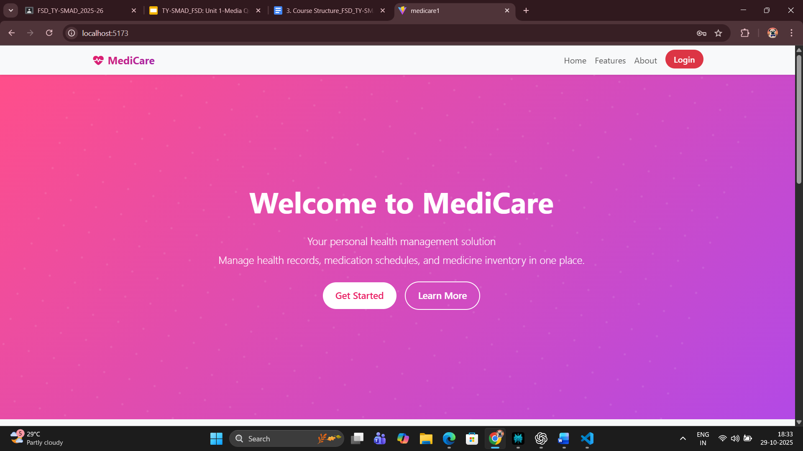
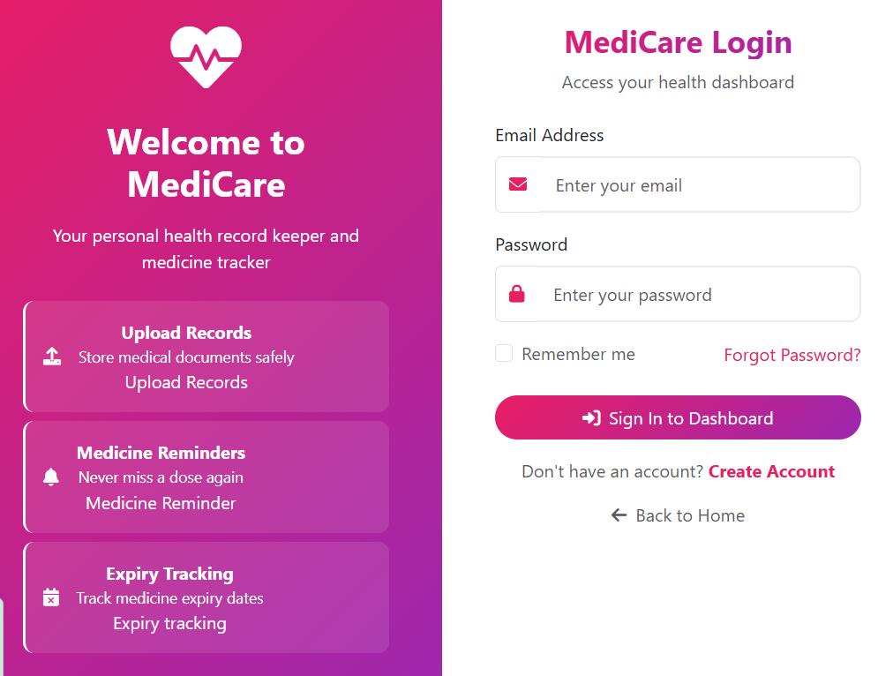
Implementation & Results (Front-End)

Slide 7
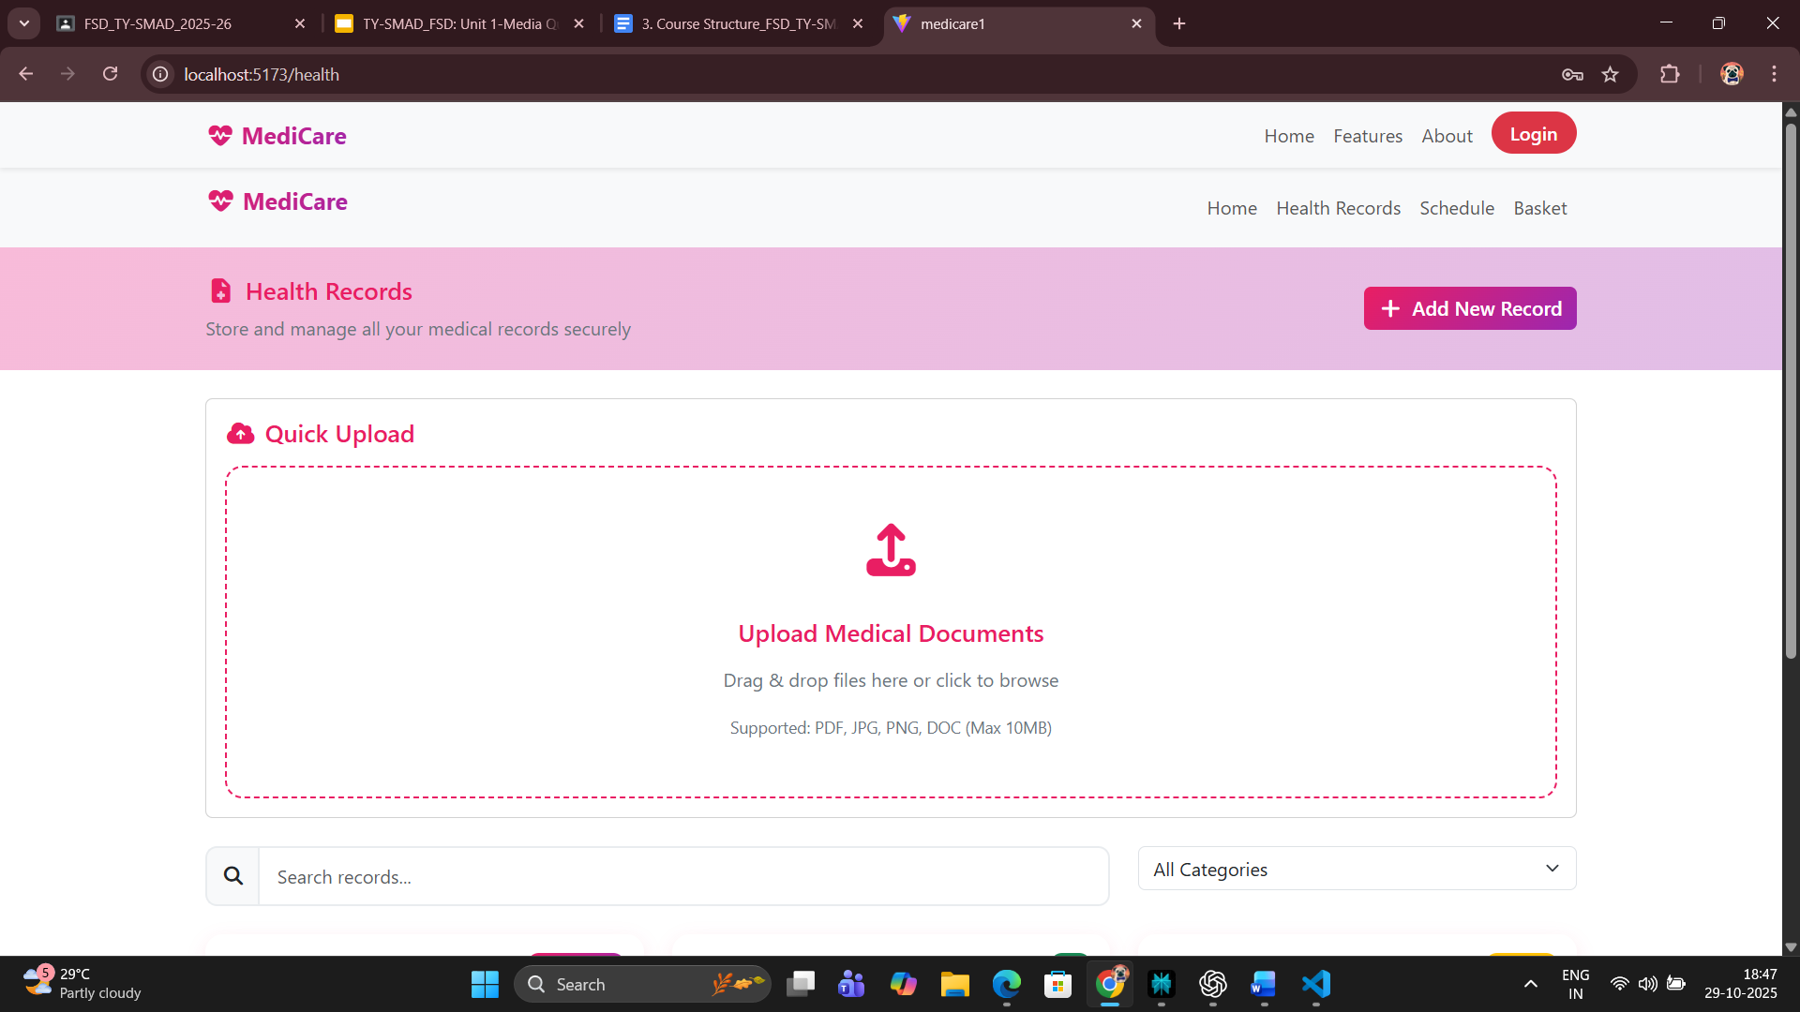
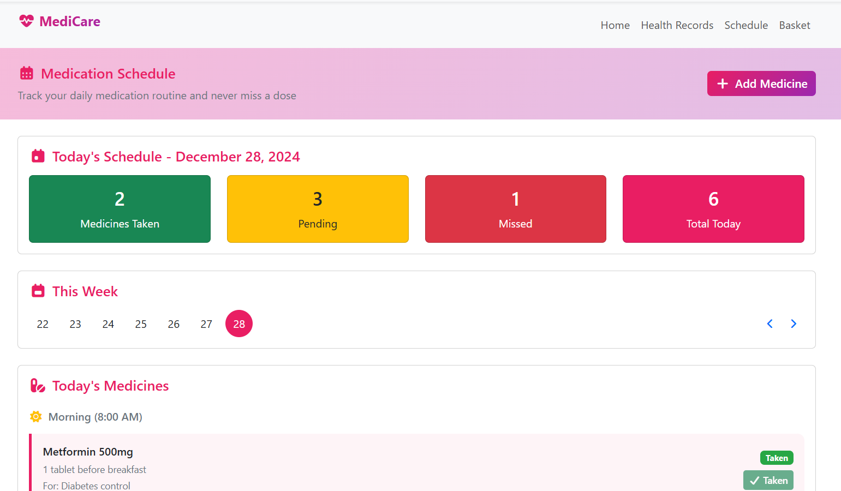
Implementation & Results (Back-End)

Slide 8
Demo
User Journey:
Login/Register
Upload medical reports
Add medicines with reminders
Receive alerts
Track medicine stock
Live Flow:
Dashboard → Upload → Schedule → Alerts

Slide 9
Challenges and Solutions
Challenges:
- File upload & storage
- Alert scheduling
- State management
- Security handling
Solutions:
- Implemented JS timers & notifications
- Used React Context API

Slide 10
Conclusion and Future Scope
Conclusion:
MediCare provides a secure and efficient system for managing medical records and medicine schedules.
Future Scope:
- Integration with wearable devices
- Doctor-patient portal
- AI-based suggestions
- SMS/email notifications

