Slide 1


Auto-Attendance System using Face Detection and Recognition
Team Members:
1. Rohini Das - 20BCB0098
2. Dharmik Naicker – 20BCB0148
3. Shobhit Agrawal – 20BDS0162
4. Somit Jain – 20BDS0181

Slide 2
Contents
Introduction
Problem Statement
Literature Review
About Dataset
Proposed Methodology
Performance Measure
Results
Comparison
Conclusion
Reference

Slide 3
Introduction
Facial recognition technology has seen significant advancements in recent years, with growing interest in developing more accurate and efficient models. However, the task of facial recognition remains challenging due to the high variability of faces in images, including differences in pose, expression, and lighting conditions.
To address this challenge, researchers have proposed using deep learning techniques, such as convolutional neural networks (CNNs), to extract high-level features from images for face detection and recognition.

Slide 4
Problem Statement
In this project, we focus on developing a face detection and recognition model using ResNet50, a deep CNN architecture that has shown excellent performance in image recognition tasks.
We use transfer learning to fine-tune the model for our specific task of facial recognition, leveraging the pre-trained ResNet50 model's existing weights and adding new layers designed to recognize faces.
Input will be datasets of images like AT&T and FaceScrub datasets.
Output will be the accuracy of our model for classification of the images (in the validation set) into correct classes.

Slide 5
Literature Review
Ref No | Title | Method | Dataset | Performance Metrics | Objective/ Limitation
[1] | Discovering the Best Feature Extraction and Selection Algorithms for Spontaneous Facial Expression Recognition | SIFT+FAP, mRMR, Adaboost and SVM | Feedtum and NVIE | Accuracy ± One standard deviation | Direct comparison of texture, geometry, and their fusion, in addition to numerous selection methods
[3] | Algorithm for Efficient Attendance Management: Face Recognition based approach | Face Recognition based approach, methods (Histogram normalization, median filtering, Voila and Jones, Haar classifiers, Kernel Methods, Neural Networks, EigenFace) | Own images from database | Accuracy | To increase the efficiency of face recognition algorithm using fast face detection algorithm. Limitation: There is a need to use some algorithms that can recognize the faces in veil to improve the system performance.

Slide 6
Literature Review
Ref No | Title | Method | Dataset | Performance Metrics | Objective/ Limitation
[2] | Direct comparison of texture, geometry, and their fusion, in addition to numerous selection methods | Adaboost, Detector Cascade | Original Dataset | Accuracy | Achieve high detection rate in processing images extremely rapidly.
[4] | Real Time Human Face Detection And Tracking | Vila Jones algorithm, Adaboost, Cascading | Own dataset | Accuracy | Real time human face detection and tracking

Slide 7
Literature Review
Ref No | Title | Method | Dataset | Performance Metrics | Objective/ Limitation
[5] | Convolutional Neural Networks (CNNs) for face mask detection and recognition. | Own Dataset - of over 500 images with masks and without masks | Accuracy | Exact value not mentioned | its sensitivity to different lighting conditions, camera angles
[6] | CNN, Mobile_NetV2, Tensorflow framework | Own local dataset, separate test dataset | Accuracy | 96.85 | Small or imbalanced dataset, focused on evaluating the performance in controlled environments, not scalable

Slide 8
Literature Review
Ref No | Title | Method | Dataset | Performance Metrics | Objective/ Limitation
[7] | KNN, python libraries like bumpy, PIL, Keras OpenFace, Nvidia Software Development Kit. | Own dataset with photos of 11 student faces with 15 images to train and 5 images to test for each student | Accuracy | 100% for the dataset they created | It was not tested on a real life dataset which can lead to decrease in accuracy. It doesn't work well for faces with masks.
[8] | Unsupervised learning approach, GAN to generate synthetic face images, CNN for detection, ResNet | One normal light face detection dataset WIDER FACE and the low-light face detection dataset DARK FACE | Accuracy | 60.7% | Proposed HLA still requires many low-light Images, extend HLA to other high-level tasks

Slide 9
Literature Review
Ref No | Title | Method | Dataset | Performance Metrics | Objective/ Limitation
[9] | CNN with multiple convolutional & pooling layers, fully connected layers, FaceNet and OpenFace architectures, TensorFlow and Keras libraries | LFW and Pin Faces as network learning datasets, ORL Faces dataset for testing | Accuracy, Precision, Recall | 98% | Privacy concerns, ethical implications
[10] | RCNN, YOLO V3, Azure | Own dataset with 20 photos of each student | Accuracy | 100% but only in paper’s dataset | The model is not tested for a large number of people.

Slide 10
Literature Review
Ref No | Title | Method | Dataset | Performance Metrics | Objective/ Limitation
[11] | Deep learning: Convolutional Neural Network, Spatial transformer network (STN) | Two datasets: LFW (Labelled Faces in the Wild) dataset, and their own classroom dataset | Accuracy | For LFW: 98.67% For Classroom dataset: 100% | Limited training data (classroom data having only 25 frames)
[12] | Single shot multi-box detector and VGG network | Own dataset and WIDER dataset | Accuracy | 94.66% | Wider set of use cases won't work so advancement needs to be made in hardware for efficiency, powerfulness,

Slide 11
Literature Review
Ref No | Title | Method | Dataset | Performance Metrics | Objective/ Limitation
[13] | Face recognition system that uses OpenCV and deep learning techniques | Own dataset of real and fake faces. | Accuracy | authors report that the system achieves high accuracy | the privacy implications of collecting and storing facial images also need to be considered
[14] | Haar Cascade classifier with their proposed system | Own Dataset - Face video of 3–5 s recorded for every student in the class | Accuracy | 93.1% | Intolerant to noise, Proper security measures against attacks

Slide 12
About Dataset AT&T
The dataset was collected from kaggle and it was put to use within the framework of a face recognition experiment run in tandem with the Speech, Vision, and Robotics Group of the Cambridge University Engineering Department.
Each of the forty individual themes is represented by 10 photographs. Images of various persons were captured at different times of day, with varied lighting conditions, and with the subject either wearing or not wearing spectacles, or having open eyes and a smile on their face. All the pictures were taken head-on with the subjects against a uniformly black background (with tolerance for some side movement).
The size of each image is 92x112 pixels, with 256 gray levels per pixel. The images are organized in 40 directories (one for each subject), which have names of the form sX, where X indicates the subject number (between 1 and 40). In each of these directories, there are ten different images of that subject, which have names of the form Y.pgm, where Y is the image number for that subject (between 1 and 10).
Challenges faced during the use of dataset was while preprocessing the images using keras library the acceptable extensions are .img, .png, .jpeg. Jpg etc but our images are of the form .pgm because of which we needed to convert all the images to appropriate extensions. In this case we converted the images into .png.

Slide 13
About Dataset FaceScrub
The FaceScrub dataset is a public dataset of facial images that is commonly used for research in facial recognition and computer vision. It was created by researchers at the University of Massachusetts, Amherst and Columbia University, and contains about 43000 images of celebrities collected from the internet.
The images in the dataset are labeled with the celebrity's name. The dataset includes images of both male and female celebrities from a variety of ethnic backgrounds, and the images are captured in a wide range of lighting and pose conditions.
The size of each image is in the range 3KB – 100KB. The images are organized in separate directories for every celebrity. In each of these directories, there are different number of images, which have names according to the celebrity’s name with a different number with each file. The images are in JPEG, PNG and BMP formats and have a resolution of about 100x100 pixels.
One of the main challenges encountered while working with the FaceScrub dataset was the high computational demands required to effectively process and analyze the large amount of data contained in the dataset. The significant size of the dataset, along with the high dimensionality of the images, could make it computationally intensive to train deep learning models or perform complex analyses, requiring specialized hardware and careful optimization strategies.

Slide 14
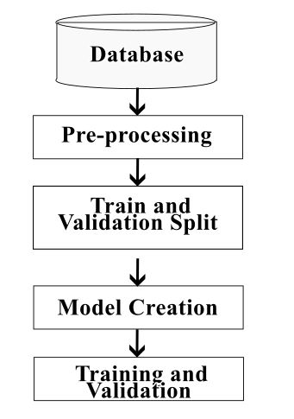
Proposed Methodology

Slide 15
Proposed Methodology
Database: We have used the AT&T and FaceScrub database, which are openly accessible database with different images of distinct subjects taken at different time with varying lighting, facial expressions.
Preprocessing: After importing the dataset, we are resizing the images to 180*180 and changed the extension (.pgm to .png).
Train and Validation Split: The pre-processed data is now divided into train and validation sets, we split the dataset into 80-20.
Model Creation: ResNet-50, a convolutional neural network with 50 layers, is what we employ. A network that has been pretrained using more than a million photos from the ImageNet database was loaded. Then, we supplemented the pretrained model with our own layers.
Training and Validation: After creating the model, we are running multiple epochs . Each epoch consists of training the model and validating it.

Slide 16
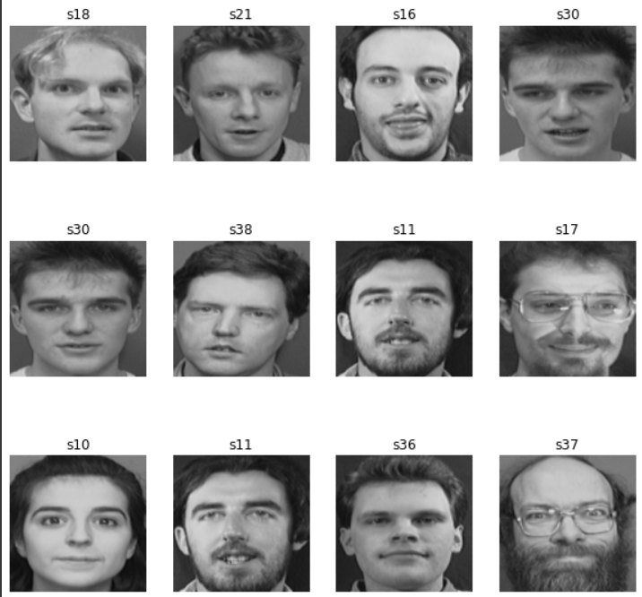
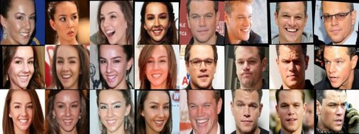
Sample Screenshots
Dataset Name | Screen Shot
AT&T
FaceScrub

Slide 17

Performance Measure
Accuracy: Accuracy is a measure of how close a measured or calculated value is to the true or expected value. It is often expressed as a percentage, and is commonly used to assess the performance of models or algorithms in machine learning, data analysis, and other fields.
Validation Accuracy: Validation accuracy is a metric that measures the performance of a machine learning model on a separate validation dataset that is not used for training the model. It is often used to estimate how well the model will generalize to new, unseen data.
$$Accuracy =\frac{TP+TN}{TP+TN+FP+FN}$$
Validation $Accuracy =\frac{TP+TN}{TP+TN+FP+FN}$

Slide 18


Performance Measure
Loss: Loss refers to the difference between the predicted values of the model and the actual values of the training data. It is a measure of how well the model is able to fit the training data.
Validation Loss: Validation loss is a measure of how well a model generalizes to new, unseen data. During the training process, a portion of the available data is typically set aside as a validation dataset. After each training epoch, the model's performance on the validation dataset is evaluated using a loss function, such as “sparse_categorical_crossentropy”, and the resulting value is called the validation loss.
$$L = −\left(\frac{1}{N}\right)×Σ\left(y×log\left(y_pred\right)\right)$$
$$L = −\left(\frac{1}{N}\right)×Σ\left(y×log\left(y_pred\right)\right)$$

Slide 19
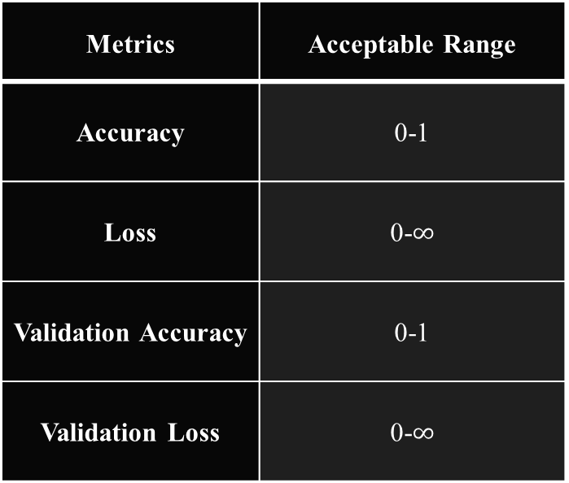
Performance Measure
Metrics | Acceptable Range
Accuracy | 0-1
Loss | 0-$∞$
Validation Accuracy | 0-1
Validation Loss | 0-$∞$

Slide 20
Results
Method | Dataset | Accuracy | Loss | Validation Accuracy | Validation Loss
ResNet-50 + 3 additional layers | AT&T | 1.00 | 0.0405 | 0.9872 | 0.2188
 | FaceScrub

Slide 21
Comparison (AT&T Dataset)
Reference No. | Proposed Model | Existing Work | Proposed Model Accuracy | Existing Work Accuracy
[15] | ResNet-50 + 3 additional layers | ANN combined with modified MAML. | 98.72% | 96.20%
[16] | ResNet-50 + 3 additional layers | Residual CNN - Resnet 152v2 is the residual network variation used by the authors | 98.72% | 97%
[17] | ResNet-50 + 3 additional layers | CNN with the Approximation Wavelet Transformation | 98.72% | 97.42%
[18] | ResNet-50 + 3 additional layers | AlexNet-CNN architecture-based transfer learning framework | 98.72% | fc6: 96% fc7: 98.17% fc8: 97%
[19] | ResNet-50 + 3 additional layers | AB-FR model, a convolutional neural network face recognition method based on BiLSTM and attention mechanism. | 98.72% | 96.79%

Slide 22
Comparison (FaceScrub Dataset)
Reference No. | Proposed Model | Existing Work | Proposed Model Accuracy | Existing Work Accuracy

Slide 23
Conclusion
In conclusion, this paper has demonstrated the effectiveness of transfer learning using the ResNet-50 architecture along with three additional layers for a specific task. By leveraging the pre-trained ResNet-50 model on a large dataset, the model was able to learn useful features that were relevant to the new dataset. The addition of three extra layers allowed the model to adapt to the new task more effectively, resulting in a higher validation accuracy compared to other published papers in the same domain.
This approach employs several aspects of image classification, object detection, and segmentation and the high accuracy achieved by our proposed method can help improve the efficiency and accuracy of automated systems in various domains, especially automating attendance in classes.
Overall, this study highlights the potential of transfer learning using pre-trained models, particularly the ResNet-50 architecture, in improving the performance of deep learning models in different tasks. Further research can be conducted to finetune the applicability of our model on live data in a production environment.

Slide 24
Reference
[1] Zhang, Ligang & Tjondronegoro, Dian & Chandran, V.. (2012). Discovering the Best Feature Extraction and Selection Algorithms for Spontaneous Facial Expression Recognition. Proceedings - IEEE International Conference on Multimedia and Expo. 1027-1032. 10.1109/ICME.2012.97.
[2] Viola, Paul & Jones, Michael. (2001). Robust Real-Time Object Detection. International Journal of Computer Vision - IJCV. 57.
[3] Yousaf, Muhammad Haroon & Baloch, Naveed Khan & Ahmad, Waqar & Baig, Muhammad. (2012). Algorithm for Efficient Attendance Management: Face Recognition based approach. international journal of computer science issues. 9.
[4] Smitha, & Hegde, Pavithra & Afshin,. (2020). Face Recognition based Attendance Management System. International Journal of Engineering Research and. V9. 10.17577/IJERTV9IS050861.
[5]C, J. N., Karigar, A., & Anantapura, A. (2022). Convolution Neural Network Based Covid -19 Face Mask Detection and Recognition. 2022 IEEE 2nd Mysore Sub Section International Conference (MysuruCon), Mysore Sub Section International Conference (MysuruCon), 2022 IEEE 2nd, 1–4.
https://doi.org/10.1109/MysuruCon55714.2022.9972430 (Accessed on 04/02/2023)
[6] Mishra, S. K., & Ojha, N. K. (2021, September). A Novel Approach for Face Mask Detection using Tensorflow for Covid-19. In 2021 Third International Conference on Inventive Research in Computing Applications (ICIRCA) (pp. 1362-1366). IEEE.
[7] Shanmuhappriya, M. (2021, December). Automatic Attendance Monitoring System Using Deep Learning. In Proceedings of the First International Conference on Combinatorial and Optimization, ICCAP 2021, December 7-8 2021, Chennai, India.

Slide 25
Reference
[8] Wang, W., Wang, X., Yang, W., & Liu, J. (2022). Unsupervised face detection in the dark. IEEE Transactions on Pattern Analysis and Machine Intelligence, 45(1), 1250-1266.
[9] Miakshyn, O., Anufriiev, P., & Bashkov, Y. (2021, December). Face Recognition Technology Improving Using Convolutional Neural Networks. In 2021 IEEE 3rd International Conference on Advanced Trends in Information Theory (ATIT) (pp. 116-120). IEEE.
https://paperswithcode.com/dataset/lfw(Accessed on 04/02/2023)
https://paperswithcode.com/dataset/orl (Accessed on 04/02/2023)
https://www.kaggle.com/hereisburak/pins-face-recognition(Accessed on 04/02/2023)
[10] Khan, S., Akram, A., & Usman, N. (2020). Real time automatic attendance system for face recognition using face API and OpenCV. Wireless Personal Communications, 113, 469-480.
[11] Sarkar, P. R., Mishra, D., & Subhramanyam, G. R. S. (2019). Automatic attendance system using deep learning framework. In Machine intelligence and signal analysis (pp. 335-346). Springer Singapore.
https://www.kaggle.com/datasets/jessicali9530/lfw-dataset(Accessed on 04/02/2023)
[12] Athanesious, J. J., Adithya, S., Bhardwaj, C. A., Lamba, J. S., & Vaidehi, A. V. (2019). Deep learning based automated attendance system. Procedia Computer Science, 165, 307-313.
http://shuoyang1213.me/WIDERFACE/(Accessed on 04/02/2023)

Slide 26
Reference
[13] Mandol, S., Mia, S., & Ahsan, S. M. M. (2021, December). Real Time Liveness Detection and Face Recognition with OpenCV and Deep Learning. In 2021 5th International Conference on Electrical Information and Communication Technology (EICT) (pp. 1-6). IEEE.
[14] Shah, K., Bhandare, D., & Bhirud, S. (2021). Face recognition-based automated attendance system. In International Conference on Innovative Computing and Communications: Proceedings of ICICC 2020, Volume 1 (pp. 945-952). Springer Singapore.
[15] Atallah, R. R., Kamsin, A., Ismail, M. A., & Al-Shamayleh, A. S. (2022). Neural network with agnostic meta-learning model for face-aging recognition NN-MAML for face-aging recognition. Malaysian Journal of Computer Science, 35(1), 56-69.
[16] Husain, A., & Vishvakarma, V. P. (2022, March). Face Recognition Method Based on Residual Convolution Neural Network. In IOP Conference Series: Materials Science and Engineering (Vol. 1228, No. 1, p. 012005). IOP Publishing.
[17] Eragi, S., BenSaid, F., & Alimi, A. (2022). Efficient Human Face Recognition in Real-Life Applications using the Discrete Wavelet Transformation (HFRDWT).
[18] Lokku, G., Reddy, G. H., & Prasad, M. G. (2021, June). A robust face recognition model using deep transfer metric learning built on AlexNet convolutional neural network. In 2021 International conference on communication, control and information sciences (ICCISc) (Vol. 1, pp. 1-6). IEEE.
[19] Qi, X., Wu, C., Shi, Y., Qi, H., Duan, K., & Wang, X. (2023). A Convolutional Neural Network Face Recognition Method Based on BiLSTM and Attention Mechanism. Computational Intelligence and Neuroscience, 2023.

