Slide 1
Customer Churn Analysis
Customer Intelligence | Python + SQL | Portfolio Project

Slide 2
Business Problem
Subscription cancellations reduce recurring revenue.
Goal: measure churn, compare customer segments, and recommend retention actions.
Churn is defined as a populated cancellation_date.

Slide 3
Data and Method
SQLite tables: db_customer, db_subscription, db_support.
Python: pandas, NumPy, Matplotlib, Seaborn.
Support interactions aggregated by customer before joining.
Engineered churn status, tenure, churn month, risk tier, and revenue-at-risk fields.

Slide 4
Key Performance Indicators
Customers analyzed: 21
Churned customers: 6
Churn rate: 28.57%
Retention rate: 71.43%
Average tenure: 1028.7 days

Slide 5
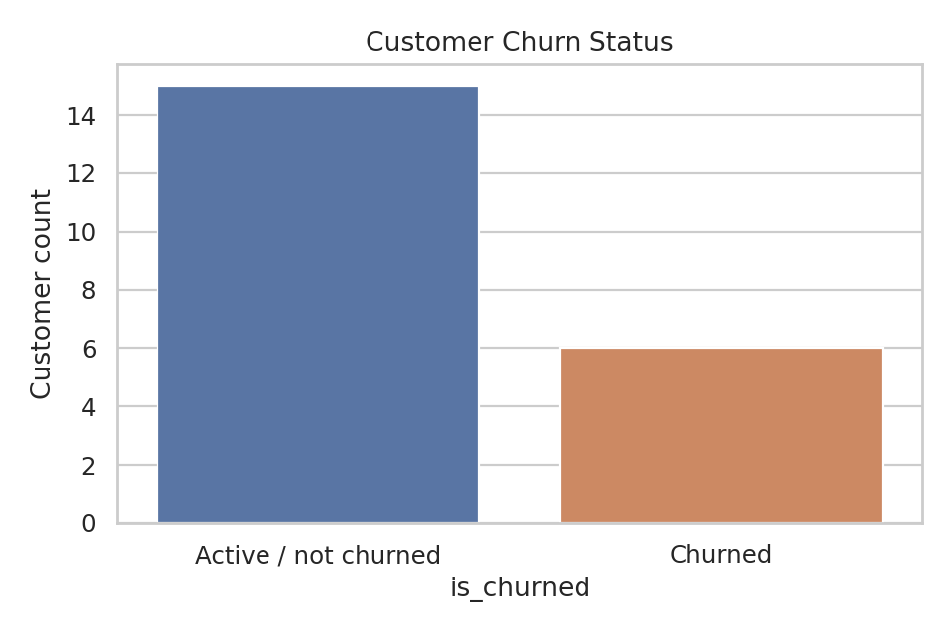
Churn Status

Slide 6
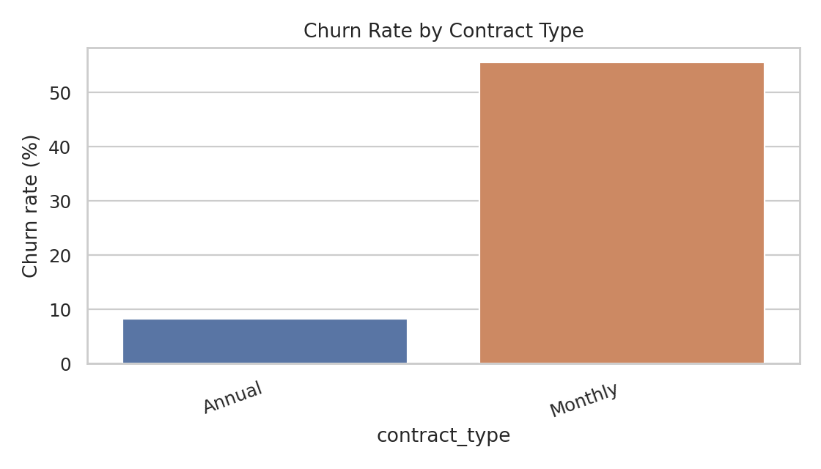
Churn by Contract Type

Slide 7
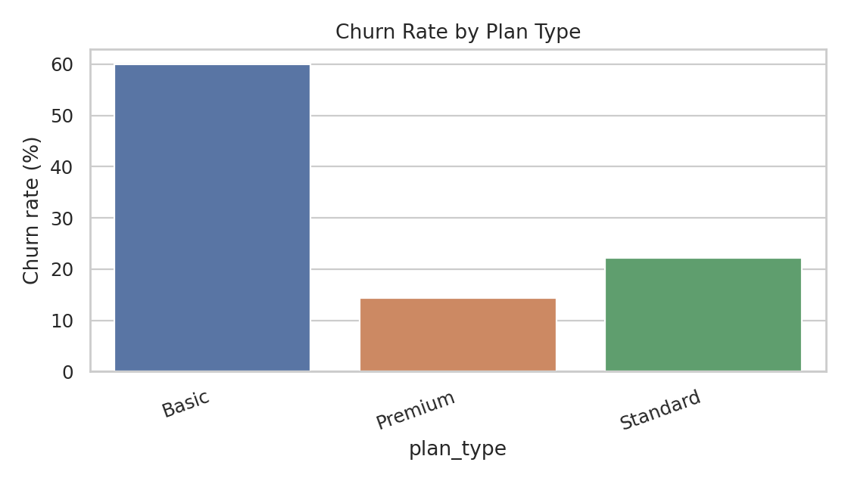
Churn by Plan Type

Slide 8
Recommendations
Prioritize high-risk active customers for retention outreach.
Investigate cancellation reasons and support escalations.
Compare contract and plan groups before changing pricing.
Monitor monthly churn after interventions.

Slide 9
Limitations and Next Steps
Small sample: 21 customer/subscription rows and 9 support interactions.
Segment differences are directional, not statistically conclusive.
Validate with a larger and more recent dataset.
Confirm currency and reporting period before claiming financial impact.

