Slide 1
Digital Portfolio
STUDENT NAME: Jasmine A.H
REGISTER NO AND NMID: 222401243 asunm11024ai133
DEPARTMENT: Bsc computer science with Artificial intelligence
COLLEGE:D R.B.C.C.CHindu Madras University

Slide 2
PROJECT TITLE
Digital Portfolio

Slide 3


AGENDA
Problem Statement
Project Overview
End Users
Tools and Technologies
Portfolio design and Layout
Features and Functionality
Results and Screenshots
Conclusion
Github Link
3/21/2024 Annual Review

Slide 4

PROBLEM STATEMENT
Students today need a professional online presence to showcase their academic achievements, skills, and projects. A personal portfolio website serves as a digital resume, allowing students to present their information in an organized and visually appealing way.
Students today need a professional online presence to showcase their academic achievements, skills, and projects. A personal portfolio website serves as a digital resume, allowing students to present their information in an organized and visually appealing way.
However, many students face challenges in creating such a portfolio due to:
1. Lack of technical knowledge in web development (HTML, CSS, JavaScript).
2. Difficulty in designing responsive layouts that work on both desktop and mobile devices.
3. Managing multimedia files such as profile images or project screenshots, especially when hosted on external platforms like Google Drive.
4. Navigation issues, where sections like About, Skills, Projects, and Contact are not clearly separated or easy to access.
5. Integration problems, such as broken image links due to incorrect file-sharing permissions (e.g., “Could not load image. Check Drive sharing settings” error when using Google Drive).
Because of these issues, students are unable to effectively communicate their skills, experiences, and career goals to recruiters, teachers, or collaborators.
Thus, there is a need to design and develop a responsive student portfolio website using HTML, CSS, and JavaScript, where:
The About Section introduces the student with a working profile picture.
The Skills Section highlights technical and soft skills.
The Projects Section showcases academic and personal projects.
The Contact Section provides ways to connect (email, LinkedIn, etc.).
All media files are properly embedded with correct permissions to avoid broken links.

Slide 5

PROJECT OVERVIEW
In today’s digital era, students require an online presence to showcase their skills, academic achievements, and personal projects. A personal portfolio website acts as a modern resume, enabling students to highlight their talents in an interactive and visually engaging way. This project aims to build a student portfolio website using HTML, CSS, and JavaScript.
The portfolio consists of multiple sections such as About, Skills, Projects, and Contact, ensuring that all relevant details are structured and easily accessible. The project also emphasizes responsive design, making the website functional across devices such as desktops, tablets, and smartphones

Slide 6

WHO ARE THE END USERS?
Students (academic projects, resumes)
Job seekers (to share with recruiters).
Freelancers (to show clients).
Professionals (to highlight experience and achievements).
Students (academic projects, resumes)
Job seekers (to share with recrui
Freelancers (to show clients). ✓ Freelancers
Professionals (to highlight experience and achievements).

Slide 7

TOOLS AND TECHNIQUES
HTML Structure (pages, sections).
CSS Styling (colors, layouts, responsiveness).
JavaScript Interactivity (navigation menu, animations, form validation), Mention code editor CODEPEN and hosting platform (GitHub Pages)

Slide 8
POTFOLIO DESIGN AND LAYOUT
Sections included:
Home/About Me Projects
Skills
Contact Responsive layout (mobile desktop view).
8

Slide 9
FEATURES AND FUNCTIONALITY
Navigation bar with smooth scrolling.
Project showcase with images/details.
Interactive elements (hover effects, animations).
Contact form (with validation).
Responsive design for all devices.

Slide 10

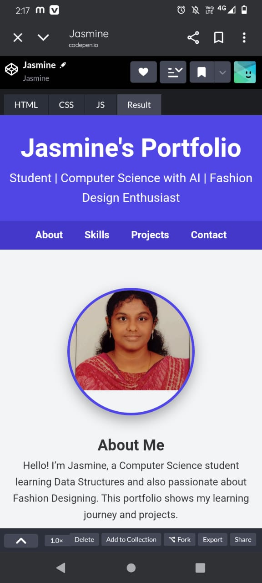
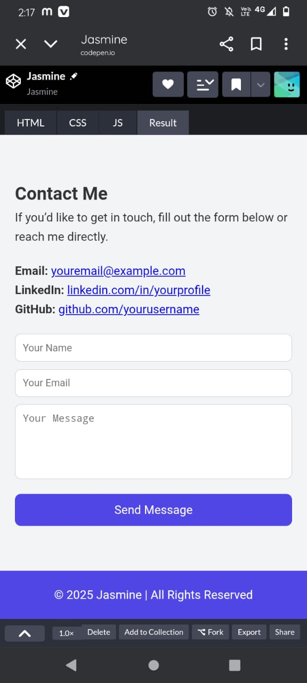
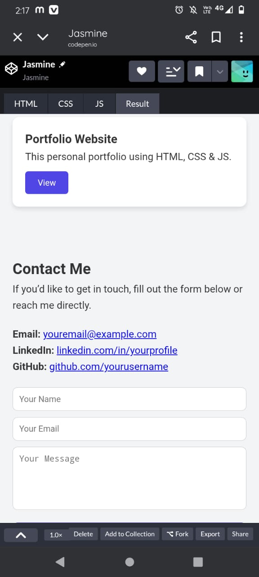
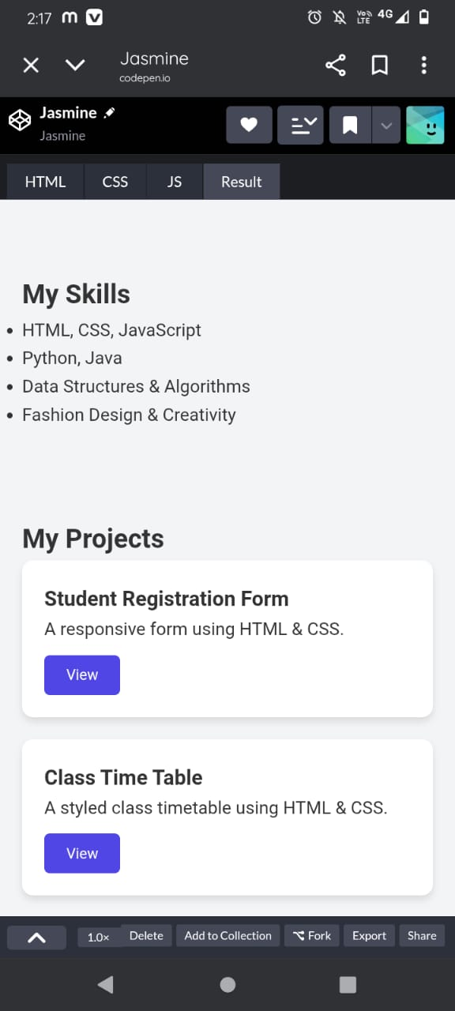
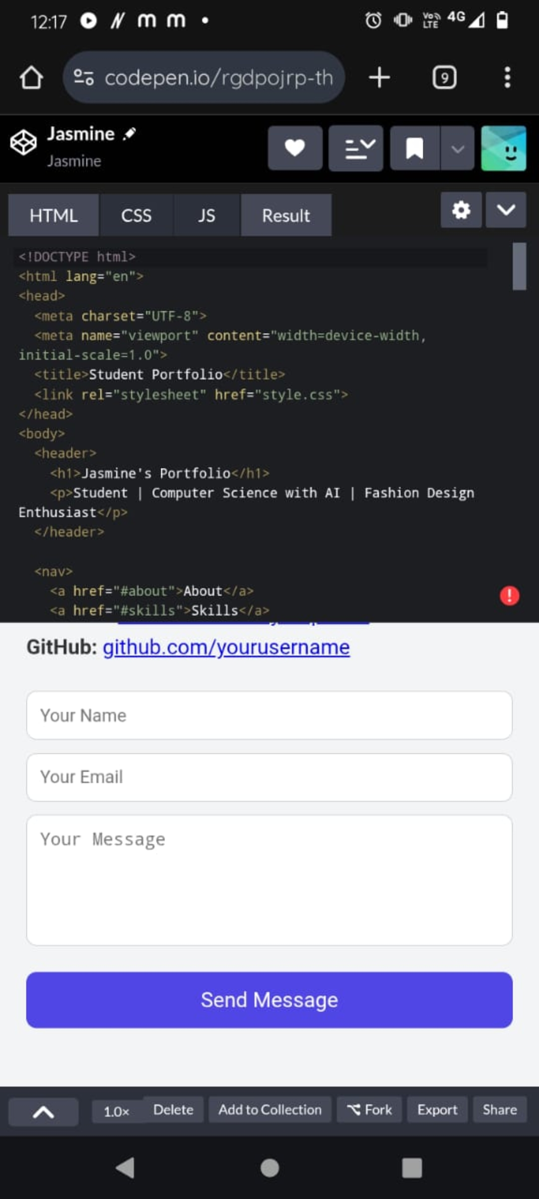
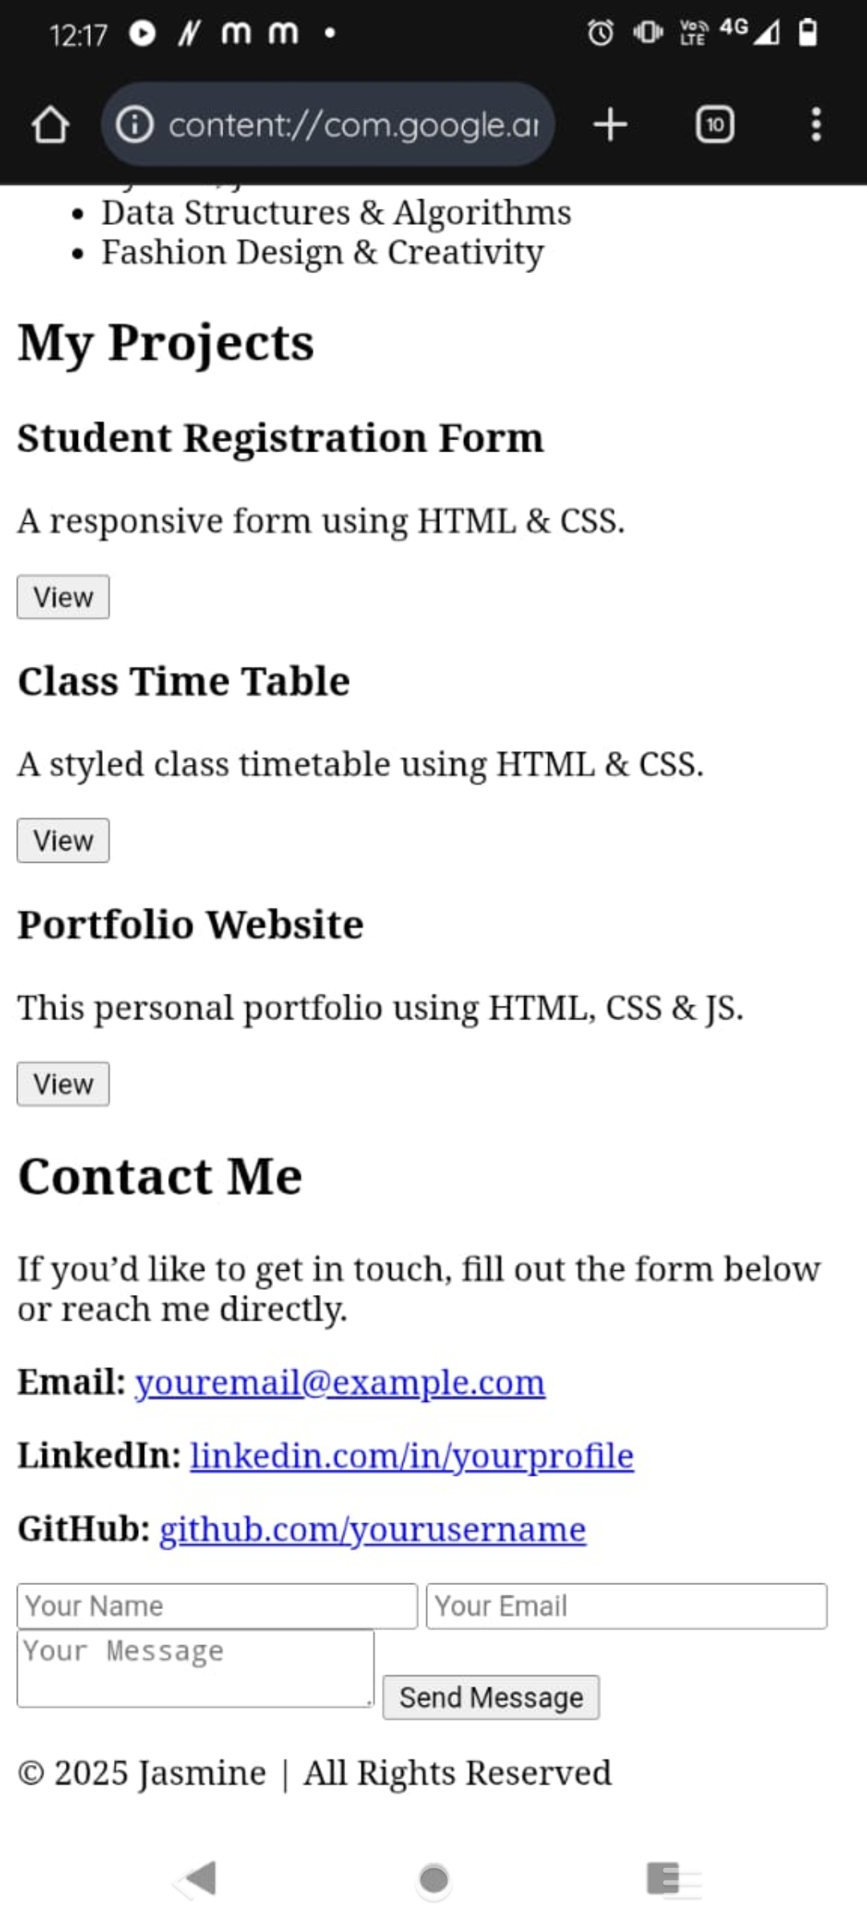
RESULTS AND SCREENSHOTS
Screenshots of each section
Before vs After (plain HTML with CSS & JS).
3/21/2024 Annual Review
10

Slide 11
CONCLUSION
The Student Portfolio Website project was successfully developed using HTML, CSS, and JavaScript. The website provides a structured platform for students to showcase their personal details, skills, academic projects, and contact information in a professional and interactive manner.
11
Highlights of your project
Final summary
Benefits to society

