Slide 1


DEPARTMENT OF COMPUTER SCIENCE AND ENGINEERING
20CS7503 & DESIGN PROJECT – III
END SEMESTER PRACTICAL EXAMINATION- NOV / DEC 2025
REVIEW PRESENTATION
Batch No.:18
Date:28.11.2025
Session:AN

Slide 2
TITLE OF THE PROJECT
GuideName: THENMOZHI, AP/CSE
Team Members:
I.MOHAMMAD HALITH (811722104089)
K.REHAAN (811722104122)
R.ROHINTH (811722104125)
B.SACHIN (811722104126)

Slide 3
OBJECTIVE OF THE PROJECT
1.To detect leaf regions accurately from image data using deep learning techniques.
2.To classify detected leaves into their respective species or disease categories.
3.To support automated agriculture, plant health monitoring, and crop management.

Slide 4
INTRODUCTION
1.Deep learning has revolutionized image processing with high accuracy in detection and classification. Its use in agriculture ensures better analysis of plant health and productivity.
2. Leaves are essential indicators of plant species, growth, and disease conditions.
Studying them helps in monitoring crop health and agricultural sustainability.
3. Manual identification of plants and diseases is slow and often inaccurate.
Automated systems using AI provide faster and more reliable results.
4. CNNs and advanced deep learning models extract fine details from leaf images.
They can recognize patterns based on color, shape, and texture differences.
5.Such techniques promote precision farming and smart crop management.
They support early disease detection, boosting yield and reducing losses.

Slide 5
LITERATURE SURVEY
TITLE | AUTHORS | PUBLISHER | TECHNOLOGY USED
Soybean Disease Detection via Interpretable Hybrid CNN-GNN | Jahin et al. | 2025/IEEETransactions on Computational Social Systems | CNN+GNN(GraphSAGE), Grad-CAM
Enhancing Leaf Classification Using GAT-GCN Hybrid Model | Sundhar et al. | 2025/Computers and Electronics in Agriculture | GAT-GCN Hybrid
Plant Leaf Disease Detection Using Deep Learning: A Multi-Dataset Approach | Krishna et al | 2025/Expert Systems with Application | Multi-dataset Deep Learning
Multi-Class Plant Leaf Disease Detection: A CNN-Based Approach with Mobile App Integration | Brahimi, Mohamed, Arsenovic, Marko, et al. | 2024/Ecologic al Informatics | Hybrid CNN architectures with large dataset training
A Review of Deep Learning Techniques for Plant Disease Detection | Kamal, Khushboo, et al. | Artificial Intelligence in Agriculture, 2020 | Survey of CNN, RNN, GAN models applied to plant leaves

Slide 6
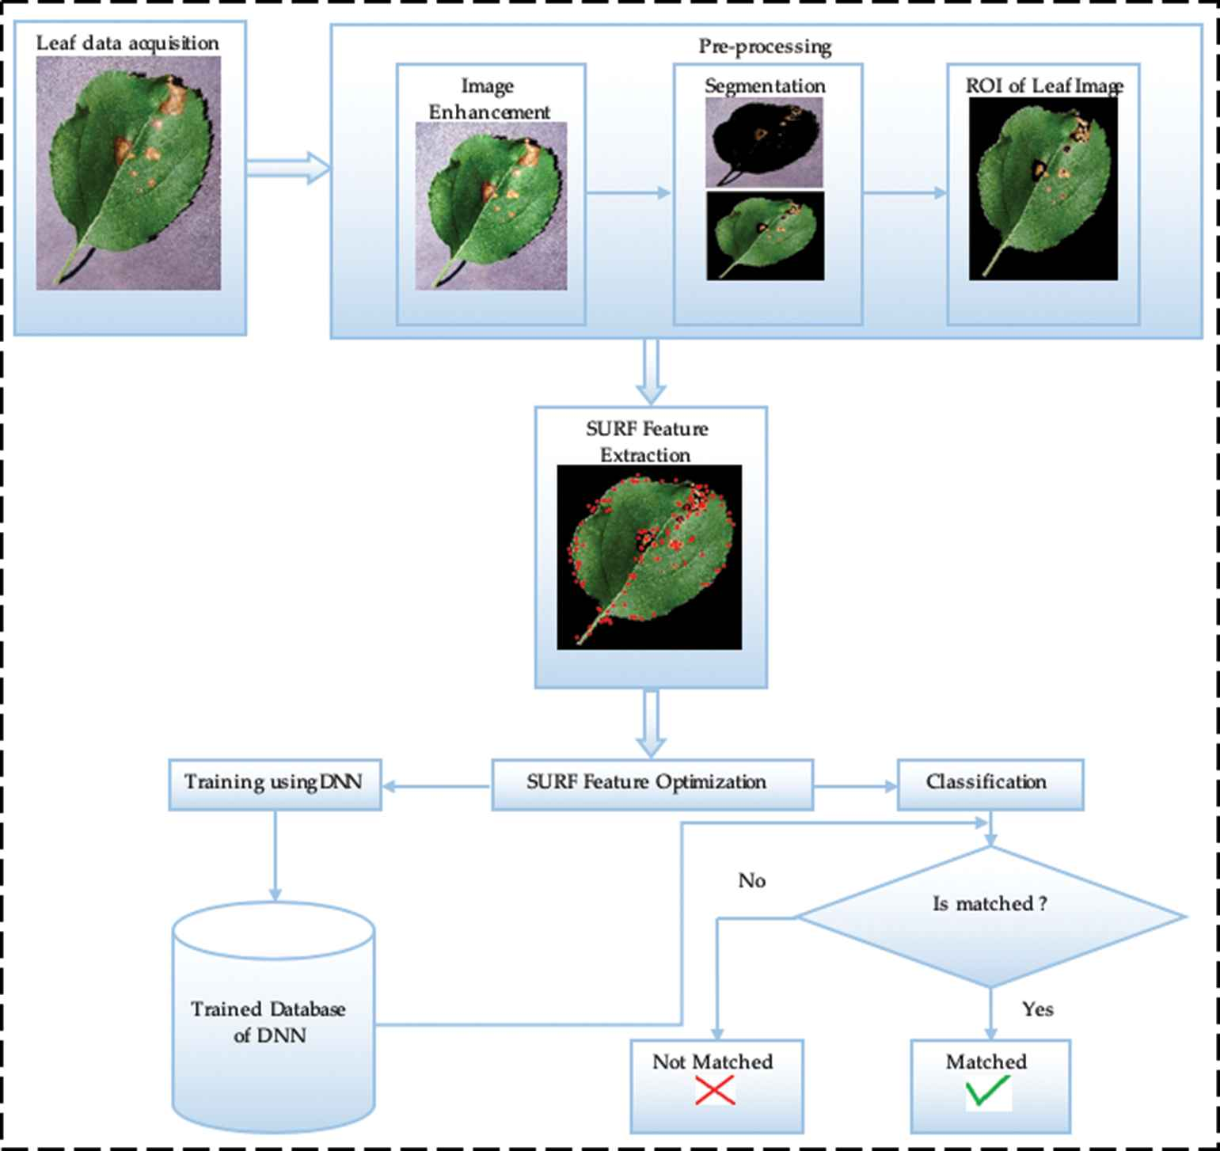
EXISTING SYSTEM ARCHITECTURE

Slide 7
PROBLEM IDENTIFICAITON
1. Manual leaf disease identification is slow and prone to human error.
2. Farmers cannot analyze large numbers of leaf images accurately.
3. Traditional image-processing methods fail in complex backgrounds.
4. Early disease detection is difficult, leading to crop damage and low yield.
5. There is no automated system to detect and classify leaf diseases efficiently.

Slide 8
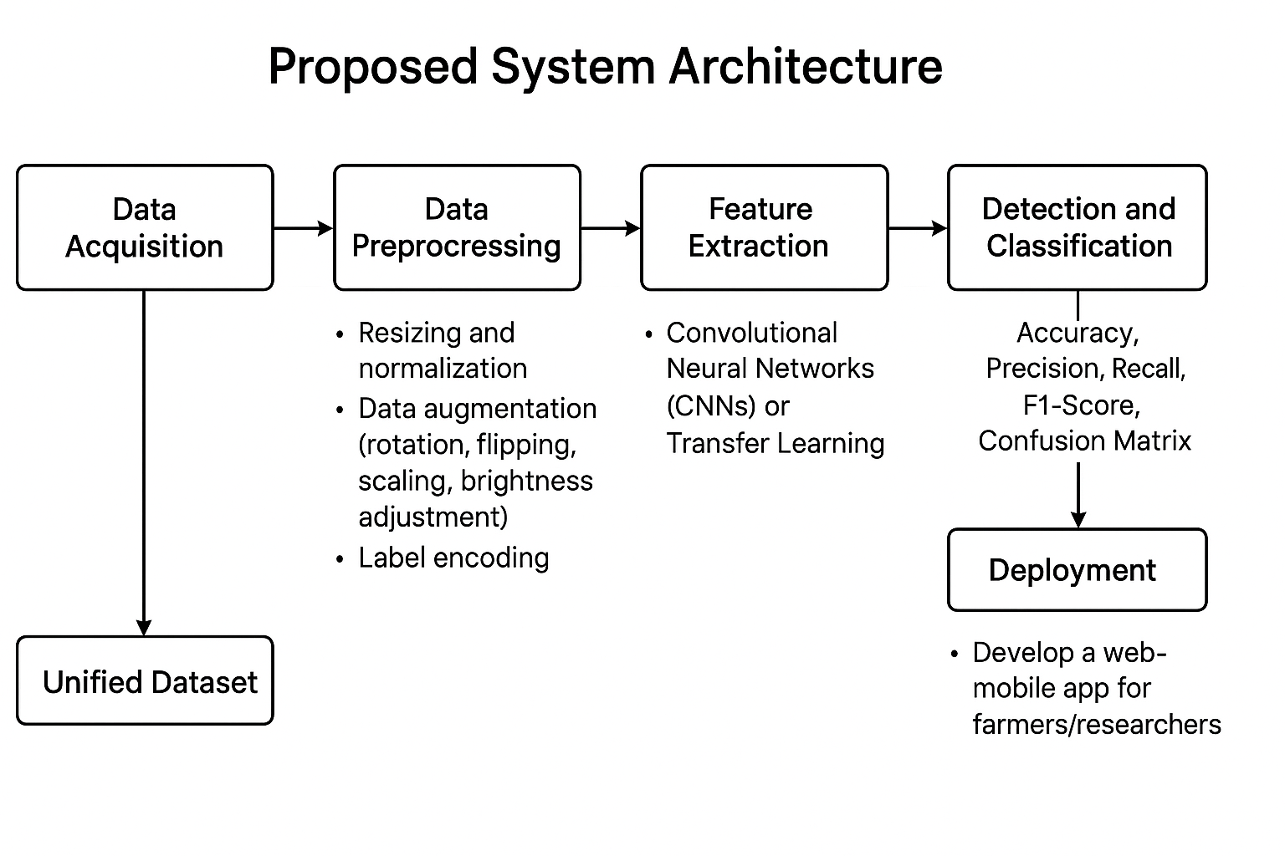
PROPOSED SYSTEM ARCHITECTURE

Slide 9
SOFTWARE AND HARDWARE REQUIREMENTS
HARDWARE
1. Processor : Dual core processor 2.6.0 GHZ
2. RAM : 4GB
3. Hard Disk : Min 4GB
4. Keyboard : standard keyboard
SOFTWARE
1. Programming Language : Python
2. Data Storage :Google Drive
3. Libraries : OpenCV, PIL (Pillow), NumPy & Pandas
4.Deployment Tool : Flask / FastAPI ,Google Cloud

Slide 10
MODULES
1. Data collection and processing module
2. Future extraction module
3. Leaf detection module
4. Disease classification module
5. Evaluation and Deployment module

Slide 11
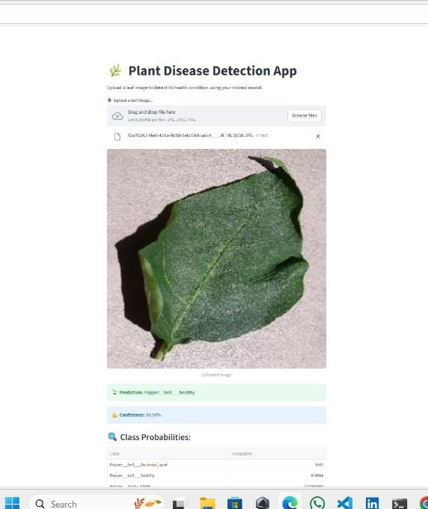
Data collection and processing module
Collect leaf images from existing datasets or capture new images.
Perform preprocessing steps such as resizing, normalization, noise removal, and augmentation (rotation, flipping, contrast enhancement).

Slide 12
Future extraction module
Use deep learning models (CNN, ResNet, VGG, etc.) to extract features automatically.
Focus on leaf texture, shape, and color variations that help in detecting disease patterns.

Slide 13
Leaf detection module
Apply segmentation techniques (e.g.,thresholding) to separate the leaf from the background.
Ensure only the region of interest (ROI – leaf portion) is passed for further analysis.

Slide 14
Disease classification module
Train a deep neural network to classify leaves into categories: healthy vs. diseased.
Further classify into specific disease types (e.g., blight, rust, mildew).
Use transfer learning for improved accuracy.

Slide 15
Evaluation and Deployment module
Evaluate model performance using accuracy, precision, recall, F1-score, and confusion matrix.
Deploy the trained model as a desktop app, web app, or mobile app for real-time leaf disease detection.

Slide 16
CONCLUSION
1. This project presents a deep learning-based system for detecting and classifying leaf diseases. The model effectively processes images through preprocessing, detection, and classification stages. It ensures early and accurate identification of plant diseases.
2. The system can be deployed as a user-friendly application for farmers and researchers. It supports smart agriculture by reducing manual inspection efforts. Overall, the project enhances crop health management through automation.

Slide 17
FUTURE ENHANCEMENTS
Future enhancements can include integrating the system with IoT devices and drones to enable real-time monitoring of crop fields. This would help farmers detect diseases early without manually inspecting each plant. The system can also be expanded to support more plant species and complex disease patterns.
2. Additionally, a mobile application can be developed for quick on-field diagnosis using a smartphone camera. The model can be enhanced with self-learning capabilities to improve accuracy over time. Cloud storage and analytics can be added for better farm data management. These enhancements will further support smart agriculture and boost crop productivity.

