Slide 1

The sparse and low-rank interpretation of
SVD-based denoising for vibration signals
22MAT230
Mathematics for Computing 4
Team 15 (AIE-C):
Arepalle Charan Kumar Reddy(24207)
Manda Rohit vardhan (24231)
Pagala Sai Vandith Reddy (24239)
Sirigiri Saradhi (24265)

Slide 2
Problem Statement
Vibration signals acquired from rotating machinery are typically contaminated by strong background noise, making condition monitoring and fault diagnosis difficult.
Existing SVD methods can enhance fault-related components but often lead to amplitude distortion and inconsistent denoising performance.
Early-stage bearing faults generate weak impulsive components in vibration signals that are masked by noise and cannot be extracted using raw time-domain or frequency-domain analysis.

Slide 3
OBJECTIVES
To model vibration signal denoising as a sparse and low-rank optimization problem using a matrix representation of time-series data.
To analyze and compare classical TSVD, heuristic reweighted SVD (RSVD), and weighted soft-threshold SVD (WSSVD)
To implement fault classification using machine learning models trained on features extracted from WSSVD-denoised signals.
To denoise acoustic signals (.wav/mp3), validating its robustness beyond vibration-only data.

Slide 4
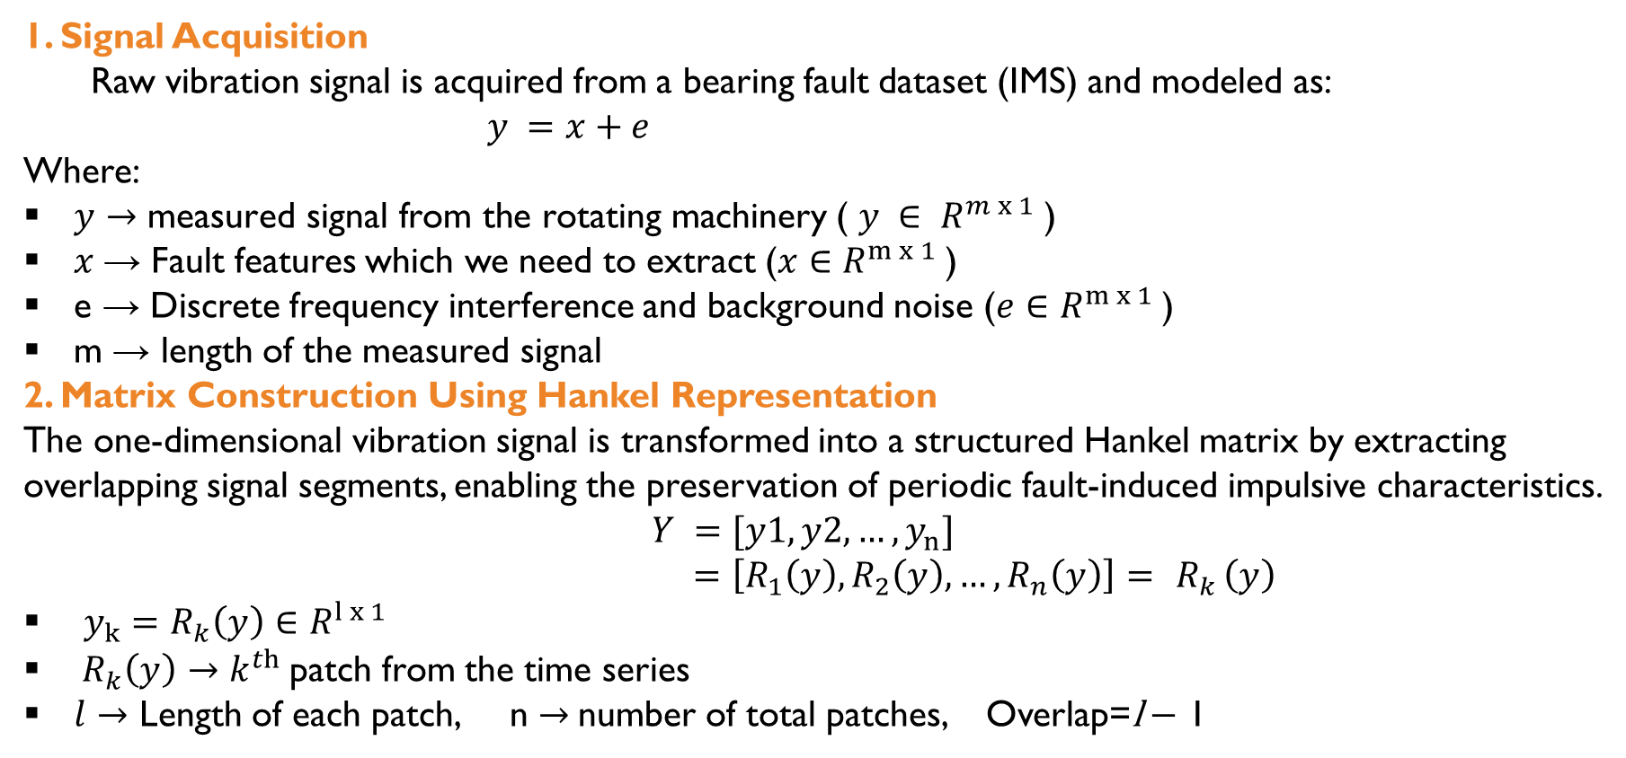
Methodology
1. Signal Acquisition
  Raw vibration signal is acquired from a bearing fault dataset (IMS) and modeled as:
$y =x+e$
Where:
$y→\text{measured} \text{signal} \text{from} \text{the} \text{rotating} \text{machinery}$ ( $y ∈ R^{m x 1}$)
$x$→ Fault features which we need to extract ($x∈R^{m x 1}$)
e → Discrete frequency interference and background noise ($e∈R^{m x 1}$)
m → length of the measured signal
2. Matrix Construction Using Hankel Representation
The one-dimensional vibration signal is transformed into a structured Hankel matrix by extracting overlapping signal segments, enabling the preservation of periodic fault-induced impulsive characteristics.
$Y =[y1,y2,…,y_{n}]$
$=\left[R_{1}\left(y\right),R_{2}\left(y\right),…,R_{n}\left(y\right)\right]= { R}_{k}\left(y\right)$
$y_{k}=R_{k}\left(y\right)∈R^{l x 1}$
${ R}_{k}\left(y\right)→k^{th}$patch from the time series
$l$ $→$ Length of each patch, n $→$number of total patches, Overlap=l − 1

Slide 5
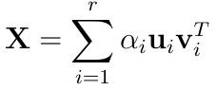
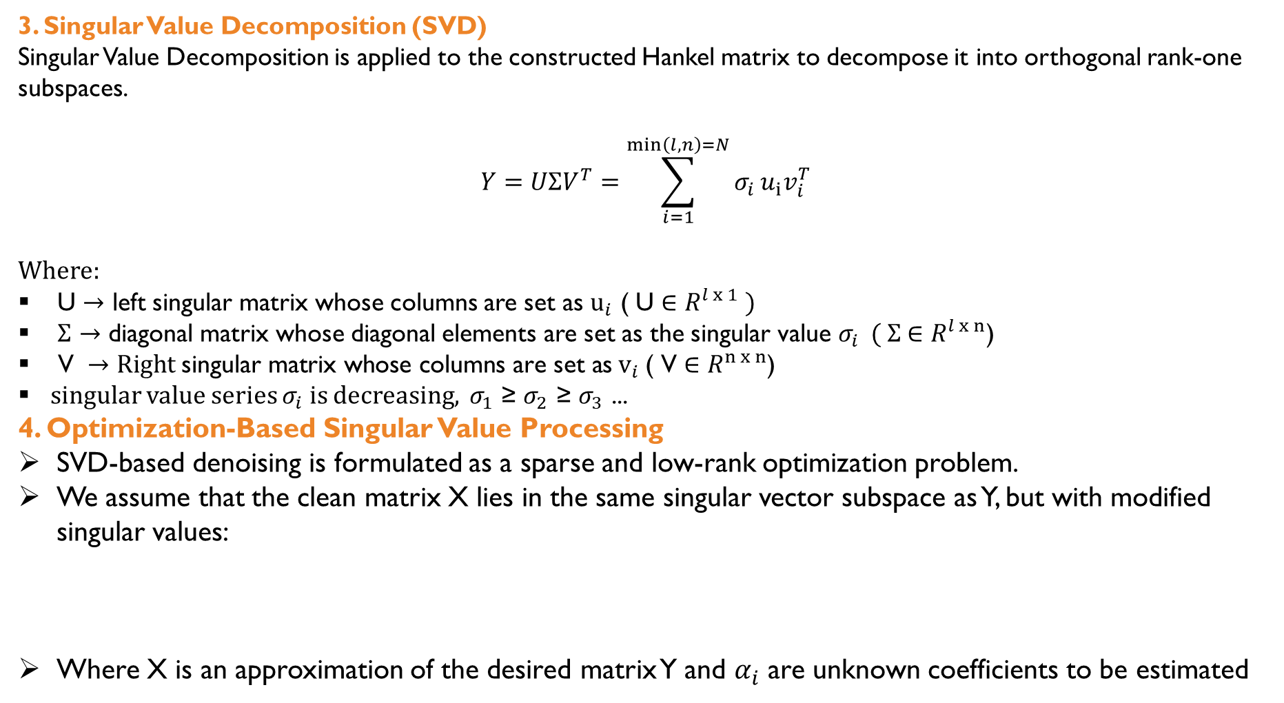
3. Singular Value Decomposition (SVD)
Singular Value Decomposition is applied to the constructed Hankel matrix to decompose it into orthogonal rank-one subspaces.
$$Y=UΣV^{T}=\sum_{i=1}^{\min\left(l,n\right)=N}{σ_{i}}u_{i}v_{i}^{T}$$
Where:
U $→$ left singular matrix whose columns are set as $u_{i}$ ( U ∈ $R^{l x 1} )$
$Σ$ $→$ diagonal matrix whose diagonal elements are set as the singular value $σ_{i}$ ( $Σ$ ∈ $R^{l x n}$)
$\text{V} →Right \text{singular} \text{matrix} \text{whose} \text{columns} \text{are} \text{set} \text{as}{ v}_{i} \text{( }\text{V}\text{ ∈ }R^{n x n}$)
singular value series $σ_{i}$ is decreasing, $σ_{1}$ ≥ $σ_{2}$ ≥ $σ_{3}$ ...
4. Optimization-Based Singular Value Processing
SVD-based denoising is formulated as a sparse and low-rank optimization problem.
We assume that the clean matrix X lies in the same singular vector subspace as Y, but with modified singular values:
Where X is an approximation of the desired matrix Y and $α_{i}$ are unknown coefficients to be estimated

Slide 6
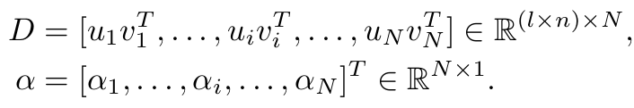

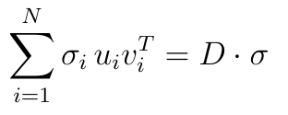

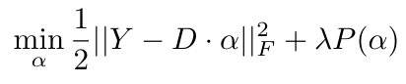

Representing as dictionary
Let
So
Let formulate as an optimization problem
and
Where:
is the Frobenius norm
λ is the trade-off parameter,
P(α) is the regularization of α.

Slide 7
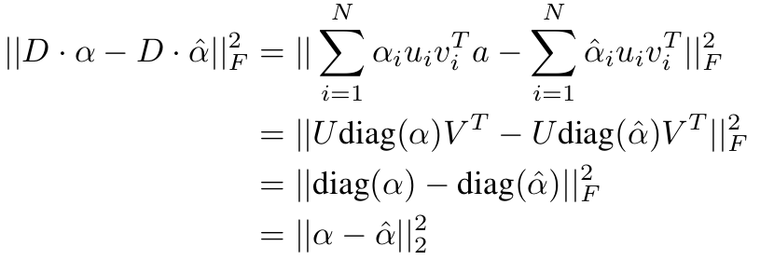



So
CASE 1: TSVD (ℓ₀ NORM)

Slide 8
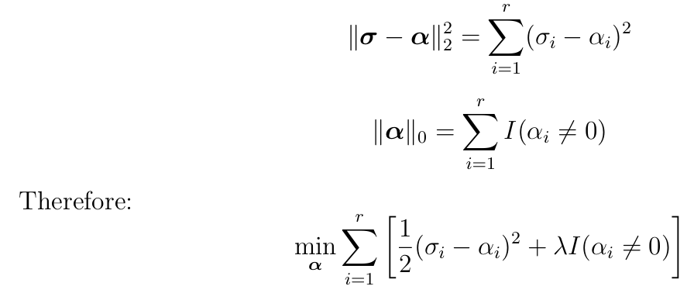

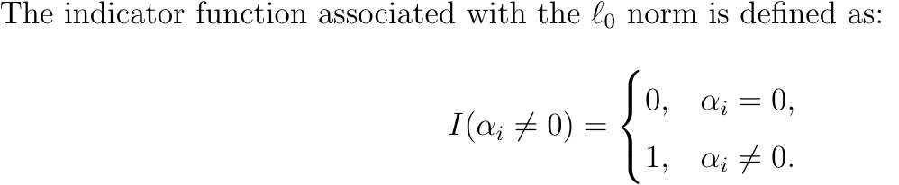

Slide 9
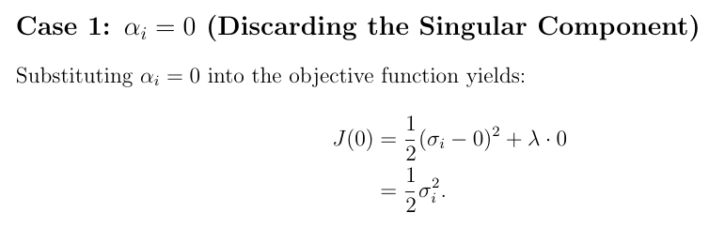
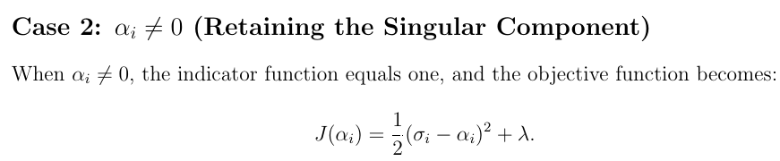
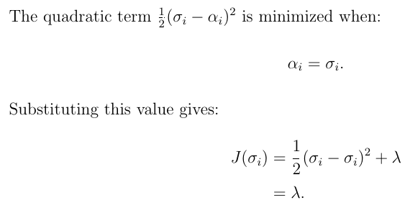


Slide 10
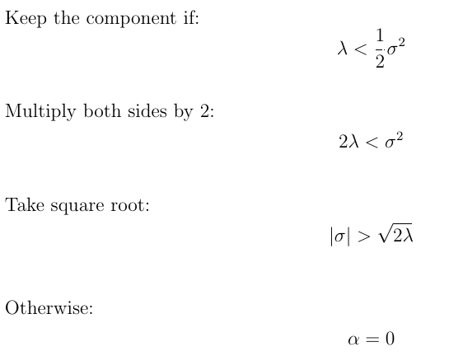
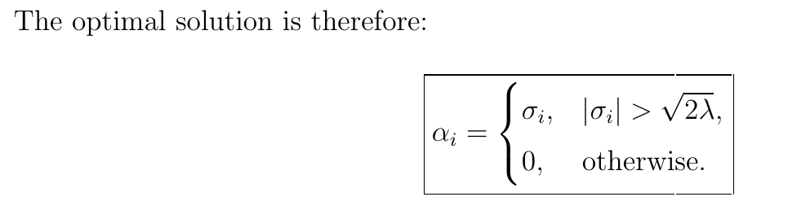

Case 2 : Proposed WSSVD ( weighted ℓ₁-norm minimization )
Standard ℓ₁ regularization treats all singular values equally and leads to uniform soft thresholding. This causes fault-related components to be penalized in the same manner as noise. To address this limitation, fault-related information is introduced through component dependent weights.

Slide 11
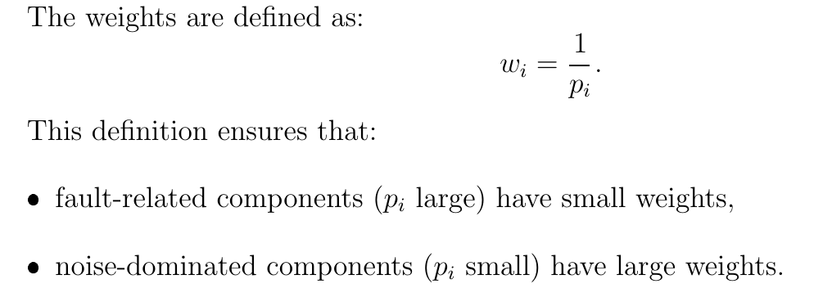
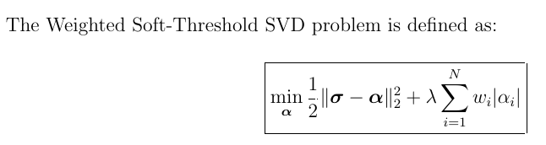
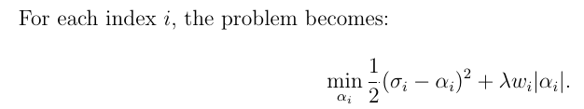

Slide 12
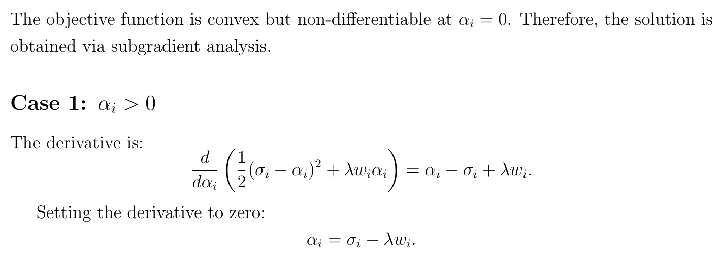
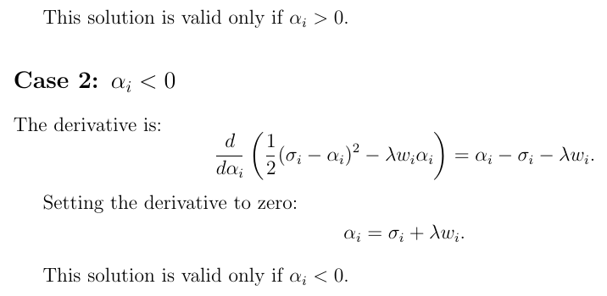

Slide 13
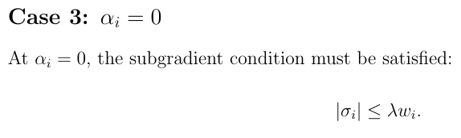
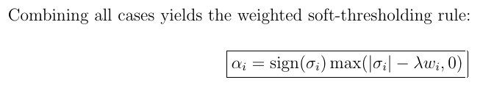
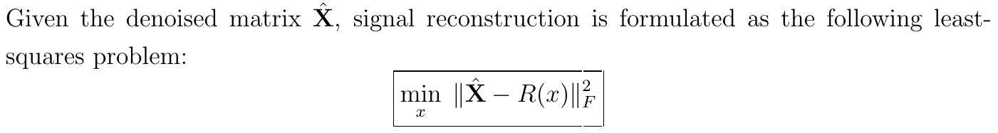
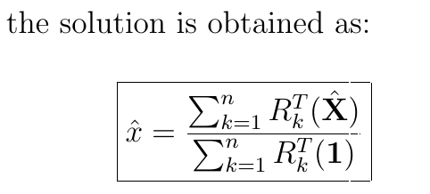
5. Signal Reconstruction

Slide 14
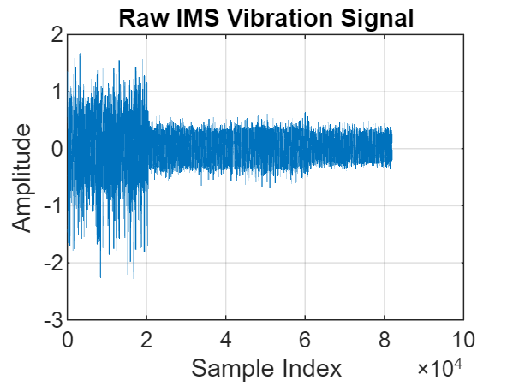
Results
Raw vibration signal acquired from the IMS bearing dataset, sampled at 20 kHz. The signal is heavily contaminated by noise, making early-stage fault-related impulses difficult to observe directly.

Slide 15
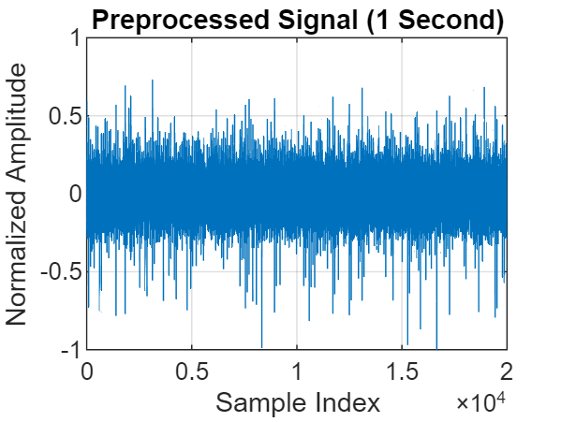
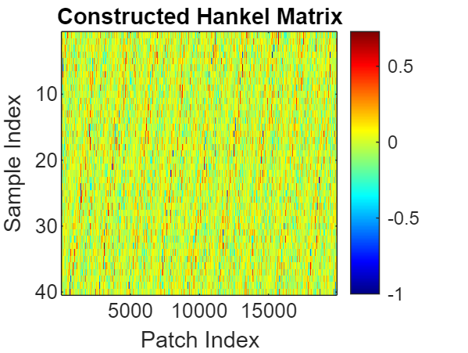
Preprocessed vibration signal after DC removal, normalization, and segmentation to one second
Hankel matrix constructed from the vibration signal using overlapping patches (overlap = l − 1), preserving temporal correlation and enabling low-rank analysis.

Slide 16
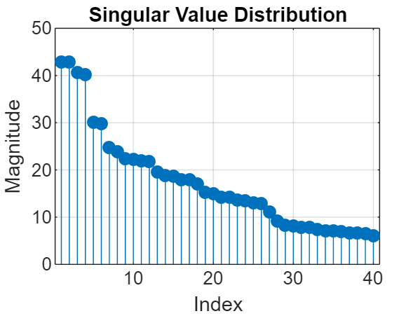
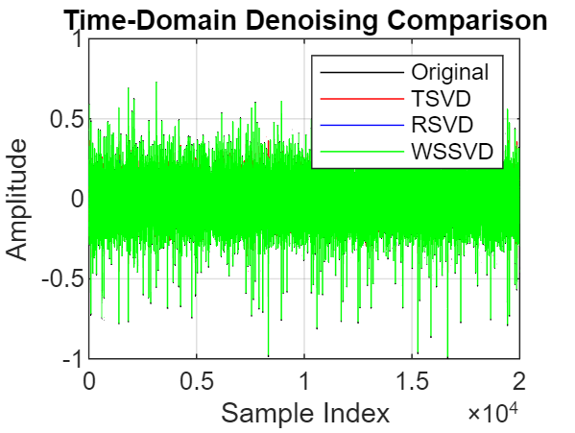
Singular value distribution of the constructed Hankel matrix
Time-domain comparison of denoising methods. WSSVD preserves impulsive fault characteristics more clearly than TSVD and RSVD.

Slide 17
Thank you

