Slide 1
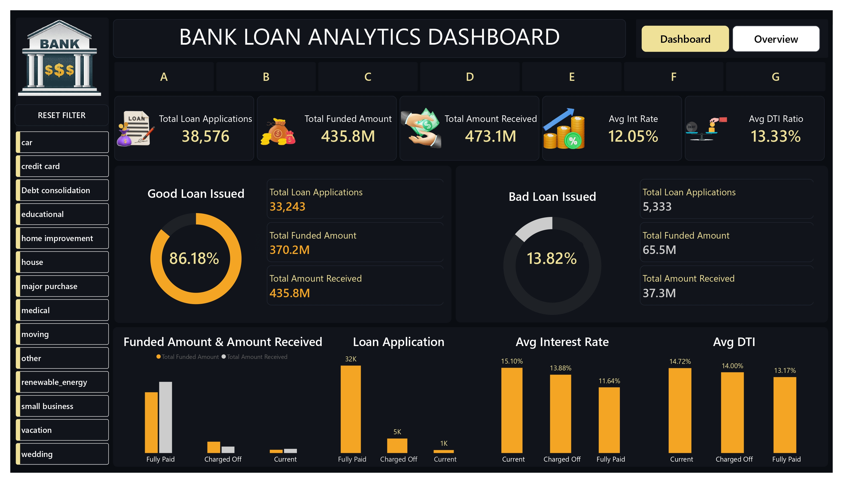

Slide 2
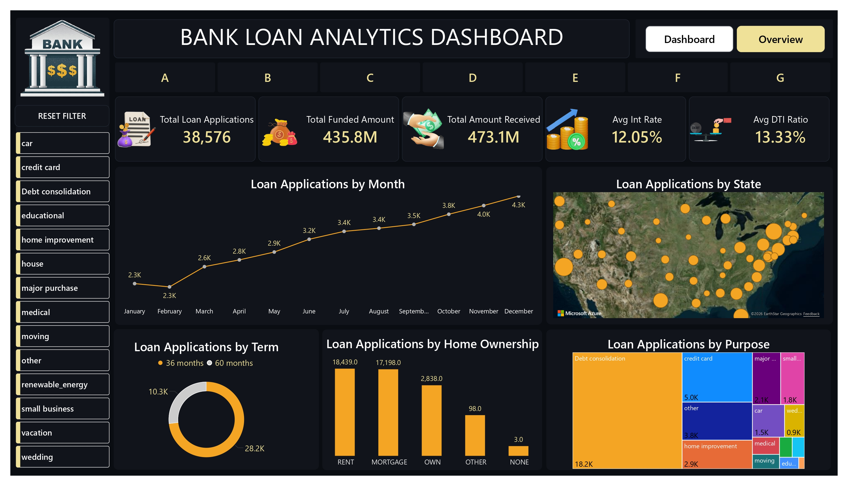

Slide 6
Canvas Background - #0B0D12
Visual BG - #11151C
Borders - #232A35
Gold - #F5A524
Grey - first second
Title -- white
Kpi value -- last second column first one -- #F0E199

