Slide 1

Basic Details of the Team and Problem Statement
Ministry/Organization Name/Student Innovation:
Ministry of Home Affairs
PS Code:SIH1440 Problem Statement Title: An application under which all rescue agencies are registered and which can display the location of other rescue relief agencies during natural/ man made calamities
Team Name: ResQ
Team Leader Name: Satvik Taviti
Institute Code (AISHE): CBIT
Institute Name: Chaitanya Bharathi Institute Of Technology
Theme Name: Disaster Management

Slide 2
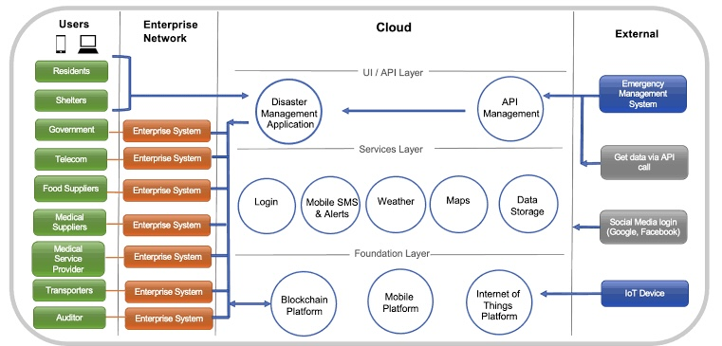
Idea/Approach Details
Idea/Solution:
The proposed solution constitutes a self-organizing, multi-platform system that exploits emerging technologies to optimize disaster response coordination. This system encompasses the development of both Android and web applications, which act as interlinked interfaces for rescue agencies in an efficient way .The prototype functions as follow:
When a user submits a photo of a disaster, the AI tool integrated into our application performs image analysis and verification to determine its authenticity, thereby reducing the occurrence of false alarms
After receiving a true alert , the system triggers real-time communication and collaboration among rescue agencies, facilitating the sharing of incident details, resources, deployment plans, and logistics.
Our platform utilizes blockchain for decentralized coordination, intelligently assigning tasks to agencies based on proximity, resources, and expertise, ensuring efficient and effective responses.
AI-powered chatbots, using NLP and machine learning, seamlessly integrated into the platform, facilitate real-time text-based communication among agencies. They automate routine tasks, provide instant access to data, and enhance inter-agency collaboration, optimizing operational efficiency.
After completing rescue operations, agencies use the system to log their status, updating the central platform in real-time. This feature allows agencies to communicate outcomes, such as mission completion or ongoing efforts, providing an accurate overview of ongoing response efforts and enhancing coordination during crisis response
Technology stack :
Frontend: Flutter(Framework),Dart ,React, Redux , Mapbox API
Developer Tools: VSCode ,Android Studio, Xcode
Backend: Firebase ,Node.js, Express, PostgreSQL AI: TensorFlow for Chatbots Blockchain: For secure, tamper-proof data management and smart contract execution. AI and Machine Learning: To analyze real-time data and optimize resource allocation. IoT (Internet of Things): For data collection from sensors and devices in disaster-affected areas Cloud Infrastructure: To ensure scalability and reliability
VIDEO LINK: Click here for video presentation

Slide 3
Idea/Approach Details
Use Cases:
Dynamic Resource Allocation:
The platform can efficiently allocate resources such as personnel, medical supplies, and vehicles to disaster-stricken areas in real-time, reducing response time and saving lives.
Automated Risk Assessment:
By integrating AI and IoT data, our solution can provide agencies with instant risk assessments, helping them make informed decisions during disasters.
Global Collaboration:
Our platform transcends geographical boundaries, allowing agencies from different countries to collaborate seamlessly during international crises.
Custom Filters:
Enable users to filter agencies by criteria like expertise, location, and available resources.
Remote Access:
Support remote access for agencies operating in different locations or responding to distant incidents.
Disaster Recovery Tracking system:
It is build with a web-based platform for tracking and managing the recovery process following a disaster.
Multi-Language Support:
Offer the application in multiple languages for global accessibility.
Feedback and Improvement:
Gather feedback from users and incidents to continually improve response strategies.
Dependencies / Show stopper
Showstopper:
Centralized Database and Security:
Create a Centralized Database for Rescue Organizations to Register their Geographical coordinates, Contact, and Expertise Information.
Financial Support:
Agencies can also help financially as the app supports transactions through the integration of the Razorpay payment gateway.
Data Privacy and Security:
Ensuring the privacy and security of sensitive data is paramount. We are committed to implementing state-of-the-art encryption and access controls.
Interactive User Interface with Geospatial interface:
We have developed an interface featuring a geospatial map
Swarm Robotics Integration:
Imagine drones, robots, and autonomous vehicles working in unison to conduct search and rescue missions, enabled by our self-organizing platform.
Dependencies:
API Integration: Depend on Mapbox for mapping and TensorFlow for AI chatbots.
User Adoption: Success relies on agencies and public using the platform actively

Slide 4
Team Member Details
Team Leader Name: Satvik Taviti
Branch (Btech/Mtech/PhD etc): Btech Stream (ECE, CSE etc): IT Year (I,II,III,IV): Ⅲ
Team Member 1 Name: Sai Rohit Tanuku
Branch (Btech/Mtech/PhD etc): Btech Stream (ECE, CSE etc): AIML Year (I,II,III,IV): Ⅲ
Team Member 2 Name: K.Srreyasri
Branch (Btech/Mtech/PhD etc): Btech Stream (ECE, CSE etc): IT Year (I,II,III,IV): Ⅲ
Team Member 3 Name: N. Sri Gayatri
Branch (Btech/Mtech/PhD etc): Btech Stream (ECE, CSE etc): IT Year (I,II,III,IV): Ⅲ
Team Member 4 Name: Sathvik Vanaparthy
Branch (Btech/Mtech/PhD etc): Btech Stream (ECE, CSE etc): AIML Year (I,II,III,IV): Ⅲ
Team Member 5 Name: M.Sneha Latha
Branch (Btech/Mtech/PhD etc): Btech Stream (ECE, CSE etc): AIML Year (I,II,III,IV): Ⅲ
Team Mentor 1 Name: Type Your Name Here
Category (Academic/Industry): Expertise (AI/ML/Blockchain etc): Domain Experience (in years):
Team Mentor 2 Name: Type Your Name Here
Category (Academic/Industry): Expertise (AI/ML/Blockchain etc): Domain Experience (in years):

