Slide 1

Ethical Hacking
Name:Rohit kumar
Roll no:4917170
Presented by

Slide 2

Introduction
◆hacking
◆Ethical hacking
◆hacking terminology
◆Types of hacker
◆ways of hacking

Slide 3

Hacking Hacking is what a hacker/cracker does on target to gain unauthorized access and compromise the target for own benifit.

Slide 4

Ethical hacking
Ethical Hacker does the same thing as that of hacker
ethically, legally and his objectives are to:
◆Be watchful on intruder/stealth activities.
◆Protect target from reconnaissance
◆Secure target
◆Use updated anti malware softwares
◆Educate users on information security

Slide 5
Hacking terminology
●Target : system/Network/application/software
●Security: Confidentiality,Integrity,Availability
●Attack : Violation of security
●Threat : Possibility of danger
●Bug/Flaw :Threat to security
●Vulnerability :Weakness/Bug/Flaw/Attack surface
●Exploit :Piece of code or action

Slide 6
Types of Hacker
◆White hat hacker(Ethical hacker)
◆Black hat hacker(Malicious or cracker)
◆Grey hat hacker(Ethical+cracker)
◆Blue hat hacker(Bug tester)
◆Script Kiddle
◆Hactivism

Slide 7
Ways of hacking
◆Phising
◆Dos attack
◆DDos attack
◆Sniffing
◆Spoofing
◆SQL injection
◆Viruses & Worms
◆Back Doors
◆Trojan horses

Slide 8
Ways of hacking(contd..)
◆Key loggers
◆Brute Forcing
◆Fake Messangers
◆Cookie Stealer
◆DNS poisoning or PHARMING

Slide 9
Phase of hacking
Reconnaissance
Scanning
Ganning access
Maintaining access
Clearing tracks

Slide 10
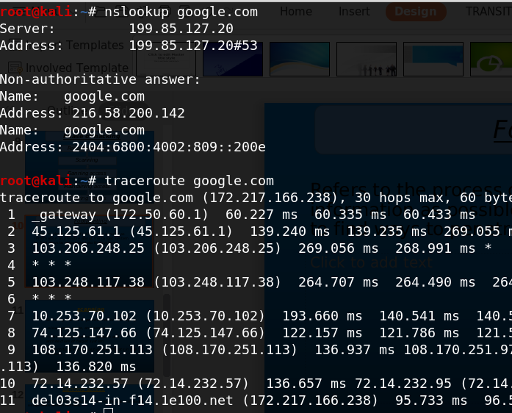
Refers to the process of collecting as much as information as possible about the target system to find ways to penetrate into the system.
Footprinting

Slide 11
Footprinting tool
◆Google hacking/Dorking
◆whois lookup
◆search engine
◆social media
◆Maltego
◆Email-tracking

Slide 12
scanning Scanning is a set of procedures for identifying ->live hosts, ports, and services -> discovering Operating system and architecture of target system. ->Identifying vulnerabilities and threats in the network.

Slide 13
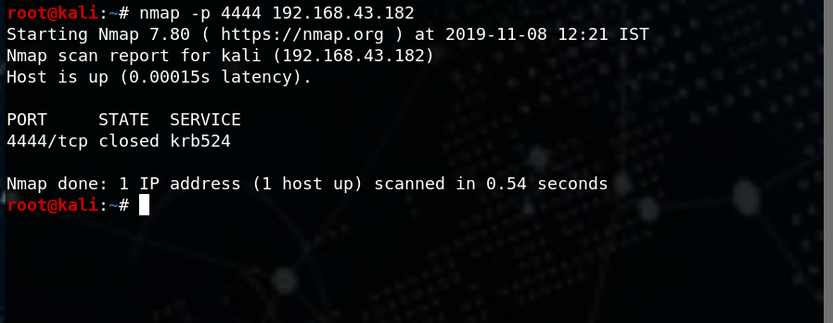
Network scanning
Nmap

Slide 14
Ganning access ->This phase is where an attacker breaks into the system/network using various tools or methods. ->After entering into a system, he has to increase his privilege to administrator level ->so he can install an application he needs or modify data or hide data.

Slide 15
Maintaning access Hacker may just hack the system to show it was vulnerable or he can be so mischievous that he wants to maintain or persist the connection in the background without the knowledge of the user. ->This can be done using Trojans or other malicious files.

Slide 16
Clearing Track No thief wants to get caught. An intelligent hacker always clears all evidence so that in the later point of time, no one will find any traces leading to him. -> This involves modifying/corrupting/deleting the values of Logs, modifying registry values and uninstalling all applications he used and deleting all folders he created.

Slide 17
conclusion 1).Introduction of ethical hacking 2).Operating system concept 3).Footprinting 4).Google hacking/Dorking 5).Network scanning 6).System hacking & password breacking 7).Stagnography & cryptography 8).Trojans & backdoors 9).Virus & worms 10).Sniffers & Phishing 11).Social Engineering 12).Denial of service

Slide 18
scope of Ethical Hacker ◆Wipro ◆Tcs ◆Infosys ◆Tech mahindra ◆IBM & all it company ◆Hcl ◆financial service provider ◆Airtel ◆Airlines ◆Reliance ◆Hotel ◆Military and law enforcement agencies ◆Defence organisation ◆Detective companies ◆Central buero of investigation ◆National security agencies ◆Graduates can setup own company through use of ethical hacking

