Slide 1


SQL INJECTION

Slide 2
Database
->Database is a collection of data.
website point of view
Database is used for storing user ids,passwords,
web page details and more.

Slide 3
what is sql injection ?
->sql injection is Common and famous method of hacking at present time.
Using this method
->Unauthorized person can access the database of the website.
->Attacker can get all details from the database.

Slide 4
way of sql injection
Using tools Without tools
sql injection tools
• SQLDict • SQLExec
• SQLbf • SQLSmack
• SQL2.exe • SQLPoke
• SQLNinja
use this tool
◆ sqlmap

Slide 5

SQLMAP

Slide 6
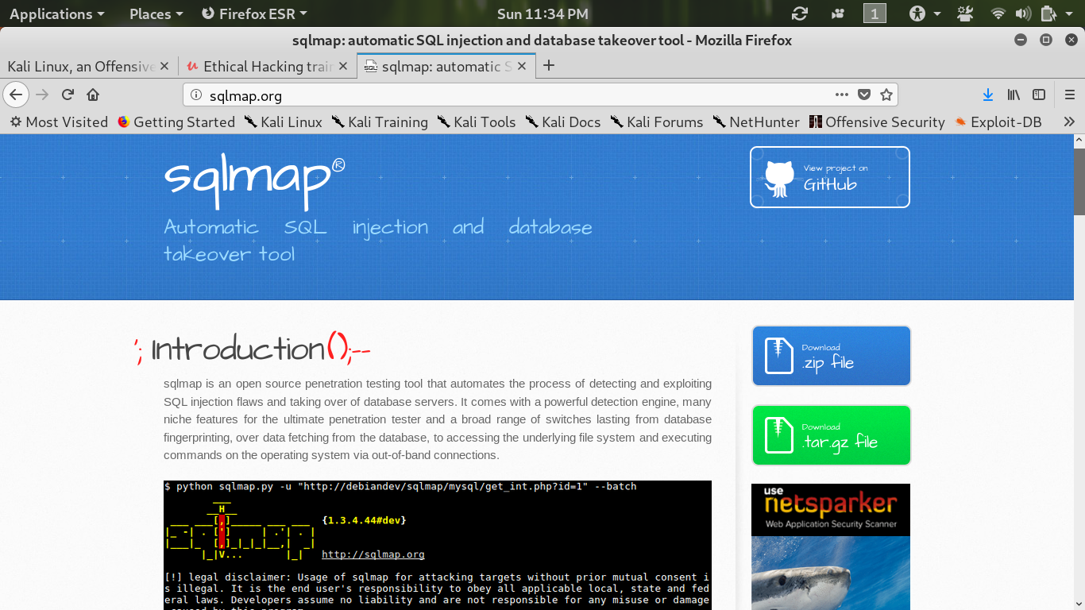

Slide 7
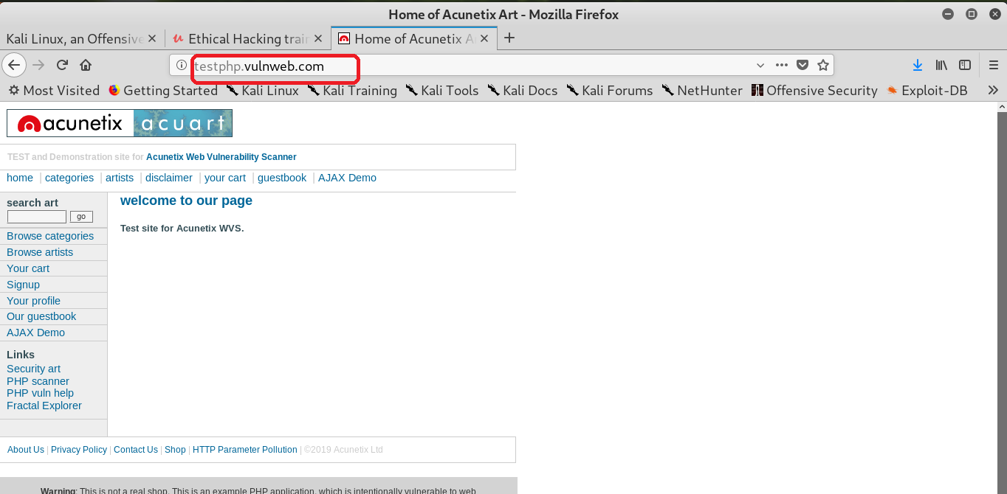
Aim:- hack http://testphp.vulnweb.com
HACK
FOR SIGNUP

Slide 8
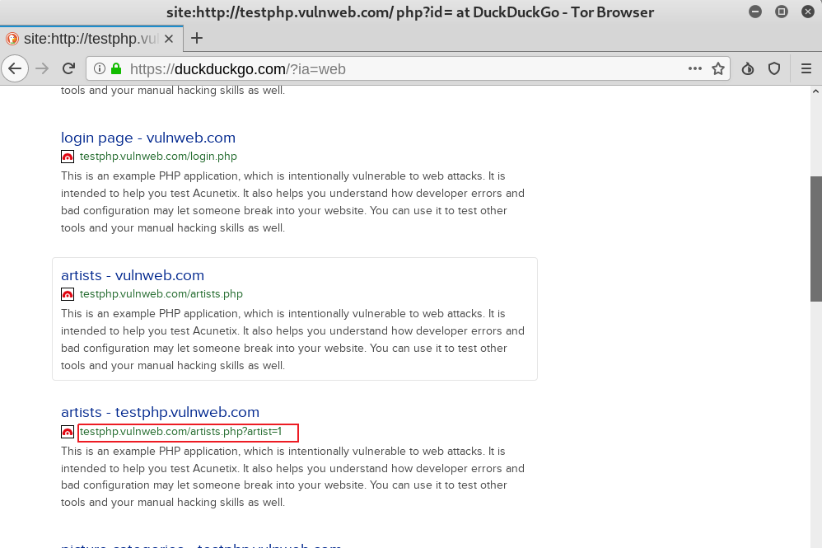
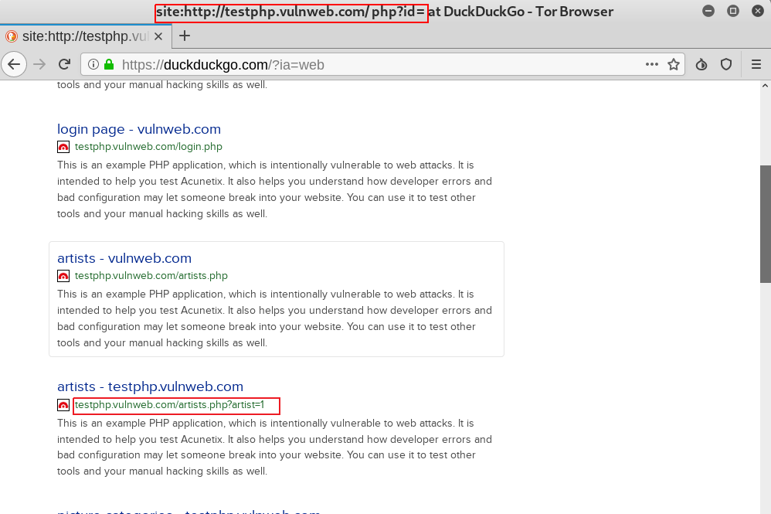
CHECKING VULNERABILITY LINK
USE THIS LINK

Slide 9
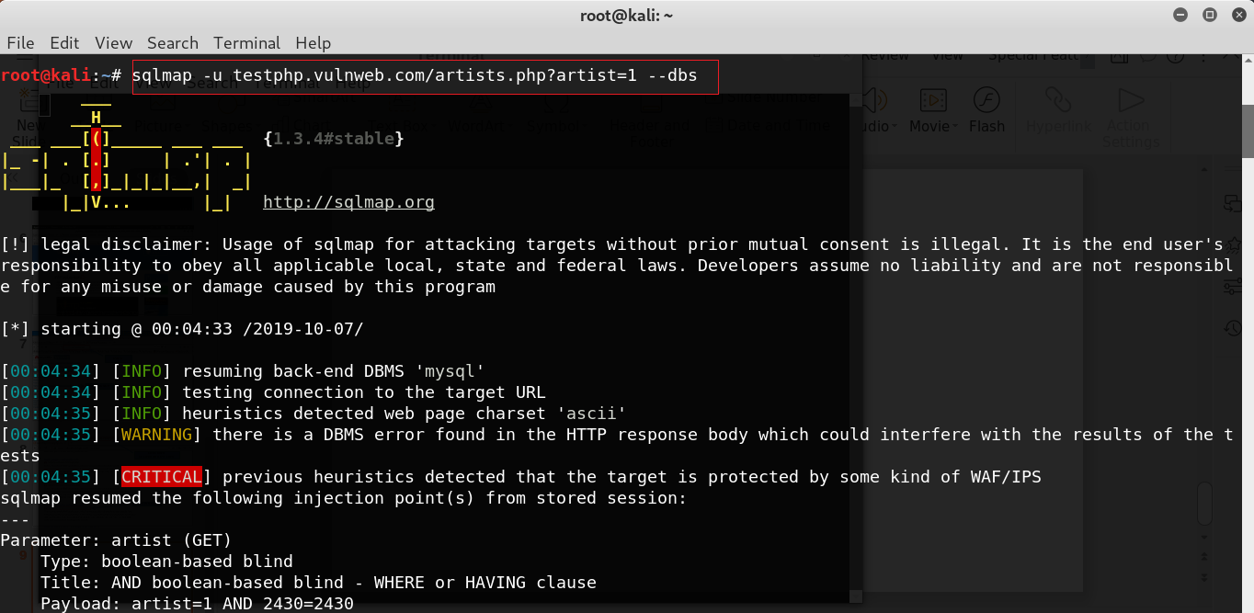
find database

Slide 10
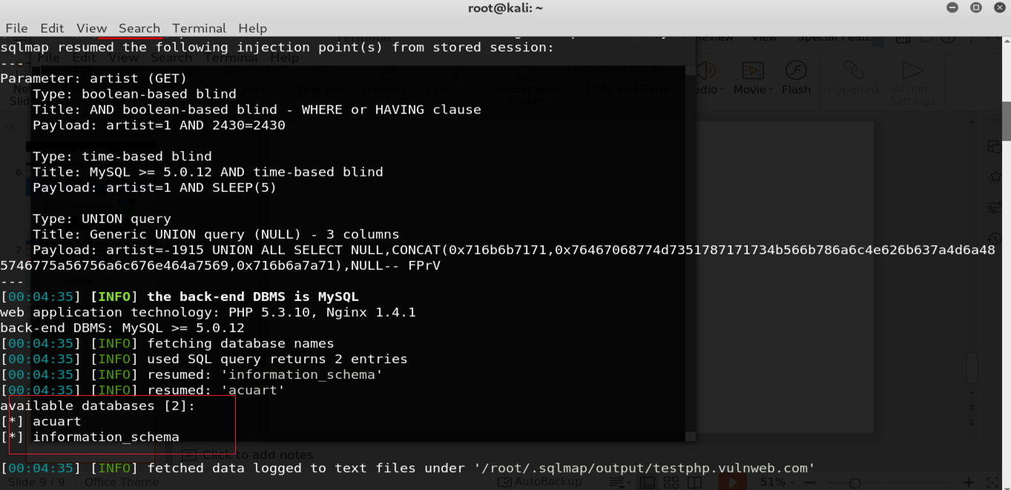
meet database

Slide 11
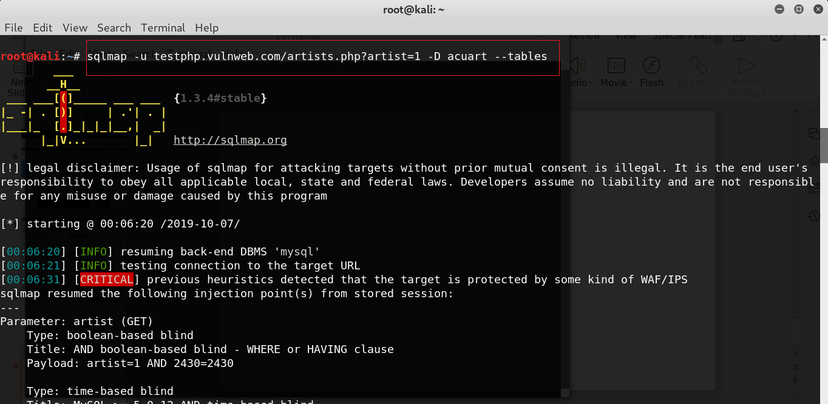
find table in database

Slide 12
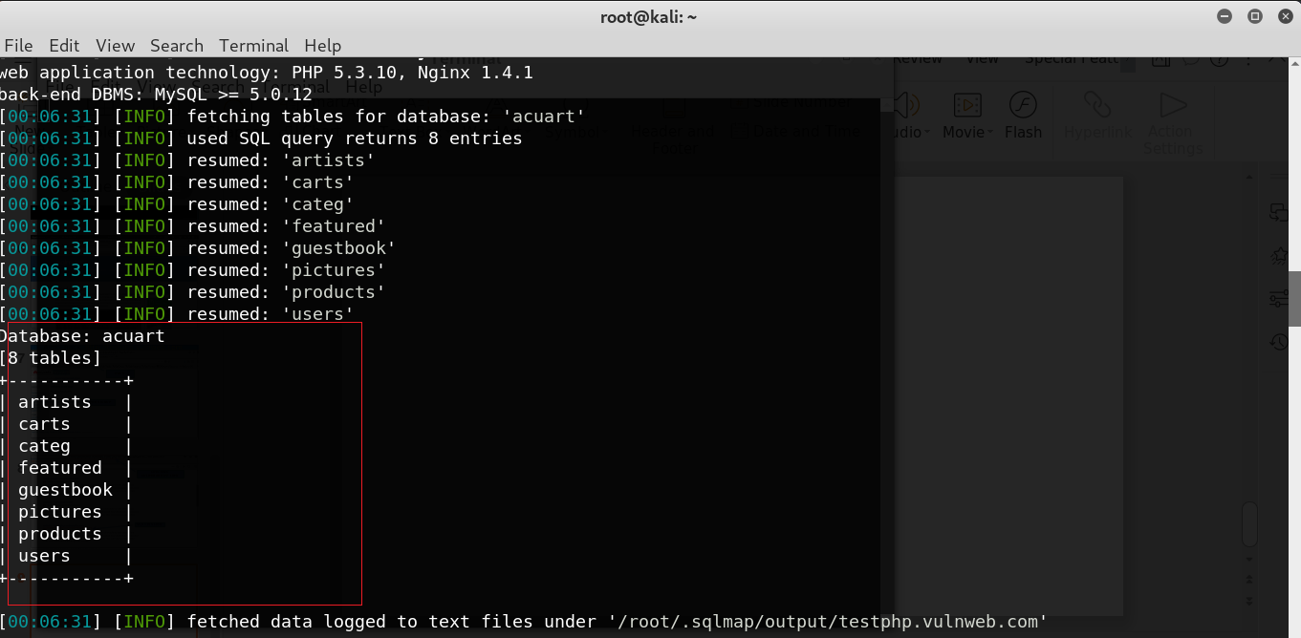
meet table

Slide 13
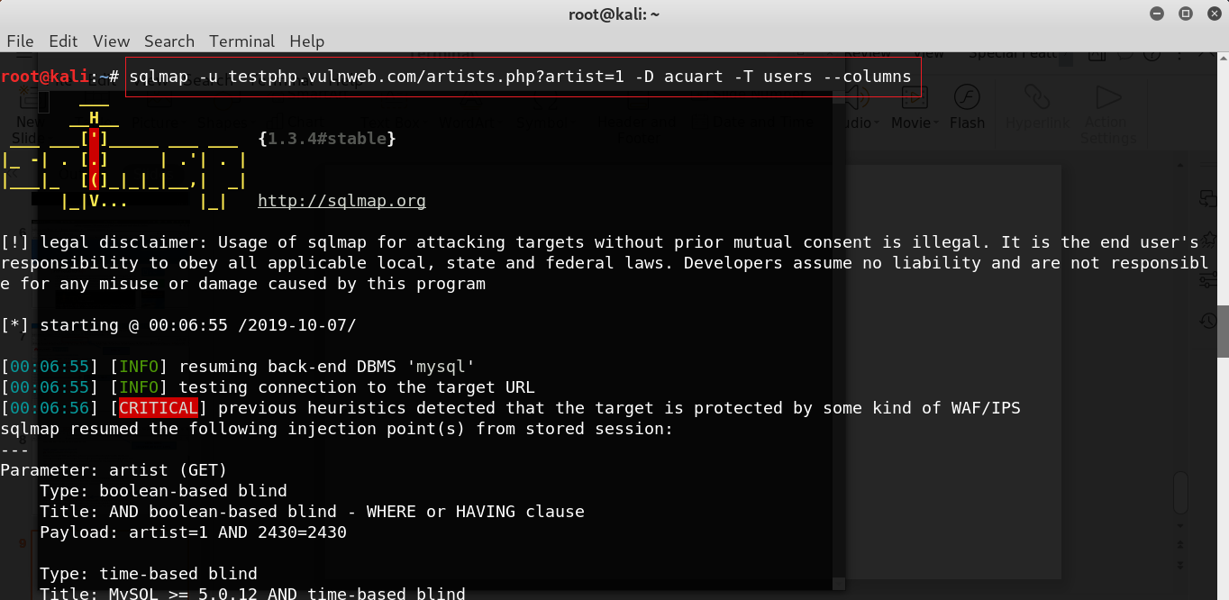
find column

Slide 14
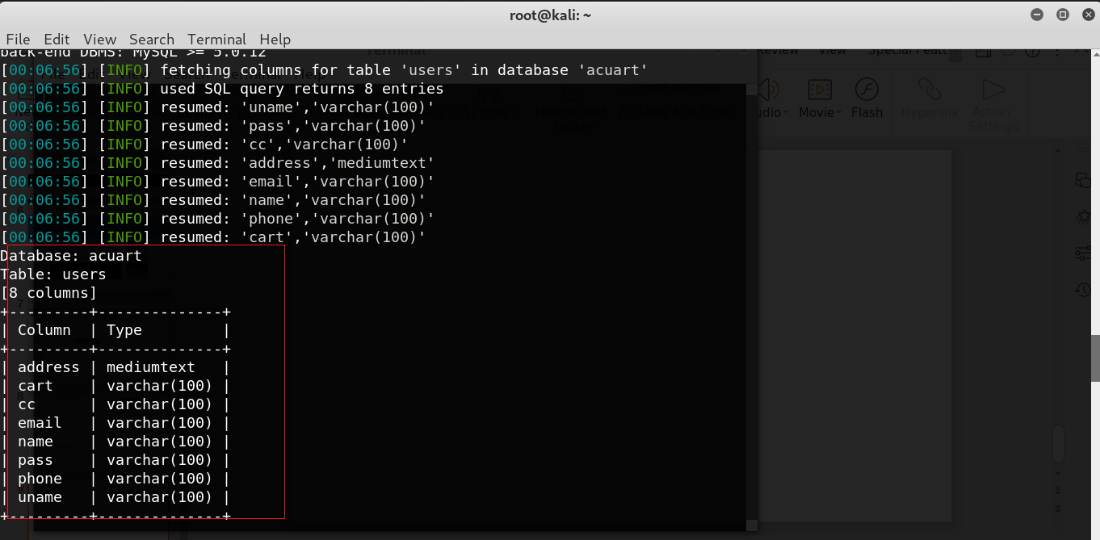
meet columns

Slide 15
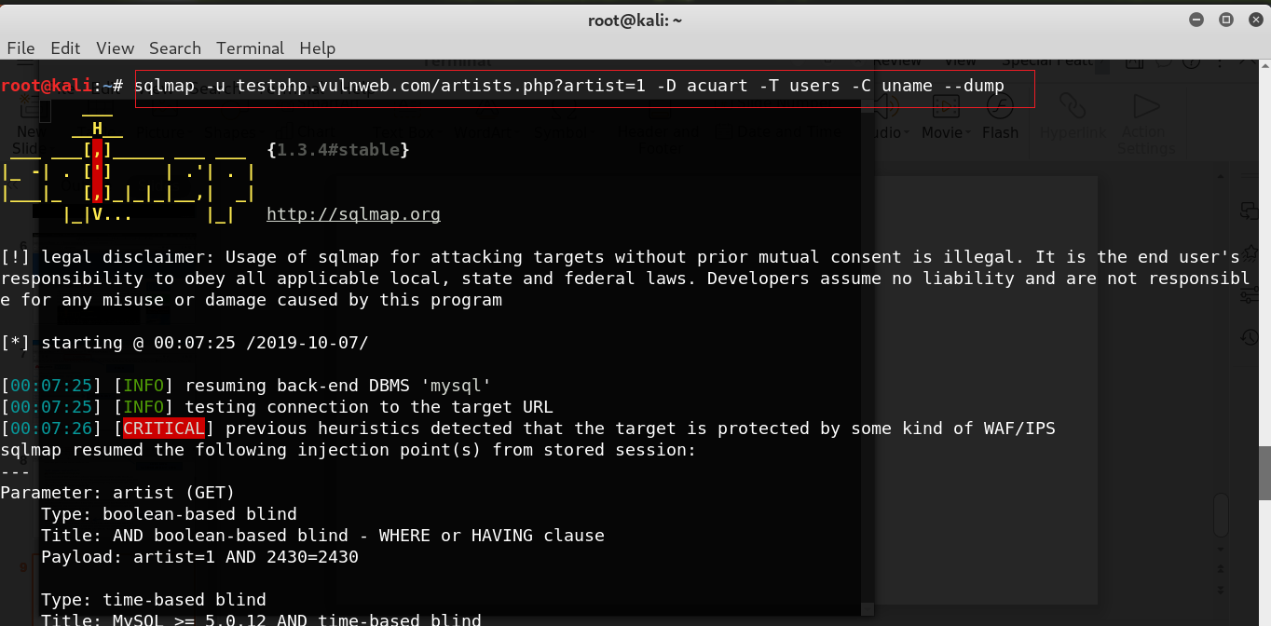
find username

Slide 16
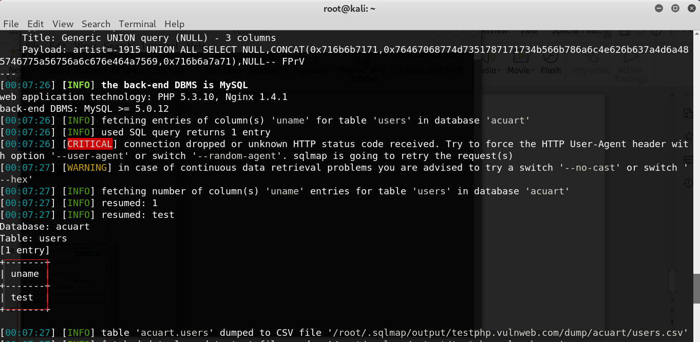
meet
username

Slide 17
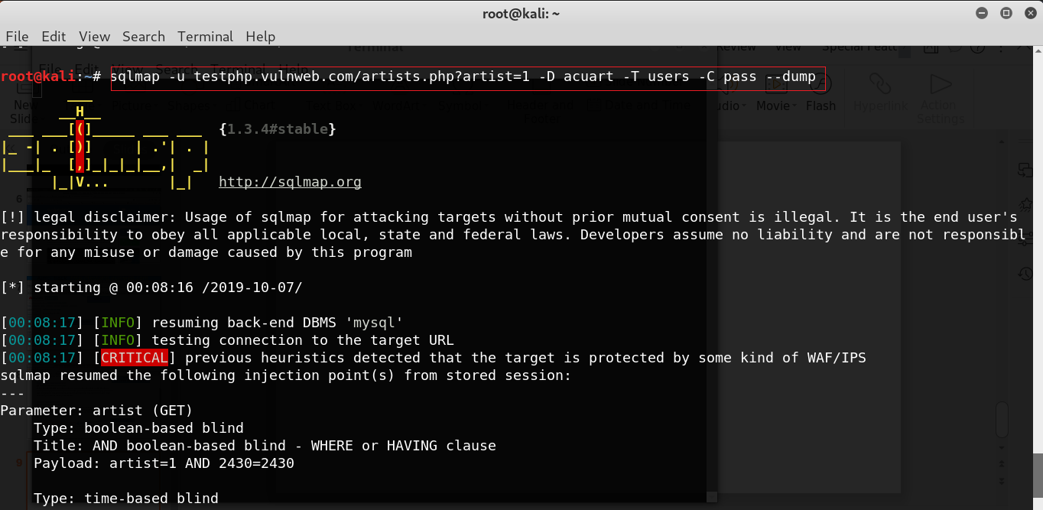
find
password

Slide 18
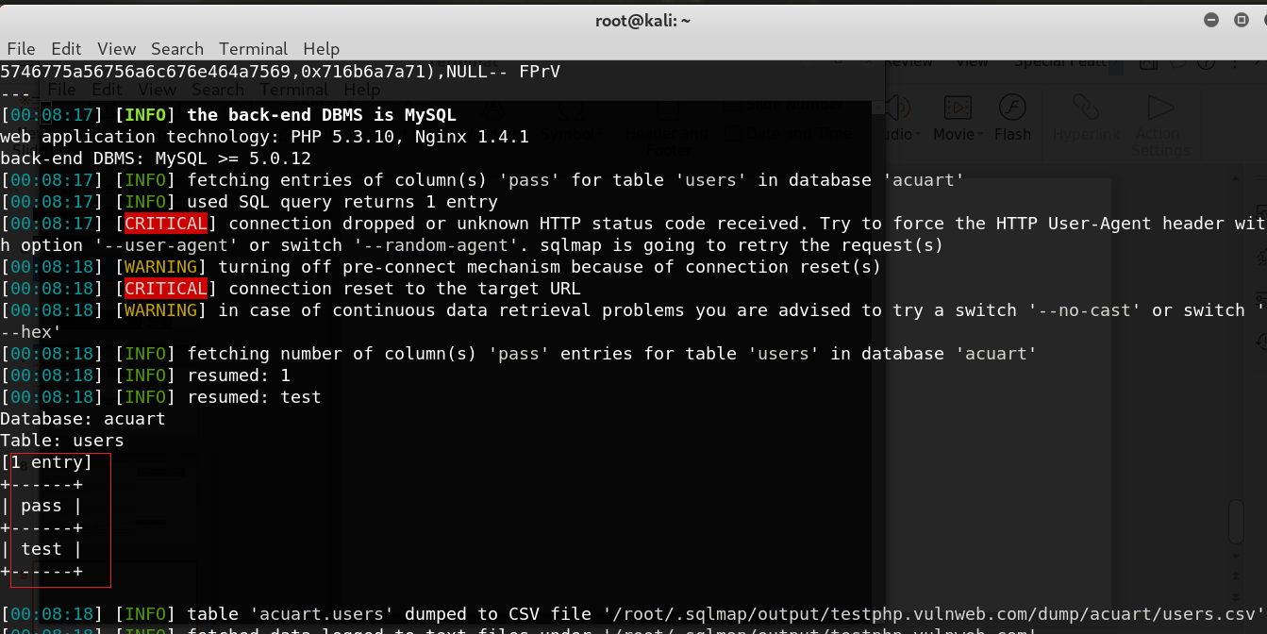
meet
password

