Slide 1
uWSGI, Docker, Kubernetes

Slide 2
uWSGI
uWSGI is a Python WSGI server implementation typically used for running Python web applications.
Process:
Create an instance of the python interpreter
Handle incoming HTTP requests and forward them to the application.

Slide 3
Django-uWSGI app flow
DB
Django app
Django app
Django app
UI
uWSGI

Slide 4
Docker app flow
Docker container
DB
Django app
Django app
Django app
UI
uWSGI

Slide 5
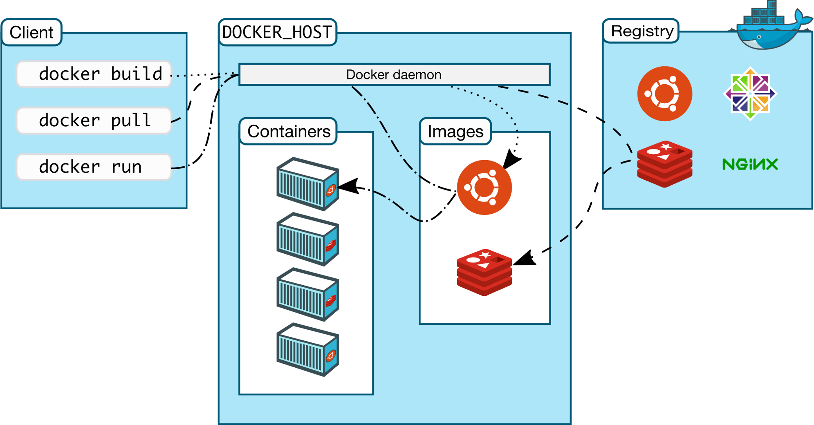
Docker architecture

Slide 6
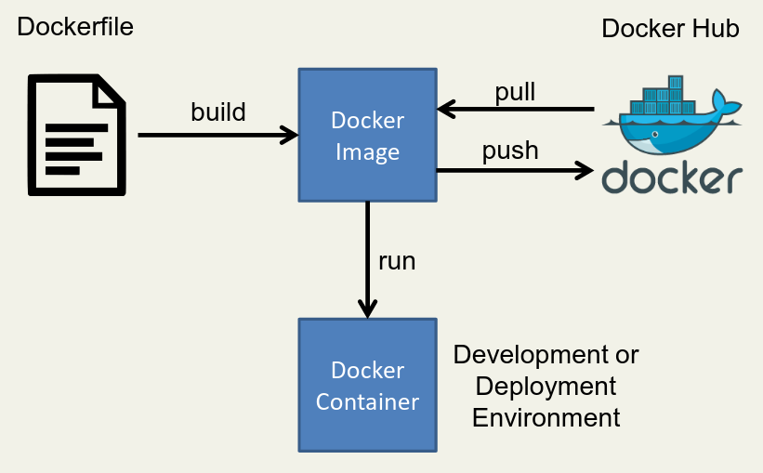
Execution flow

Slide 7
Kubernetes app flow
Kubernetes
Docker container
Django app
uWSGI
UI
Service
DB
Docker container
Django app
uWSGI

Slide 8
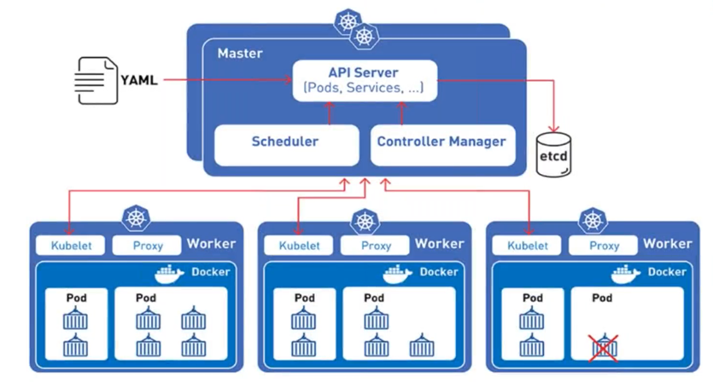
Kubernetes architecture

