Slide 1
Open Access
Free/Open Software,
Open Data,
Creative Commons
Wikipedia:
Commonalities and Distinctions
Stevan Harnad
UQAM & U Southampton
FSFS Kerala 2008

Slide 2
What is Open Access (OA)?
Free online access
to refereed research articles
FSFS Kerala 2008

Slide 3
Open Access to What?
ESSENTIAL:
to all 2.5 million annual research articles
published in all 25,000 peer-reviewed journals
(and peer-reviewed conferences)
in all scholarly and scientific disciplines, worldwide
OPTIONAL:
(because these are not all author give-aways, written only for usage and impact):
1. Books
2. Textbooks
3. Magazine articles
4. Newspaper articles
5. Music
6. Video
7. Software
8. “Knowledge”
(or because author’s choice to self-archive can only be encouraged, not required in all cases):
9. Data
10. Unrefereed Preprints
FSFS Kerala 2008

Slide 4
There are two ways to provide OA:
Green OA Self-Archiving: Authors self-archive the articles they publish in the 25,000 peer-reviewed journals
Gold OA Publishing: authors publish in one of the c. 3500 OA http://www.doaj.org/
NB: This presentation is exclusively about providing Green OA, through university policy reform (by mandating Green OA Self-Archiving).
It is not about Gold OA Publishing, which is in the hands of the publishing community, not the university community.
(Green OA may or may not eventually lead to Gold OA, but it will lead with certainty to OA.)
FSFS Kerala 2008

Slide 5
Why OA?
OA maximizes research progress: uptake, usage, applications and impact
Direct benefit of OA: research progress
Side-Benefits of OA: developing world access, student access, public access
FSFS Kerala 2008

Slide 6
How to provide (Green) OA?
Self-archive in Institutional Repository
Universities and Funders Mandate Self-Archiving
FSFS Kerala 2008

Slide 7







Impact cycle begins:
Research is done
Researchers write
pre-refereeing
“Pre-Print”
12-18 Months
Submitted to Journal
Pre-Print reviewed by Peer Experts – “Peer-Review”
Pre-Print revised by article’s Authors
Refereed “Post-Print” Accepted, Certified, Published by Journal
Researchers can access the Post-Print if their university has a subscription to the Journal
New impact cycles: New research builds on existing research
FSFS Kerala 2008

Slide 8
Impact cycle begins:
Research is done
Researchers write
pre-refereeing
“Pre-Print”
12-18 Months
Submitted to Journal
This limited subscription-based access can be supplemented by self-archiving the Postprint in the author’s own institutional repository as follows:
Pre-Print reviewed by Peer Experts – “Peer-Review”
Pre-Print revised by article’s Authors
Refereed “Post-Print” Accepted, Certified, Published by Journal
Researchers can access the Post-Print if their university has a subscription to the Journal
New impact cycles: New research builds on existing research
FSFS Kerala 2008

Slide 9




Impact cycle begins:
Research is done
Researchers write
pre-refereeing
“Pre-Print”
12-18 Months
Submitted to Journal
Pre-Print reviewed by Peer Experts – “Peer-Review”
Post-Print
is self-archived in University’s Eprint Archive
Pre-Print revised by article’s Authors
Refereed “Post-Print” Accepted, Certified, Published by Journal
More impact cycles:
Researchers can access the Post-Print if their university has a subscription to the Journal
New impact cycles: New research builds on existing research
FSFS Kerala 2008
Notes:
To maximise research access, supplement the existing system:
Do as before, but also:
Self-archive the preprint in your university’s Eprint Archive, so every would-be user can access it.
Self-archive the postprint in your university’s Eprint Archive, so every would-be user can access it.
Research access is maximized and so research impact is maximized.

Slide 10
FSFS Kerala 2008

Slide 11
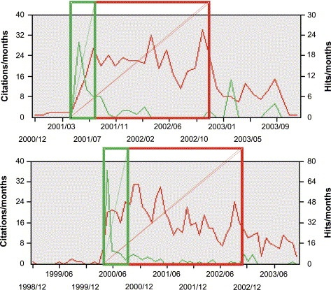
Usage Advantage + Early Advantage: OA Articles are
Downloaded more and early downloads lead to later citations
Data from arXiv
Downloads (“hits”) in the first 6 months correlate with citations 2 years later
Most articles are not cited at all
Brody, T., Harnad, S. and Carr, L. (2006) Earlier Web Usage Statistics as Predictors of Later Citation Impact. Journal of the American Association for Information Science and Technology (JASIST) 57(8): 1060-1072. http://eprints.ecs.soton.ac.uk/10713/
FSFS Kerala 2008
Notes:
Multiple regression analysis. Here four metrics are tested against citation counts as the criterion.

Slide 12
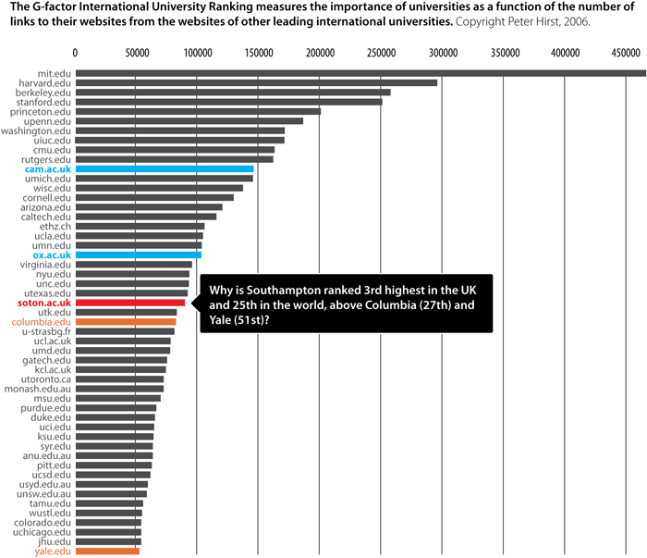
(Competitive Advantage): The earlier you mandate Green OA, the sooner (and bigger) your university's competitive advantage: U. Southampton School of Electronics and Computer Science was the first in the world to adopt an OA self-archiving mandate. (Competitive Advantage vanishes at 100% OA.)
FSFS Kerala 2008

Slide 13
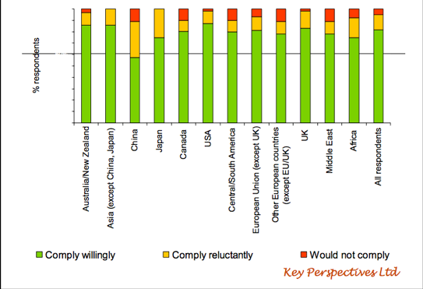
OA Mandates: Across all countries and disciplines, 95% of researchers report that they would comply with a self-archiving mandate from their funders and/or employers, and over 80% report that they would do so willingly. -- But only 15% self-archive spontaneously, if it not mandated.
FSFS Kerala 2008

Slide 14
University of Tasmania
+Repository -Incentive -Mandate
Green line: total annual output
Red line: proportion self-archived
Data courtesy of Arthur Sale
FSFS Kerala 2008

Slide 15
University of Queensland
+Repository +Incentive -Mandate
Green line: total annual output
Red line: proportion self-archived
Data courtesy of Arthur Sale
FSFS Kerala 2008

Slide 16
Queensland University of Technology
+Repository +Incentive +Mandate
Green line: total annual output
Red line: proportion self-archived
Data courtesy of Arthur Sale
FSFS Kerala 2008

Slide 17
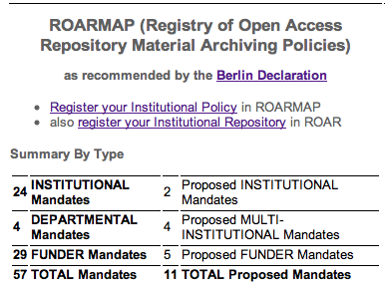
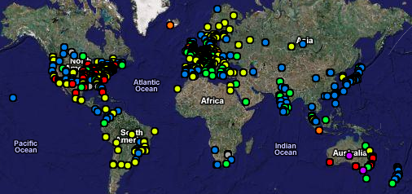
Many Repositories
but few deposits
because deposit mandates are still few:
15% of annual 2.5 million articles
FSFS Kerala 2008

Slide 18
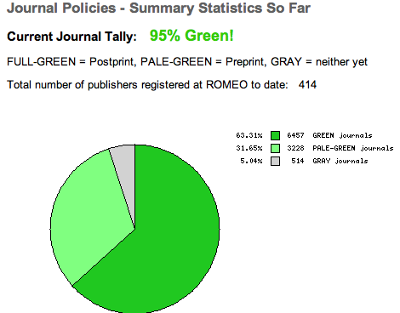
What About Copyright?
Mandate ID/OA: Immediate Deposit, Optional Access:
All articles must be deposited immediately upon acceptance for publication. Publishers have no say over institution-internal record-keeping.
Embargoed articles can
be made Closed Access
instead of Open Access.
63% of journals are Green
(already endorse
immediate OA)
ROMEO/EPRINTS (Directory of Journal Policies on author OA Self-Archiving): http://romeo.eprints.org/
FSFS Kerala 2008

Slide 19
For the articles in the 37% of journals that have an embargo policy, the free EPrints institutional Repository-creating software has an ”Email Eprint Request" Button:
The user who reaches the metadata for a Closed Access article puts his email in a box and clicks.
This sends an automatic email to the author, with a URL on which the author clicks to automatically email the eprint to the requester.
FSFS Kerala 2008

Slide 20
Harvard’s Copyright Reservation Mandate Model (with opt-out) vs
ID/OA
(Immediate Deposit/Optional Access)
Mandate Model (no opt-out)
FSFS Kerala 2008

Slide 21
Copyright Reform (and Gold OA) will follow Universal Green OA
Universal Green OA needs to be mandated
Mandates need to be successfully adopted globally
ID/OA is the weakest OA mandate, hence the easiest to reach consensus on adopting
ID/OA moots all copyright concerns
Copyright Reform should not be made a precondition for mandating OA
FSFS Kerala 2008

Slide 22
Open Access,
Free/Open Software,
Open Data
Creative Commons Licensing
Wikipedia
The Commonalities and Distinctions
(1) Exception-Free Creator Give-Away? (Created for uptake, usage and impact alone?)
(2) Peer-Revewed?
(3) Published?
(4) Publicly Funded?
(5) Copyright Barrier?
(**6) Access to code?
(7) Modifying/Remixing/"re-using" code?
(8) Republishing Code?
FSFS Kerala 2008

Slide 23
Open Access
(*1) Exception-Free Creator Give-Away (Created for uptake, usage and impact alone)
(*2) Peer-Revewed
(*3) Published
(4) Publicly Funded? Not all (hence funder mandates are not enough)
(5) Copyright Barrier? Some (hence ID/OA mandate preferable to license negotiation mandate)
(**6) Access to code
(7) Modifying/Remixing/"re-using" code? No (refereed research article texts not to be modified or re-mixed)
(8) Republishing Code allowed? No (but no need for published article text – but no need either, if text is already OA)
FSFS Kerala 2008

Slide 24
Free/Open Software
(1) Exception-Free Creator Give-Away? (Created for uptake, usage and impact alone?) Not all (nor most, yet)
(2) Peer-Revewed? Most not
(3) Published? Most not
(4) Publicly Funded? Some only
(5) Copyright Barrier? Some
(**6) Access to code
(*7) Modifying/Remixing/"re-using" code
(*8) Republishing Code
FSFS Kerala 2008

Slide 25
Open Data
(1) Exception-Free Creator Give-Away? (Created for uptake, usage and impact alone?) Not all (nor most, yet)
(2) Peer-Revewed? Most not
(3) Published? Most not
(4) Publicly Funded? Some only
(5) Copyright Barrier? Most not
(**6) Access to code
(*7) Modifying/Remixing/"re-using" code
(*8) Republishing Code
FSFS Kerala 2008

Slide 26
Creative Commons Licensing
(Books, Music, Video)
(1) Exception-Free Creator Give-Away? (Created for uptake, usage and impact alone?) Not all (nor most, yet)
(2) Peer-Revewed? Most not
(3) Published? Some
(4) Publicly Funded? Some only
(5) Copyright Barrier? Most
(**6) Access to code
(*7) Modifying/Remixing/"re-using" code
(*8) Republishing Code
FSFS Kerala 2008

Slide 27
Wikipedia
(*1) Exception-Free Creator Give-Away (Created for uptake, usage and impact alone)
(2) Peer-Revewed? Not
(3) Published? Most not
(4) Publicly Funded? Not
(5) Copyright Barrier Not
(**6) Access to code
(*7) Modifying/Remixing/"re-using" code
(*8) Republishing Code
FSFS Kerala 2008

Slide 28
Open Access,
Free/Open Software,
Open Data
Creative Commons Licensing
Wikipedia
The only shared invariant across all 5 is the quest for:
(**6) Access to code
And what makes it possible to mandate Open Access to the code (text) for refereed research is that it is all an author give-away already, written solely for access, uptake, usage and impact, not for fee or royalty.
FSFS Kerala 2008

Slide 29
SUMMARY: Free/Open Software (notably the first Free Software for creating OAI-compliant Open Access Institutional Repositories, EPrints, created in 2000, distributed under the GNU license, and now used worldwide) has been central to the growth of the Open Access Movement. However, there are also crucial distinctions that need to be made and understood, among the movements for (1) Free/Open source software, (2) Open Access (to peer-reviewed research), (3) Open Data, (4) Creative Commons licensing, and (5) Wikipedia-style collective writing. Open Access (OA) is focussed primarily on refereed research articles. The crucial distinctions revolve mostly around (a) the fundamental difference between author giveaway vs. non-giveaway work and (b) the functional differences between the re-use needs for peer-reviewed research article texts on the one hand, and data, software and other kinds of digital content on the other.
FSFS Kerala 2008

Slide 30
Author’s URLs (UQAM & Southampton):
http://www.crsc.uqam.ca/
http://users.ecs.soton.ac.uk/harnad/
BIBLIOGRAPHY ON OA IMPACT ADVANTAGE:
http://opcit.eprints.org/oacitation-biblio.html
BOAI Self-Archiving FAQ: http://www.eprints.org/self-faq/
CITEBASE (scientometric engine): http://citebase.eprints.org/
EPRINTS: http://www.eprints.org/
OA ARCHIVANGELISM: http://openaccess.eprints.org/
ROAR (Registry of OA Repositories): http://roar.eprints.org/
ROARMAP (Registry of OA Repository Mandates):
http://www.eprints.org/openaccess/policysignup/
ROMEO/EPRINTS (Directory of Journal Policies on author OA Self-Archiving): http://romeo.eprints.org/
FSFS Kerala 2008

