Slide 1
Lending Case Study ASSIGNMENT SUBMISSION
Name:

Slide 2
Abstract
This company is the largest online loan marketplace, facilitating personal loans, business loans, and financing of medical procedures. Borrowers can easily access lower interest rate loans through a fast online interface.
The credit loss is the amount of money lost by the lender when the borrower refuses to pay or runs away with the money owed. In other words, borrowers who default cause the largest amount of loss to the lenders. In this case, the customers labelled as 'charged-off' are the 'defaulters'.
The company wants to understand the driving factors (or driver variables) behind loan default, i.e. the variables which are strong indicators of default. The company can utilize this knowledge for its portfolio and risk assessment.

Slide 3
Problem solving methodology
Analyze Data
Sort
columns which will be useful for analysis
Analyze Missing Values
Dr
Drop columns if required or
impute missing values
Dr
Understand various variable
Make Univariate analysis and Bivariate analysis
Dr
Perform sanity checks

Slide 4
Univariate Analysis
# | Type | Count
1 | Defaulter | 5019
2 | Cleared | 30463
 | Total | 35482
# | Grade | % of Default
1 | A | 5.67
2 | B | 11.79
3 | C | 16.54
4 | D | 21.21
5 | E | 26.4
6 | F | 31.83
7 | G | 33.92
# | Type | % of Default
1 | educational | 16.61
2 | debt_consolidation | 15.00
3 | home_improvement | 11.49
4 | car | 10.74
5 | credit_card | 10.39
# | Type | % of Default
1 | Not Verified | 12.13
2 | Source Verified | 14.56
3 | Verified | 16.45

Slide 5
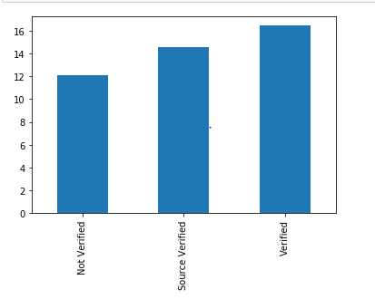
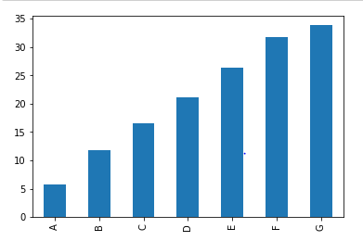
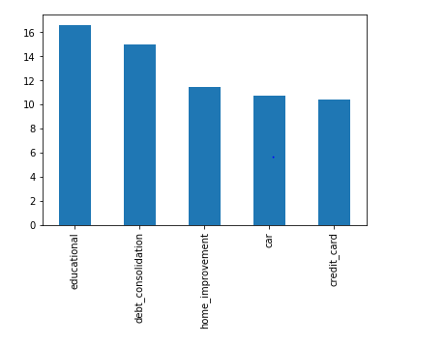
Univariate Analysis
% Of Defaults

Slide 6
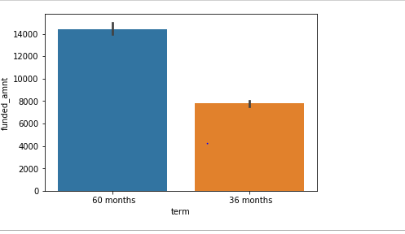
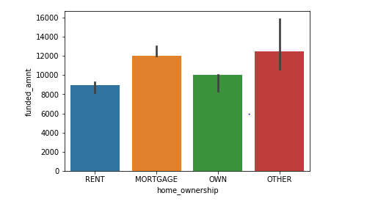
Bivariate Analysis
Loan which are funded for 60 months and are default
Loan which are funded and are default and their owner ship status

Slide 7
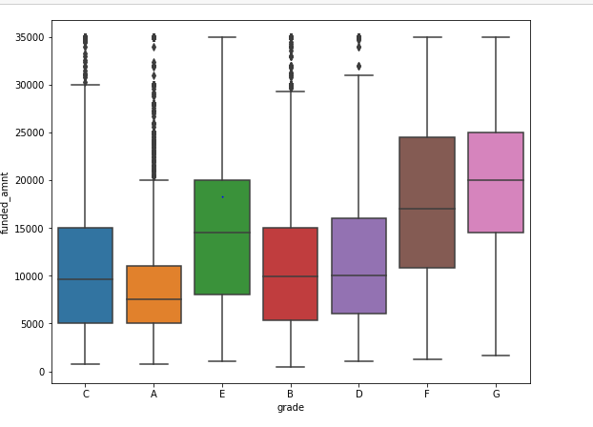
Plot 1
Based on box plot we can see borrower which falls under grade A are likely to get high value loans and lending company should follow this pattern.

Slide 8
Conclusions
We can concluded that we should prefer to give loan to borrower with Grade A and for shorter duration.

