Slide 1
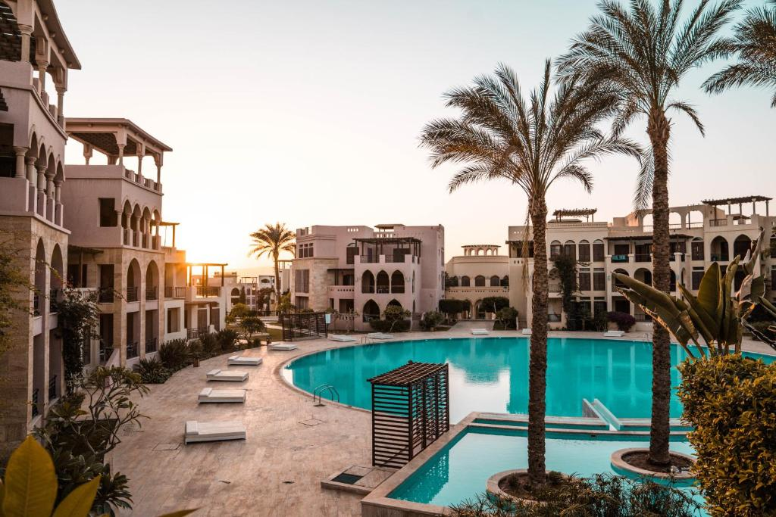
CAPSTONE EDA PROJECT
HOTEL BOOKINGS ANALYSIS
Team Project By :-
Rohit Sonawane

Slide 2
ACKNOWLEDGEMENT :-
I would express my gratitude towards the entire team of “Almabetter” for acknowledging us with such important domain and providing us an opportunity to work on real life problems through Capstone Project.

Slide 3
Algorithm/Steps followed :-
1.Importing necessary packages and libraries.
2.Calling File from Github Repository.
3.Analysing the data set.
4.Checking null/NAN/duplicate rows.
5.Changing Datatype if any required.
5.Fixing the outliers.
6.Drop certain columns/combined certain columns to make our data sheet free Avoid
of any irrelevant data.
7.Applying the concept of Data Wrangling and Data Visualization such that we can
analyse the data sheet and retrieve required information.

Slide 4
Problem Statement :-
Have you ever wondered when the best time of year to book a hotel room is? Or the optimal length of stay in order to get the best daily rate? This hotel booking dataset can help you explore those questions!
This data set contains booking information for a city hotel and a resort hotel, and includes information such as when the booking was made, length of stay, the number of adults, children, and/or babies, and the number of available parking spaces, among other things. All personally identifying information has been removed from the data. Explore and analyze the data to discover important factors that govern the bookings.

Slide 5
Description of columns :-
Column_name | Column_description
Hotel | Contain data values hotel City ,Resort
is_canceled | Contains boolean data values 0→not_canceled 1→canceled
lead_time | Number of days between the entering date of booking and arrival date
arrival_date_year | Year of the arrival date of guests
arrival_date_month | Month of the arrival date of guests
arrival_date_week_number | Week number of year of arrival date
arrival_date_day_of_month | Day of the arrival of guests

Slide 6
distribution_channel | TA/TO
is_repeated_guest | Having values 1->repeated guests 0->no repeated guests
previous_cancellations | Number of previous bookings that were cancelled by the guests prior to the current booking
Previous_booking_not_cancellations | Number of previous bookings that were not cancelled by the guests prior to the current booking
reserved_room_type | Room type -- reserved
booking_changes | Number of changes made to the booking from the moment the booking was entered on the pms until the moment of check-in or cancellation
deposit_type | Categorical values—No deposit , Refund, Non-refund
agent | ID of the travel agency made the booking

Slide 7
Stays_in_weekend_nights | Number of days for stay on weekend night
Stays_in_week_nights | Number of days for stay on week day
adults | Number of adults
children | Number of children
babies | Number of babies
meal | Type of meal offered
country | Countries from where guests arrived
market_segment | Categorical values like TA→Travel agent TO→ Tour Operators

Slide 8
company | ID of the company which made the booking
days_in_waiting_list | Number of days the booking was in the waiting list before it was confirmed
customer_type | Categorical values→ contract group, transisent, party
Average_daily_rate | Obtained by dividing the sum of all lodging transaction by the total number of staying nights
required_car_parking_spaces | Number of car parking spaces used by guests
total_of_special_requests | Number of special requests made by guests(eg-extra bedsheet)
reservation_status | Contains the current status
total_members | Number of adults + Number of children + Number of babies

Slide 9
Analysis & Observations :-
Here I present some of the basic as well as some advanced observations retrieved from the data sheet.
I do,
Univariate Analysis
Bivariate and Multivariate Analysis

Slide 10
Univariate Analysis :-
Which Hotel type Most Preferred.
Which agent made the most bookings?
What is the percentage of repeated guests?
What is the most preferred room type by the customers?
What type of food is mostly preferred by the guests?
What type of food is mostly preferred by the guests?
In which month most of the bookings happened?
Which distribution channel is mostly used for hotel booking?
Which year had highest bookings?

Slide 11
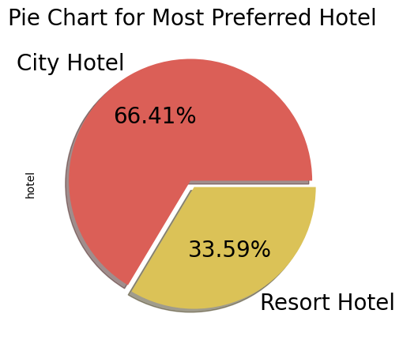
1. Which Hotel type Most Preferred.
We observed City Hotel shares 66.41% .

Slide 12
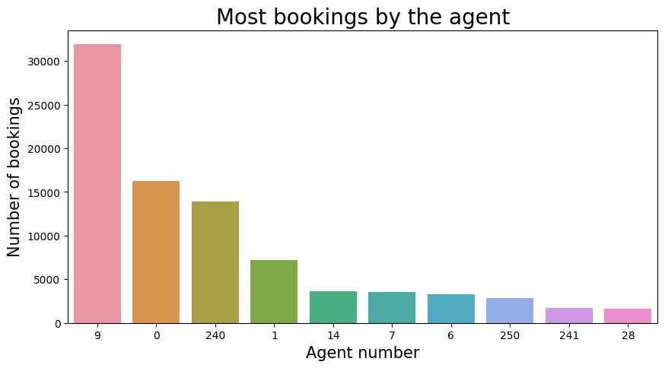
2.Which agent made the most bookings?
Most bookings were made by Agent No. 9.
Less booking were made by Agent No. 28.

Slide 13
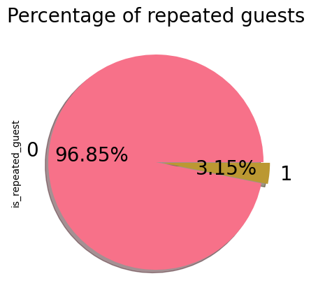
3.What is the percentage of repeated guests?
Here,
0 – means guest is not repeated
1 – means guest is repeated
So,
96.85 % guest is not repeated.

Slide 14
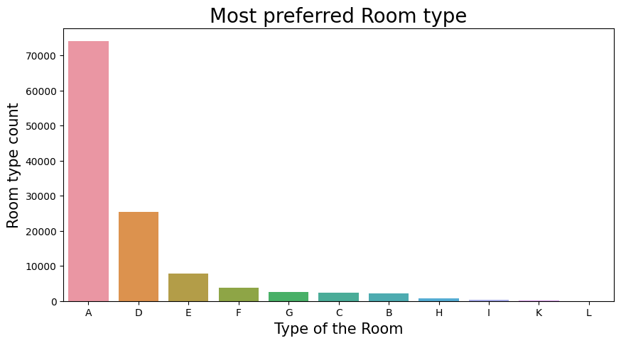
4.What is the most preferred room type by the customers?
I observed that most of guest preferred room type is “A”.

Slide 15
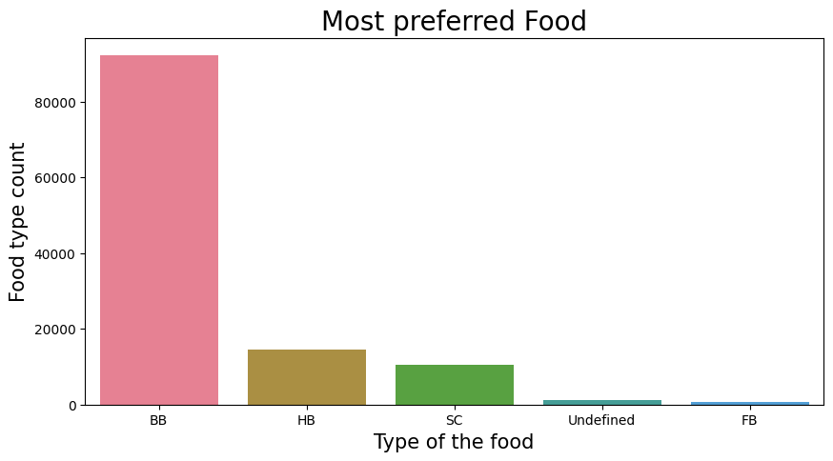
5.What type of food is mostly preferred by the guests?
Most Guest Preferred “BB” type of food.

Slide 16
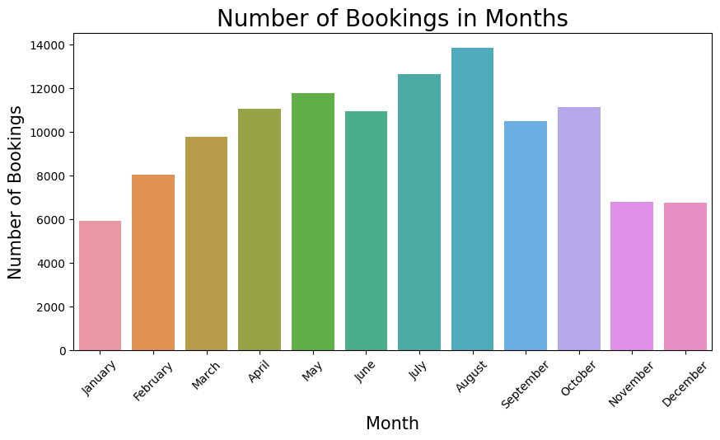
6.In which month most of the bookings happened?
It's clearly seen that the most booking are in month of “August”.

Slide 17
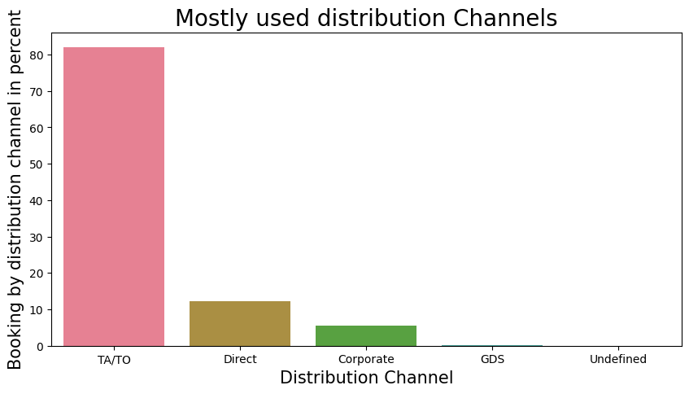
7.Which distribution channel is mostly used for hotel booking?
I observed mostly used distribution Channel is TA/TO (Travel Agent/Travel Organisation).

Slide 18
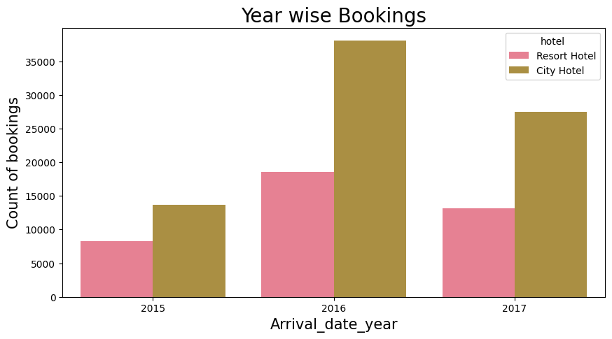
8. Which year had highest bookings?
We observed 2016 has more bookings than 2015 and 2017.

Slide 19
Bivariate and Multivariate Analysis :-
Which hotel type has the highest ADR?
Which hotel has longer waiting time?
Which distribution channel contributed more to ADR in order to increase the income?
What is optimal stay length in both types of hotel?

Slide 20
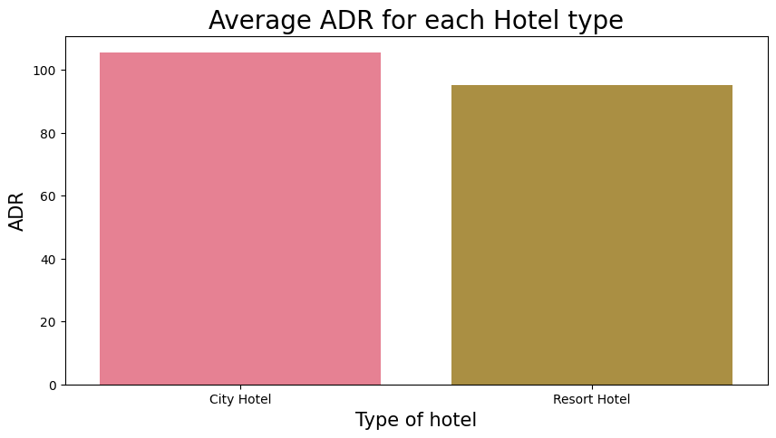
9. Which hotel type has the highest ADR?
City Hotel has highest Average ADR .

Slide 21
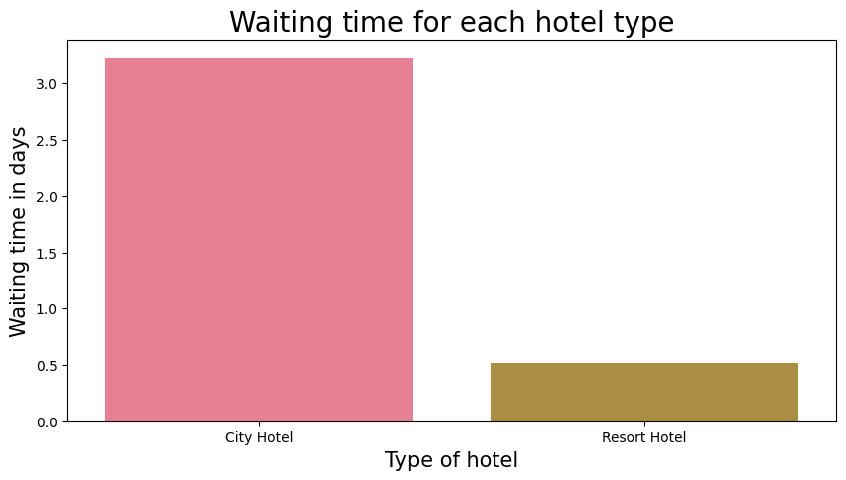
10.Which hotel has longer waiting time?
City Hotel has longer waiting time than Resort Hotel.

Slide 22
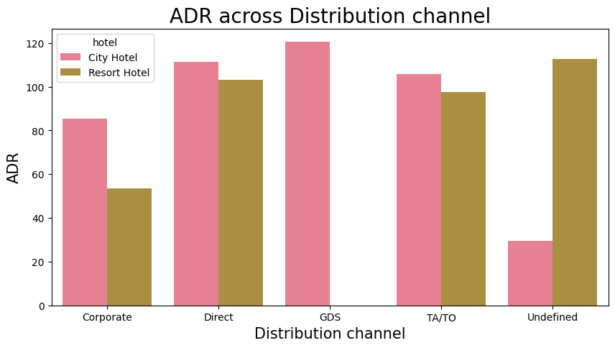
11.Which distribution channel contributed more to ADR in order to increase the income?
I observed “Direct” and “TA/TO” contribute in ADR of Both “City Hotel and Resort Hotel”.

Slide 23
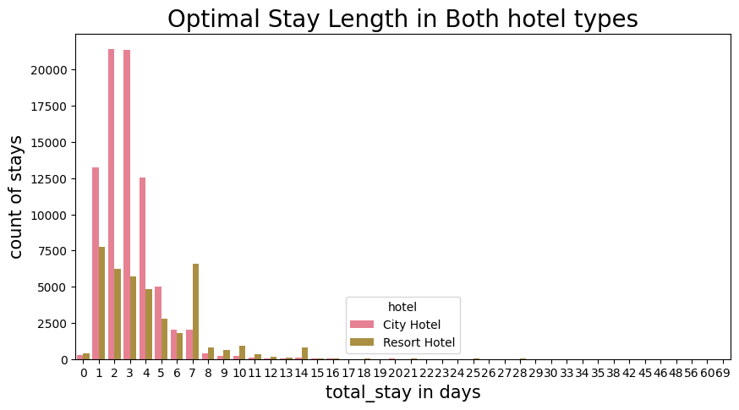
12.What is optimal stay length in both types of hotel?
I observed City Hotel has optimal stay of 2 days and Resort Hotel has optimal stay of 1 day.

Slide 24
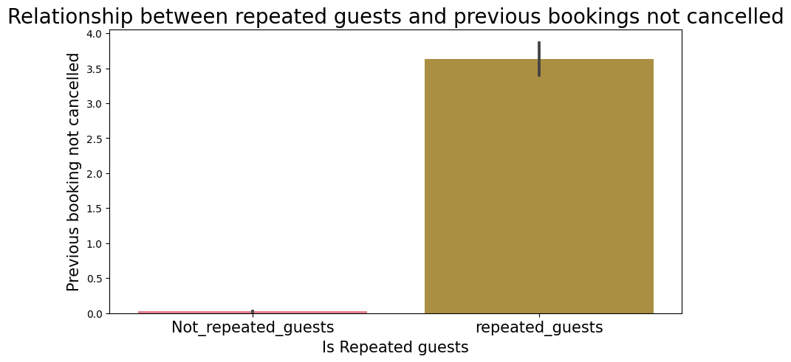
13.Relationship between the repeated guests and previous bookings not cancelled?
I observed that Repeated guests do not cancelled their booking.

Slide 25
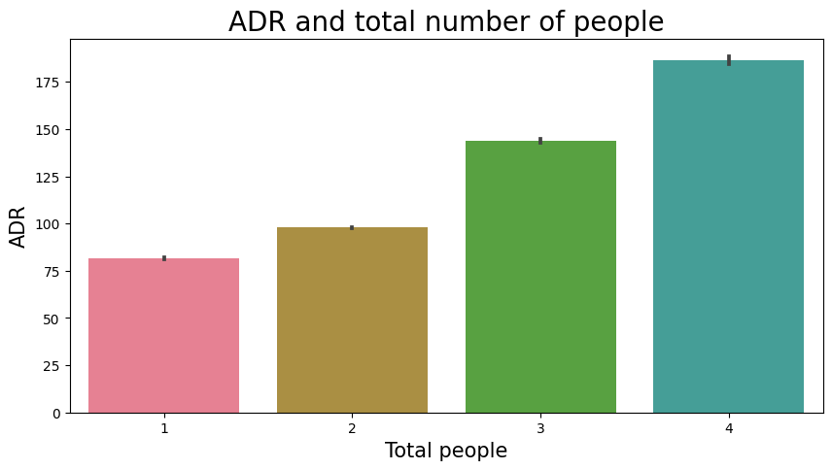
14.Relationship between ADR and total number of people?
I observed more the Total People are staying more the ADR.

Slide 26
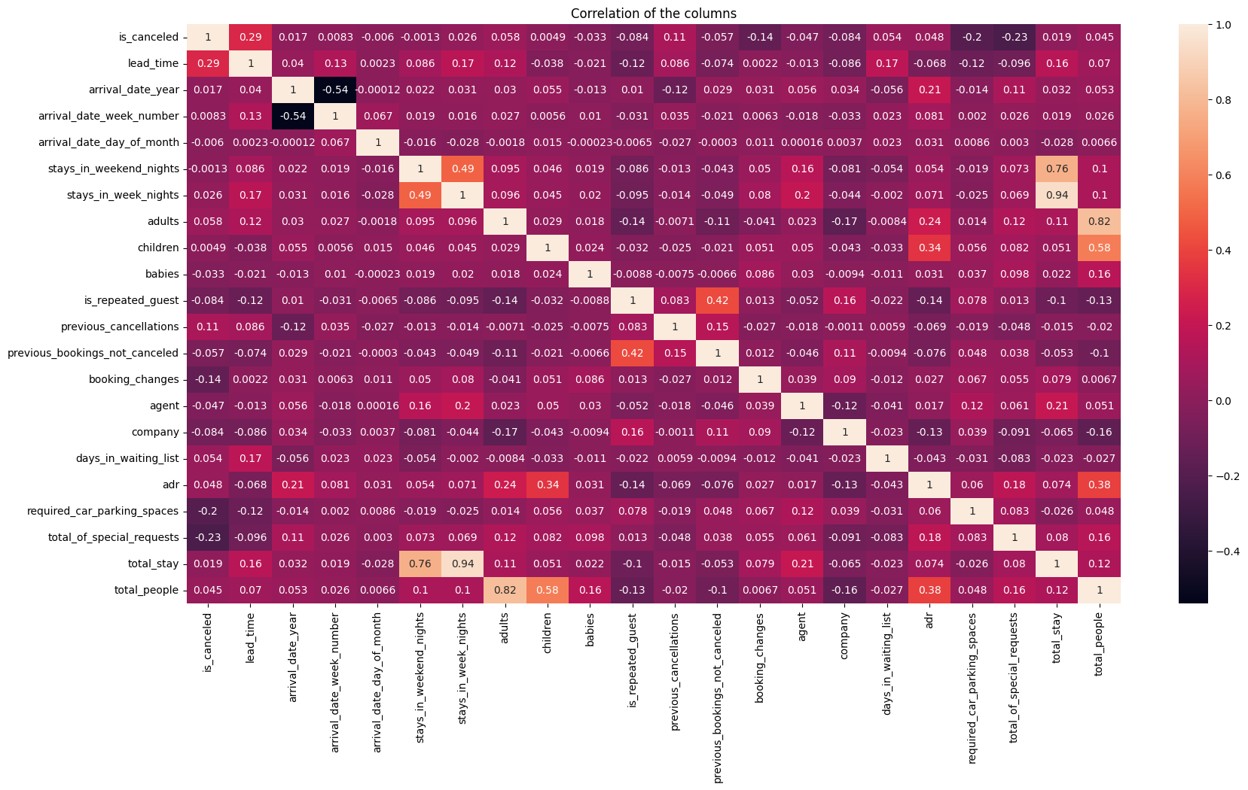
15.Analysing the correlation.
arrival_date_year and arrival_date_week_number
columns has negative
correlation which
is -0.54.
stays_in_week_nights and total_stays has positive correlation which is 0.94.

Slide 27
Conclusion :-
City hotel is mostly preferred hotel by guests.
Agent no. 9 made the most bookings.
Percentage of repeated guest is less which is 3.15%.
Room type A is mostly preferred room type.
Mostly preferred food type is BB type food.
August month has most bookings.
TA/TO distribution channel is mostly used and percentage is 82.00 %.
City hotel has highest ADR. Highest ADR means more revenue.
2016 year had highest bookings and bookings were 56622.
City hotel has higher waiting time means city hotel is busier hotel.
GDS distribution channel contributed most in ADR in city hotel but no contribution in resort hotel.
Optimal stay length in both hotel type is less than 7 days.
Repeated guests do not cancel their bookings but not repeated guests cancel.
If number of people is more then ADR is also increases means revenue increases.
arrival_date_year and arrival_date_week_number columns has negative correlation which is -0.54.
stays_in_week_nights and total_stays has positive correlation which is 0.94.

Slide 28
THANK YOU

