Slide 1

Seasonal Agriculture Performance Analysis
Rohit Tamboli
Lakhmi Chand Institute of Technology
AICTE STU ID : STU64d8e66ea92461691936366

Slide 2

PROBLEM STATEMENT
Agricultural performance varies with seasonal environmental conditions, farming practices, resource availability and economic conditions. This project analyzes the supplied agricultural dataset to identify meaningful seasonal patterns in yield, production, revenue, profit, water use, water efficiency and environmental risk. The goal is to develop evidence-based conclusions and practical recommendations for seasonal agricultural planning.

Slide 3
Project Description
The project analyzes 4,000 farm-level agricultural records across seasons, locations, crops, environmental conditions, farming practices, production, costs, revenue, profit and resource usage. The data is cleaned using season-wise median imputation for missing Rainfall_mm, Soil_Moisture_pct and Yield_Tonnes_Ha values. No rows are dropped, so all 4,000 records remain. Exploratory and statistical analysis compares Kharif, Rabi and Zaid seasons, crops, irrigation methods and states using descriptive statistics, visualizations, correlation analysis and the Kruskal–Wallis test.

Slide 4

WHO ARE THE END USERS?
Primary End Users • Farmers & farm managers — support crop and season planning. • Agricultural analysts — compare yield, profit and resource efficiency. • Agribusiness planners — evaluate crop and irrigation performance. • Policy & extension teams — identify seasonal and regional patterns. • Researchers & students — study agricultural performance using data analytics. The analysis is descriptive/statistical and does not provide causal or predictive guarantees.

Slide 5

Technology Used
Python • Pandas — data cleaning, grouping and aggregation • NumPy — numerical analysis • Matplotlib — charts and plots • Seaborn — statistical visualizations and heatmaps • SciPy — Kruskal–Wallis statistical testing • Jupyter Notebook / Google Colab — analysis workflow

Slide 6
Technology Used
Dataset • seasonal_agriculture_performance_dataset.csv • 4,000 records • 28 variables • 3 seasons: Kharif, Rabi, Zaid • 8 crops, 8 states and 4 irrigation methods

Slide 7
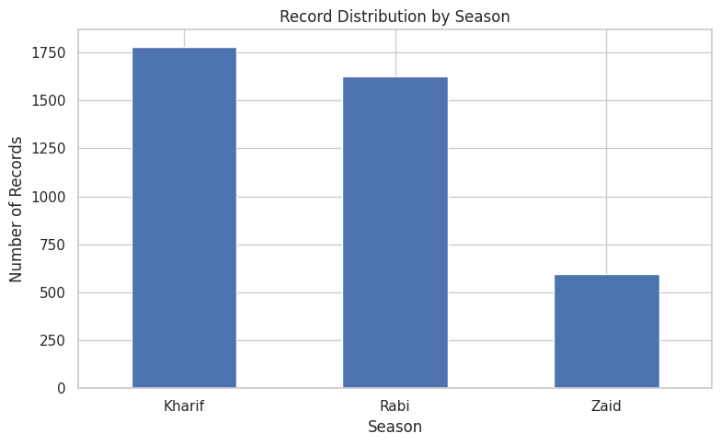
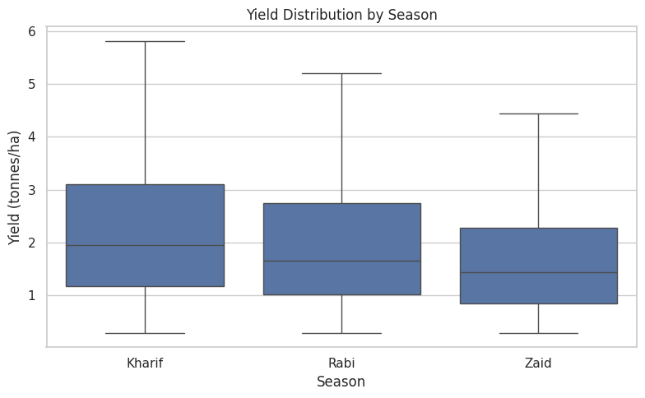
RESULTS
Seasonal Performance
Kharif: 5.64 t/ha yield, INR 178,915 average profit, 57.79% profitable. Rabi: 5.08 t/ha yield, INR 87,689 average profit, 48.86% profitable. Zaid: 4.67 t/ha yield, INR -24,805 average profit, 35.52% profitable. Kharif has the strongest overall performance, while Zaid is the weakest economically.

Slide 8
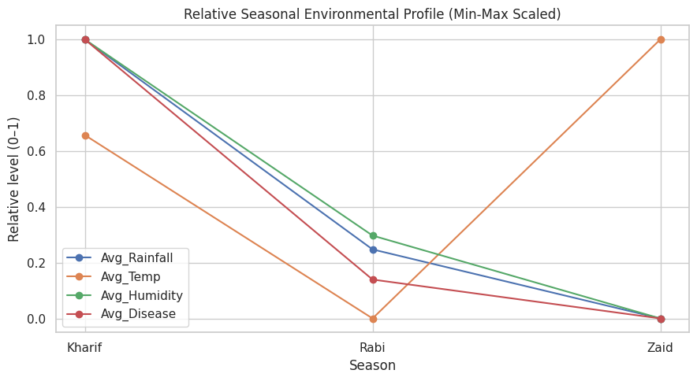
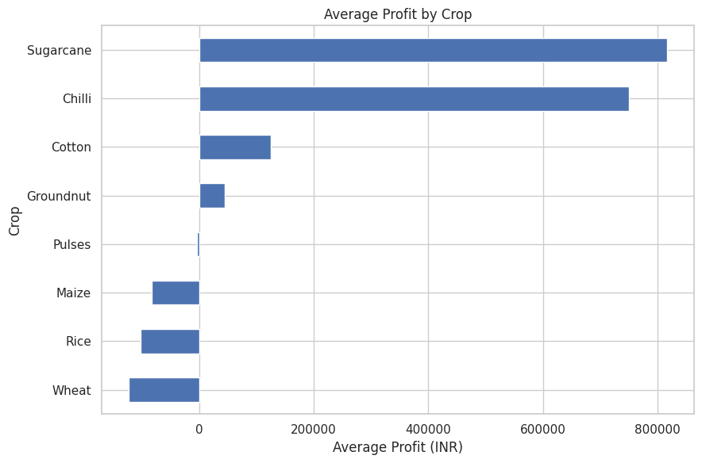
RESULTS
Environmental & Crop Performance
Environmental profile: Kharif has the highest rainfall (852.11 mm), humidity (71.81%) and disease/pest risk (54.47%). Zaid is hottest (31.04°C) and driest (299.12 mm rainfall). Crop profitability: Sugarcane (INR 817,188) and Chilli (INR 750,878) have the highest average profits. Wheat, rice and maize have negative average profits.

Slide 9
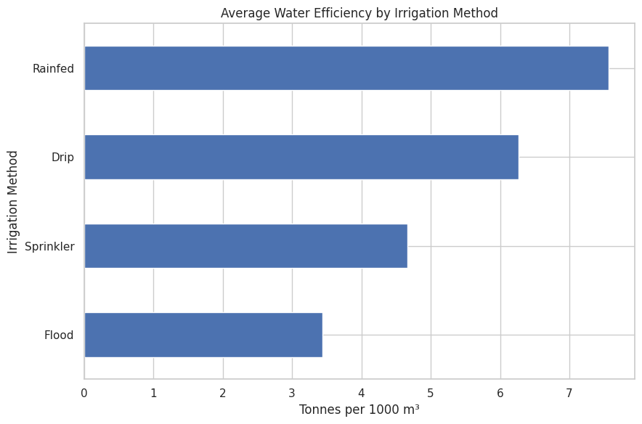
RESULTS
Irrigation & Resource Efficiency
Drip irrigation has the highest average yield (6.58 t/ha) and average profit (INR 219,626). Rainfed has the highest average water-efficiency ratio (7.56 tonnes per 1,000 m³), while Flood has the lowest (3.44). These are descriptive associations; crop, farm size and season differ across irrigation groups.

Slide 10
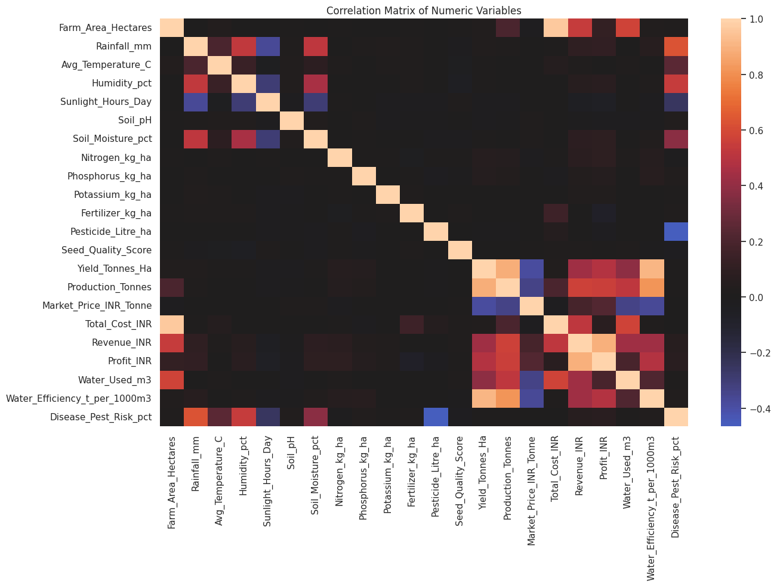
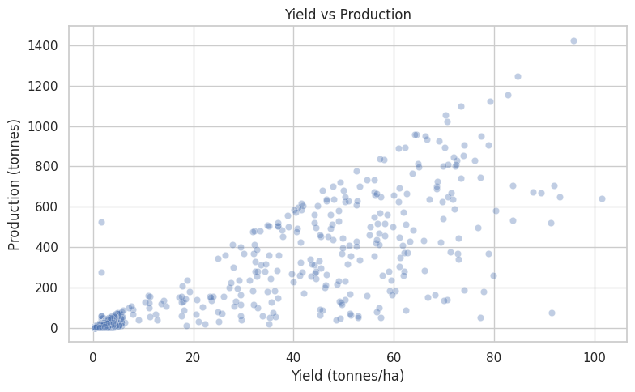
RESULTS
Relationships Between Variables
Yield is strongly correlated with production (r = 0.88) and water efficiency (r = 0.91). Profit is strongly correlated with revenue (r = 0.89) and moderately with yield (r = 0.49). Production generally rises with yield, but farm area also affects total production. Correlation indicates association, not causation.

Slide 11
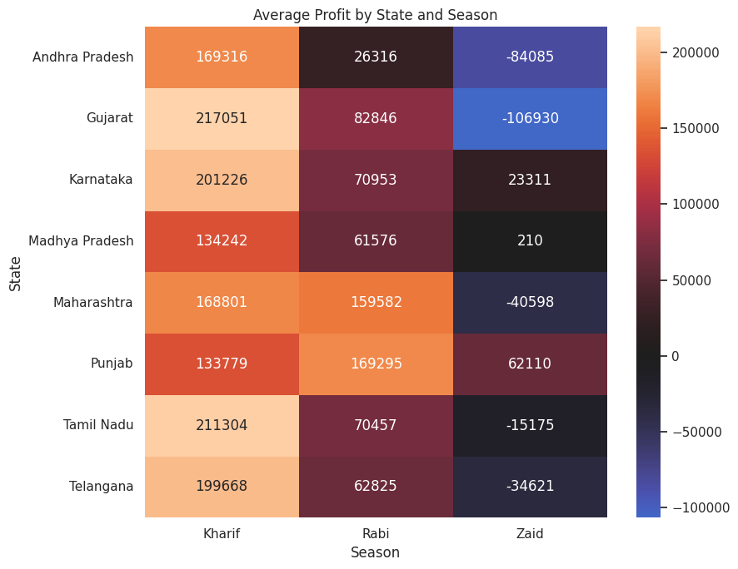
RESULTS
Regional Consistency & Statistical Testing
The state × season profit heatmap shows that the broad Kharif advantage appears in many states, but regional differences and exceptions are visible. Kruskal–Wallis testing at the 5% significance level found statistically significant seasonal differences for yield, profit, revenue, water efficiency, rainfall, temperature, humidity and disease/pest risk. Water use was borderline. Statistical significance should be considered alongside effect size and practical importance.

Slide 12
Future scope
• Build predictive models for yield and profit. • Develop an interactive dashboard for season, crop, state and irrigation comparisons. • Add more years and external weather/market data. • Perform causal or controlled analysis of irrigation and crop choices. • Add crop-specific and region-specific optimization. • Monitor seasonal risk indicators for decision support. Current project scope: descriptive and statistical data analytics; no predictive ML model or dashboard is included in the supplied notebook.

Slide 13
GitHub Link
https://github.com/rohit-tamboli/Seasonal-Agriculture-Performance-Analysis.git

Slide 14
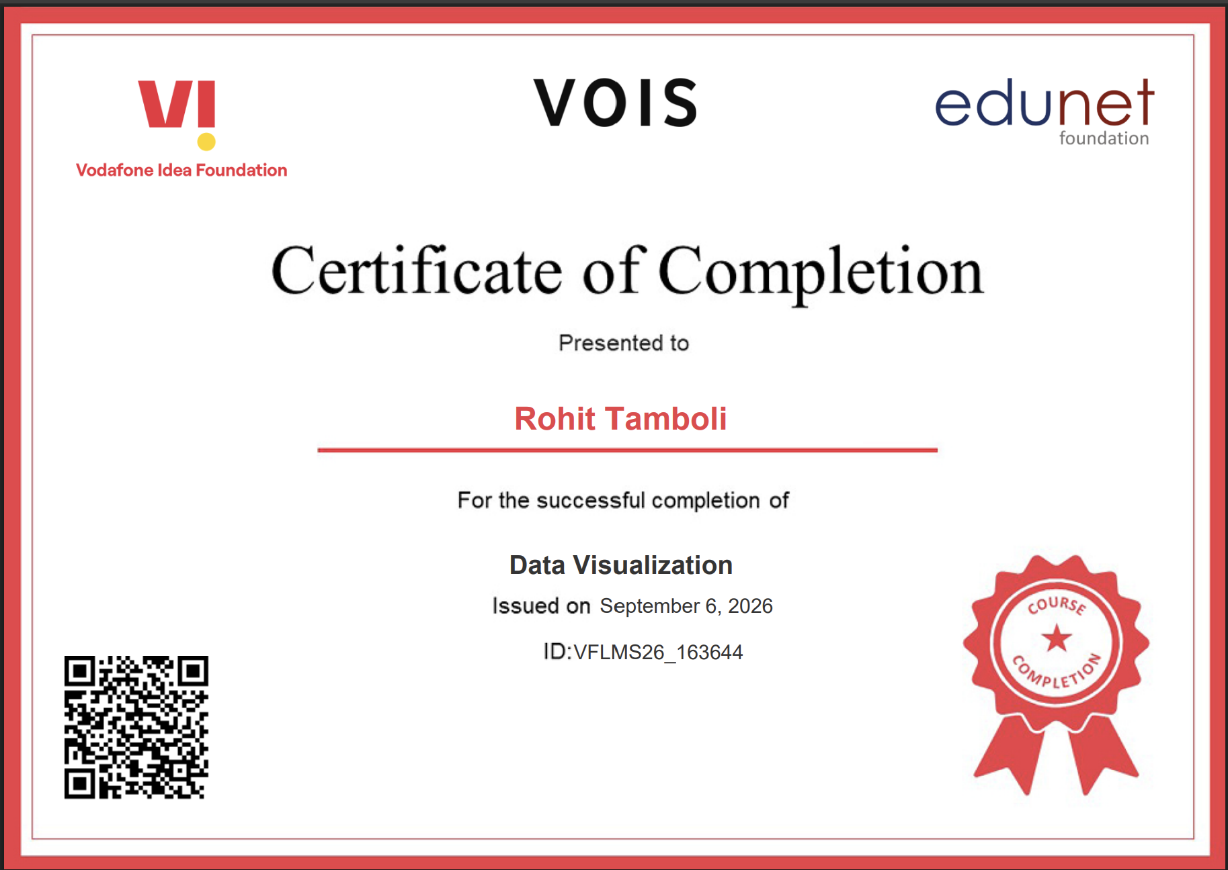
VOIS Course completion certificate - Course name- Data Visualization

Slide 15
Thank you
Seasonal Agriculture Performance Analysis
.
.

