Slide 1
Adjacency List Method
One list for the vertices and one for the nodes adjacent to the vertex.
struct AdjListNode
{
int dest;
struct AdjListNode* next;
};
struct AdjList
{
struct AdjListNode *head;
};

Slide 3
Adjacency List Method
class Graph
{
private:
int V;
struct AdjList* array;
public:
Graph(int V);
AdjListNode* newAdjListNode(int dest);
void addEdge(int src, int dest);
void printGraph();
};
Graph(int V)
{
this->V = V;
array = new AdjList [V];
for (int i = 0; i < V; ++i)
array[i].head = NULL;
}

Slide 4
Adjacency Matrix
An adjacency matrix is implemented using a two dimensional array.
class AdjacencyMatrix
{
private:
int n;
int **adj;
public:
AdjacencyMatrix(int n);
void add_edge(int origin, int destin);
void display();
}
AdjacencyMatrix(int n)
{
this->n = n;
adj = new int* [n];
for (int i = 0; i < n; i++)
{
adj[i] = new int [n];
for(int j = 0; j < n; j++)
{
adj[i][j] = 0;
}
}
}
Notes:
https://www.sanfoundry.com/cpp-program-implement-adjacency-matrix/

Slide 6
Add Edge
ADJACENCY MATRIX
void add_edge(int origin, int destin)
{
adj[origin][destin] = 1;
adj[destin][origin] = 1;
}
ADJECENCY LIST
void addEdge(int src, int dest)
{
AdjListNode* newNode = newAdjListNode(dest);
newNode->next = array[src].head;
array[src].head = newNode;
newNode = newAdjListNode(src);
newNode->next = array[dest].head;
array[dest].head = newNode;
}

Slide 7
Weighted Graphs
Weighted Graphs are graphs that contain edges with an associated value (non-negative integer)
They may be directed or undirected
Weighted graphs can be used to represent length of routes, capacity of a line, or energy required to move certain objects
Used in looking for the shortest paths

Slide 8
Shortest Path Algorithms
The shortest path problem is about finding a path between 2 vertices in a graph such that the total sum of the edges weights is minimum.
BFS finds the shortest path if all the edges weights are 1

Slide 9
Bellman Ford’s Algorithm
This algorithm is used to find the shortest path from the source vertex to all other vertices.
It is a single source algorithm
Can handle negative weights except if negative cycles occur.
Used to detect if a negative cycle occurs (path having a negative weight sum)
The path from the source node to any other node can be at maximum V-1 edges long

Slide 10
1) This step initializes distances from source to all vertices as infinite and distance to source itself as 0. Create an array dist[] of size |V| with all values as infinite except dist[src] where src is source vertex.
2) This step calculates shortest distances. Do following |V|-1 times …..a) Do following for each edge u-v ………………If dist[v] > dist[u] + weight of edge uv, then update dist[v] ………………….dist[v] = dist[u] + weight of edge uv
3) Report any negative weight cycle

Slide 11
Example
https://www-m9.ma.tum.de/graph-algorithms/spp-bellman-ford/index_en.html

Slide 12
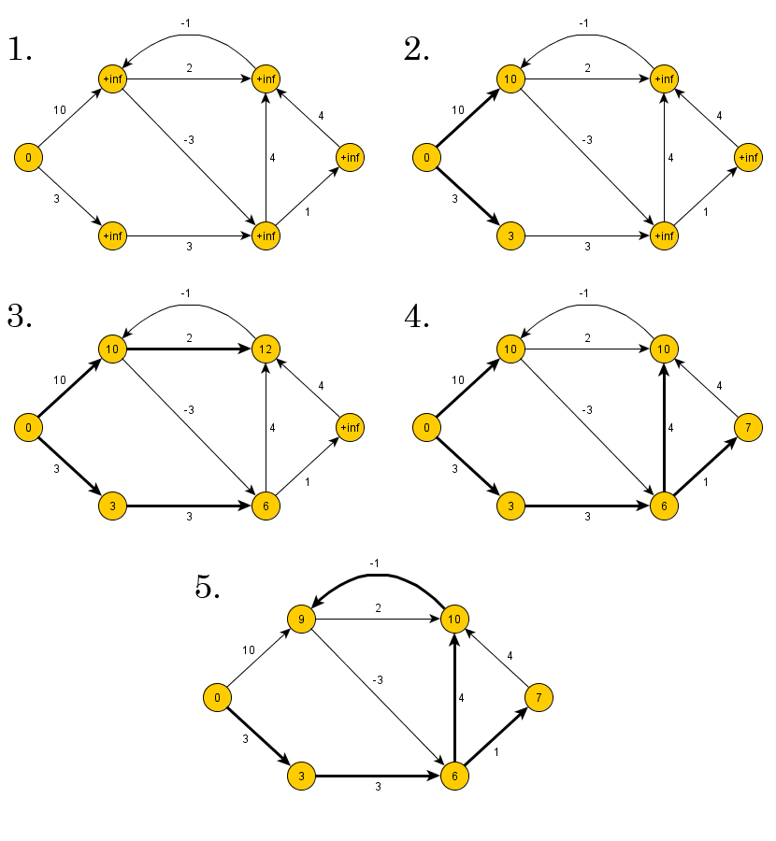

Slide 13
Dijkstra’s
Dijkstra's algorithm - is a solution to the single-source shortest path problem in graph theory.
Works on both directed and undirected graphs. However, all edges must have nonnegative weights.
Input: Weighted graph G={E,V} and source vertex v∈V, such that all edge weights are nonnegative
Output: Lengths of shortest paths (or the shortest paths themselves) from a given source vertex v∈V to all other vertices

Slide 14
Approach
The algorithm computes for each vertex u the distance to u from the start vertex v, that is, the weight of a shortest path between v and u.
the algorithm keeps track of the set of vertices for which the distance has been computed, called the cloud C
Every vertex has a label D associated with it. For any vertex u, D[u] stores an approximation of the distance between v and u. The algorithm will update a D[u] value when it finds a shorter path from v to u.
When a vertex u is added to the cloud, its label D[u] is equal to the actual (final) distance between the starting vertex v and vertex u.

Slide 15
Dijkstra pseudocode
Dijkstra(v1, v2):
for each vertex v: // Initialization
v's distance := infinity.
v's previous := none.
v1's distance := 0.
List := {all vertices}.
while List is not empty:
v := remove List vertex with minimum distance.
mark v as known.
for each unknown neighbor n of v:
dist := v's distance + edge (v, n)'s weight.
if dist is smaller than n's distance:
n's distance := dist.
n's previous := v.
reconstruct path from v2 back to v1,
following previous pointers.

Slide 16
Example: Initialization
Distance(source) = 0
0
∞
Distance (all vertices but source) = ∞
A
2
B
4
1
3
10
∞
C
2
D
2
E
∞
5
8
∞
4
6
F
1
G
∞
∞
Pick vertex in List with minimum distance.

Slide 17
Example: Update neighbors' distance
0
2
A
2
B
4
1
3
10
∞
C
2
D
2
E
∞
5
8
1
4
6
Distance(B) = 2
F
1
G
Distance(D) = 1
∞
∞

Slide 18
Example: Remove vertex with minimum distance
0
2
A
2
B
4
1
3
10
∞
C
2
D
2
E
∞
5
8
1
4
6
F
1
G
∞
∞
Pick vertex in List with minimum distance, i.e., D

Slide 19
Example: Update neighbors
0
2
A
2
B
4
1
3
10
3
C
2
D
2
E
3
5
8
1
4
6
Distance(C) = 1 + 2 = 3 Distance(E) = 1 + 2 = 3 Distance(F) = 1 + 8 = 9 Distance(G) = 1 + 4 = 5
F
1
G
9
5

Slide 20
Example: Continued...
Pick vertex in List with minimum distance (B) and update neighbors
0
2
A
2
B
4
1
3
10
3
C
2
D
2
E
3
5
8
1
4
6
Note : distance(D) not updated since D is already known and distance(E) not updated since it is larger than previously computed
F
1
G
9
5

Slide 21
Example: Continued...
Pick vertex List with minimum distance (E) and update neighbors
0
2
A
2
B
4
1
3
10
3
C
2
D
2
E
3
5
8
1
4
6
F
1
G
No updating
9
5

Slide 22
Example: Continued...
Pick vertex List with minimum distance (C) and update neighbors
0
2
A
2
B
4
1
3
10
3
C
2
D
2
E
3
5
8
1
4
6
Distance(F) = 3 + 5 = 8
F
1
G
8
5

Slide 23
Example: Continued...
Pick vertex List with minimum distance (G) and update neighbors
0
2
A
2
B
4
1
3
10
3
C
2
D
2
E
3
5
8
1
4
6
F
1
G
Previous distance
6
5
Distance(F) = min (8, 5+1) = 6

Slide 24
Example (end)
0
2
A
2
B
4
1
3
10
3
C
2
D
2
E
3
5
8
1
4
6
F
1
G
6
5
Pick vertex not in S with lowest cost (F) and update neighbors

Slide 25
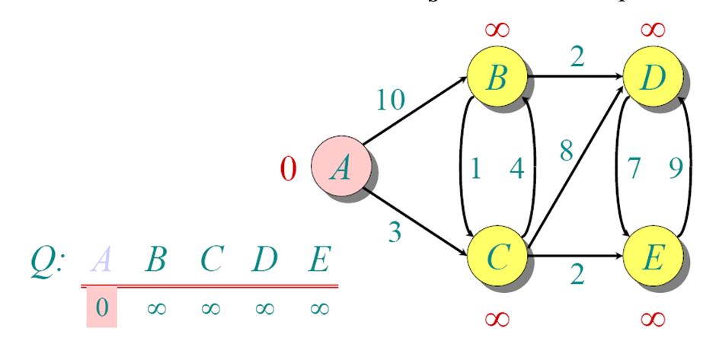
Another Example

Slide 26
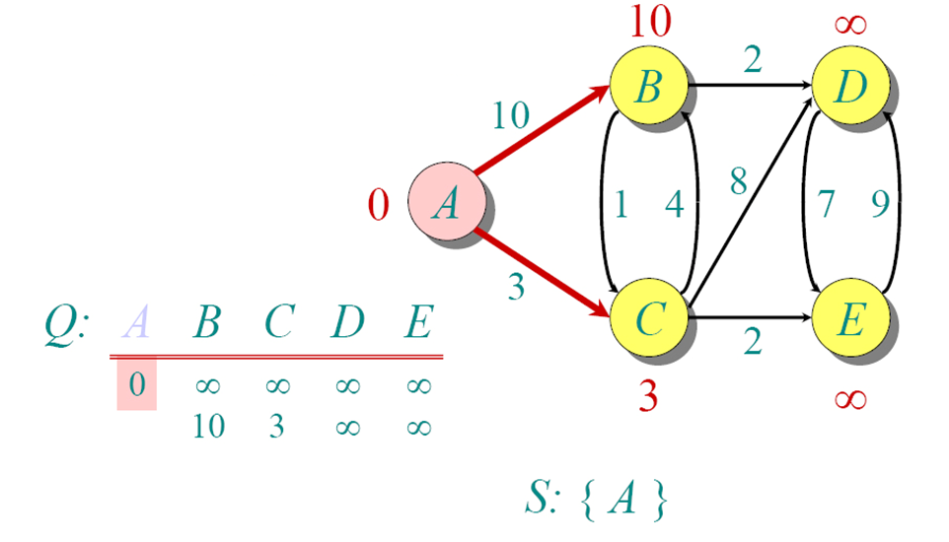
Another Example

Slide 27
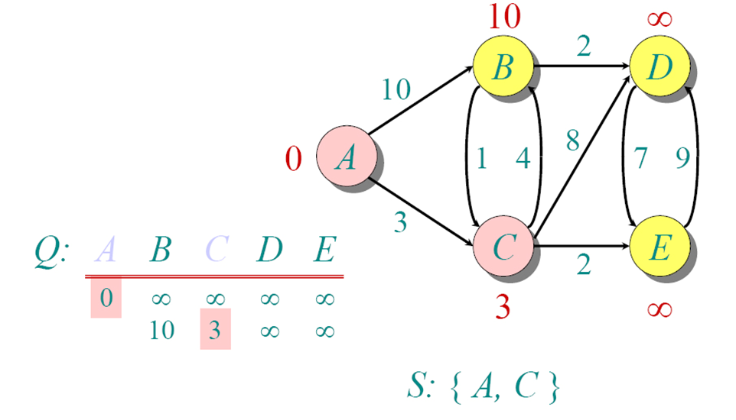
Another Example

Slide 28
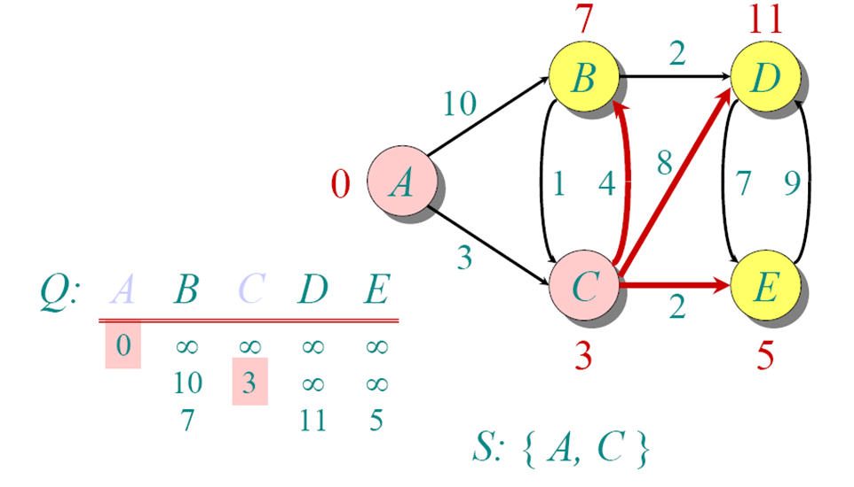
Another Example

Slide 29
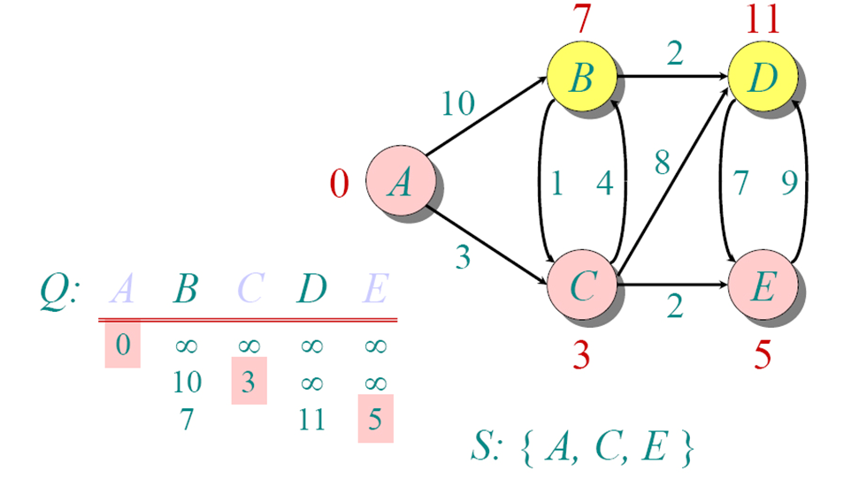
Another Example

Slide 30
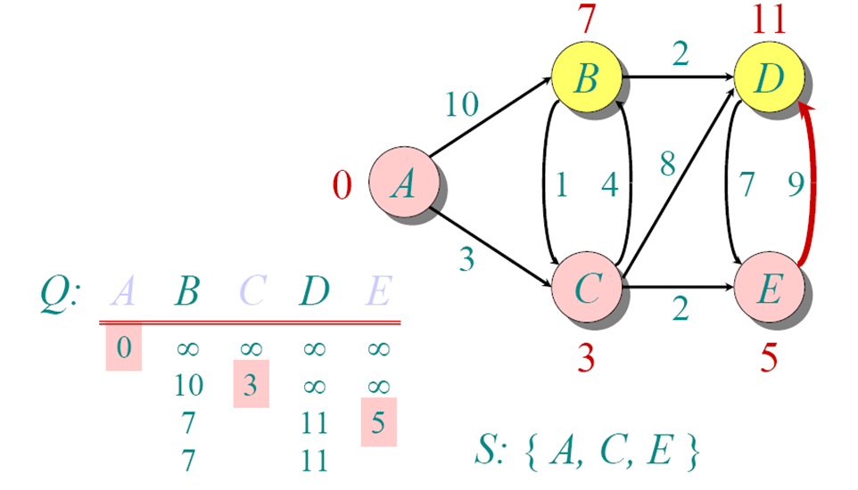
Another Example

Slide 31
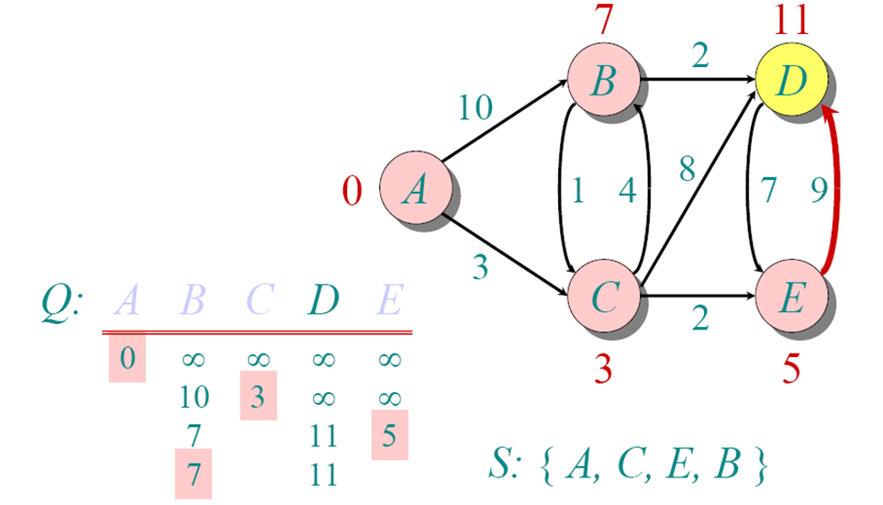
Another Example

Slide 32
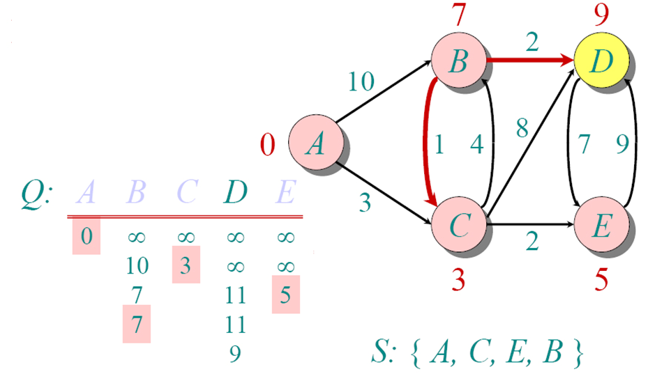
Another Example

Slide 33
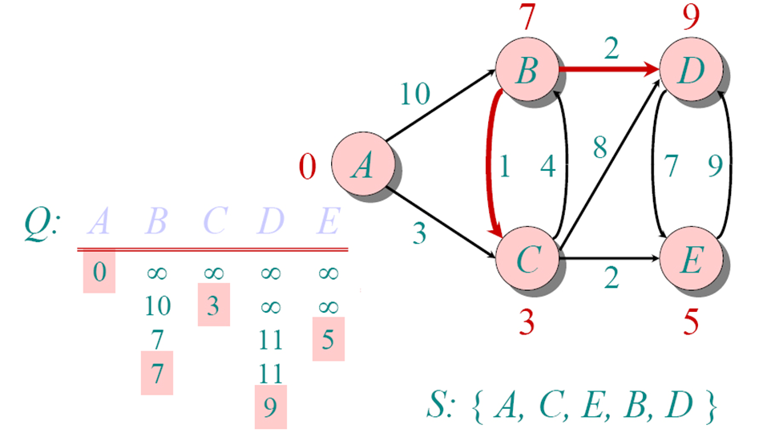
Another Example

Slide 34
BFS
The aim of BFS algorithm is to traverse the graph as close as possible to the root node.
“Ripples in a pond”
Queue is used in the implementation of the breadth first search.
Notes:
https://visualgo.net/en/dfsbfs

Slide 35
BFS
Step 1: Push the root node in the Queue.
Step 2: Loop until the queue is empty.
Step 3: Remove the node from the Queue.
Step 4: If the removed node has unvisited child nodes, mark them as visited and insert the unvisited children in the queue.

Slide 36
BFS: Start with Node 5
5
2
0
1
3
7
4
6
5 1 2 0 4 3 7 6

Slide 37
BFS: Start with Node 5
5
2
0
1
3
7
4
6
5

Slide 38
BFS: Node one-away
5
2
0
1
3
7
4
6
5

Slide 39
BFS: Visit 1 and 2
5
2
0
1
3
7
4
6
5 1 2

Slide 40
BFS: Nodes two-away
5
2
0
1
3
7
4
6
5 1 2

Slide 41
BFS: Visit 0 and 4
5
2
0
1
3
7
4
6
5 1 2 0 4

Slide 42
BFS: Nodes three-away
5
2
0
1
3
7
4
6
5 1 2 0 4

Slide 43
BFS: Visit nodes 3 and 7
5
2
0
1
3
7
4
6
5 1 2 0 4 3 7

Slide 44
BFS: Node four-away
5
2
0
1
3
7
4
6
5 1 2 0 4 3 7

Slide 45
BFS: Visit 6
5
2
0
1
3
7
4
6
5 1 2 0 4 3 7 6

Slide 46
DFS
The goal of DFS algorithm is to traverse the graph in such a way that it tries to go far from the root node
Stack is used in the implementation of the depth first search.

Slide 47
DFS
Step 1: Push the root node in the Stack.
Step 2: Loop until stack is empty.
Step 3: Peek the node of the stack.
Step 4: If the node has unvisited child nodes, get the unvisited child node, mark it as traversed and push it on stack.
Step 5: If the node does not have any unvisited child nodes, pop the node from the stack.

Slide 48
Pseudocode
void dfs (Node v) {
if (v == null)
return;
push(v);
while (stack is not empty) {
pop(v);
if (v has not yet been visited)
mark&visit(v);
for (each w adjacent to v)
if (w has not yet been visited)
push(w);
} // while
} // dfs

Slide 49
DFS: Start with Node 5
5
2
0
1
3
7
4
6
5 1 0 3 2 7 6 4

Slide 50
Preorder DFS: Start with Node 5
5
5
2
0
1
3
7
4
6
Push 5

Slide 51
Preorder DFS: Start with Node 5
5
2
0
1
3
7
4
6
Pop/Visit/Mark 5
5

Slide 52
Preorder DFS: Start with Node 5
1
2
5
2
0
1
3
7
4
6
Push 2, Push 1
5

Slide 53
Preorder DFS: Start with Node 5
2
5
2
0
1
3
7
4
6
Pop/Visit/Mark 1
5 1

Slide 54
Preorder DFS: Start with Node 5
0
2
4
2
5
2
0
1
3
7
4
6
Push 4, Push 2, Push 0
5 1

Slide 55
Preorder DFS: Start with Node 5
2
4
2
5
2
0
1
3
7
4
6
Pop/Visit/Mark 0
5 1 0

Slide 56
Preorder DFS: Start with Node 5
3
7
2
4
2
5
2
0
1
3
7
4
6
Push 7, Push 3
5 1 0

Slide 57
Preorder DFS: Start with Node 5
7
2
4
2
5
2
0
1
3
7
4
6
Pop/Visit/Mark 3
5 1 0 3

Slide 58
Preorder DFS: Start with Node 5
2
7
2
4
2
5
2
0
1
3
7
4
6
Push 2
5 1 0 3

Slide 59
Preorder DFS: Start with Node 5
7
2
4
2
5
2
0
1
3
7
4
6
Pop/Mark/Visit 2
5 1 0 3 2

Slide 60
Preorder DFS: Start with Node 5
2
4
2
5
2
0
1
3
7
4
6
Pop/Mark/Visit 7
5 1 0 3 2 7

Slide 61
Preorder DFS: Start with Node 5
6
2
4
2
5
2
0
1
3
7
4
6
Push 6
5 1 0 3 2 7

Slide 62
Preorder DFS: Start with Node 5
2
4
2
5
2
0
1
3
7
4
6
Pop/Mark/Visit 6
5 1 0 3 2 7 6

Slide 63
Preorder DFS: Start with Node 5
4
2
5
2
0
1
3
7
4
6
Pop (don’t visit) 2
5 1 0 3 2 7 6

Slide 64
Preorder DFS: Start with Node 5
2
5
2
0
1
3
7
4
6
Pop/Mark/Visit 4
5 1 0 3 2 7 6 4

Slide 65
Preorder DFS: Start with Node 5
5
2
0
1
3
7
4
6
Pop (don’t visit) 2
5 1 0 3 2 7 6 4

Slide 66
Preorder DFS: Start with Node 5
5
2
0
1
3
7
4
6
Done
5 1 0 3 2 7 6 4

Slide 67
Preorder DFS: Start with Node 5 Note: edge (0,3) removed
5
2
0
1
3
7
4
6
5 1 0 7 6 2 4 3

Slide 68
Topo
Assume indegree is stored with each node.
Repeat until no nodes remain:
Choose a node of zero indegree and output it.
Remove the node and all its edges and update indegres.

Slide 69
Procedure
We use a temporary stack. We don’t print the vertex immediately, we first recursively call topological sorting for all its adjacent vertices, then push it to a stack.
Finally, print contents of stack. Note that a vertex is pushed to stack only when all of its adjacent vertices (and their adjacent vertices and so on) are already in stack.

Slide 70
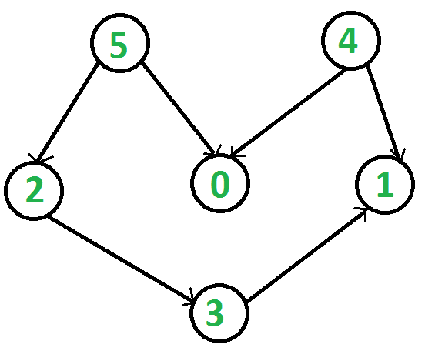

Slide 71
Sorting

Slide 72
Counting Sort
A sorting technique that counts the occurrences of an object in an array of objects.
Count elements, determine position, and output sorted array.

Slide 73
Example
Given Input data: 1, 4, 1, 2, 7, 5, 2
Range 0-9
Steps:
Take the count of each element and arrange it by the range
Modify the count array by adding the previous count to the next element in the array (Indicates the index in the output)
Access the count array and traverse the input data. For every element in the input, access the count and reduce the count of that element by 1 and place it in the output array
https://www.geeksforgeeks.org/counting-sort/

Slide 74
3) Output each object from the input sequence followed by decreasing its count by 1.
Process the input data: 1, 4, 1, 2, 7, 5, 2. Position of 1 is 2.
1, 1, 2, 2, 4, 5, 7
Input data: 1, 4, 1, 2, 7, 5, 2
1) Take a count array to store the count of each unique object.
Index: 0 1 2 3 4 5 6 7 8 9
Count: 0 2 2 0 1 1 0 1 0 0
2) Modify the count array such that each element at each index
stores the sum of previous counts.
Index: 0 1 2 3 4 5 6 7 8 9
Count: 0 2 4 4 5 6 6 7 7 7

Slide 75
Counting Sort
Stable Sorting Array –
Time Complexity of

Slide 76
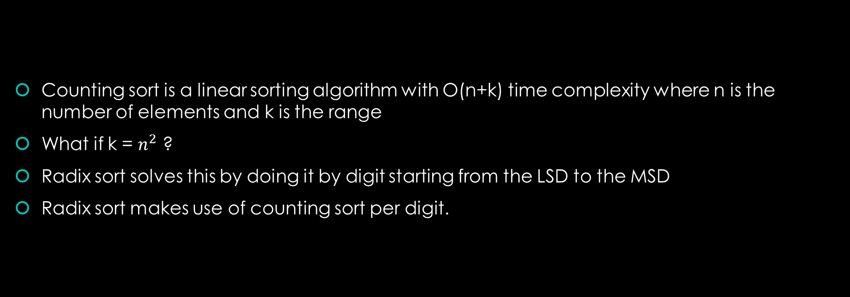
Radix Sort
Counting sort is a linear sorting algorithm with O(n+k) time complexity where n is the number of elements and k is the range
What if k = $n^{2}$ ?
Radix sort solves this by doing it by digit starting from the LSD to the MSD
Radix sort makes use of counting sort per digit.

Slide 77
Example
Example
Original, unsorted list:
170, 45, 75, 90, 802, 24, 2, 66
Sort by least significant digit (1’s)
170, 90, 802, 2, 24, 45, 75, 66
Sort by next significant digit (10’s)
802, 2, 24, 45, 66, 170, 75, 90
Sort by most significant digit (100’s)
2, 24, 45, 66, 75, 90, 170, 802
https://www.geeksforgeeks.org/radix-sort/

Slide 78
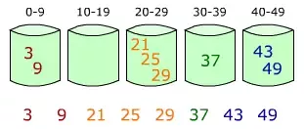
Bucket Sort
Bucket sort is mainly useful when input is uniformly distributed over a range. Take a look at the bucket.
Create a bucket that have ranges (0 to 9, 10 to 19 etc)
Recurse to the list and identify what bucket a specific item needs to go into.

Slide 79
Pseudocode
BUCKET_SORT (A)
n ← length [A]
For i = 1 to n do
Insert A[i] into list B[nA[i]]
For i = 0 to n-1 do
Sort list B with Insertion sort
Concatenate the lists B[0], B[1], . . B[n-1] together in order.

