Slide 1
Adjacency List Method
One list for the vertices and one for the nodes adjacent to the vertex.
struct AdjListNode
{
int dest;
struct AdjListNode* next;
};
struct AdjList
{
struct AdjListNode *head;
};

Slide 3
Adjacency List Method
class Graph
{
private:
int V;
struct AdjList* array;
public:
Graph(int V);
AdjListNode* newAdjListNode(int dest);
void addEdge(int src, int dest);
void printGraph();
};
Graph(int V)
{
this->V = V;
array = new AdjList [V];
for (int i = 0; i < V; ++i)
array[i].head = NULL;
}

Slide 4
Adjacency Matrix
An adjacency matrix is implemented using a two dimensional array.
class AdjacencyMatrix
{
private:
int n;
int **adj;
public:
AdjacencyMatrix(int n);
void add_edge(int origin, int destin);
void display();
}
AdjacencyMatrix(int n)
{
this->n = n;
adj = new int* [n];
for (int i = 0; i < n; i++)
{
adj[i] = new int [n];
for(int j = 0; j < n; j++)
{
adj[i][j] = 0;
}
}
}
Notes:
https://www.sanfoundry.com/cpp-program-implement-adjacency-matrix/

Slide 6
Add Edge
ADJACENCY MATRIX
void add_edge(int origin, int destin)
{
adj[origin][destin] = 1;
adj[destin][origin] = 1;
}
ADJECENCY LIST
void addEdge(int src, int dest)
{
AdjListNode* newNode = newAdjListNode(dest);
newNode->next = array[src].head;
array[src].head = newNode;
newNode = newAdjListNode(src);
newNode->next = array[dest].head;
array[dest].head = newNode;
}

Slide 7
Weighted Graphs
Weighted Graphs are graphs that contain edges with an associated value (non-negative integer)
They may be directed or undirected
Weighted graphs can be used to represent length of routes, capacity of a line, or energy required to move certain objects
Used in looking for the shortest paths

Slide 8
Shortest Path Algorithms
The shortest path problem is about finding a path between 2 vertices in a graph such that the total sum of the edges weights is minimum.
BFS finds the shortest path if all the edges weights are 1

Slide 9
Bellman Ford’s Algorithm
This algorithm is used to find the shortest path from the source vertex to all other vertices.
It is a single source algorithm
Can handle negative weights except if negative cycles occur.
Used to detect if a negative cycle occurs (path having a negative weight sum)
The path from the source node to any other node can be at maximum V-1 edges long

Slide 10
1) This step initializes distances from source to all vertices as infinite and distance to source itself as 0. Create an array dist[] of size |V| with all values as infinite except dist[src] where src is source vertex.
2) This step calculates shortest distances. Do following |V|-1 times …..a) Do following for each edge u-v ………………If dist[v] > dist[u] + weight of edge uv, then update dist[v] ………………….dist[v] = dist[u] + weight of edge uv
3) Report any negative weight cycle

Slide 11
Example
https://www-m9.ma.tum.de/graph-algorithms/spp-bellman-ford/index_en.html

Slide 12
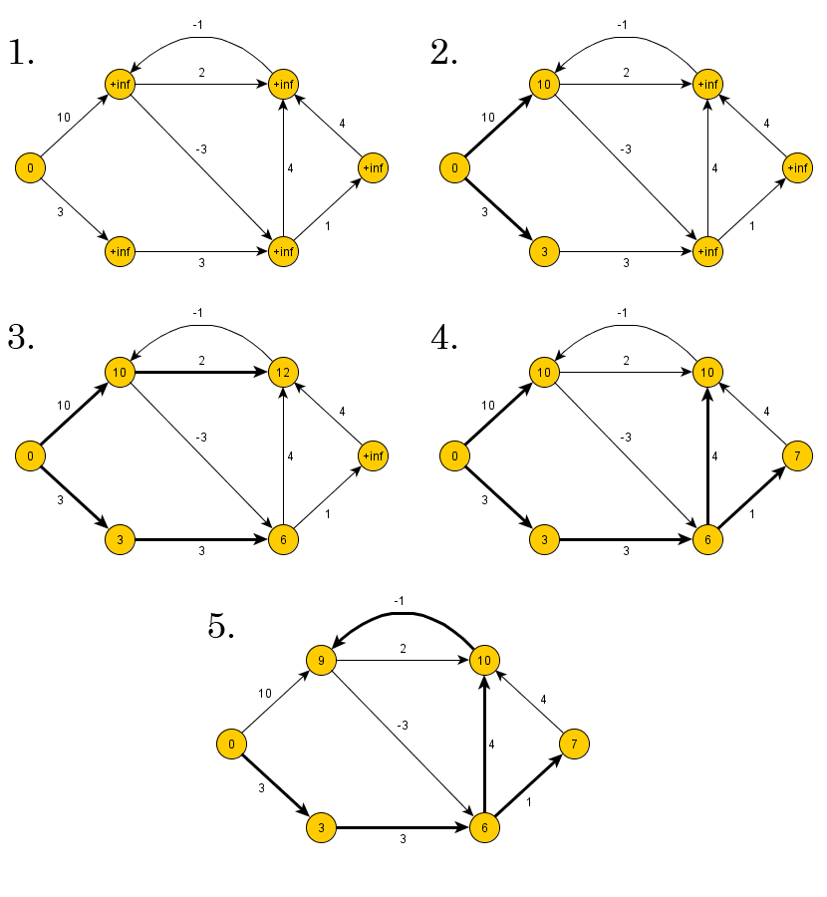

Slide 13
Dijkstra’s

Slide 14
BFS
The aim of BFS algorithm is to traverse the graph as close as possible to the root node.
“Ripples in a pond”
Queue is used in the implementation of the breadth first search.
Notes:
https://visualgo.net/en/dfsbfs

Slide 15
BFS
Step 1: Push the root node in the Queue.
Step 2: Loop until the queue is empty.
Step 3: Remove the node from the Queue.
Step 4: If the removed node has unvisited child nodes, mark them as visited and insert the unvisited children in the queue.

Slide 16
BFS: Start with Node 5
5
2
0
1
3
7
4
6
5 1 2 0 4 3 7 6

Slide 17
BFS: Start with Node 5
5
2
0
1
3
7
4
6
5

Slide 18
BFS: Node one-away
5
2
0
1
3
7
4
6
5

Slide 19
BFS: Visit 1 and 2
5
2
0
1
3
7
4
6
5 1 2

Slide 20
BFS: Nodes two-away
5
2
0
1
3
7
4
6
5 1 2

Slide 21
BFS: Visit 0 and 4
5
2
0
1
3
7
4
6
5 1 2 0 4

Slide 22
BFS: Nodes three-away
5
2
0
1
3
7
4
6
5 1 2 0 4

Slide 23
BFS: Visit nodes 3 and 7
5
2
0
1
3
7
4
6
5 1 2 0 4 3 7

Slide 24
BFS: Node four-away
5
2
0
1
3
7
4
6
5 1 2 0 4 3 7

Slide 25
BFS: Visit 6
5
2
0
1
3
7
4
6
5 1 2 0 4 3 7 6

Slide 26
DFS
The goal of DFS algorithm is to traverse the graph in such a way that it tries to go far from the root node
Stack is used in the implementation of the depth first search.

Slide 27
DFS
Step 1: Push the root node in the Stack.
Step 2: Loop until stack is empty.
Step 3: Peek the node of the stack.
Step 4: If the node has unvisited child nodes, get the unvisited child node, mark it as traversed and push it on stack.
Step 5: If the node does not have any unvisited child nodes, pop the node from the stack.

Slide 28
Pseudocode
void dfs (Node v) {
if (v == null)
return;
push(v);
while (stack is not empty) {
pop(v);
if (v has not yet been visited)
mark&visit(v);
for (each w adjacent to v)
if (w has not yet been visited)
push(w);
} // while
} // dfs

Slide 29
DFS: Start with Node 5
5
2
0
1
3
7
4
6
5 1 0 3 2 7 6 4

Slide 30
Preorder DFS: Start with Node 5
5
5
2
0
1
3
7
4
6
Push 5

Slide 31
Preorder DFS: Start with Node 5
5
2
0
1
3
7
4
6
Pop/Visit/Mark 5
5

Slide 32
Preorder DFS: Start with Node 5
1
2
5
2
0
1
3
7
4
6
Push 2, Push 1
5

Slide 33
Preorder DFS: Start with Node 5
2
5
2
0
1
3
7
4
6
Pop/Visit/Mark 1
5 1

Slide 34
Preorder DFS: Start with Node 5
0
2
4
2
5
2
0
1
3
7
4
6
Push 4, Push 2, Push 0
5 1

Slide 35
Preorder DFS: Start with Node 5
2
4
2
5
2
0
1
3
7
4
6
Pop/Visit/Mark 0
5 1 0

Slide 36
Preorder DFS: Start with Node 5
3
7
2
4
2
5
2
0
1
3
7
4
6
Push 7, Push 3
5 1 0

Slide 37
Preorder DFS: Start with Node 5
7
2
4
2
5
2
0
1
3
7
4
6
Pop/Visit/Mark 3
5 1 0 3

Slide 38
Preorder DFS: Start with Node 5
2
7
2
4
2
5
2
0
1
3
7
4
6
Push 2
5 1 0 3

Slide 39
Preorder DFS: Start with Node 5
7
2
4
2
5
2
0
1
3
7
4
6
Pop/Mark/Visit 2
5 1 0 3 2

Slide 40
Preorder DFS: Start with Node 5
2
4
2
5
2
0
1
3
7
4
6
Pop/Mark/Visit 7
5 1 0 3 2 7

Slide 41
Preorder DFS: Start with Node 5
6
2
4
2
5
2
0
1
3
7
4
6
Push 6
5 1 0 3 2 7

Slide 42
Preorder DFS: Start with Node 5
2
4
2
5
2
0
1
3
7
4
6
Pop/Mark/Visit 6
5 1 0 3 2 7 6

Slide 43
Preorder DFS: Start with Node 5
4
2
5
2
0
1
3
7
4
6
Pop (don’t visit) 2
5 1 0 3 2 7 6

Slide 44
Preorder DFS: Start with Node 5
2
5
2
0
1
3
7
4
6
Pop/Mark/Visit 4
5 1 0 3 2 7 6 4

Slide 45
Preorder DFS: Start with Node 5
5
2
0
1
3
7
4
6
Pop (don’t visit) 2
5 1 0 3 2 7 6 4

Slide 46
Preorder DFS: Start with Node 5
5
2
0
1
3
7
4
6
Done
5 1 0 3 2 7 6 4

Slide 47
Preorder DFS: Start with Node 5 Note: edge (0,3) removed
5
2
0
1
3
7
4
6
5 1 0 7 6 2 4 3

Slide 48
Sorting

Slide 49
Counting Sort
A sorting technique that counts the occurrences of an object in an array of objects.
Count elements, determine position, and output sorted array.

Slide 50
Example
Given Input data: 1, 4, 1, 2, 7, 5, 2
Range 0-9
Steps:
Take the count of each element and arrange it by the range
Modify the count array by adding the previous count to the next element in the array (Indicates the index in the output)
Access the count array and traverse the input data. For every element in the input, access the count and reduce the count of that element by 1 and place it in the output array
https://www.geeksforgeeks.org/counting-sort/

Slide 51
3) Output each object from the input sequence followed by decreasing its count by 1.
Process the input data: 1, 4, 1, 2, 7, 5, 2. Position of 1 is 2.
1, 1, 2, 2, 4, 5, 7
Input data: 1, 4, 1, 2, 7, 5, 2
1) Take a count array to store the count of each unique object.
Index: 0 1 2 3 4 5 6 7 8 9
Count: 0 2 2 0 1 1 0 1 0 0
2) Modify the count array such that each element at each index
stores the sum of previous counts.
Index: 0 1 2 3 4 5 6 7 8 9
Count: 0 2 4 4 5 6 6 7 7 7

Slide 52
Counting Sort
Stable Sorting Array –
Time Complexity of

Slide 53
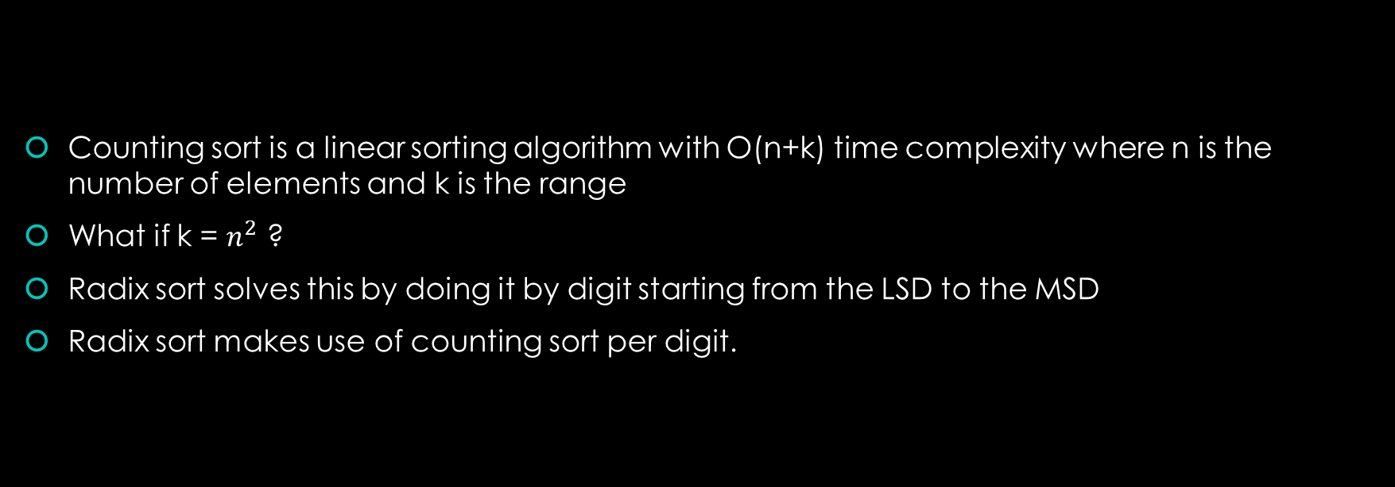
Radix Sort
Counting sort is a linear sorting algorithm with O(n+k) time complexity where n is the number of elements and k is the range
What if k = $n^{2}$ ?
Radix sort solves this by doing it by digit starting from the LSD to the MSD
Radix sort makes use of counting sort per digit.

Slide 54
Example
Example
Original, unsorted list:
170, 45, 75, 90, 802, 24, 2, 66
Sort by least significant digit (1’s)
170, 90, 802, 2, 24, 45, 75, 66
Sort by next significant digit (10’s)
802, 2, 24, 45, 66, 170, 75, 90
Sort by most significant digit (100’s)
2, 24, 45, 66, 75, 90, 170, 802
https://www.geeksforgeeks.org/radix-sort/

Slide 55
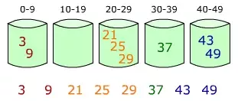
Bucket Sort
Bucket sort is mainly useful when input is uniformly distributed over a range. Take a look at the bucket.
Create a bucket that have ranges (0 to 9, 10 to 19 etc)
Recurse to the list and identify what bucket a specific item needs to go into.

Slide 56
Pseudocode
BUCKET_SORT (A)
n ← length [A]
For i = 1 to n do
Insert A[i] into list B[nA[i]]
For i = 0 to n-1 do
Sort list B with Insertion sort
Concatenate the lists B[0], B[1], . . B[n-1] together in order.

