Slide 1
Sorting

Slide 2
Counting Sort
A sorting technique that counts the occurrences of an object in an array of objects.
Count elements, determine position, and output sorted array.

Slide 3
Example
Given Input data: 1, 4, 1, 2, 7, 5, 2
Range 0-9
Steps:
Take the count of each element and arrange it by the range
Modify the count array by adding the previous count to the next element in the array (Indicates the index in the output)
Access the count array and traverse the input data. For every element in the input, access the count and reduce the count of that element by 1 and place it in the output array
https://www.geeksforgeeks.org/counting-sort/

Slide 4
Counting Sort
Stable Sorting Array –
Time Complexity of

Slide 5
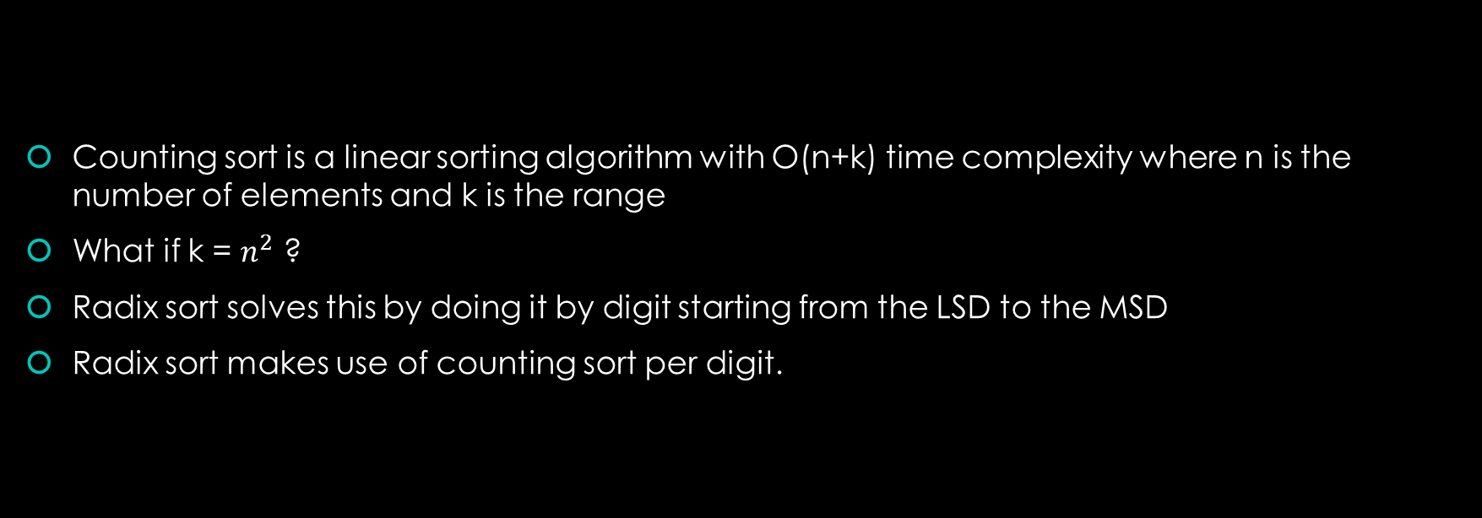
Radix Sort
Counting sort is a linear sorting algorithm with O(n+k) time complexity where n is the number of elements and k is the range
What if k = $n^{2}$ ?
Radix sort solves this by doing it by digit starting from the LSD to the MSD
Radix sort makes use of counting sort per digit.

Slide 6
Example
Example
Original, unsorted list:
170, 45, 75, 90, 802, 24, 2, 66
Sort by least significant digit (1’s)
170, 90, 802, 2, 24, 45, 75, 66
Sort by next significant digit (10’s)
802, 2, 24, 45, 66, 170, 75, 90
Sort by most significant digit (100’s)
2, 24, 45, 66, 75, 90, 170, 802
https://www.geeksforgeeks.org/radix-sort/

Slide 7
Bucket Sort

