Slide 1



Slide 2
Contributing to Ansible
Developing Ansible Modules

Slide 3
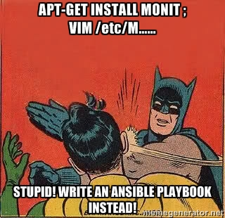
....wait a min....what the heck is Ansible?
software platform for CM systems
Agentless
Secure
Scalable

Slide 4

....so what can we do with ansible?
package installation
shell commands
install/update package
management systems, clone git
stop, start, re-start service

Slide 5

.....also ansible comes with batteries included!!
Ansible comes bundled with nearly all the mostly used applications/protocols etc in computing world. http://docs.ansible.com/list_of_all_modules.html

Slide 6

...need any thing out of the box??
write down our own custom modules....and the best part...guess??

Slide 7

It's free of any language barrier

Slide 8
....cool...seems interesting, so what are the different components of a module?
Though ansible modules can be written in any language, we will stick to Python in this post. In Python, a module is generally a single file with 3 different parts:
Documentation: A multiline string literal and a valid YAML document. It contains the detailed description of module.
Logic: The programatic way to perform task and uses various resources provided by Ansible.
Ansible framework: bunch of basic utilities to perform its tasks, imported by all modules using the following import statement:
          from ansible.module_utils.basic import *

Slide 9

...let's try bulding some custom modules..

Slide 10
files hosted on github....
https://github.com/hellodk
repository : ansible-meetup-bangalore

Slide 11
Basic configurations
1. From the file /etc/ansible/ansible.cfg, uncomment the line
library = /usr/share/ansible
2. In the file /etc/ansible/hosts
        create an entry with 127.0.0.1

Slide 12
...steps to follow
1. Create a new directory inside /usr/share/ansible/
      sudo mkdir external
2. Make a new file, inside the external directory
      sudo vi test_module
3. Now you can write your yml based play-book
      vi test_playbook.yml

Slide 13
....executing the module via playbook
$ ansible-playbook test_yml.yml

Slide 14
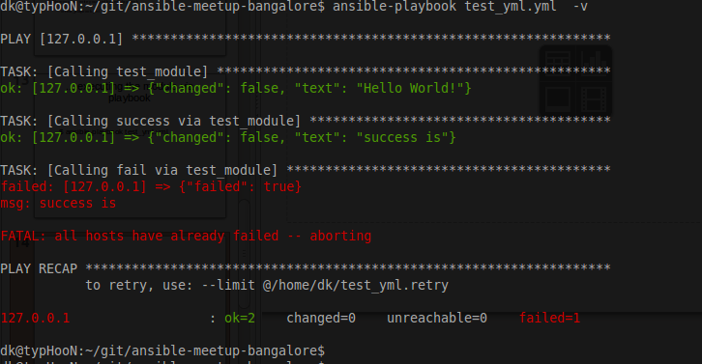

Slide 15
.....all yours...
give a shout for any queries/questions

Slide 16
Thanks!!
Deepak
hello.dk@outlook.com
in.linkedin.com/in/hellodk

Slide 17
Common Pit-falls
Modules must not output anything on standard error, because the system will merge
standard out with standard error and prevent the JSON from parsing. Capturing
standard error and returning it as a variable in the JSON on standard out is fine, and
is, in fact, how the command module is implemented.

