Slide 1
Analyzing logs using-Elasticsearch, Fluentd, and Kibana(EFK)
- Ravdeep S Pasricha
ravdeep003

Slide 2
Agenda
Why EFK
Elasticsearch, Fluentd, Kibana Overview
Demo
High Availability

Slide 3
Why EFK
Before EFK
Log files across the server
Grep/shell scripting mess
Production system access
EFK:
Detecting log patterns
Easily Searchable
Trouble-shooting issues

Slide 4
Elasticsearch
Elasticsearch is a search server based on Lucene.
It provides a distributed, multitenant-capable full-text search engine with a RESTful web interface and schema-free JSON documents.

Slide 5
Kibana
Kibana is an open source (Apache Licensed), browser based analytics and search dashboard for Elasticsearch.
Explore and visualize your data

Slide 6
Fluentd
Fluentd is an open source data collector for unified logging layer.
Fluentd allows you to unify data collection and consumption for a better use and understanding of data.

Slide 7
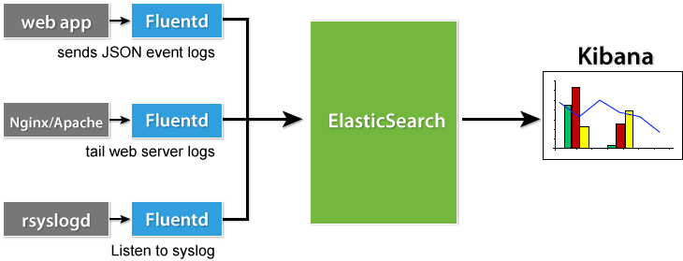

Slide 8
DEMO

Slide 9
Fluentd
Fluentd has 5 types of plugins: Input, Parser, Output, Formatter and Buffer
Input Plugins:
      in_forward
      in_http
      in_tail
      in_exec
      in_syslog

Slide 10
Output Plugins:
    out_forward
    out_mongo
    out_file
    out_s3
Buffer Plugins:
Buffer plugins are used by buffered output plugins, such as out_file, out_forward, etc
    buf_memory
    buf_file

Slide 11
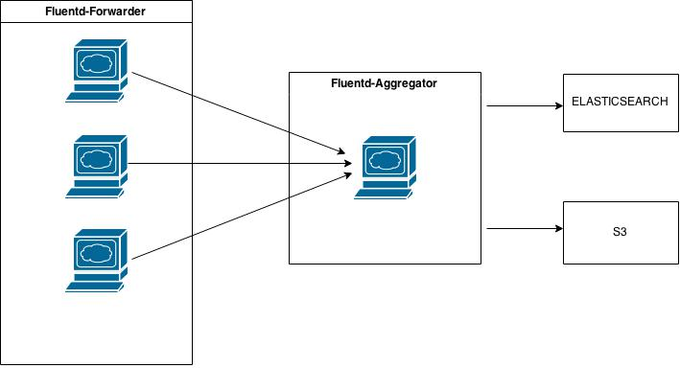
Fluentd Setup

Slide 12
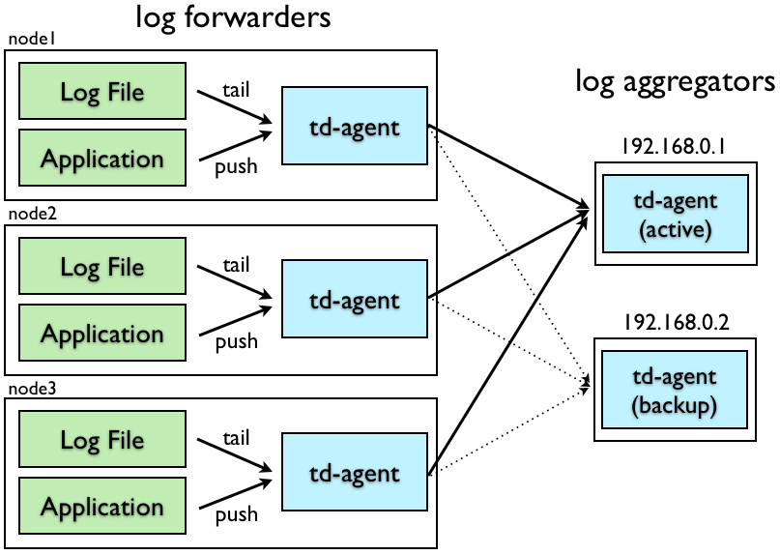
HIGH AVAILABILITY

Slide 13
THANK YOU

