Slide 1


Slide 2
Running Ansible via
API
By: Hussain Nagri
Email: hussain.nagri@knowlarity.com
Follow me @imnagri please........

Slide 3




How API works with Web Services ?
Server X
Your Server
Server X gets the call and does some magic in the background to produce result
API call to server X
With Auth Credentials
Your server gets the result.
Magic happening all over the place.
Server X returns the result

Slide 4
Ansible playbook
Create a playbook
---
- host: controller
tasks:
- name: ensure ntp package is installed
action: apt pkg=ntp
- name: ensure ntp service is restarted
action: service name=ntp state=restarted

Slide 5
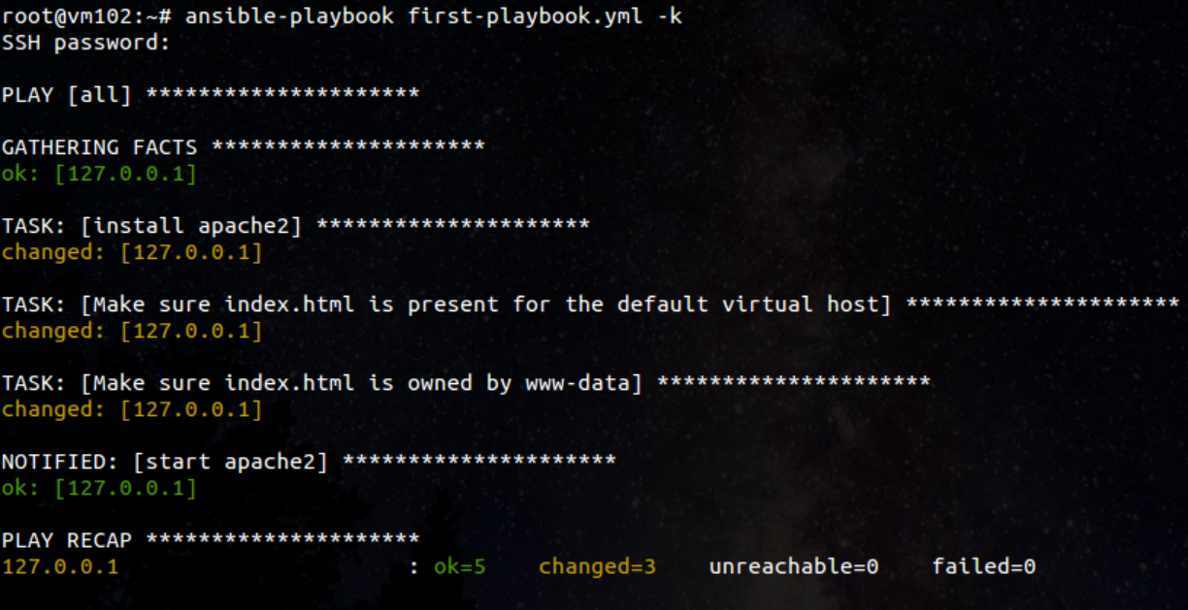
How playbook runs

Slide 6
Inventory file
[vagrant]
192.168.33.10 ansible_ssh_port=22 ansible_ssh_user=vagrant
[cluster-1]
192.168.33.12
192.168.33.13
[cluster-2]
192.168.33.14
192.168.33.15
[cluster-3]
192.168.33.16
192.168.33.17
[cluster-4]
192.168.33.18
192.168.33.19
[cluster-5]
192.168.33.20
192.168.33.21

Slide 7
How Ansible works
Ansible Server
You are here
running playbooks manually

Slide 8
How Ansible works
Create a playbook
Run the plabook for perticular server or group of servers in a console
See your playbook run and get bored to death
But
We mange 100+ servers via a single ansible instance.
Working on console is boring as well as error prone.
Though ansible automates things for you sometimes you may want to automate running of ansible.

Slide 9

Who are we ?
DevOps

Slide 10
To Automate
Everything
What do we want ?

Slide 11

How our Ansible works ?
GUI Server
API call to Ansible server
Ansible Server
Ansible server returns confirmation

Slide 12

Happy DevOps guy

Slide 13
Python Code
import ansible.runner
runner = ansible.runner.Runner(
module_name='ping', # ping is the module
module_args='',
pattern='web*',
forks=10
)
datastructure = runner.run()
# Where
# Datastructue >> {'dark': {}, 'contacted': {'192.168.33.10':
# {'invocation': {'module_name': 'ping', 'module_args': ''},
# u'changed': False, u'ping': u'pong'}}}

Slide 14
Another way
import ansible.playbook
from ansible import callbacks
from ansible import utils
stats = callbacks.AggregateStats()
playbook_cb = callbacks.PlaybookCallbacks(verbose=utils.VERBOSITY)
runner_cb = callbacks.PlaybookRunnerCallbacks(stats, verbose=utils.VERBOSITY)
ansible.playbook.PlayBook(
Playbook='/path/to/playbook.yml',
callbacks=playbook_cb,
runner_callbacks=runner_cb,
stats=stats,
Inventory='path/to/inventory/file',
extra_vars={
}
).run()

Slide 15
A terrible demo of such an awesome thing
git clone
https://nagri@bitbucket.org/nagri/ansible-python-api-demo.git

Slide 16
How is this working ?
Flask App
API call to Ansible server
Ansible Server
Ansible server returns confirmation

Slide 17

Any Questions ?

