Slide 1

Vagrant

Slide 2
@chandrashekar_m
in.linkedin.com/in/chandram/

Slide 3
Agenda
Why use Vagrant?
What is Vagrant?
DevOps with Vagrant in mind

Slide 4
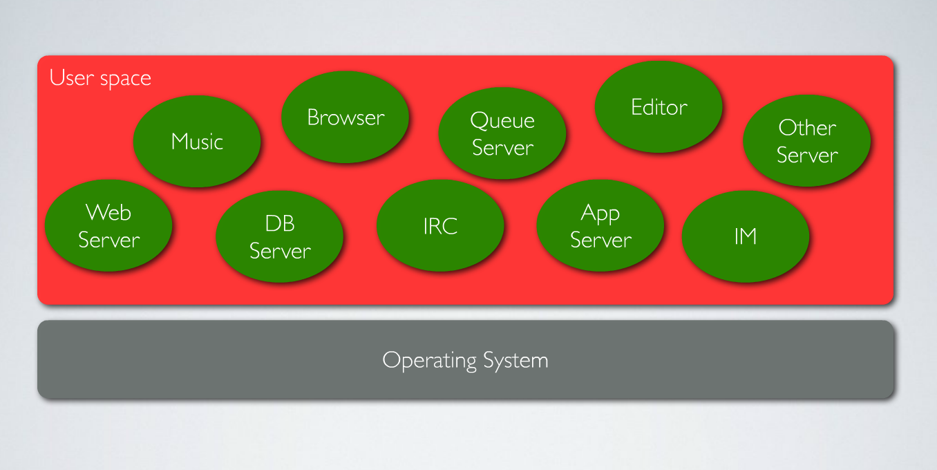

Slide 5
No Isolation.
No Repeatability.
No Verification.

Slide 6
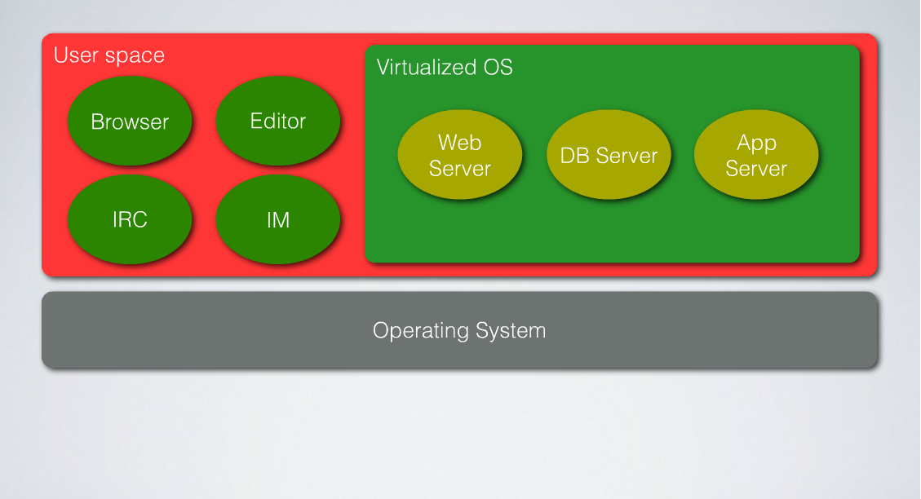

Slide 7
Isolation
Mirror Production
Test Ops scripts with a free server
Faster onboarding
Designers/Managers can do it, too!

Slide 8
Dev and Ops
Not (Dev or Ops)

Slide 9


Slide 10

#1 Dev Excuse

Slide 11
Been there...
Quick fix lost on a reboot!
I thought that service never went down...
Why did the database go down? My code doesnt do that.
I thought this compiled code would run everywhere...
http://programmingexcuses.com/

Slide 12
What is it?

Slide 13

A tool for building virtualized environments
A local cloud

Slide 14
Tao of Vagrant
Developers can check out any code repository and vagrant up.
Systems Ops engineers can vagrant up and have a complete sandbox matching production.
With vagrant up, Automation engineers can work and use the same setup scripts in both dev and prod
All this knowledge transfers to every project.

Slide 15
Quick Demo
Create and teardown virtual machines.
Use automation to provision and configure.
Network multiple machines.

Slide 16
Alternatives
Plain Desktop Virtualization
Containers
Cloud

Slide 17
Demo
Multi-Machine deployments.
Package and distribute VM images.
Plug-ins.

