Slide 1
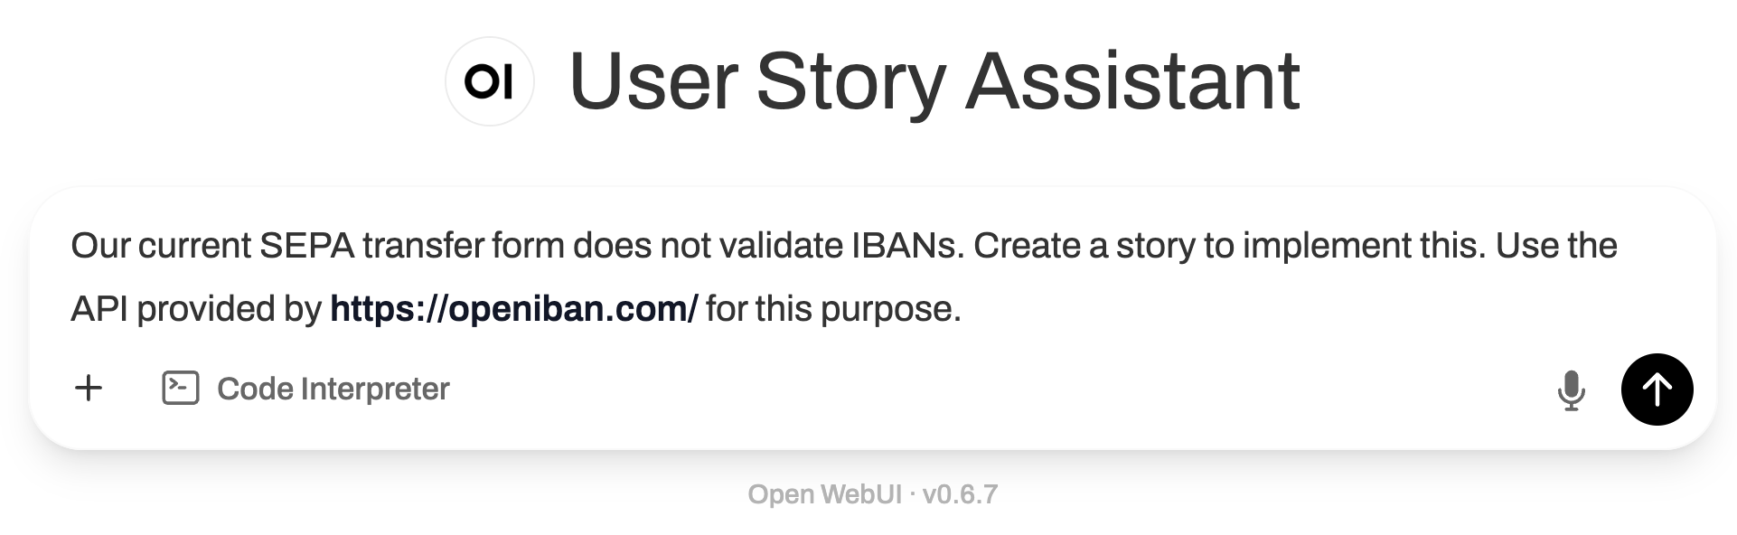
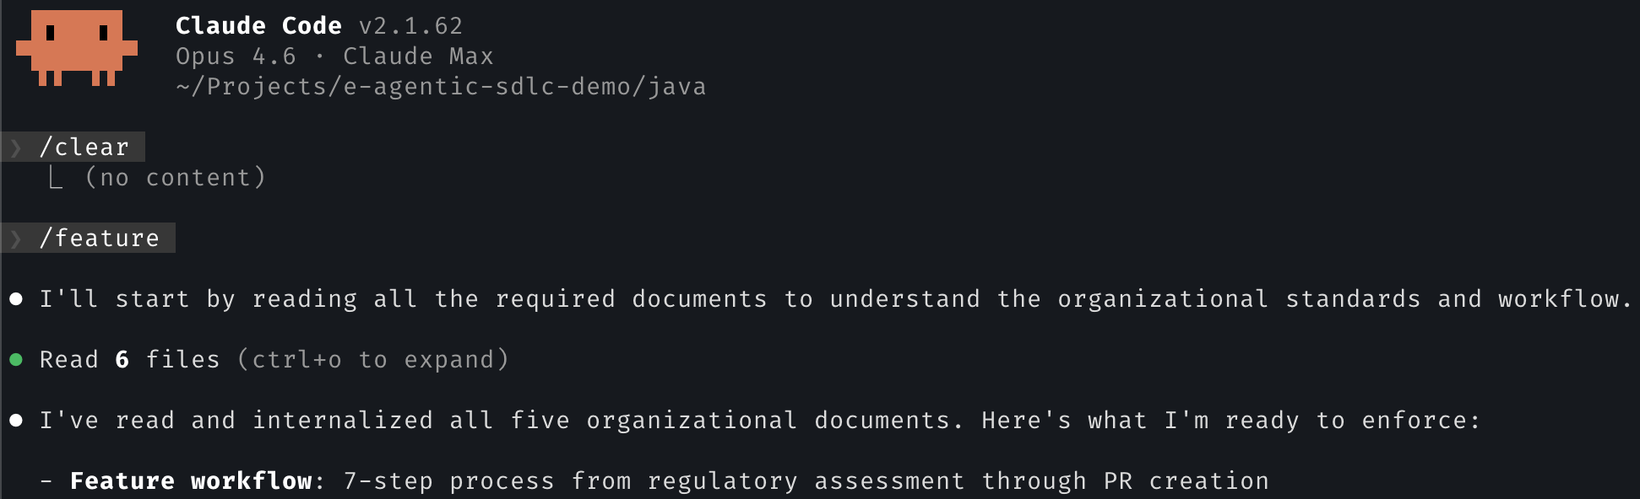
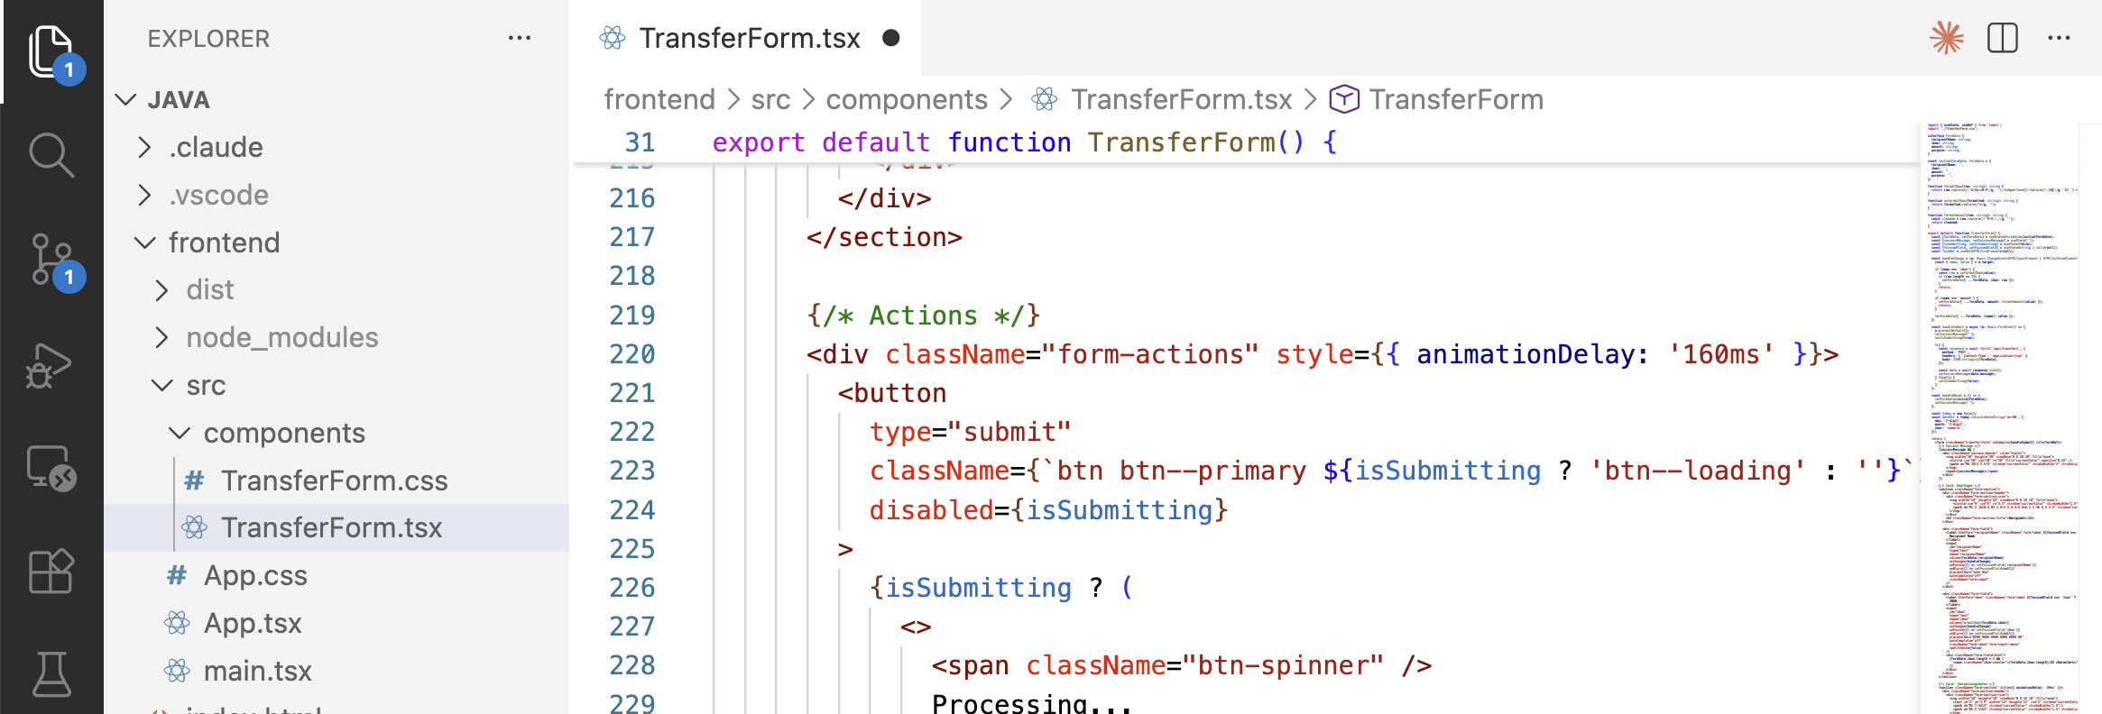
Demo - “We need IBAN validation”
Feature
Idea
Feature
Definition
Create User
Story in Jira
Handover
Plan
Implement
Manual
Test
Handover
Plan
UI Test
Implement
UI Test
Product
Owner
Developer
UI
Tester
Chat
Terminal
IDE

Slide 2
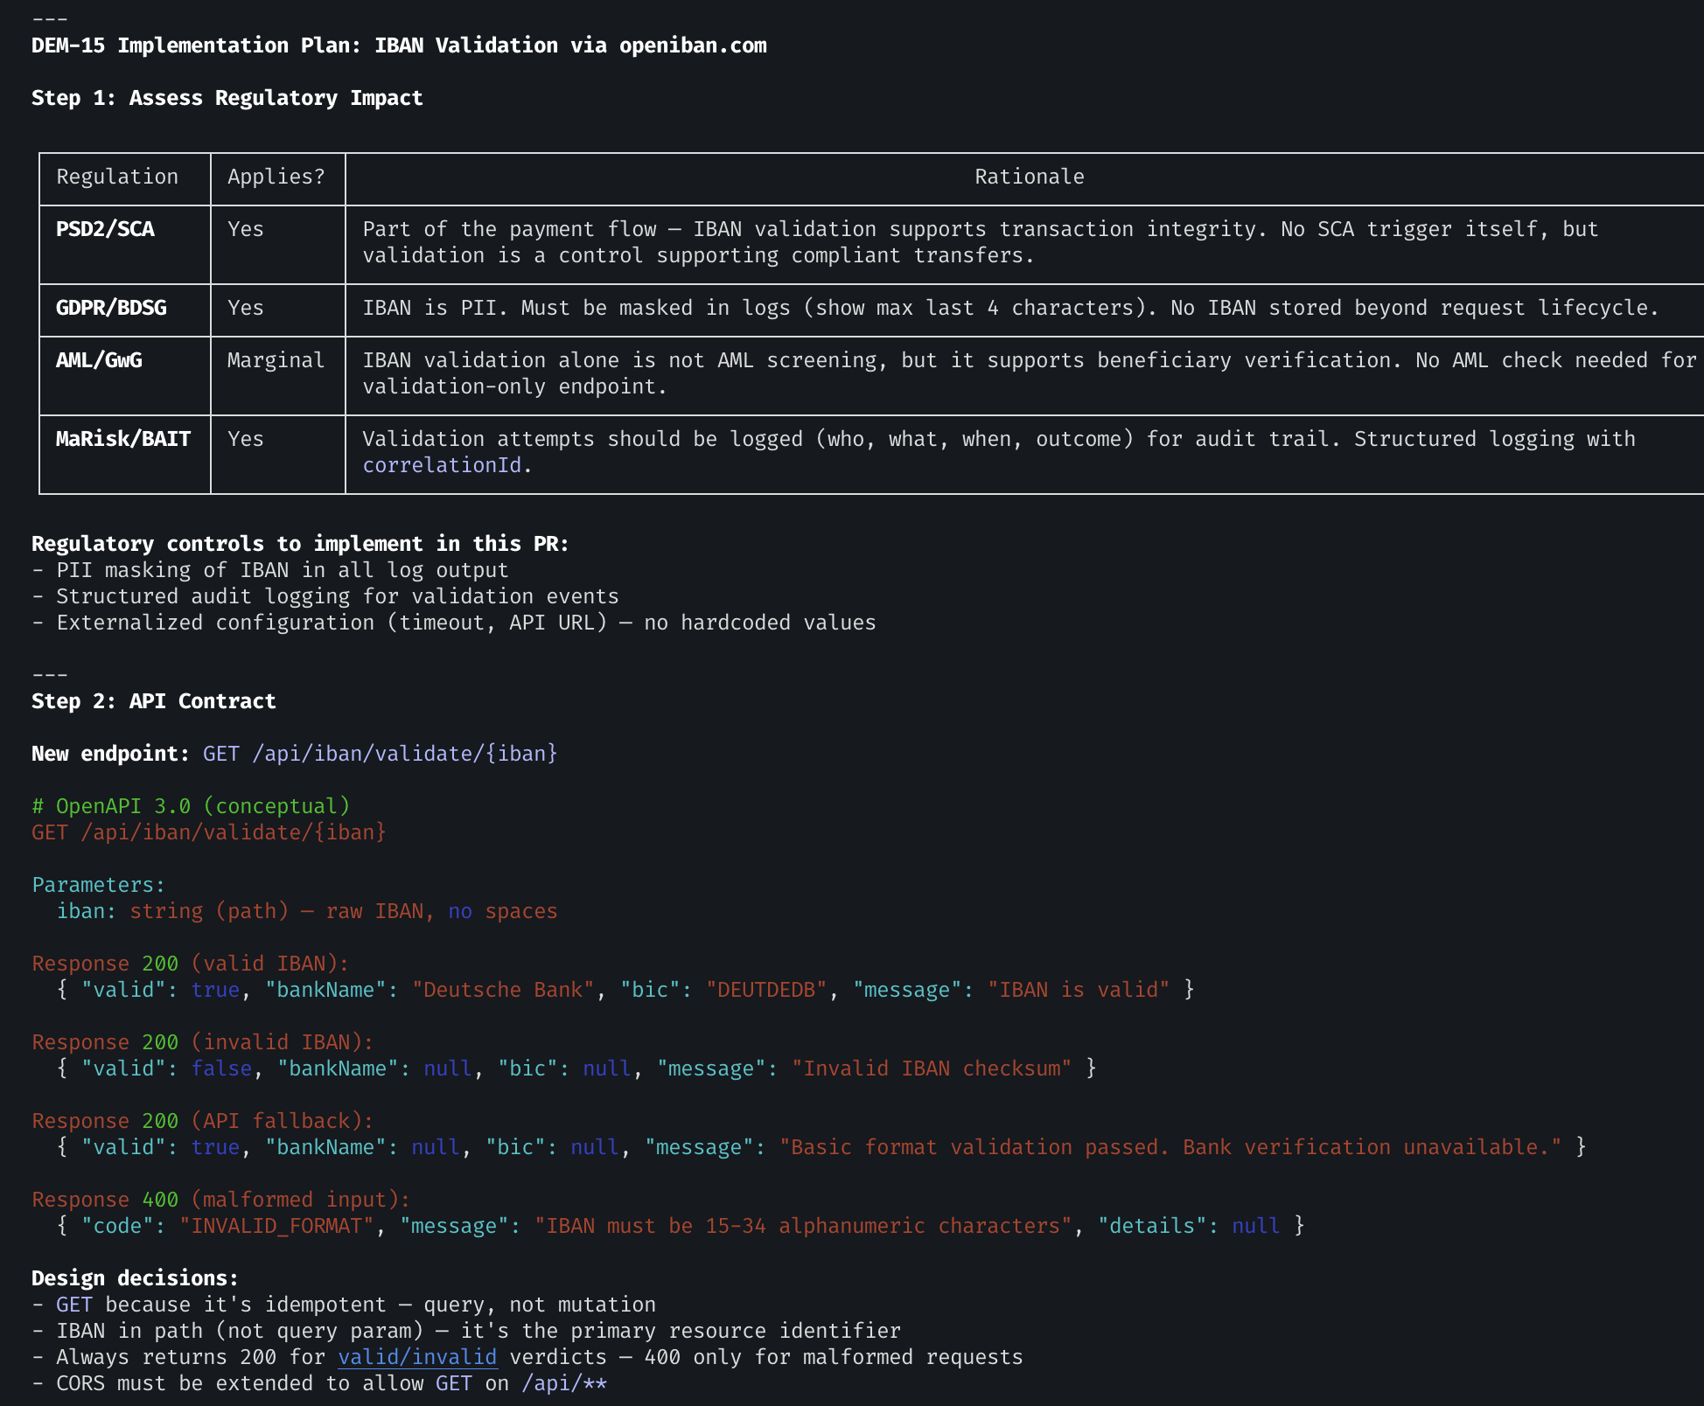
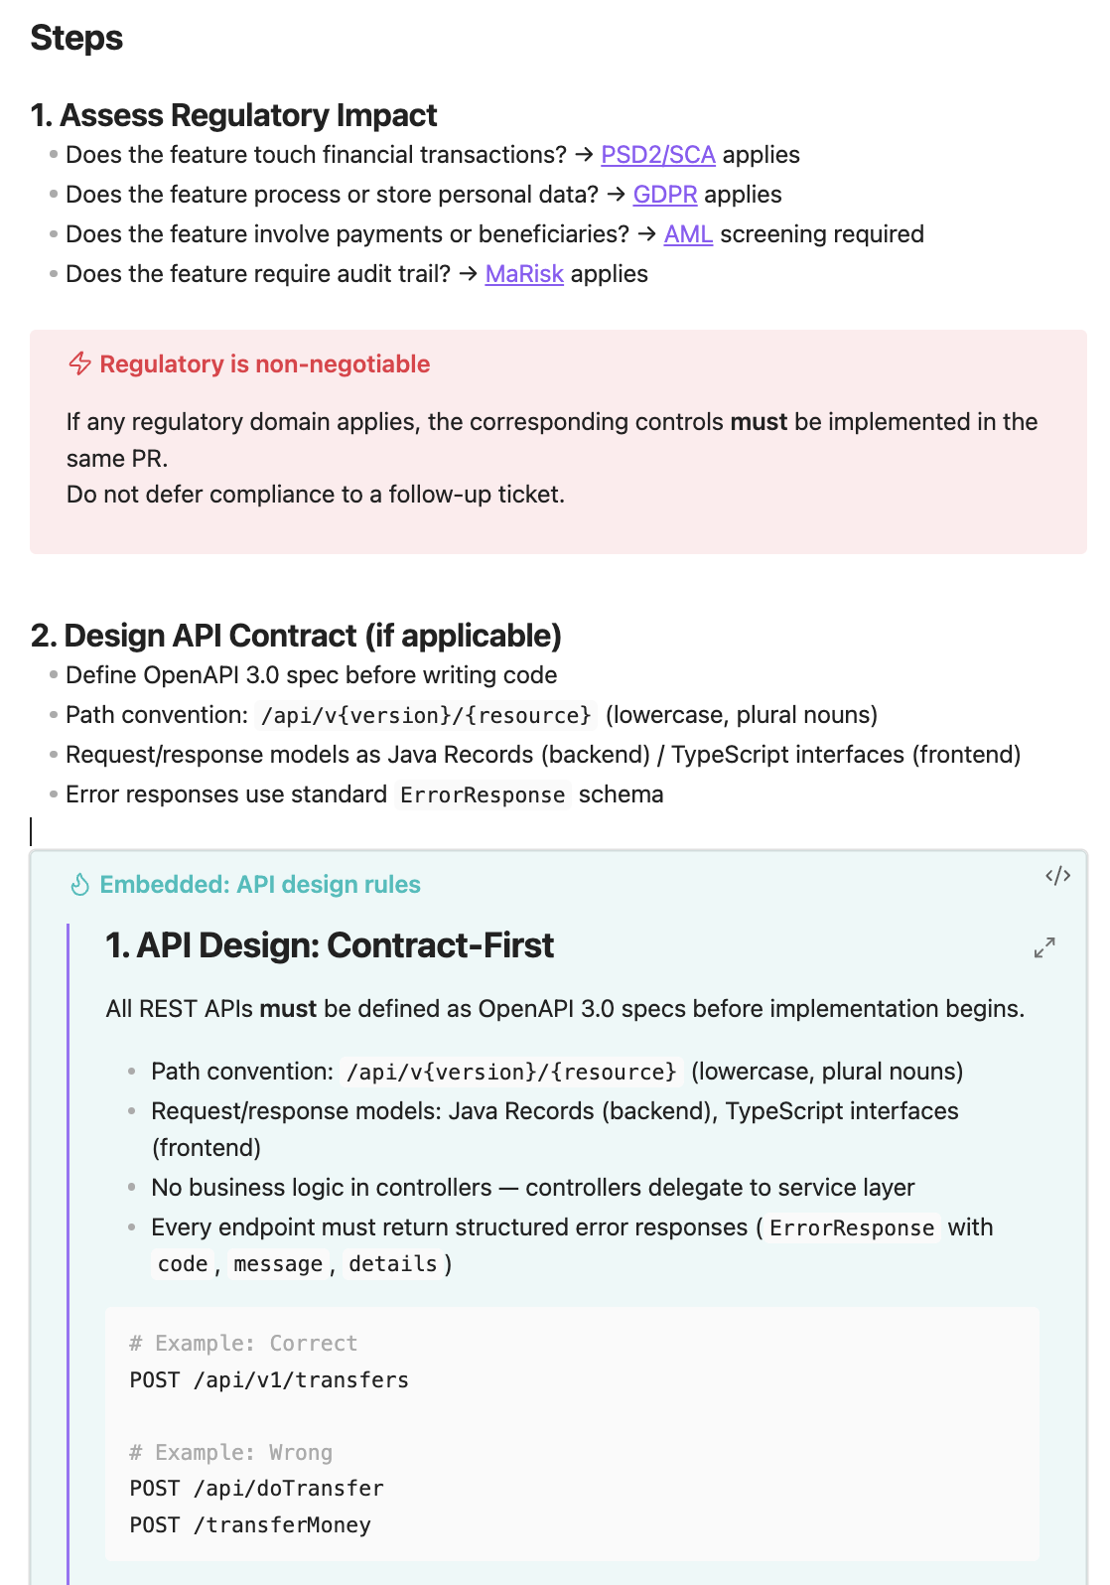
Feature
Idea
Feature
Definition
Create User
Story in Jira
Handover
Plan
Implement
Manual
Test
Handover
Plan
UI Test
Implement
UI Test

Slide 3
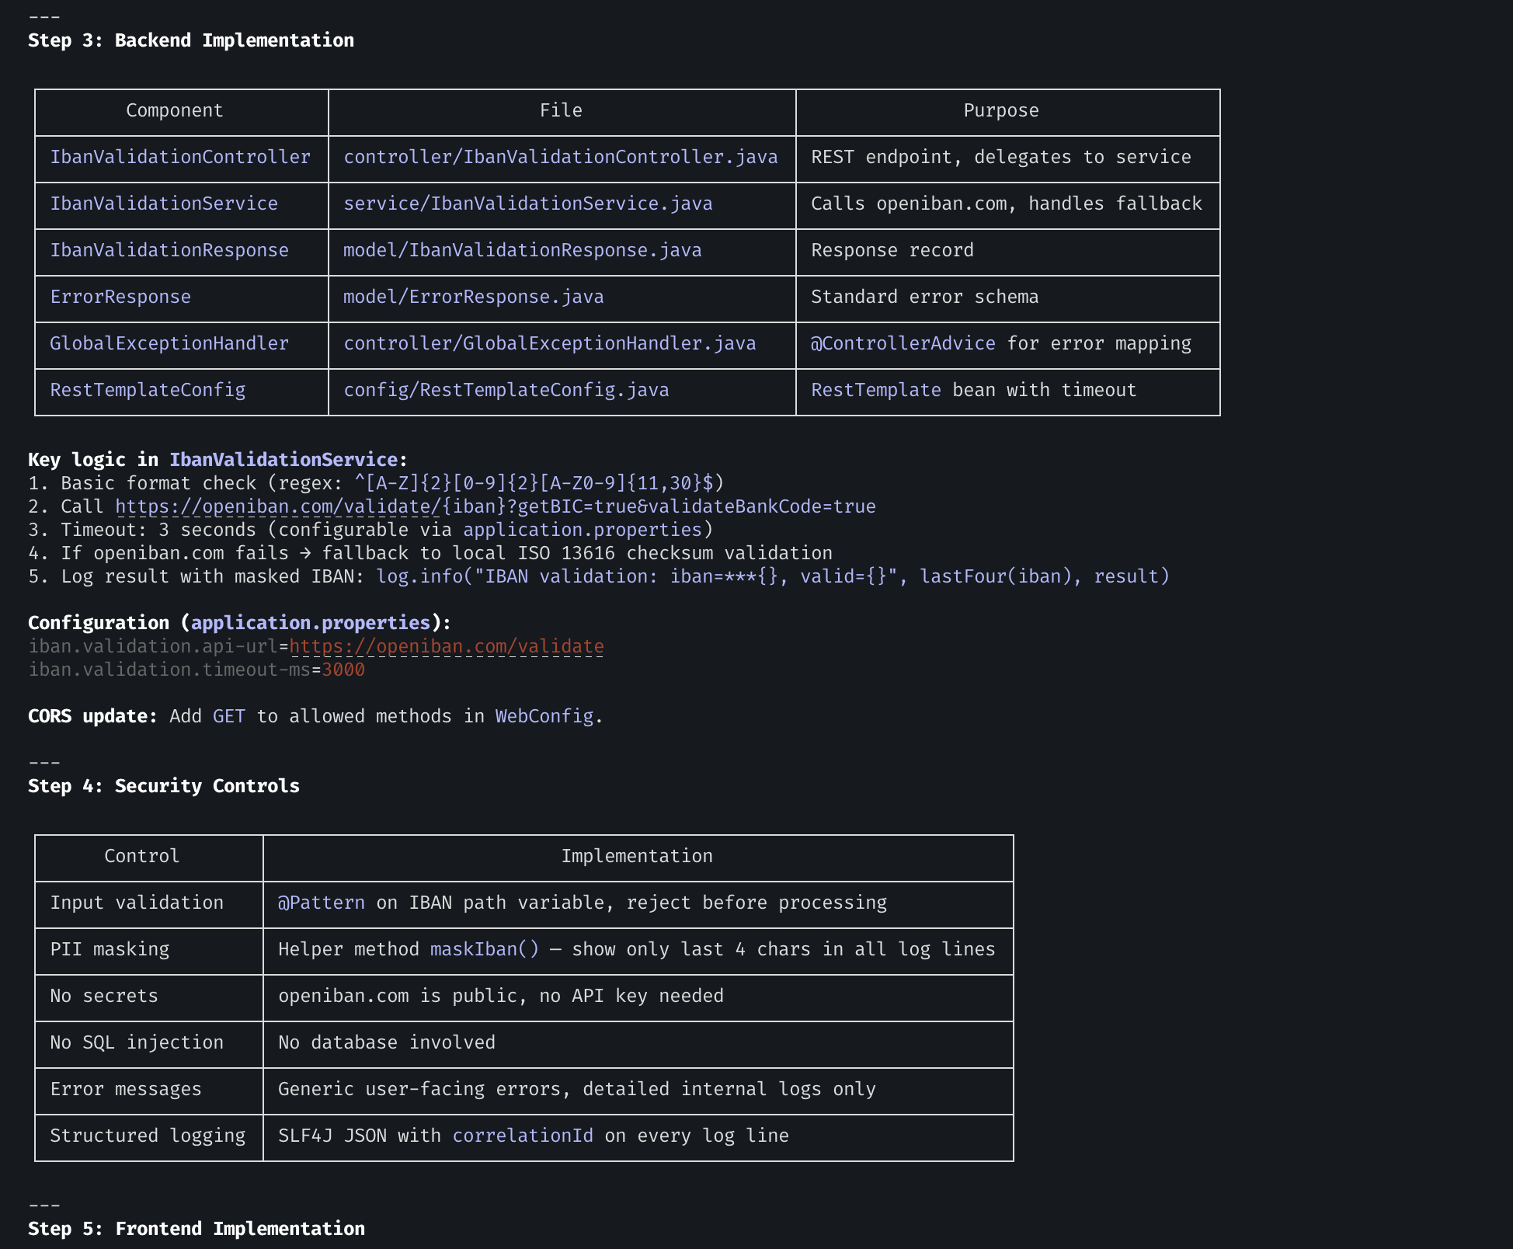
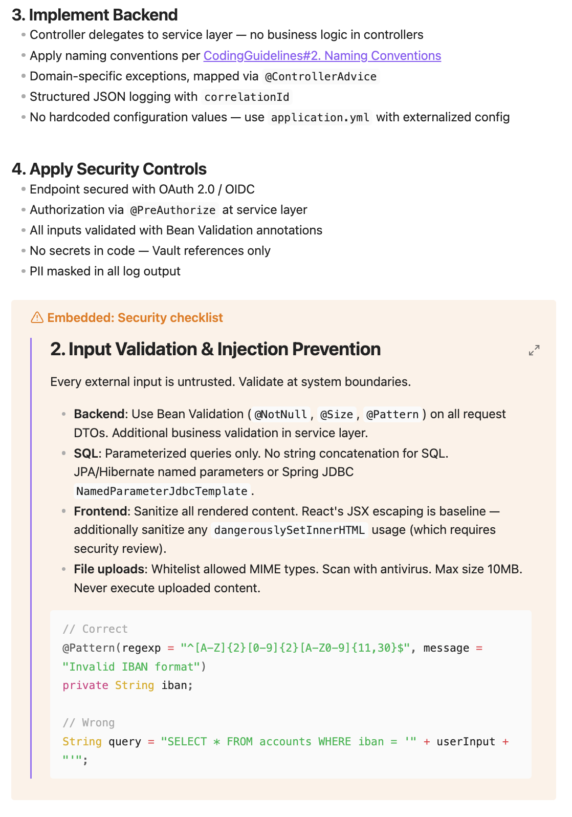
Feature
Idea
Feature
Definition
Create User
Story in Jira
Handover
Plan
Implement
Manual
Test
Handover
Plan
UI Test
Implement
UI Test

Slide 4
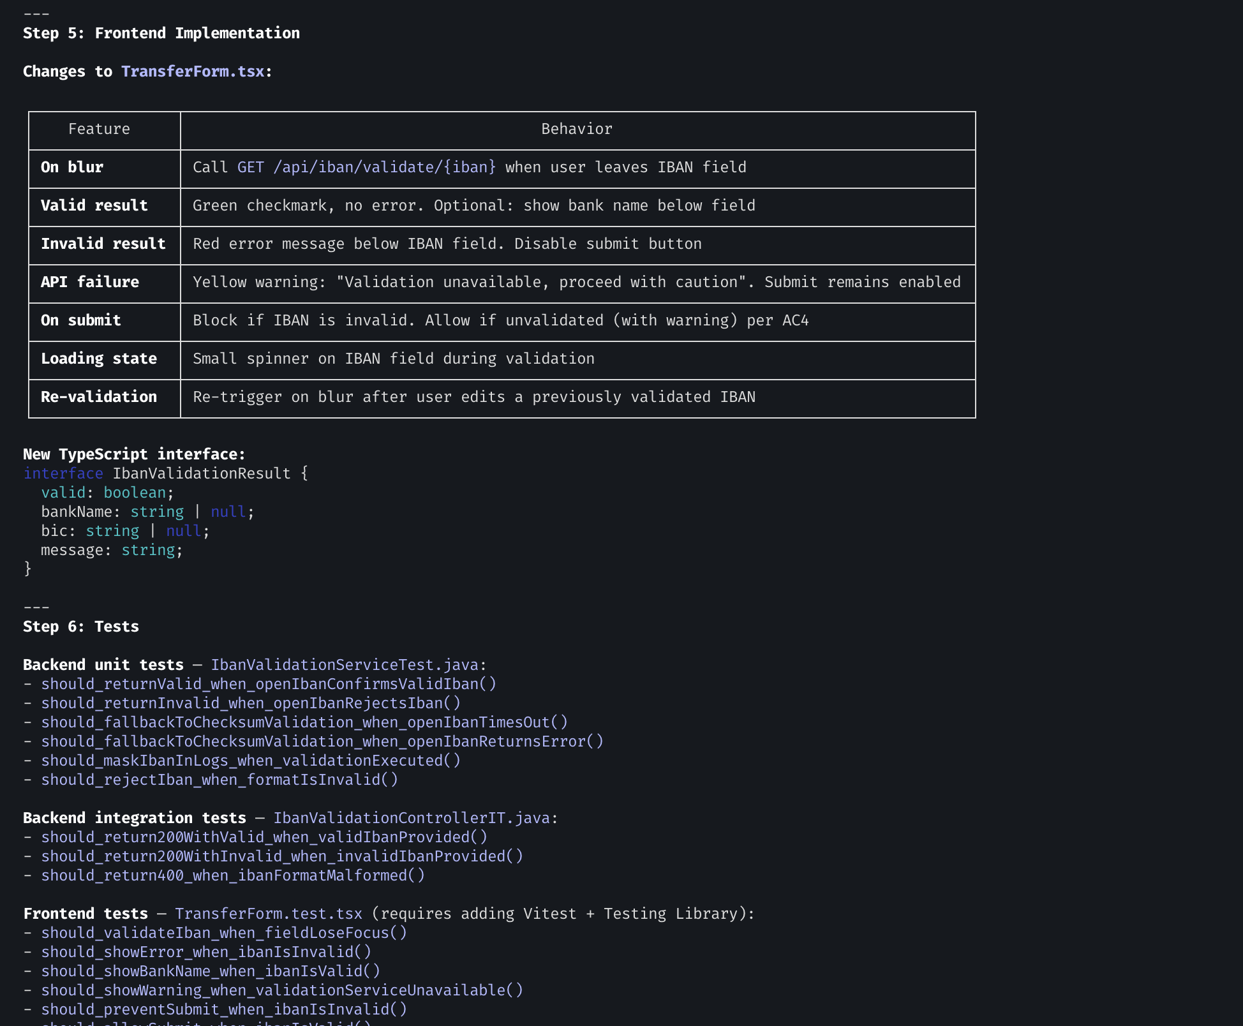
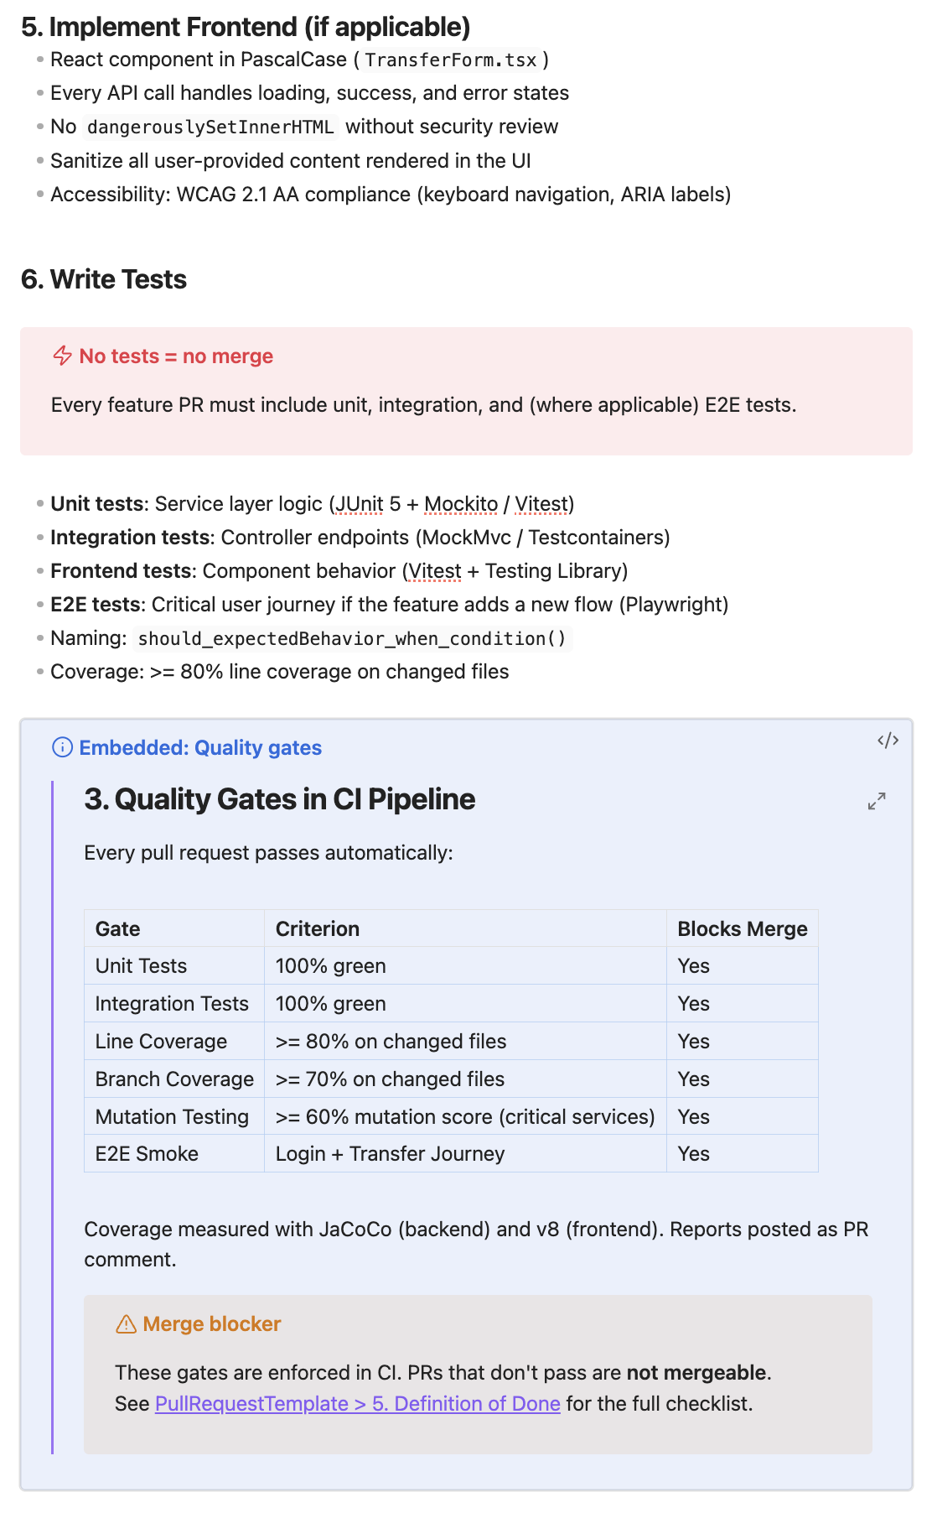
Feature
Idea
Feature
Definition
Create User
Story in Jira
Handover
Plan
Implement
Manual
Test
Handover
Plan
UI Test
Implement
UI Test

Slide 5
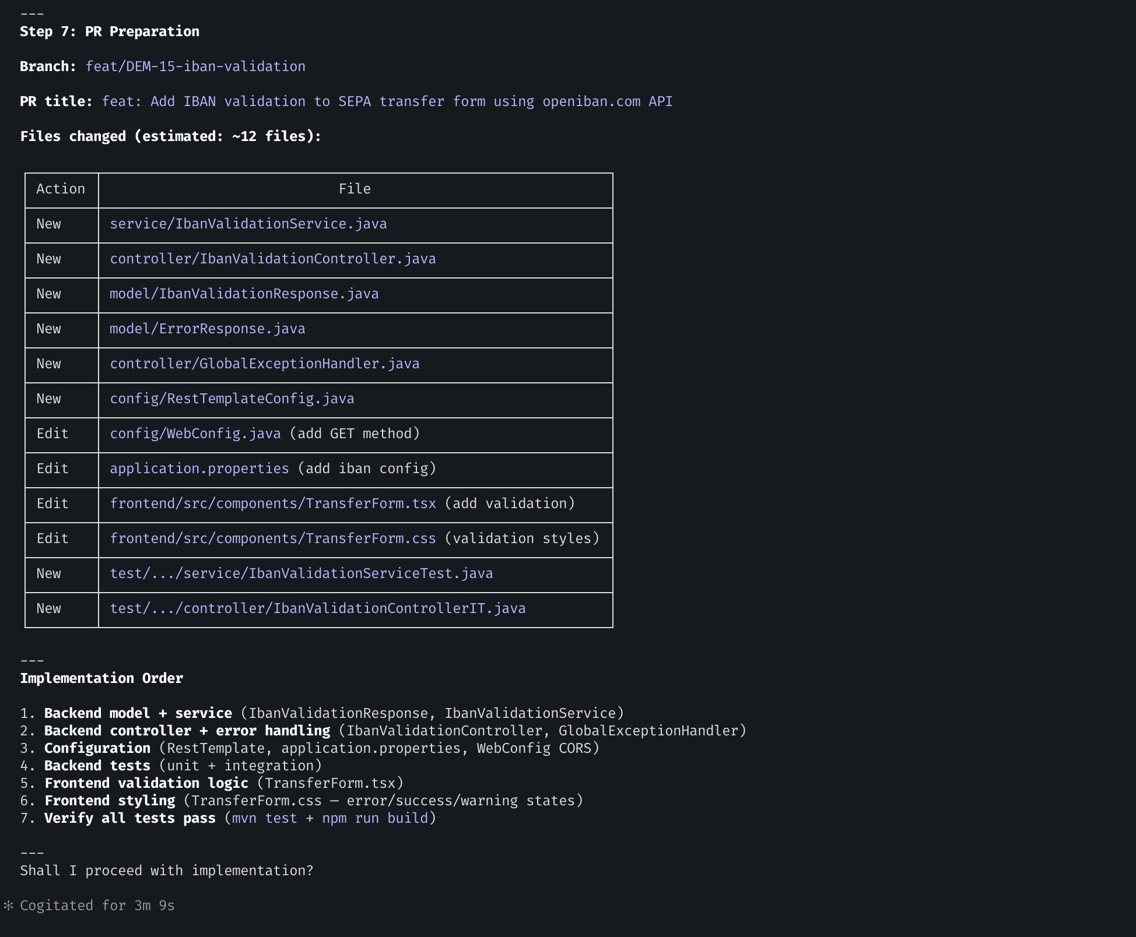
Feature
Idea
Feature
Definition
Create User
Story in Jira
Handover
Plan
Implement
Manual
Test
Handover
Plan
UI Test
Implement
UI Test

Slide 6
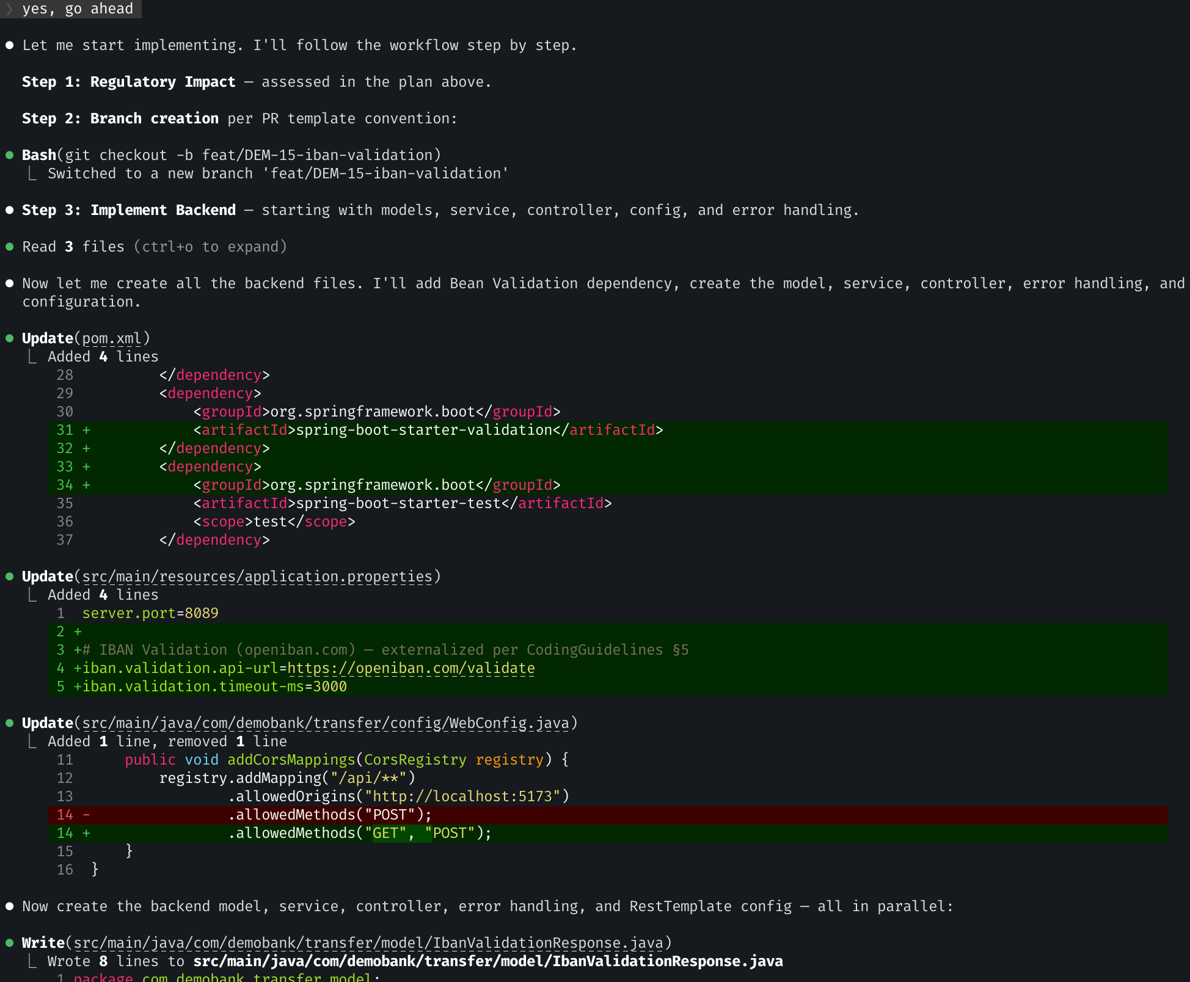
Feature
Idea
Feature
Definition
Create User
Story in Jira
Handover
Plan
Implement
Manual
Test
Handover
Plan
UI Test
Implement
UI Test

Slide 7
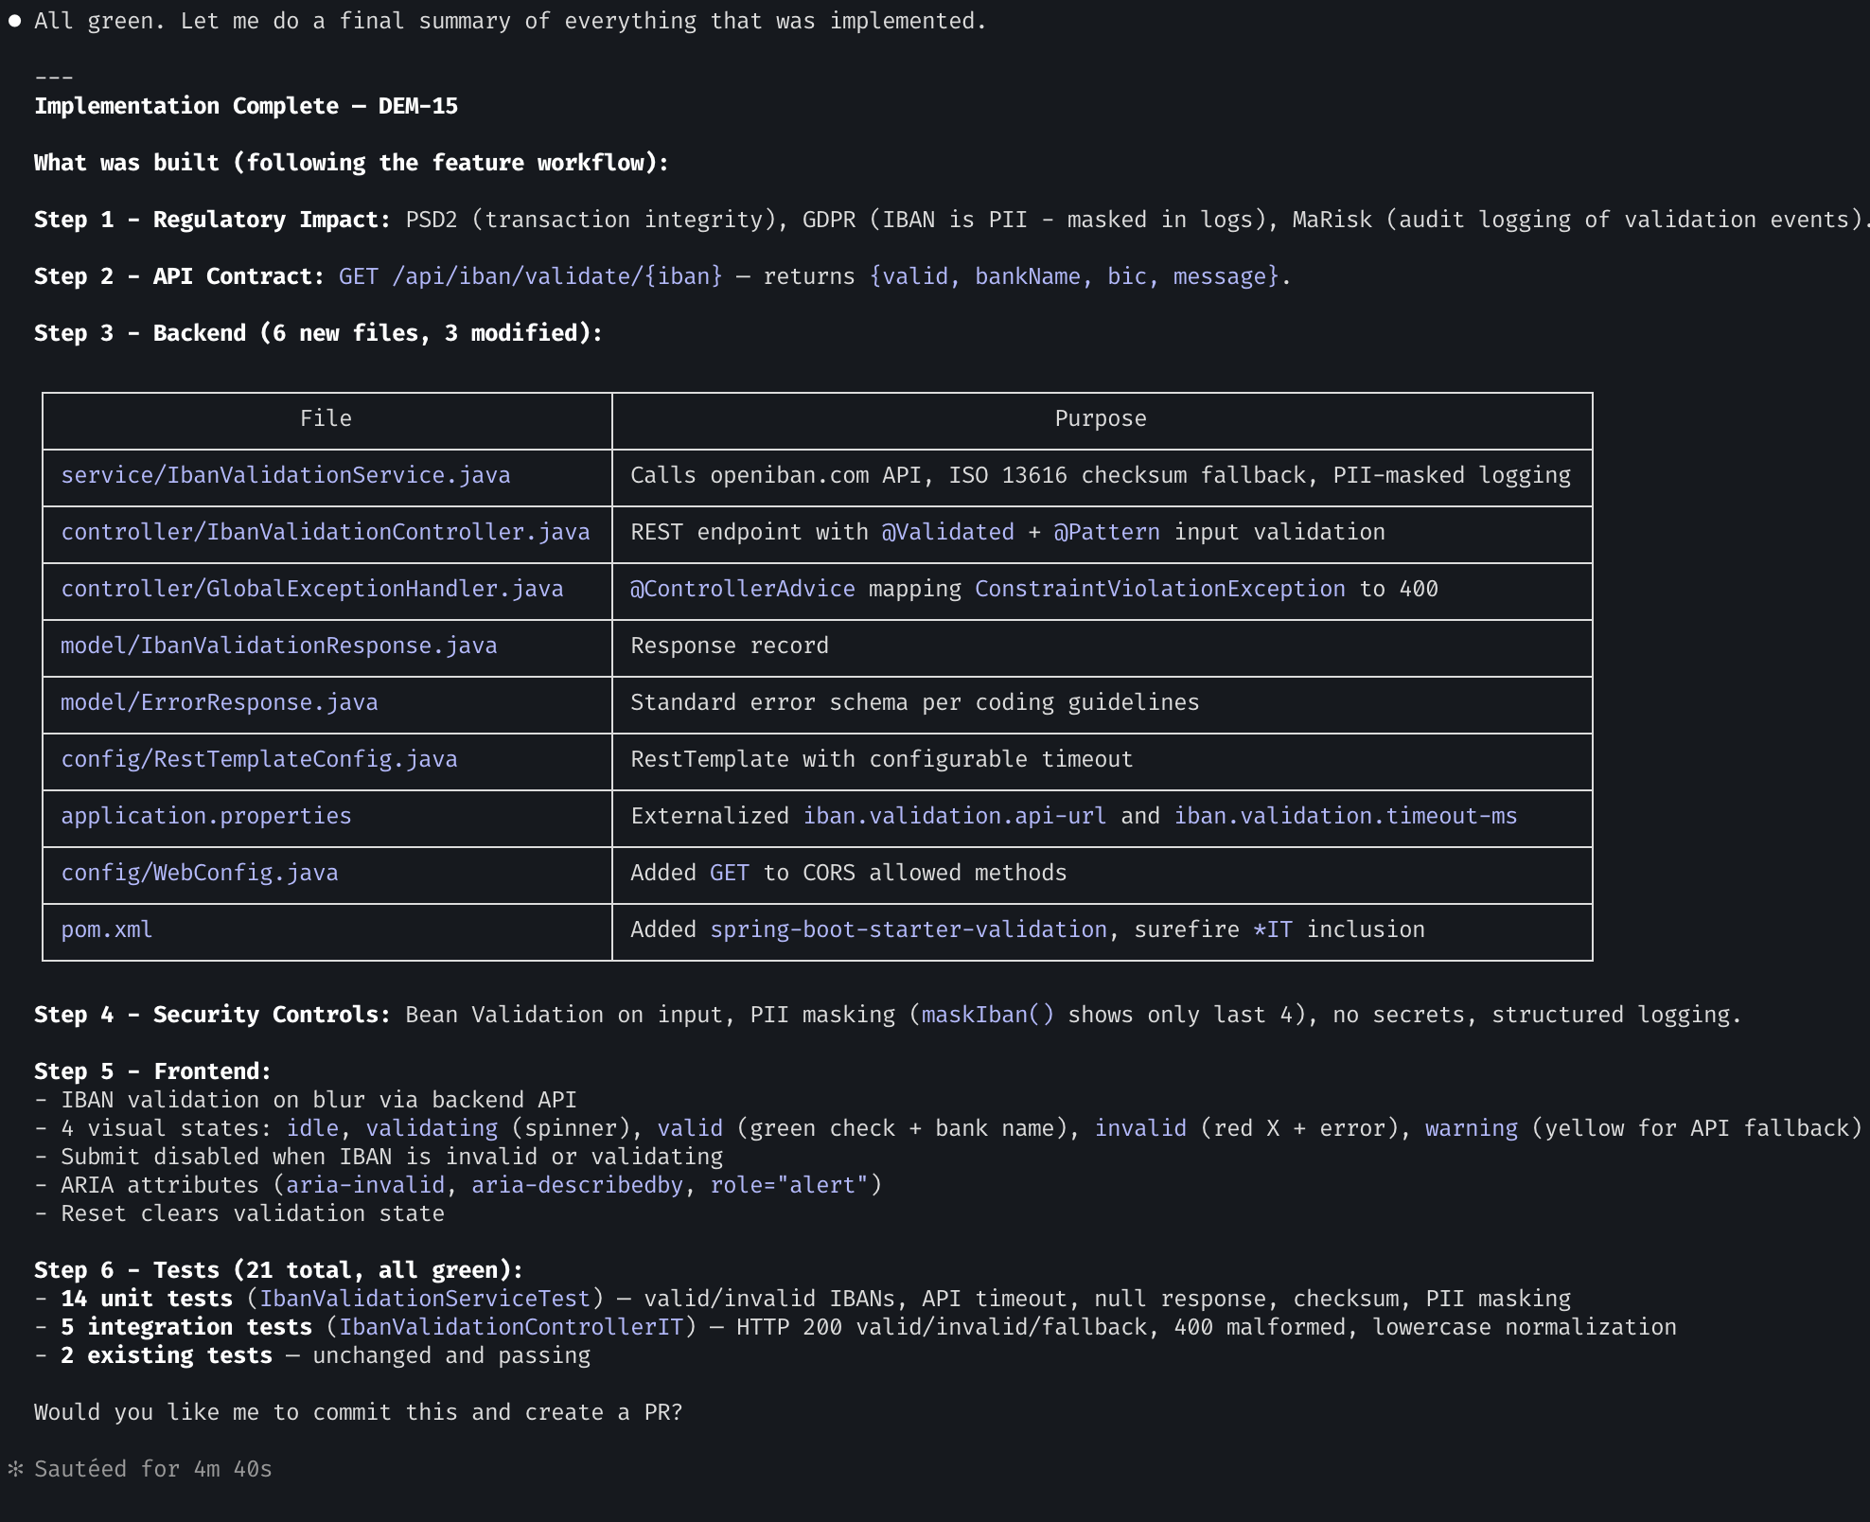
Feature
Idea
Feature
Definition
Create User
Story in Jira
Handover
Plan
Implement
Manual
Test
Handover
Plan
UI Test
Implement
UI Test

Slide 8
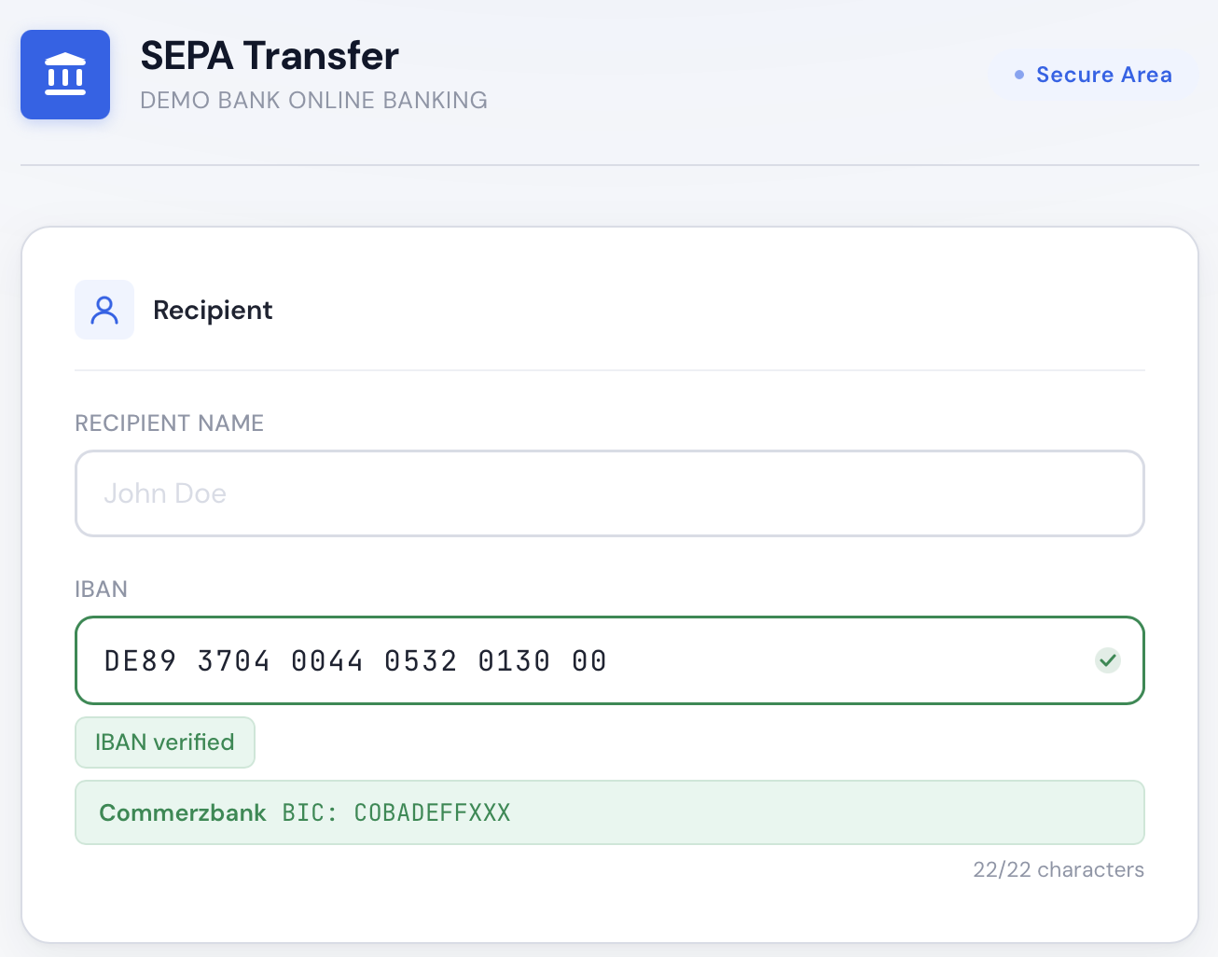
Feature
Idea
Feature
Definition
Create User
Story in Jira
Handover
Plan
Implement
Manual
Test
Handover
Plan
UI Test
Implement
UI Test

Slide 9
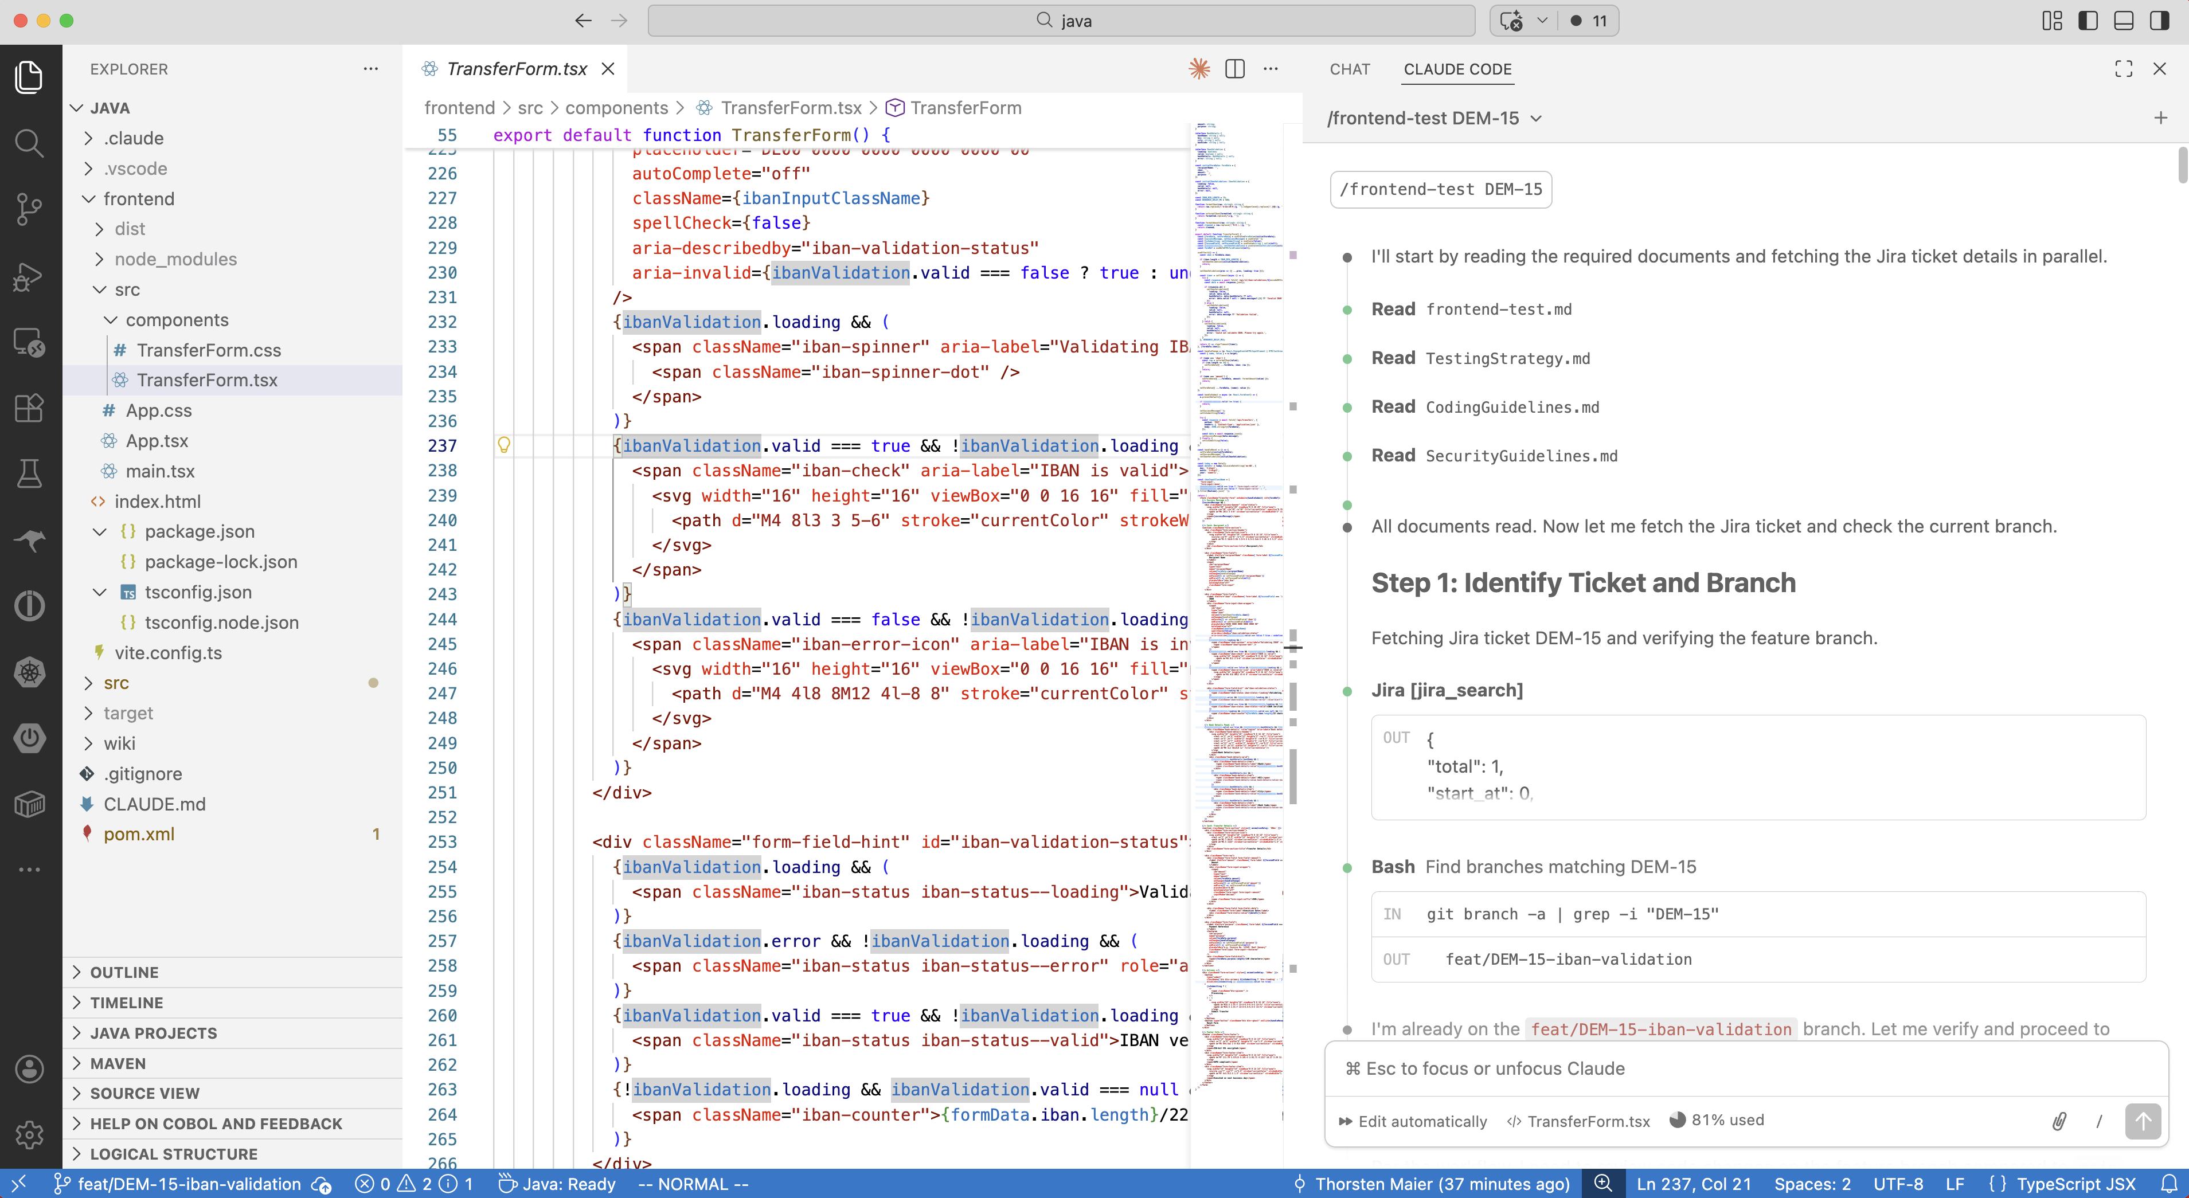
Feature
Idea
Feature
Definition
Create User
Story in Jira
Handover
Plan
Implement
Manual
Test
Handover
Plan
UI Test
Implement
UI Test

Slide 10
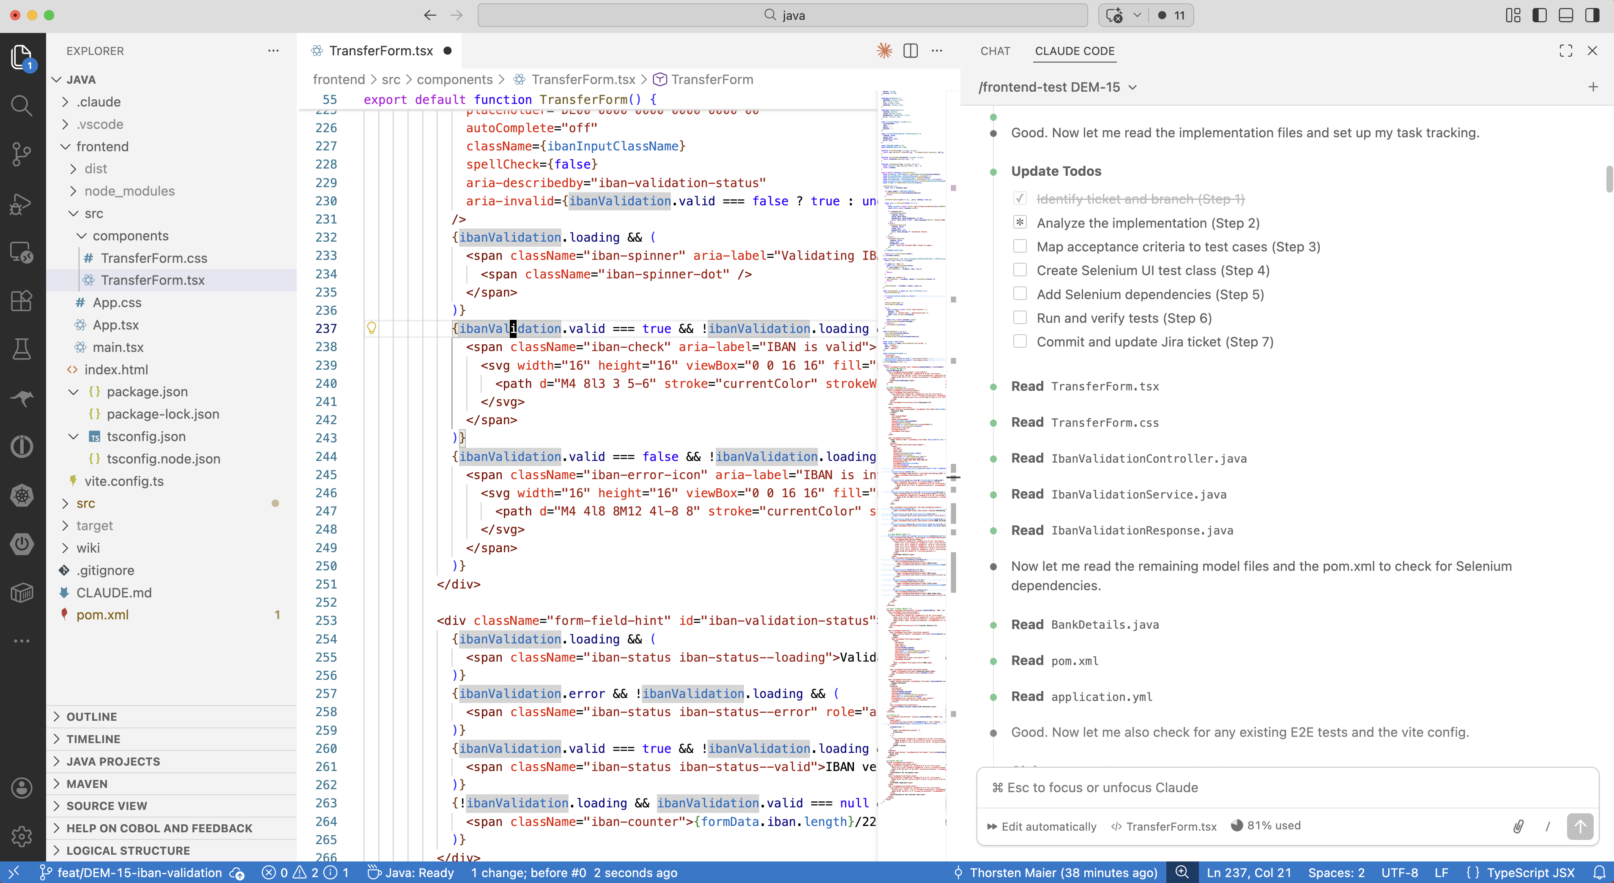
Feature
Idea
Feature
Definition
Create User
Story in Jira
Handover
Plan
Implement
Manual
Test
Handover
Plan
UI Test
Implement
UI Test

Slide 11
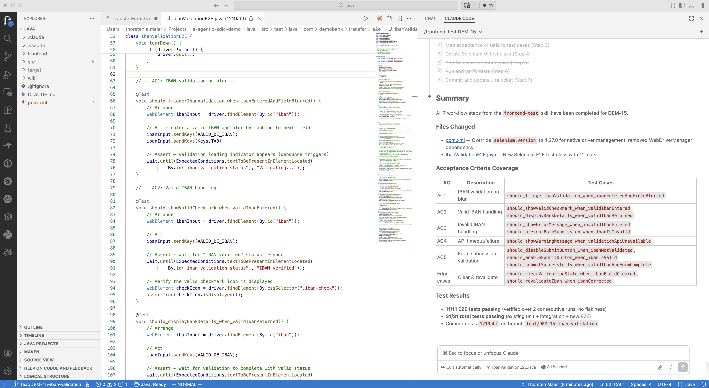
Feature
Idea
Feature
Definition
Create User
Story in Jira
Handover
Plan
Implement
Manual
Test
Handover
Plan
UI Test
Implement
UI Test

