Slide 1
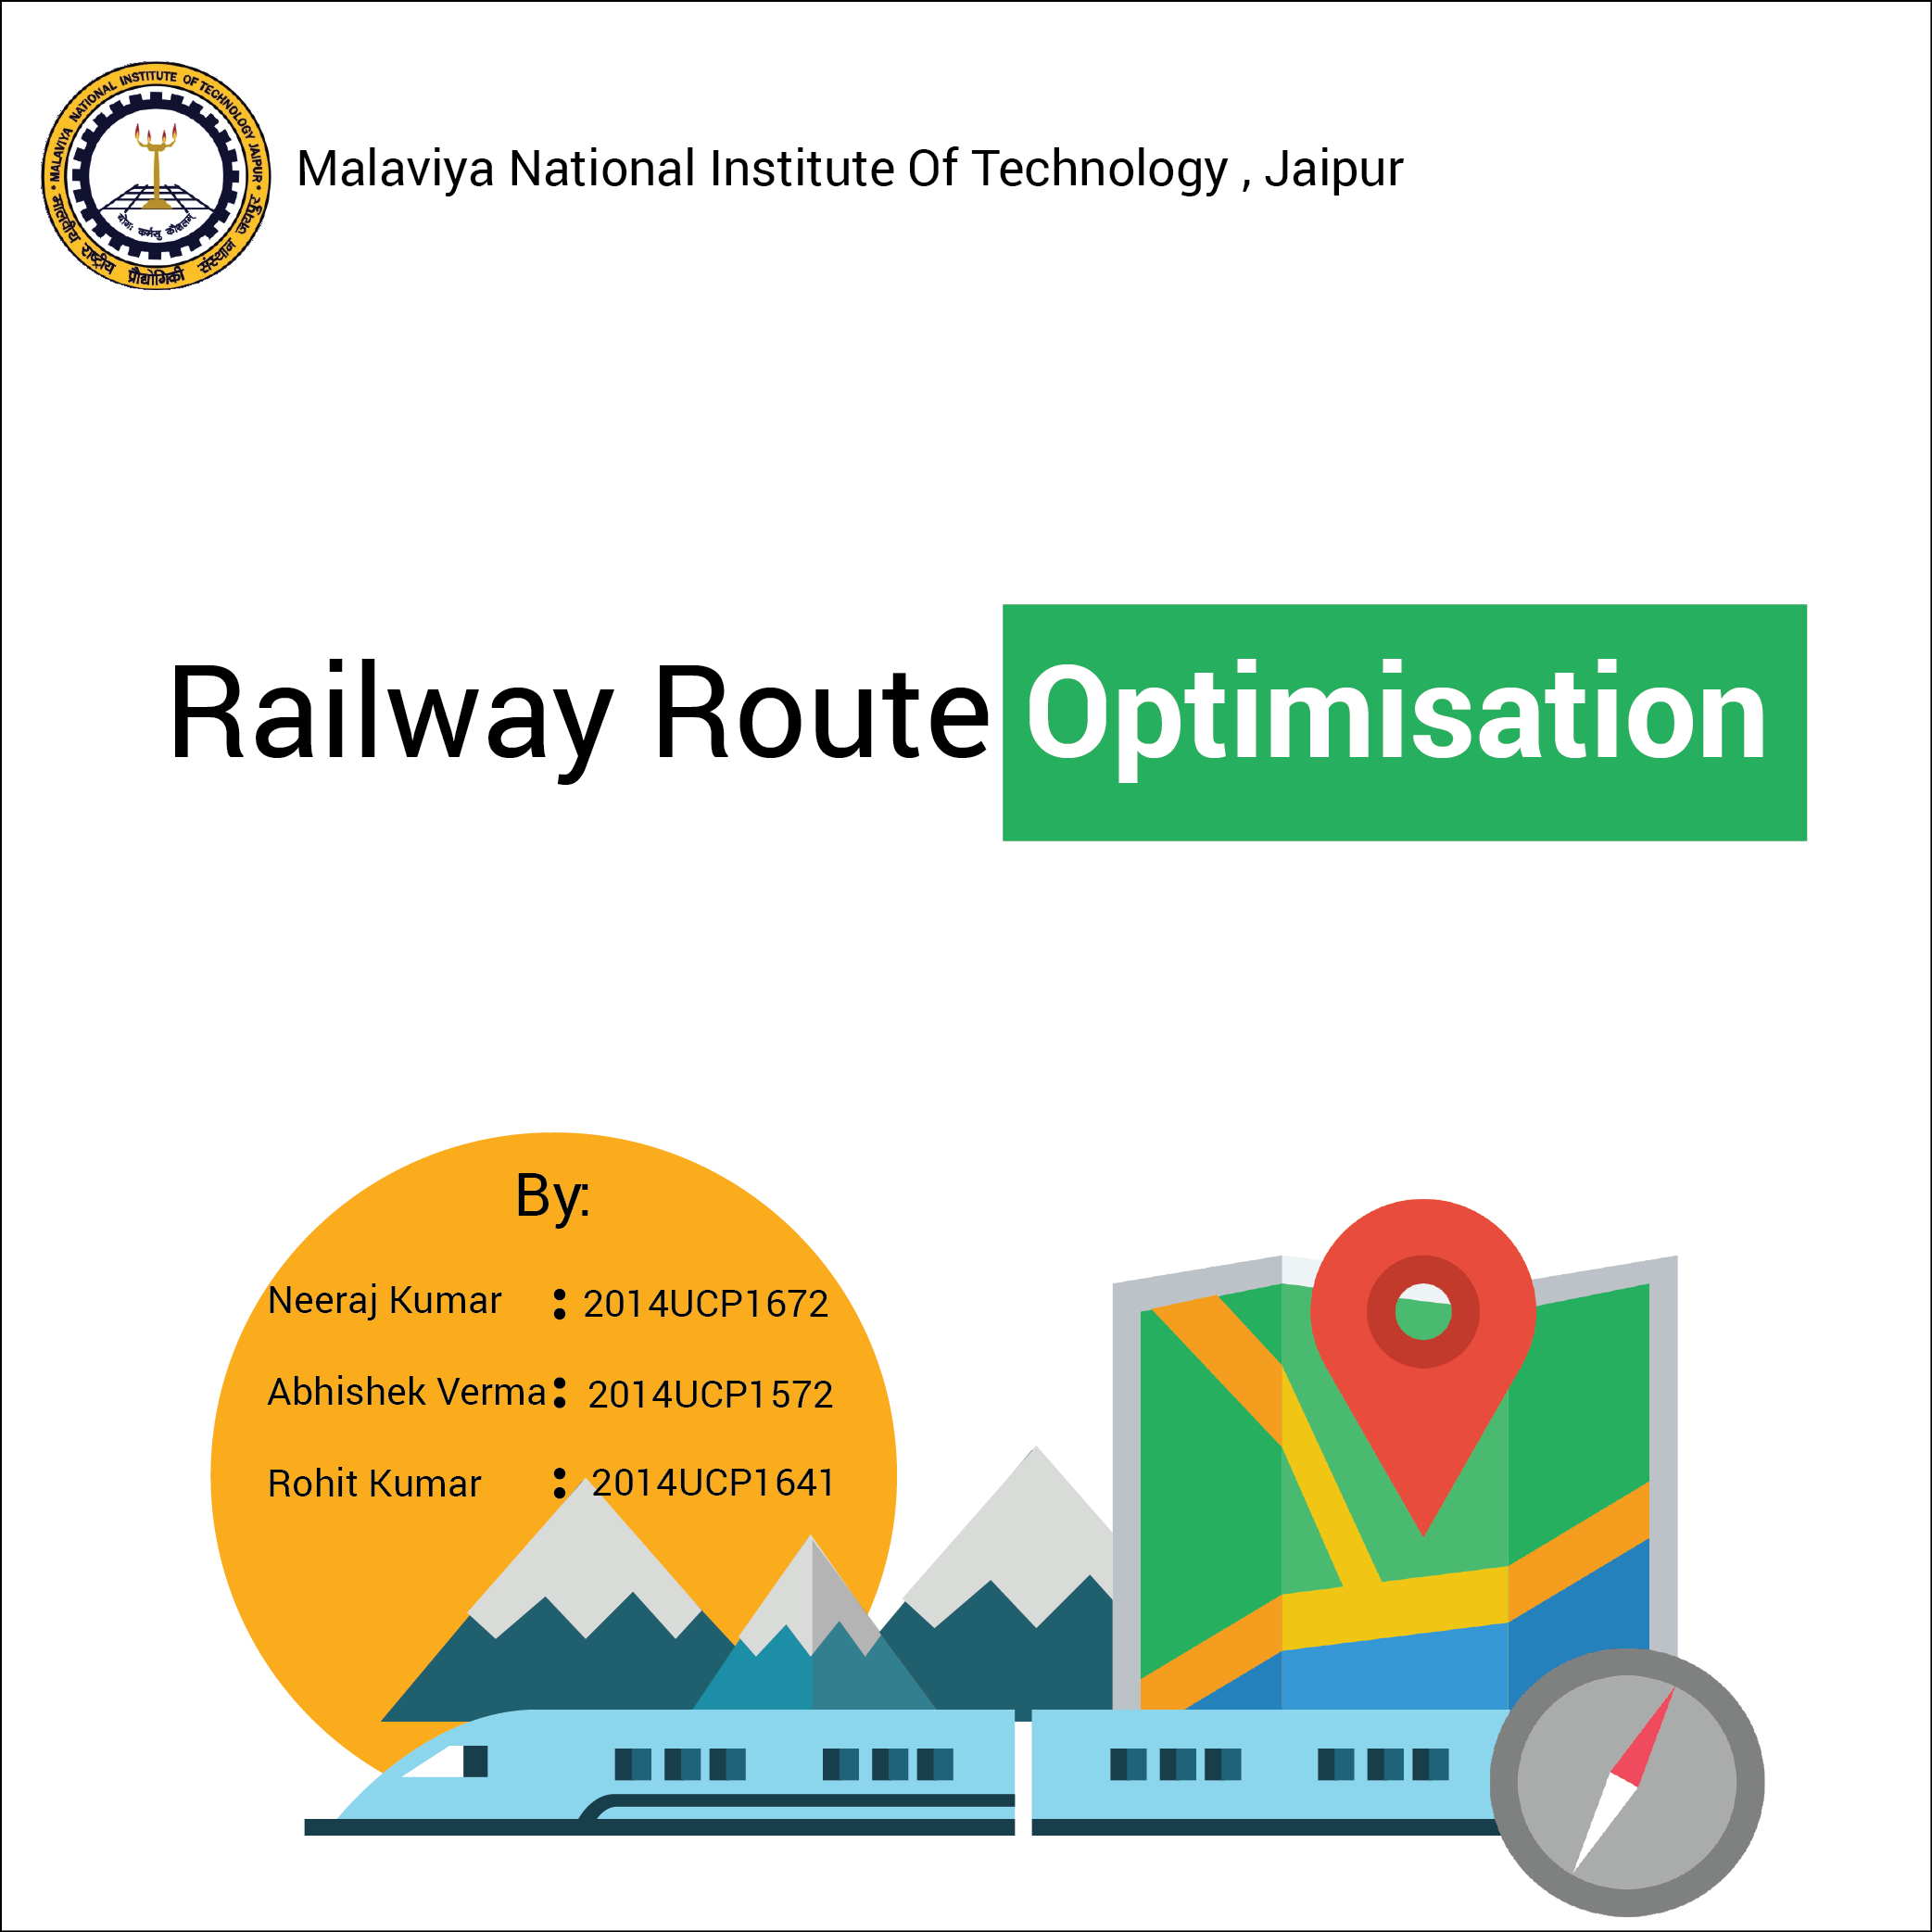

Slide 2
OBJECTIVE
The Train Route Optimisation System is focused towards providing Travellers in the railway system easily available information about the
Shortest path
so as to provide convenience to the users.

Slide 3
FRAMEWORK USED
We have used the Android App Development platform Android Studio and made an App to achieve our goal.
We have used Java on the Client Side and PHP on the Server side to process queries.
We have used the Volley framework to use the network related facilities like making requests and receiving data.

Slide 4
FRAMEWORK USED(contd.)
We have used a Live Server which we had access to and used Mysql as our database using phpMyAdmin.

Slide 5
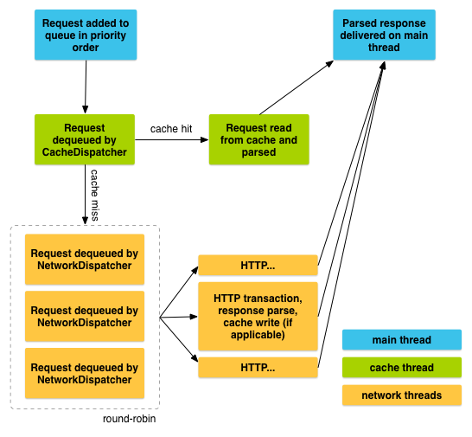
VOLLEY FRAMEWORK DETAILS.

Slide 6
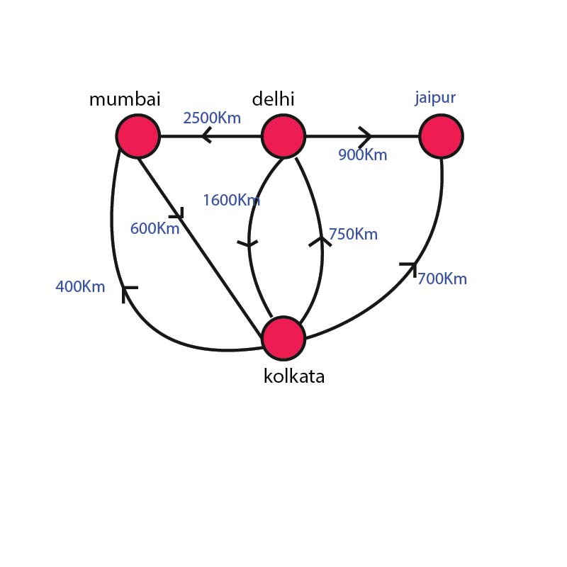
An Example : Present Graph

Slide 7
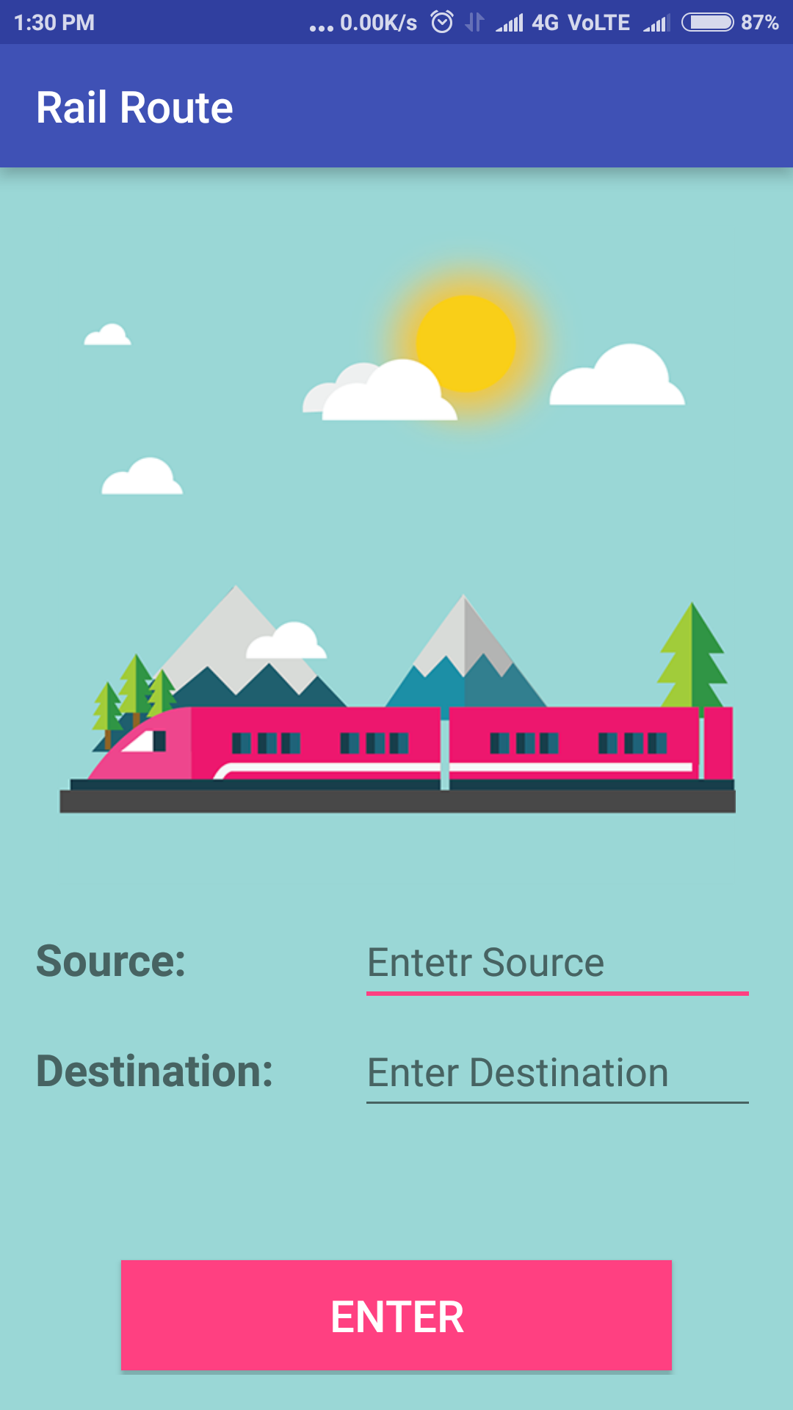
APP WORKFLOW:FRONT SCREEN

Slide 8
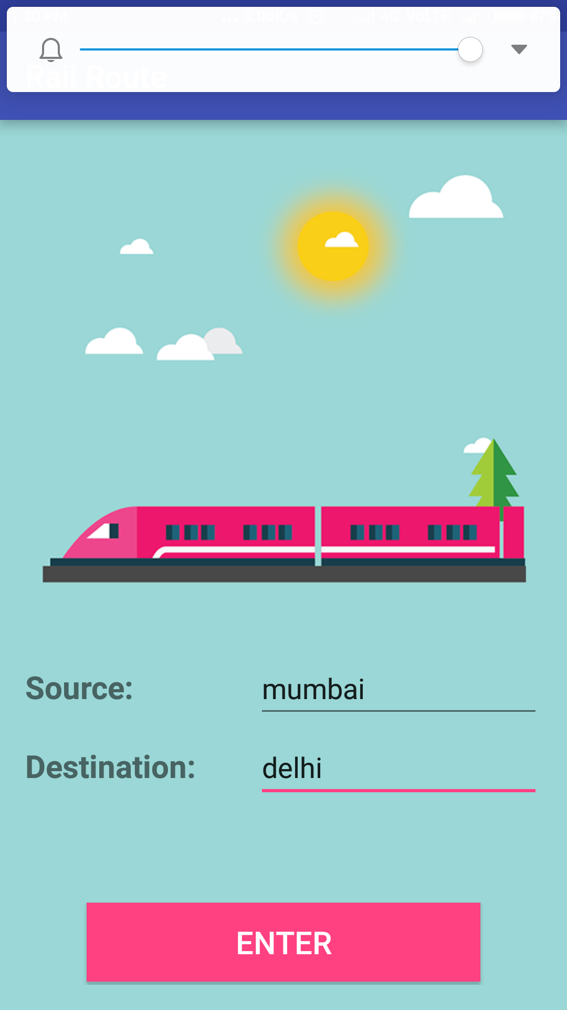
NOW WE ENTER THE SOURCE AND DESTINATION CITIES

Slide 9
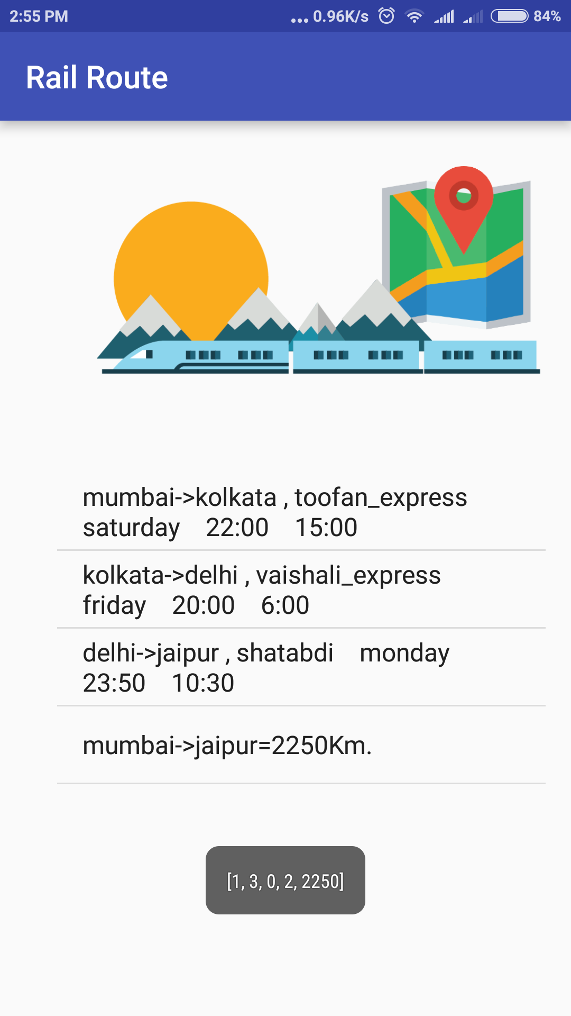
THE APP SEARCHES FOR AND SHOWS US THE SHORTEST ROUTE

Slide 10
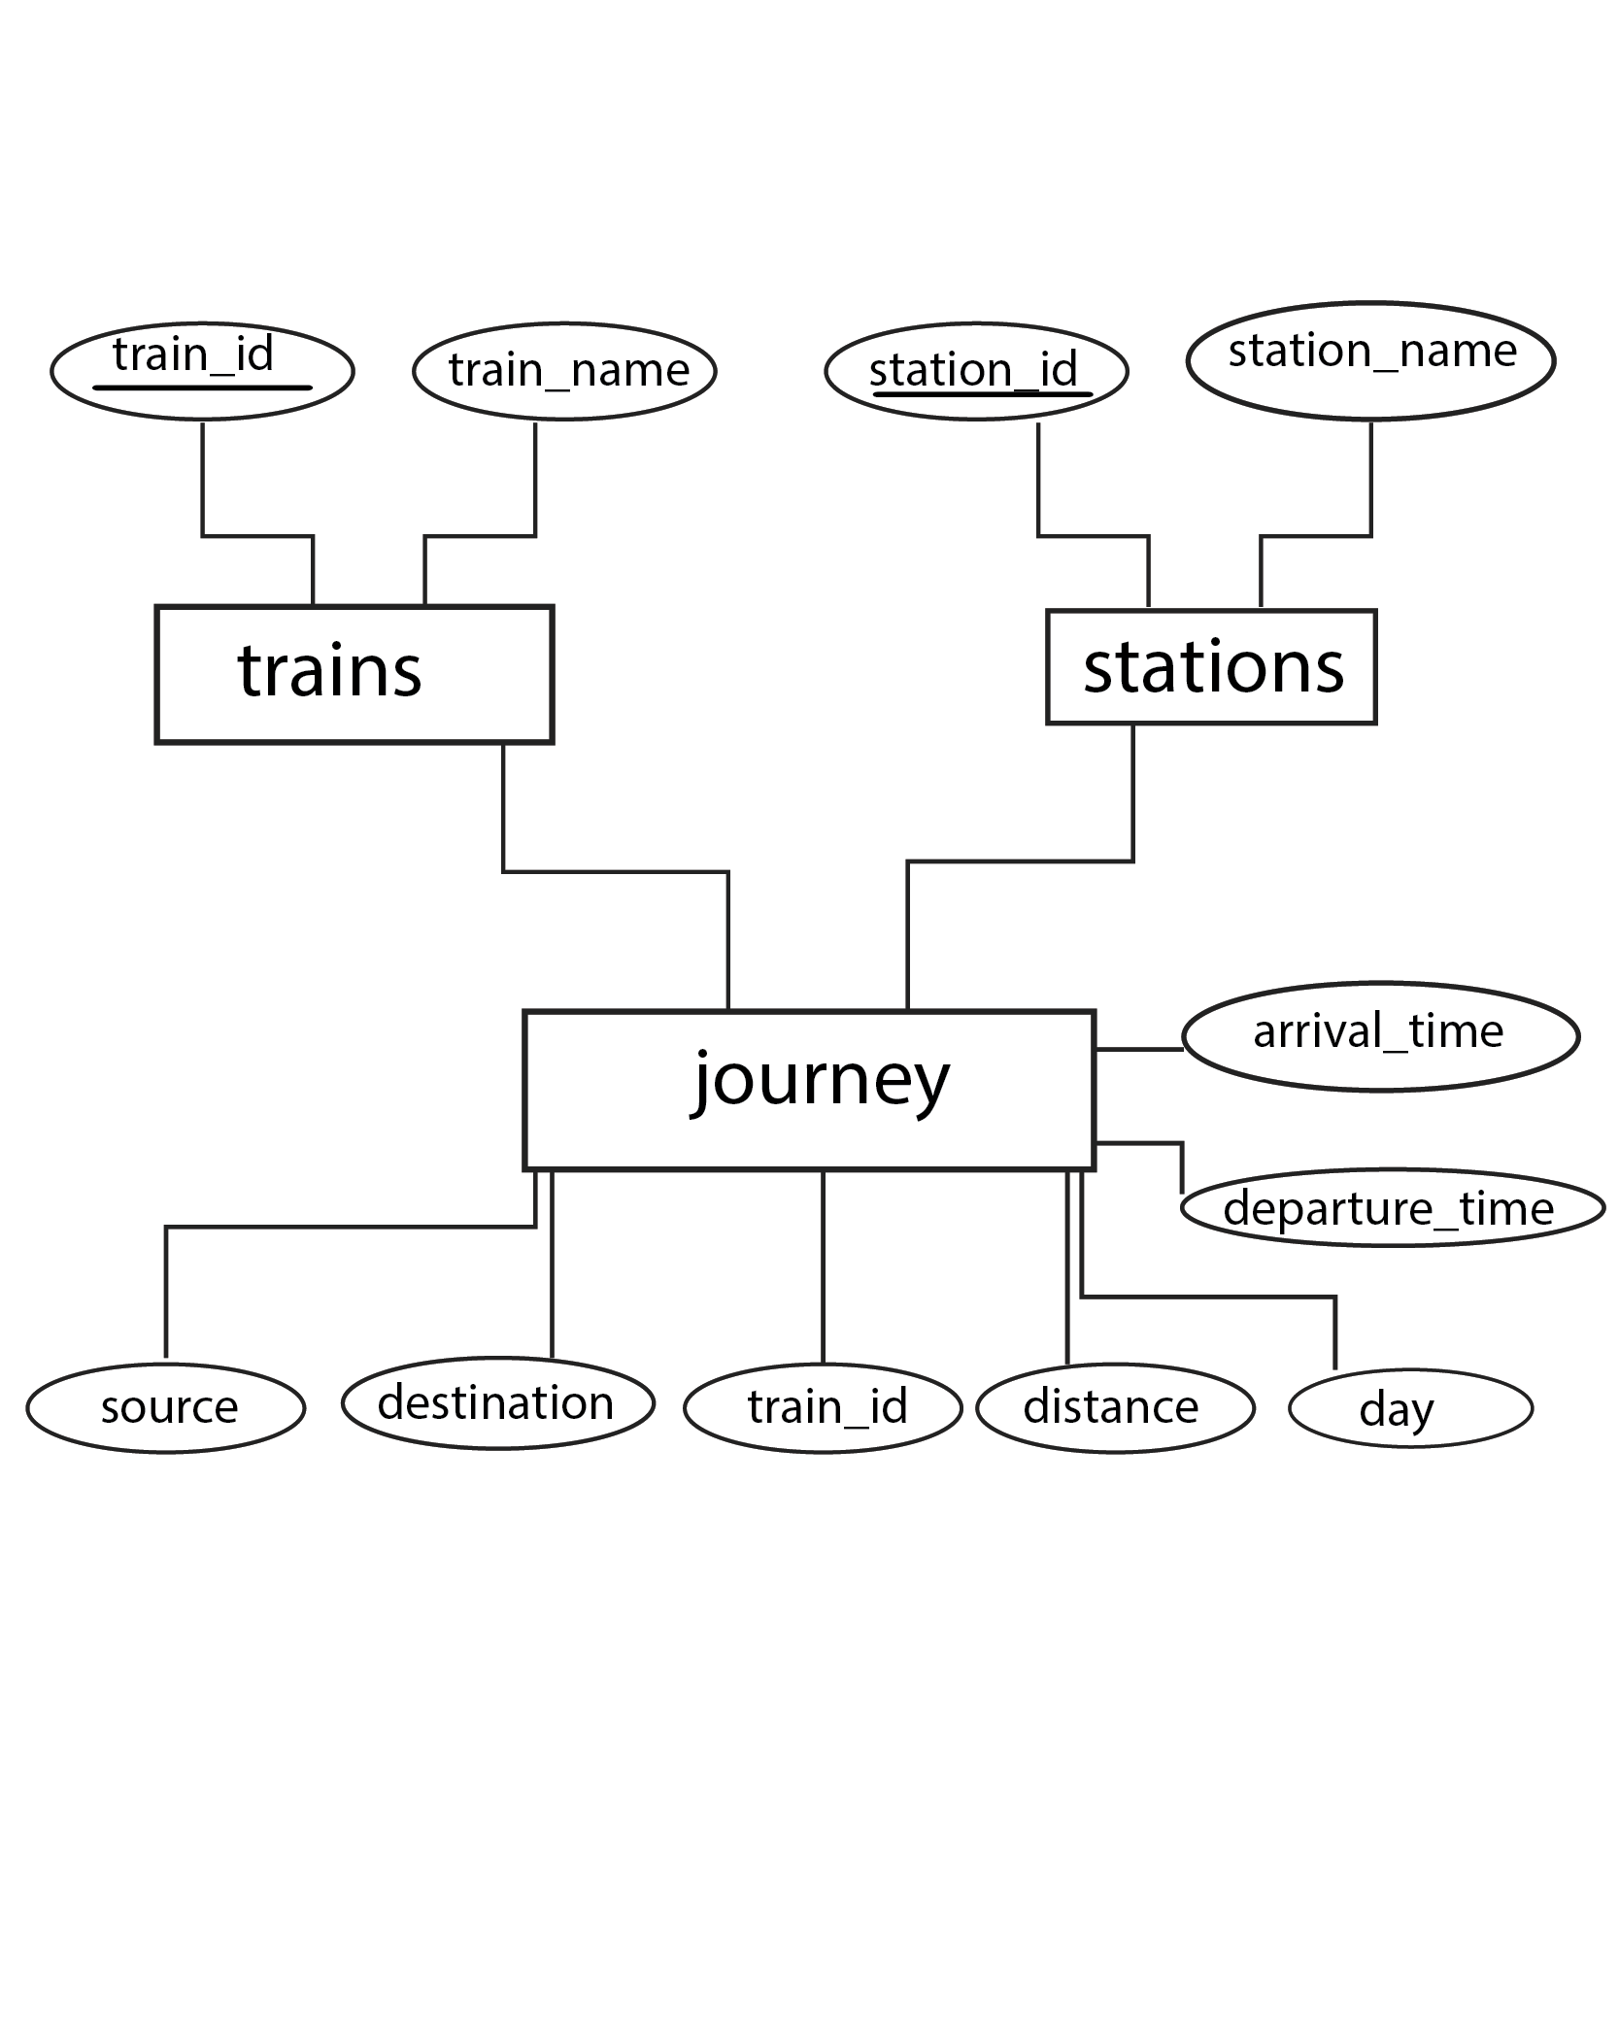
E-R Diagram

Slide 11
MODULES
Loading data and Building Graph
void onCreate() - Take the user input source and destination.
void load() - Build a graph as 2D matrix.
void load_station() - load data of station like sid , sname.
void load_route() - load data of journey like source , destionation , train_name,time .
Shortest Route Detection
GraphAlgorithm() - main Dijkstra's algorithm class which has method dijkstra to apply on graph that we have just made.

Slide 12
IMPORTANT CODE SEGMENTS
The GraphAlgorithm Class
Data fields :
int V ; // Number of Cities (Number of nodes)
int [ ][ ] graph ; // 2-d Matrix , representing the graph
Methods :
public GraphAlgorithm(int[][] array , int n) ; // Constructor
ArrayList<String> dijkstra(int src , int dest) ; // Dijkstra takes Source and Destination , gives us the route
int minDistance(int dist[], Boolean sptSet[]) ; // Helper Method for Dijkstra.

Slide 13
The Graph Representation
The Graph is represented in the adjacency matrix form. Basically , we have a two dimensional integer array , int [ ] [ ] graph . The array is indexed by the station id of the cities .
graph[i] [i] = 0 ; // for all I
graph[i] [j] = weight of edge for train from I to J , or 0 if no train exists.
The graph is loaded initially , when the system boots up , by making volley request to the Server , which returns a JSON object which we
we parse at the frontend using java to make our graph.

Slide 14
IMPOTANT CODE SEGMENTS
The Trainroute Map.
Map<String, String> trainroute = new HashMap<>();
This Map has a key of the form “i+j” , where I is the source station Id and j is the Destination Station Id .
The Value in the map is a String with the following fields:
1.Train Name , 2.Day , 3.Arrival Time , 4.Destination Time
The Stations Arraylist.
ArrayList<String> stationnames = new ArrayList<>();
This Data Structure is Indexed by the station id , and stores station names.

Slide 15
Some Problems We Faced.
Since Volley+PHP returns only a 1-D array Conveniently , and our Graph is 2-D we had to Use the Row Major Form of Storing an Array to Convert a 1-D array to a 2-D array.
Graph [I] [J] = Array [ size*I + J] ;
We had two options : To make queries to the database on run time on a as needed basis , or to load the whole database at Once at Initiating the app and do the queries Offline .
We Choose the latter option for the following Reasons:
→ Volley Queries are concurrent and asynchronous so we have no way to know which request will be returned at what time . The responses we were getting were juggled up .
→ Our Database is small and loading it at Once provides us the ability to make the App work even when the Internet Connection is weak.

Slide 16
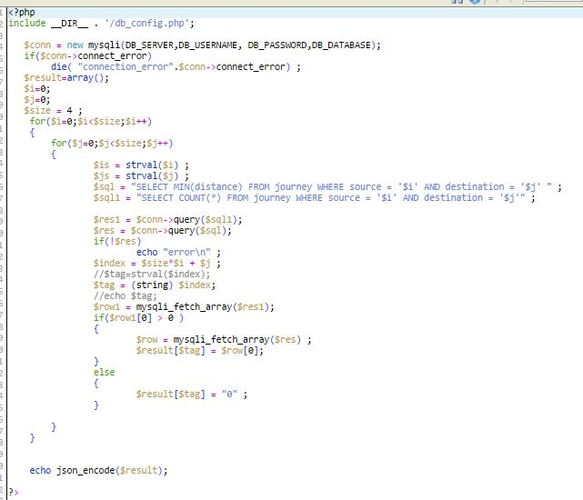
SERVER SIDE CODE : Fetching the Graph

Slide 17
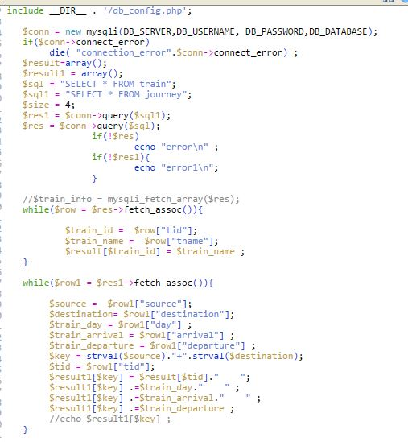
SERVER SIDE CODE:Fetching The Train Information.

Slide 18
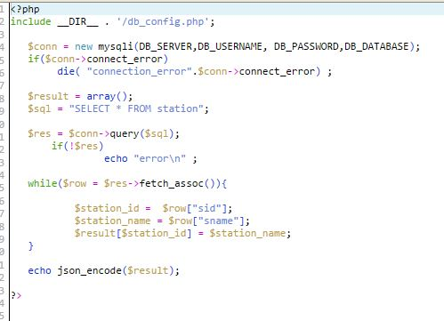
SERVER SIDE CODE:Fetching Station Information.

