Slide 1
HRM Process With AI

Slide 2
There are 9 section in this HRM process with AI
AI in Recruitment
Resume Parsing
Attendance & Leave
Chatbots
Performance Analytics
Payroll Automation
Employee Engagement
AI Tools in HR
Benefits & Challenges

Slide 3

01. AI-based Recruitment & Screening
AI scans resumes automatically
Matches skills with job description
Ranks candidates
Example:
Companies use AI to filter 1000 resumes → top 50 candidates

Slide 4
Tools used in AI based Screening
Hire Vue
ML models classify candidates based on skills, experience, keywords

Slide 5
HireVue
Hire Vue is an AI-powered video interviewing and candidate assessment platform.
Candidate records answers via video
AI analyzes:
Speech(tone,clarity)
Language (communication)
Genrate Candidate Score

Slide 6
02. Resume Parsing & Shortlisting
AI extracts:
Name
Skills
Experience
Converts resume → structured data
Tech:
NLP (Natural Language Processing)
Tools:
R Chilli
Hire Ability

Slide 7
What is RChilli?
RChilli is an AI-powered platform that helps companies extract and organize data from resumes (CVs) into a structured format.

Slide 8
Why is it needed?
Resumes come in different formats (PDF, Word, etc.), and:
HR cannot manually read thousands of resumes
Data is unstructured (different layouts, styles)
RChilli solves this by automatically extracting:
Name
Skills
Experience
Education
Contact details

Slide 9
Key Features
Resume Parsing
Extract important information from resume.
Convert into structured JSON/XML format.
Skill Extraction & Matching
Identify Skills(Python, SQL etc.)
Matches candidate with job requirements.

Slide 10
Data Standardization
Cleans and formats data
Example: “ B.Tech”, “Bachelor of Technology” → standardized
Multilingual Support
Parses resumes in multiple languages

Slide 11
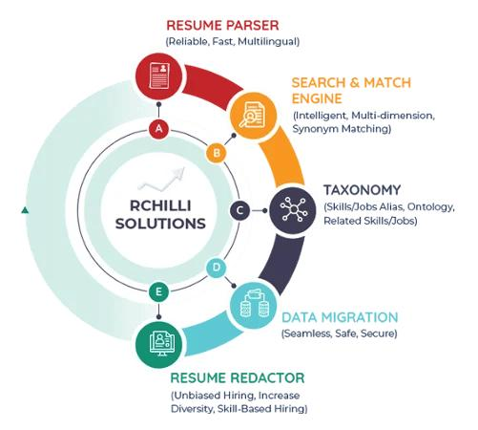
Rchilli

Slide 12
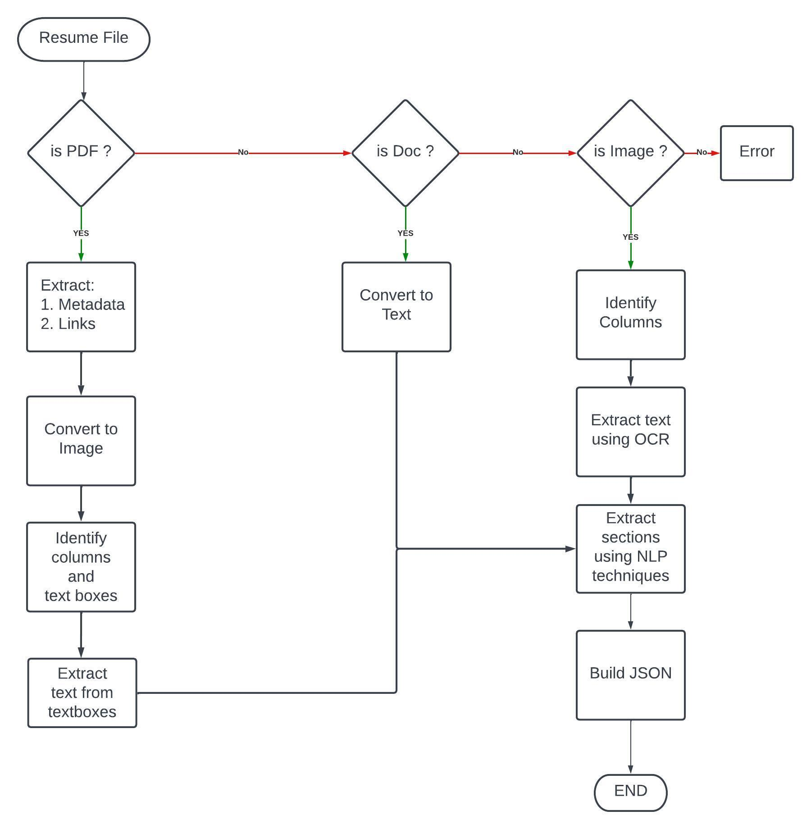
Resume Parsing Flow Chart

Slide 13
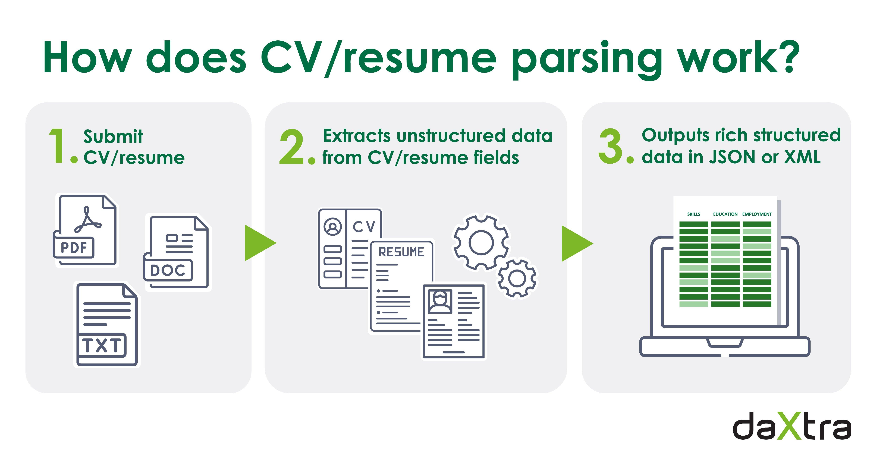
Example

Slide 14
03. Attendance & Leave Management
Face recognition / biometric systems
Auto leave approval using rules
Tech:
Computer Vision
Example:
Employee face → marked present automatically

Slide 15
Face Detection Models
Haar Cascade(opencv)
YOLO (you look only once)
MTCNN(More accurate)
Retina Face (High Accuracy)

Slide 16
Face Recognition Models
Face Net
VGG-Face
Deep Face
ARC Face

Slide 17
04. AI Chatbots for Employee Support
We can build Chatbot for answering the queries like:
Leave policy
Salary queries
Holidays
Tools:
Leena AI
Paradox Olivia
Lang Chain
Example:
“How many leaves left?” → bot replies instantly

Slide 18
What is an AI Chatbot?
An AI Chatbot is a software system that uses Artificial Intelligence (AI) to interact with employees or candidates through text or voice.
It acts like a virtual HR assistant that can answer questions, automate tasks, and assist employees 24/7.

Slide 19
Why AI Chatbots in HRM?
Traditional HR teams handle many repetitive queries like:
“What is my leave balance?”
“When will salary be credited?”
“How to apply for leave?”
Chatbots automate all this → saving time & effort.

Slide 20
Key Functions of HR Chatbots
Employee Support
Answer the employee queries.
Provide leave balance, policies, salary details
Attendance & Leave Management
Apply leave via chat
Check attendance status
Feedback Collection
Collect employee feedback
Run surveys automatically

Slide 21
Technologies Behind AI Chatbots
NLP (Natural Language Processing)
Understand human language
Example: “I want leave tomorrow”
Machine Learning
Improves responses over time
Learns from previous conversations
LLMs / Transformers
Models like GPT for intelligent conversation
Context-aware replies

Slide 22
Real-World Example
Employee: “How many leaves do I have?” Chatbot: “You have 5 remaining leaves this month.”

Slide 23
05. Performance Tracking & Analytics
AI analyzes:
Productivity
Work patterns
Predicts:
Promotions
Tech:
Machine Learning + Data Analytics

Slide 24
What is Performance Tracking?
Performance tracking is the process of monitoring and evaluating employee work, productivity, and behavior over time using data.
It answers:
How well is an employee performing?
Are goals being achieved?
Who needs improvement or promotion?

Slide 25
What is HR Analytics?
HR Analytics means using data, statistics, and machine learning to analyze employee performance and make data-driven decisions.\

Slide 26
Key Components
1. KPI (Key Performance Indicators)
Sales targets
Task completion rate
Attendance & punctuality
Quality of work
Example: Sales employee target = ₹1 lakh/month
2. Continuous Monitoring
Daily/weekly performance tracking
Real-time dashboards
Automated reports

Slide 27
3. Performance Reviews
Quarterly / annual reviews
360-degree feedback (manager + peers)
Self-assessment

Slide 28
Technologies Used
Machine Learning Models
Attrition prediction → Logistic Regression, Random Forest
NLP (Natural Language Processing)
Analyze employee feedback & sentiment
Dashboards & BI Tools
Power BI, Tableau
Cloud Platforms
Store employee data securely

Slide 29
Real-World Use Cases
Employee Performance Evaluation
Identify top performers
Detect underperformers
Promotion & Salary Decisions
Data-based promotions instead of bias
Attrition Prediction
Predict which employees may leave
Workforce Planning
Decide hiring needs based on performance trends

Slide 30
06. Payroll and HR Operations Automation
Payroll and HR Operations Automation means using software and AI tools to automatically handle HR tasks like:
Salary calculation
Attendance tracking
Leave management
Tax deductions
Employee records
Instead of manual work (Excel/paper), everything is handled by systems.

Slide 31
Key Components
1. Payroll Automation
Automatic salary calculation
Tax (TDS/PF/ESI) deduction
Payslip generation
Direct bank transfer
Example: If an employee works 26 days → system calculates salary automatically

Slide 32
2. HR Operations Automation
Attendance tracking (biometric/face recognition)
Leave approval workflows
Employee onboarding/offboarding
Performance tracking

Slide 33
Technologies Used
Machine Learning → Predict attrition, salary trends
Computer Vision → Face recognition attendance
NLP → HR chatbots
Cloud Computing → Store & manage employee data

Slide 34
07. Employee Engagement & Feedback
AI analyzes feedback using sentiment analysis
Detects unhappy and happy employees
Tech:
NLP + Sentiment Analysis

Slide 35
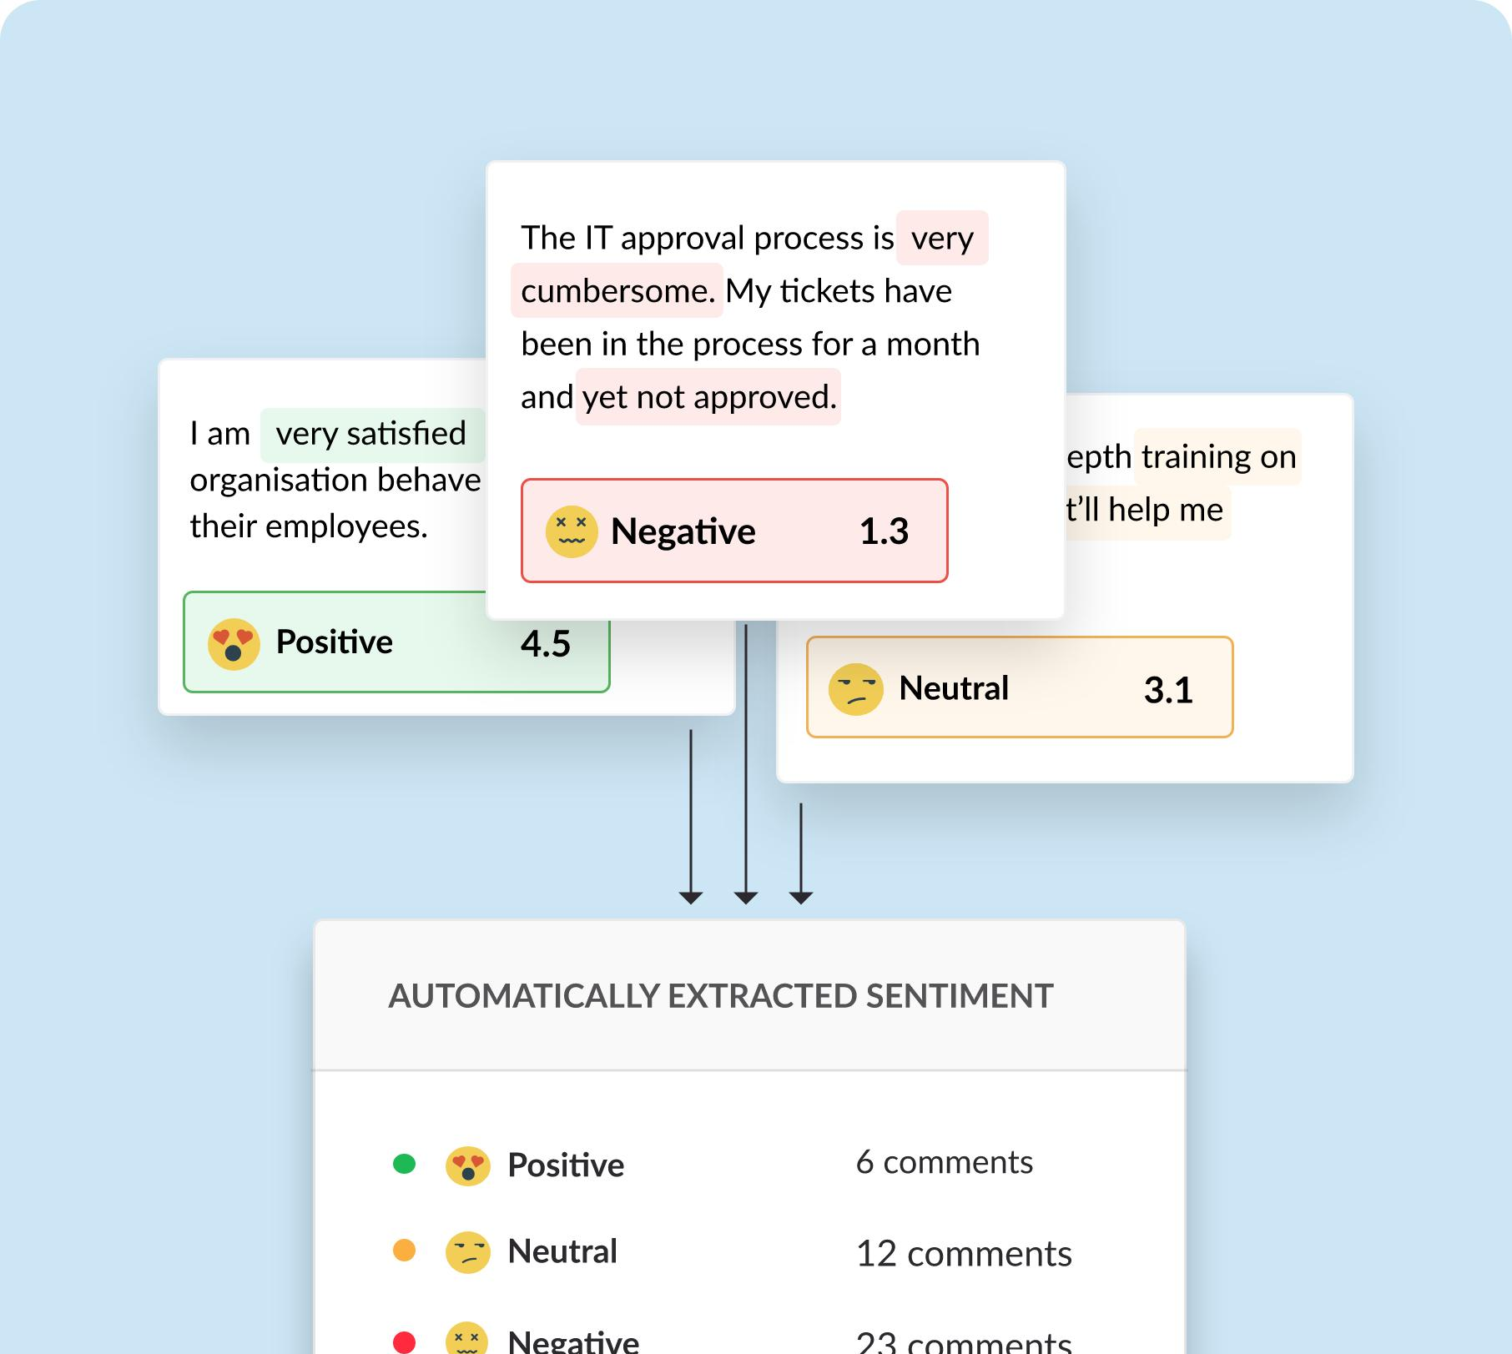
Example of Employee Engagement & Feedback

Slide 36
08. AI Tools Used in HRM
Workday
SAP SuccessFactors
Zoho People
BambooHR
Eightfold AI
Example
Used by companies for automation and analytics

Slide 37
Workday
What it is: A cloud-based ERP (Enterprise Resource Planning) system focused on HR, finance, and planning.
Key features:
Human Capital Management (HCM)
Payroll & workforce planning
Analytics & reporting
Talent management
Why companies use it: It provides real-time data insights and is widely used by large enterprises.

Slide 38
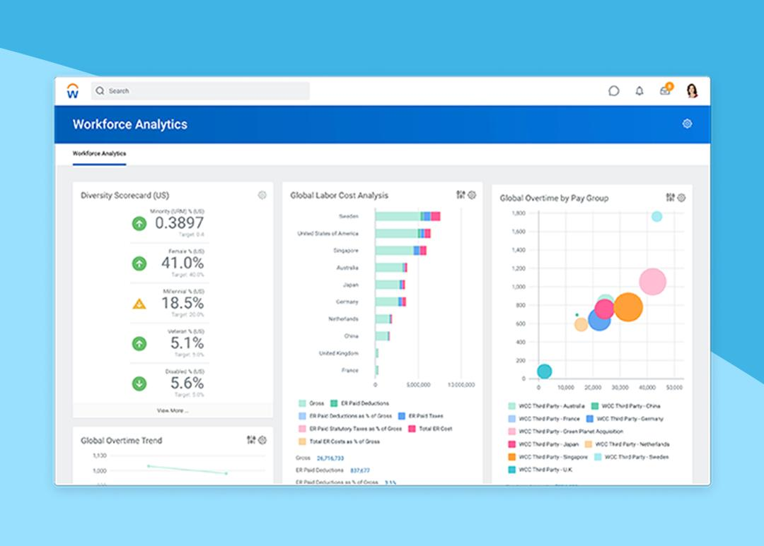
UI Of Workday

Slide 39
SAP SuccessFactors
What it is: A cloud-based HR software by SAP that manages the entire employee lifecycle.
Key features:
Recruitment & onboarding
Performance management
Learning & development
Employee experience tools
Why companies use it: Best for large organizations needing end-to-end HR solutions.

Slide 40
Zoho People
What it is: A lightweight HRMS (Human Resource Management System) designed for small to mid-sized businesses.
Key features:
Attendance & leave tracking
Employee database
Performance tracking
Integration with Zoho ecosystem
Why companies use it: Affordable and easy to use for startups.

Slide 41
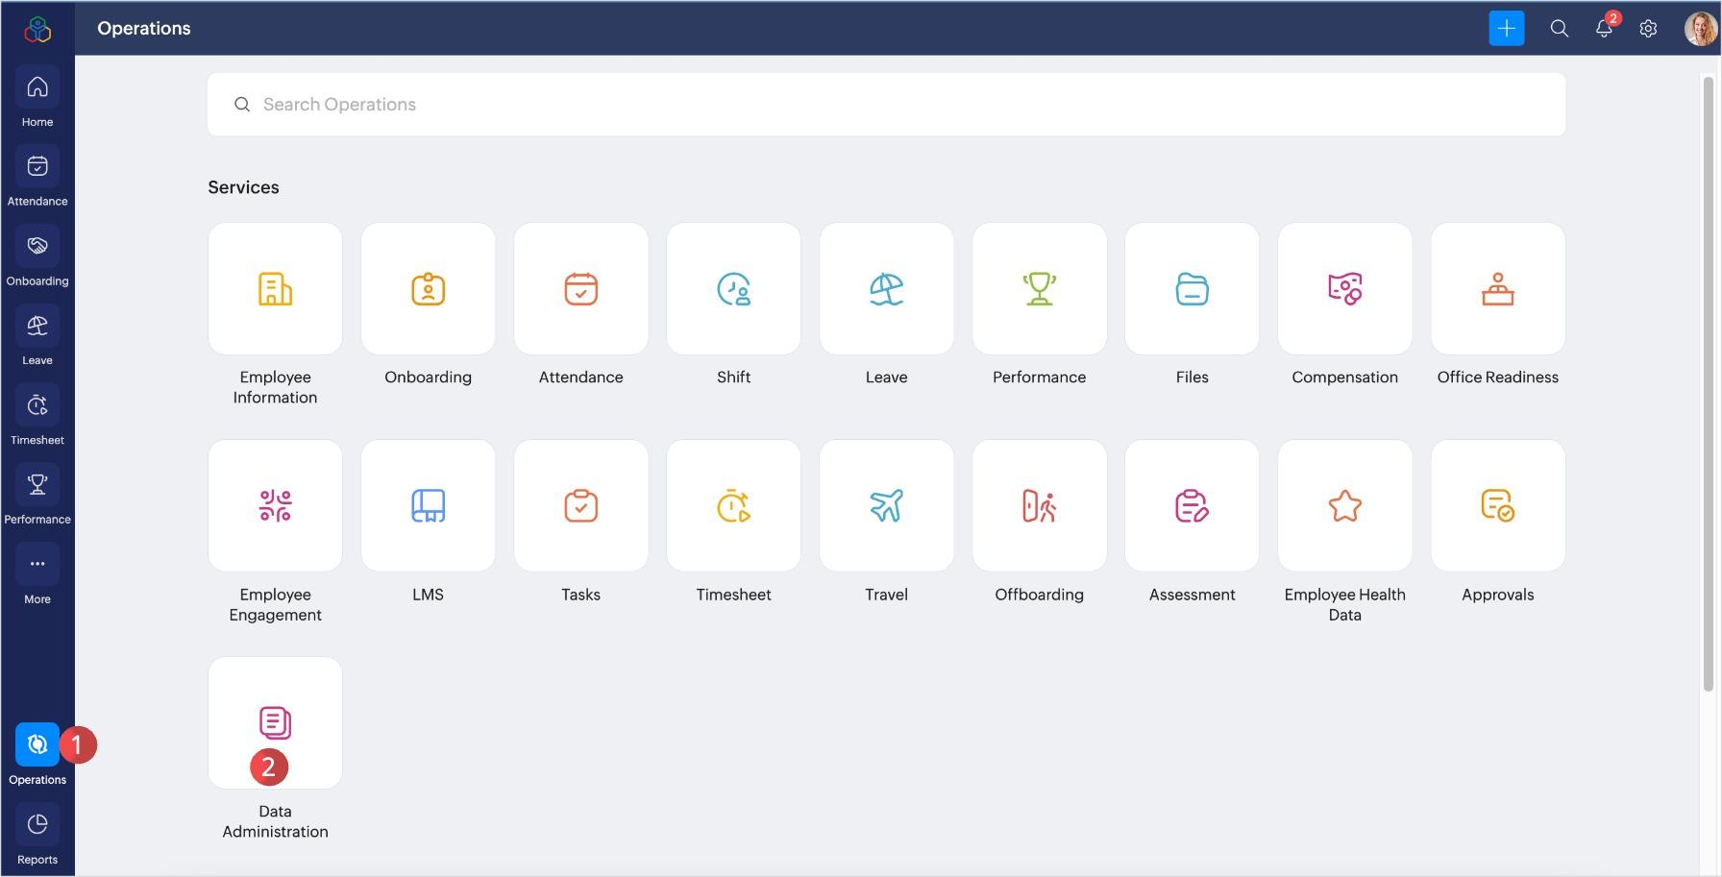
UI Of Zoho People

Slide 42
09. Benefits of AI in HRM
Saves Time
Faster Hiring
Reduce Human Error
Better Decision Making

Slide 43
Challenges of AI in HRM
Bais in AI Model
Data Privacy Issues
High implementation cost
Lack of Human touch

Slide 44
How AI Works in HRM
Resume Shortlisting -> Using NLP
Face Recognition -> CNN (attendance systems)
Chatbots ->Bulding chatbots using LLM and LangChain

Slide 45
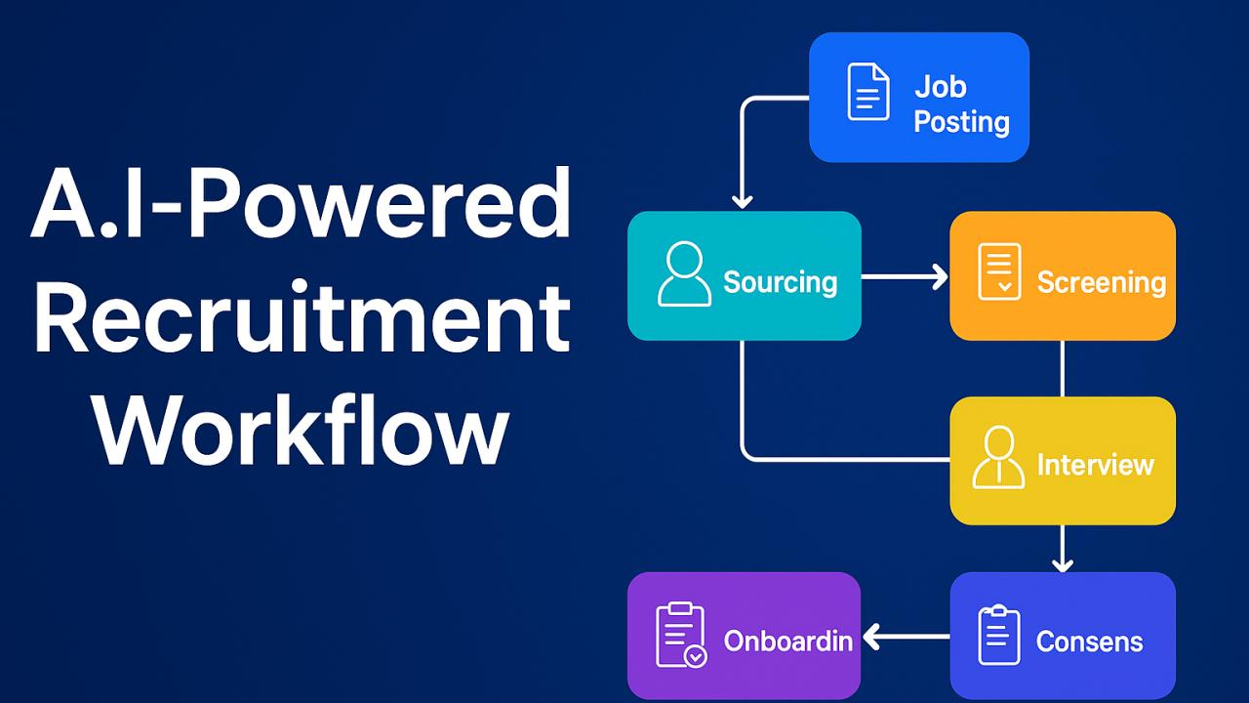
Workflow Diagram of Recruitment using AI

Slide 46
Use Cases Of HRM with AI
Resume shortlisting automation
Smart attendance system (using face recognition)
Chatbot HR and Employee queries
Employee attrition prediction

Slide 47
Conclusion
AI is transforming Human Resource Management by automating repetitive tasks and enabling data-driven decision making. From recruitment and resume parsing to attendance tracking and employee engagement, AI technologies like machine learning, NLP, and computer vision help organizations work faster, smarter, and more efficiently.
Tools such as RChilli and HireAbility automate candidate screening, while face recognition systems streamline attendance management. AI chatbots and analytics platforms further improve employee experience and organizational productivity.
Overall, AI reduces manual workload, minimizes errors, and improves hiring quality. However, challenges like data privacy, bias, and implementation cost must be carefully managed.

