Slide 1
Cost Model for Pregel in GraphX
Rohit Kumar, Alberto Abello, Toon Calders
26-09-2017

Slide 2
Outline
Quick Background
Pregel Model
Graph Partitioning
Spark GraphX
Cost Model for Pregel on GraphX
Experimental results
Current and future work

Slide 3
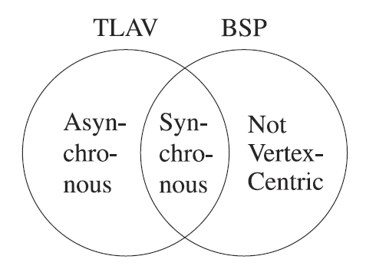
Pregel Model
The Pregel Programing model is inspired by Valiant’s Bulk Synchronous Parallel(BSP) model and is one of the popular models in Think like a vertex (TLAV) paradigm.

Slide 4
Pregel Model
Active Vertex
Non-Active Vertex
Message
Task 1
Task 6
Task 2
Task 4
Task 7
Task 3
Task 5
Task 8
Barrier 1
Barrier 2
Barrier 3
Barrier 4
Super Step 1
Super Step 2
Super Step 3
Super Step 4
Time
The total run time of the algorithm will depend highly on partitioning.

Slide 5
Graph Partitioning
Two main goals of partitioning
Minimize replication/communication cost
Balance load across partitions
How to evaluate different partitioning algorithms?
How well they meet the goals
Time and memory complexity of the algorithm

Slide 6
Graph Partitioning
Two approaches:
P1
P2
P1
P2
a
d
a
d
d
b
b
b
c
e
c
e
e
Edge-cut partitioning
P1
P2
P1
P2
a
d
a
d
b
b
b
c
e
c
e
Vertex-cut partitioning

Slide 7
Graph partitioning in GraphX
Spark GraphX uses vertex cut partitioning strategy:
RandomVertexCut
CanonicalRandomVertexCut (CRVC)
EdgePartition1D
EdgePartition2D
Degree Based Hashing(DBH)(implemented by us for GraphX)

Slide 8
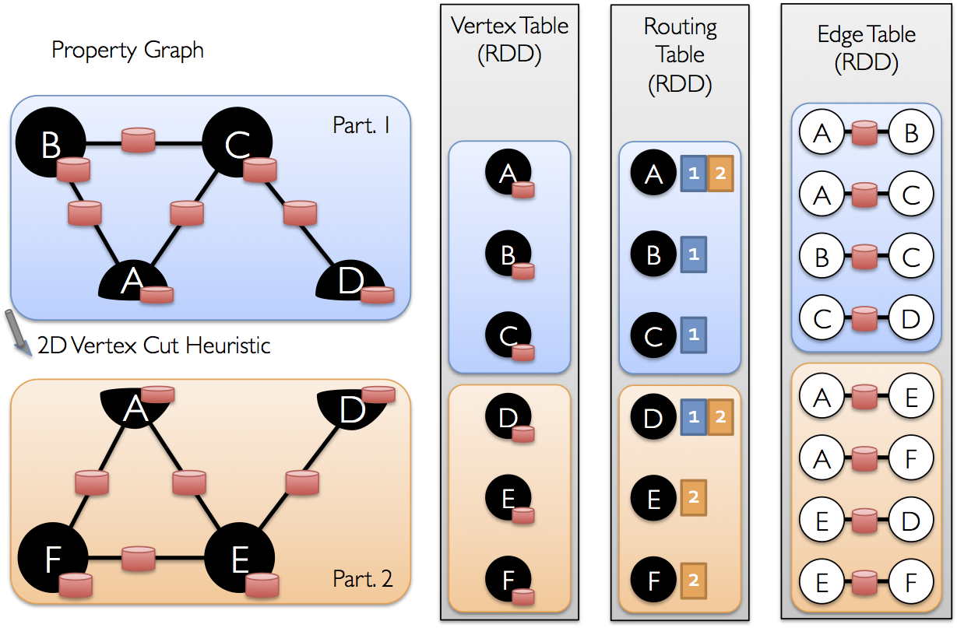
Graph Representation in GraphX
http://note.yuhc.me/2015/03/graphx-partition-strategy/

Slide 9
Pregel API in GraphX
Def pregel(initialMsg, maxIterations, activeDirection)
(vprog, sendMsg, mergeMsg)
vprog:
Vertex Program to run on every active vertex
sendMsg:
Program to run on edges incident on active vertices after Vprog
mergeMsg:
Program to merge all messages generated by sendMsg meant for one vertex for next superstep

Slide 10
Example Connected Component
def vProg(id: VertexId, attr: double, msg:double ) = {
math.min(attr, msg)
}
def sendMsg(edge: EdgeTriplet) = {
if (edge.srcAttr < edge.dstAttr) {
Iterator((edge.dstId, edge.srcAttr))
} else if (edge.srcAttr > edge.dstAttr) {
Iterator((edge.srcId, edge.dstAttr))
} else {
Iterator.empty
}
}
def mergeMsg(a: Double, b: Double): Double = math.min(a, b)

Slide 11
Pregel Model in GraphX
mapVertices
mapReduceTriplets
VertexRDD
EdgeTrippletRDD
MessageRDD
a_{msg}
a
a
b
b_{msg}
b_{msg}
b
c
c_{msg}
b_{msg}
b_{msg}
b
c
b
b_{msg}
d_{msg}
d
b_{msg}
c
d
c_{msg}
c
d
a
f_{msg}
f
a
e
e_{msg}
c_{msg}
e_{msg}
e
f
b
b_{msg}
e_{msg}
d
b
Messages for next super Step to required partitions

Slide 12
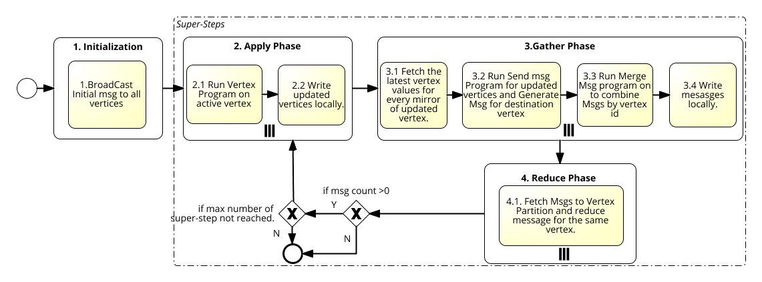
BPMN for Pregel

Slide 13
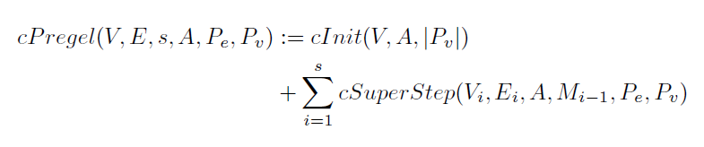
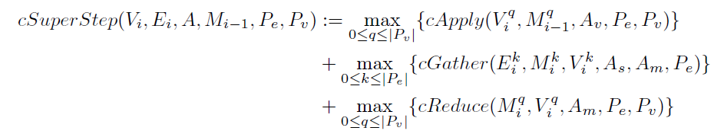
Cost Model

Slide 14
Cost per partition
cApply = cost of running vertex Program on active vertex
+ β_{w} Data written on disk + α₁
cGather = β_{r} read data from previous step
+ cost of running sendMsg Program on active edges
+ cost of merging all messages locally
+ β_{w} Data written on disk + α₂
cReduce = γ reading all messages
+ cost to merge all messages for one vertex + α₃

Slide 15
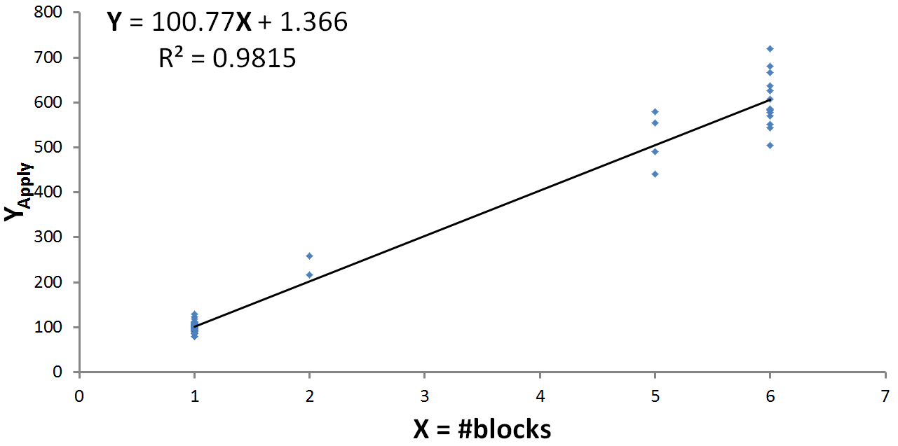
Estimating the constants
cApply = cost of running vertex Program on active vertex
+ β_{w} Data written on disk + α₁
Y = β_{w} X + α₁

Slide 16
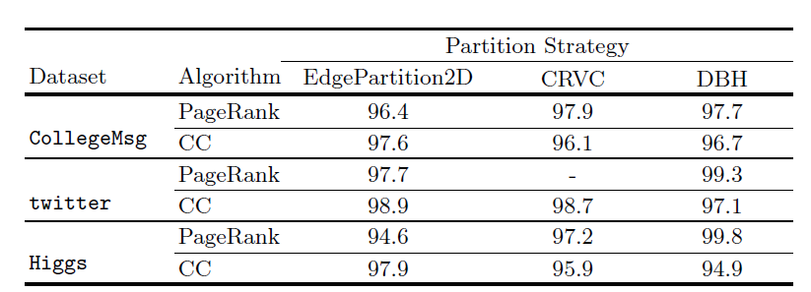
Validate cost model
Used Connected Component algorithm with CRVC partitioning on
Twitter Euro dataset to get the constants:
α₁ = 1.366 msec
α₂ = 43.214 msec
α₃ = 17.75 msec
β_{w} = 100.77 msec/Block
β_{r} = 0.012 msec/Byte
% Accuracy in estimating the run time using cost model
γ = 0.041 msec/record
Cost model is quite accurate!!

Slide 17

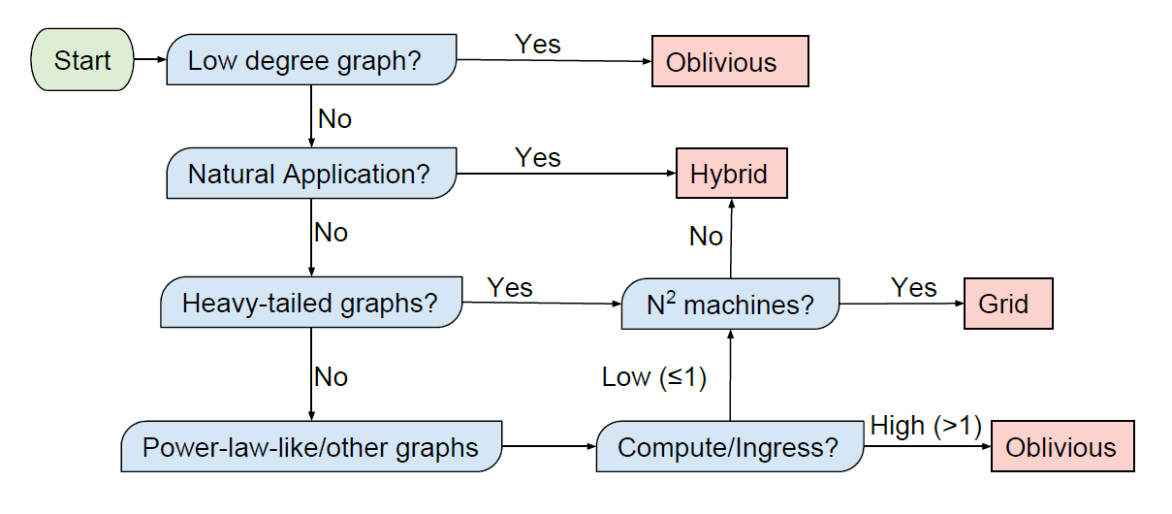
What’s Next
Verma et. al.(VLDB 2017) An experimental comparison of partitioning strategies in distributed graph processing.
Notes:
ADD VLDB paper as inspiration for rule explanation and mining.

Slide 18
Examine why a partitioning strategy is better
Algorithm dimensions
Communication pattern
Which of the three functions(vProg,mProg,sProg) are costly
Graph dimension
Degree distribution
System/Cluster dimension
Inter communication speed (artificially induced)

Slide 19
Example of rule
Graph Dimension
Low degree
Algorithm Dimension
High Communication (PageRank)
All function: same weight and is very fast
System Dimension
High speed communication
Result: DBH is better
Why:
- Writing messages in 2nd phase is cheap
- Merge messages in 3rd phase is very cheap
Insight: if sendMsg function takes more time compared to the other three functions CRVC will be better
Tested the hypothesis by artificially making sendMsg heavier.

Slide 20
Current work
Try more combinations for Graph and Algorithm to mine new rules
For time evolving graph auto change the graph partitioning strategy based on cost model
1. Use Rule based strategy to determine
Partitioning strategy.
Snapshot 1
Calculate repartition cost.(C_{R})
Estimate cost for new partitioner (C_{new})
Estimate cost using old partitioner. (C_{old})
Snapshot n
If(C_{new} - C_{old})> C_{R} + ε
Use New partitioning.

Slide 21
Take away message
There are many partitioning strategies
Picking best strategy is not trivial
Depends on Graph, algorithm and system configuration
Based on Cost model pick best strategy
Similar to cost based query optimization in RDBMS

Slide 22


The art and science of asking questions is the source of all knowledge
- Thomas Berger

Slide 23
Backup slides

Slide 24
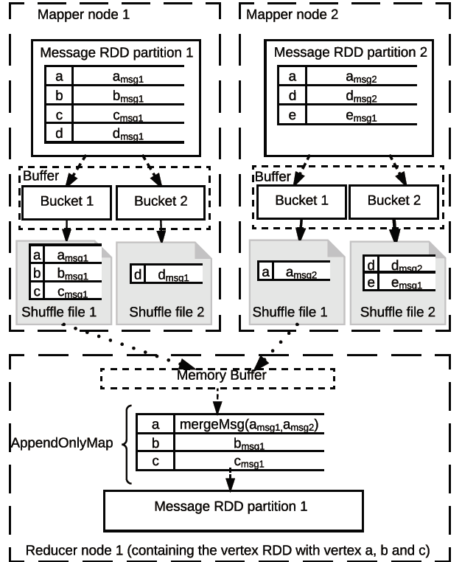
Data exchange between Gather and Reduce Phase
Multi row per file
With fixed row
Size.

Slide 25
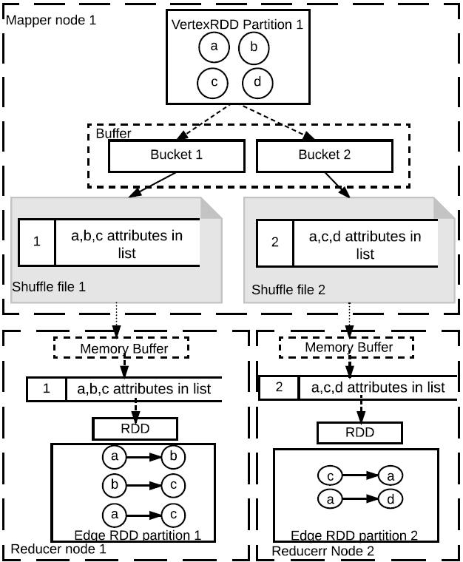
Data exchange between Apply and Gather Phase
One row per file
With variable row
Size.

Slide 26
Insight
Dominating Factor
System Configuration
Algorithm
Time
Graph Structure
Partitioning Strategy

