Slide 1
Finding simple temporal cycles in an interaction network
Rohit Kumar, Toon Calders
18-09-2017

Slide 2
Interaction Network/Graph
Interaction Network: sequence of timestamped interactions є over edges of a static graph G = (V,E).
For example
Social interaction in a social network;
Email/ Message or call interaction in a communication network;
Data exchange in a computer network;
Money transactions in a financial network.

Slide 3


Example
5
d
e
1
4
2
,7
a
8
3
, 6
b
c
(a , e,1)
(d, c, 2)
(b , c, 3)
(e , c, 4)
(a , d, 5)
(b , c, 6)
(d, c, 7)
(a , c, 8)
. . . .

Slide 4
Interaction network in a window
Window=4
d
e
1
4
2
a
3
b
c
Future Edges
(a , e,1)
(d, c, 2)
(b , c, 3)
(e , c, 4)
(a , d, 5)
(b , c, 6)
(d, c, 7)
(a , c, 8)
. . . .

Slide 5
Interaction network in a window
Window=4
5
d
e
4
2
a
3
b
c
(a , e,1)
(d, c, 2)
(b , c, 3)
(e , c, 4)
(a , d, 5)
(b , c, 6)
(d, c, 7)
(a , c, 8)
. . . .

Slide 6
Interaction network in a window
Window=4
5
d
e
4
2
a
3
, 6
b
c
(a , e,1)
(d, c, 2)
(b , c, 3)
(e , c, 4)
(a , d, 5)
(b , c, 6)
(d, c, 7)
(a , c, 8)
. . . .

Slide 7
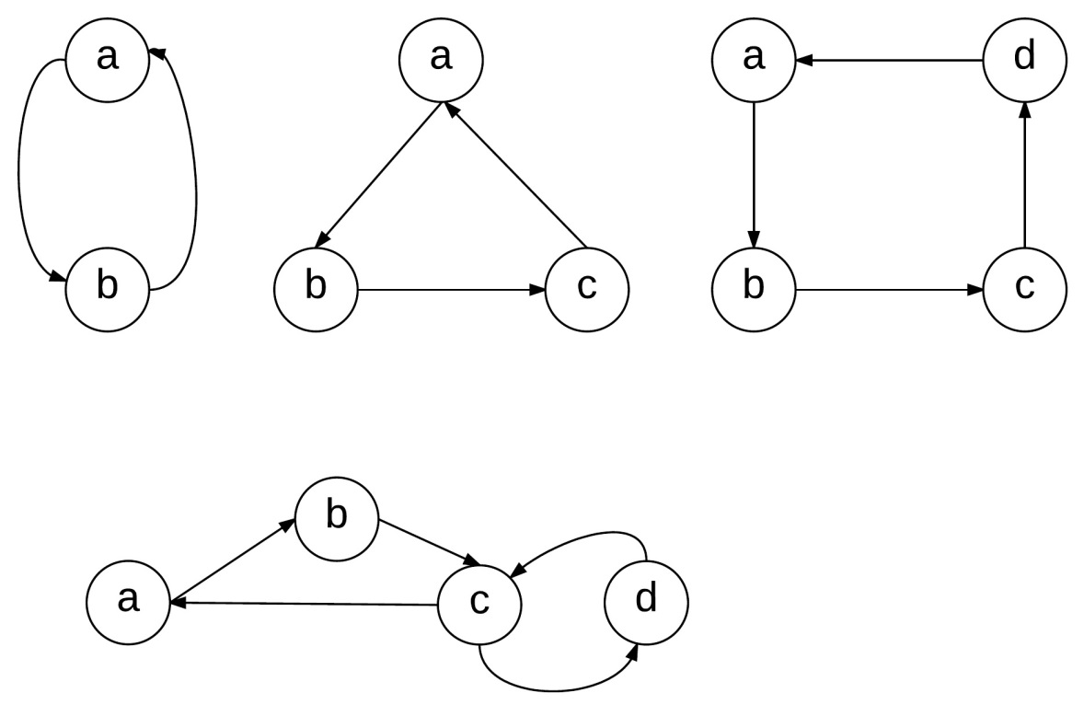
Simple Cycle
“A simple cycle is a closed path/walk with no repetitions of vertices or edges allowed, other than the repetition of starting and end vertex.”

Slide 8
Simple Temporal Cycle
5
d
e
1
4
Duration = t_{n}-t₁ = 8-5=3
2
,7
a
8
Length = #edges = 3
3
, 6
b
c
(a , d, 5) →(d, c, 7)→(c , a, 8)
(a , d, 5) →(d, c, 2)→(c , a, 8)

Slide 9
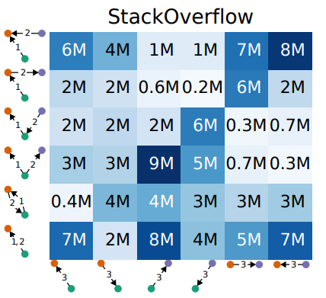
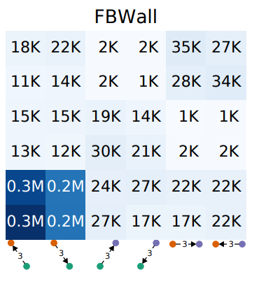
Motivation
Interaction networks: many interesting patterns.
Patterns capture differences in use of networks
Paranjape, A., Benson, A. R., & Leskovec, J. (2017). Motifs in temporal networks. In Proceedings of the Tenth ACM International Conference on Web Search and Data Mining (pp. 601-610). ACM.

Slide 10
Perspective
Simple Cycle in Retweet network
Discussion among peers
Group of fake account to promote advertisement messages.
Financial transaction network
Indicator for fraud or tax invasion.

Slide 11
What we want to study
The main focus of this study is, given an temporal network and a time window (w) :
Find all simple cycles in the time window.
Find most Frequent root nodes.
Using simple cycle length frequency distribution to categories the type of network.

Slide 12
Naïve algorithm
Window = 7 timestamps
a, b, 9
Step 1: Fetch all temporal path ending at “a”
c
f
b
c
3
2
5
1
d
b
d
d
4
3
6
4
e
d
e
e
6
5
7
6
a
a
a
a

Slide 13
Naïve algorithm
Window = 7 timestamps
a, b, 9
Step 2: Create new path by extending if possible
Report cycles if found.
c
c
f
b
b
c
a
3
3
2
5
5
1
9
d
d
b
d
d
d
b
4
4
3
6
6
4
e
e
d
e
e
e
6
6
5
7
7
6
a
a
a
a
a
a
9
9
b
b

Slide 14
Performance

Slide 15
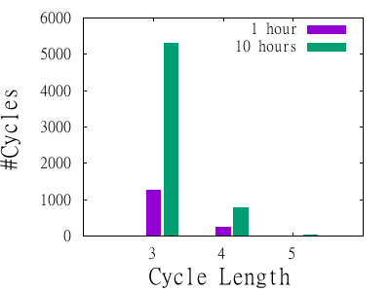
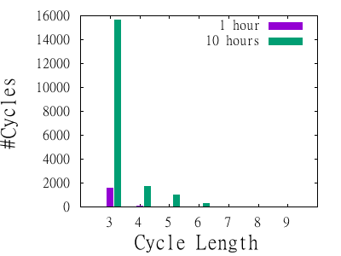
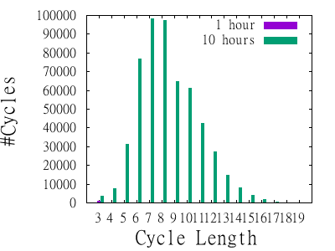
Cycle length Frequency Distribution
Facebook Chat
SMS Chat
Twitter retweet

Slide 16
Current work
Analyze the text of tweets/retweets in the temporal cycles
Most of them are advertisements and the users looked like fake accounts used to promote message on social network.
Smart algorithm using 2 or 3 pass over the data.
1st Pass: get all the root nodes and edges which might be part of a cycle.
2nd Pass: running smart DFS using the information gained in first pass.
Using cycle length distribution to categories temporal network.

Slide 17


The art and science of asking questions is the source of all knowledge
- Thomas Berger

