Slide 1
Information Propagation in Interaction Networks
Rohit Kumar, Toon Calders

Slide 2
Interaction Network/Graph
Interaction Network: sequence of timestamped interactions є over edges of a static graph G = (V,E).
For example
Social interaction in a social network;
Email/ Message or call interaction in a communication network;
Data exchange in a computer network;
Money transactions in a financial network.

Slide 3


Example
5
d
e
1
4
2
,7
a
7
3
, 6
b
c
1, (a , e)
2, (d, c)
3, (b , c)
4, (e , c)
5, (a , d)
6, (b , c)
7, (c, a)
7, (d , c)
. . . .
Notes:
Layout: spacing of list of interactions at thee bottom could Be improved

Slide 4
What we want to study!
Given a set of initial users and a time window identify the number of users who will get influenced. (Influence oracle problem)
Find top k influential users in the given interaction network under a time constrained information propagation. (Influence Maximization Problem)

Slide 5
Previous approaches
Model-based, assuming a static network:
Use probabilistic models to find influence set of a node in the network.
Are usually multi-pass and do not scale to large networks.
Exception: SKIM by Cohen et al [2014] (Sketch based but does not consider time window concept).
Data-based models
Multi pass and do not scale to large networks.
Do not consider time window.
Exception: ConTinEst by Du N et.al [2013] (needs nodes infection time along with interaction network)

Slide 6
Our Contribution
IRS Algorithm
A model-independent data-driven approach.
One pass.
Only needs interaction network data.
Considers time-constrained influence spread.

Slide 7
Information Channel
Information Channel (ic(u,v)) between nodes u and v: path of time increasing interactions (t_{1 ,}u, n₁) (t_{2,}n₁, n₂)..(t_{k,}n_{k}, v)
i.e.; t₁ < t₂ < .. < t_{k}
Duration of information channel ic:
dur(ic(u,v))= (t_{k} − t₁ + 1)
IC(u,v) = set of all ic(u,v)

Slide 8
Influence reachability Set (σ)
Reachability set σ (u) of node u in network G(V,E) : the set of all the nodes to which u has an information channel; i.e.,
σ (u) = {v ∈ V | IC(u, v) ≠ ∅ }
The influence set for a given time window length ω :
σ_{ω} (u) = {v ∈ V | ∃ ic ∈ IC(u, v) : dur(ic) < ω }

Slide 9
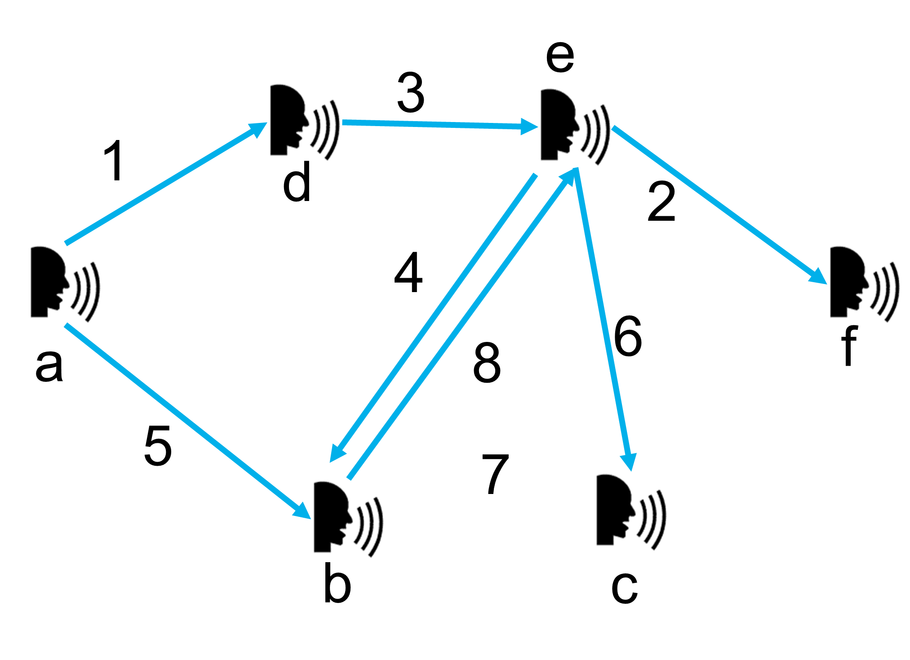

Example
ω = 3
Not time increasing
Duration greater then ω
σ(a) =
d
,e
,c
,b
σ(b) = e,c
σ(e) = b,c,f

Slide 10

Forward approach
d
e
3
Too many random access
And back tracking!!
1
2
f
4
a
b
c
S(a) =
d,1
e,1
b,1
S(b) =
S(c) =
S(d) =
e,3
b,3
S(e) =
f,2
b,4

Slide 11
Process backward
e
ω = 3
3
1
2
d
f
6
4
7
a
5
8
b
c
S(a) =
b,5
e,6
c,7
d,1
e,3
b,4
σ(a) = b,e,c,d
σ(b) = e,c
σ(c) =
σ(d) = e,b
σ(e) = b,c,f
σ(f) =
S(b) =
c,8
e,6
c,7
S(c) =
S(d) =
e,3
b,4
S(e) =
c,7
b,4
f,2
S(f) =

Slide 12
Algorithm
One pass algorithm!
S(u) = {(v, ʎ(u, v)) }
1, (a,d)
2, (e,f )
3, (d,e)
4, (e,b)
5, (a,b)
6, (b,e)
7, (e,c)
8, (b,c)
ʎ(u, v) is defined as the end time of the earliest information
channel of length ω or less from u to v.
For an entry t,u,v:
Add (S(u) , (v, t))
S(u)=Merge(S(u),S(v))
Merge:
For All (x, t’ ) ∈ S (v)
If (t – t’ ) < ω
Add (S(u), (x, t’ ))

Slide 13
Complexity Analysis
n nodes and m interactions
Time Complexity :
О (mn)
Memory Complexity:
О (n²)
Approximate the cardinality of the summary sets S(u)!
Still Too High!!

Slide 14
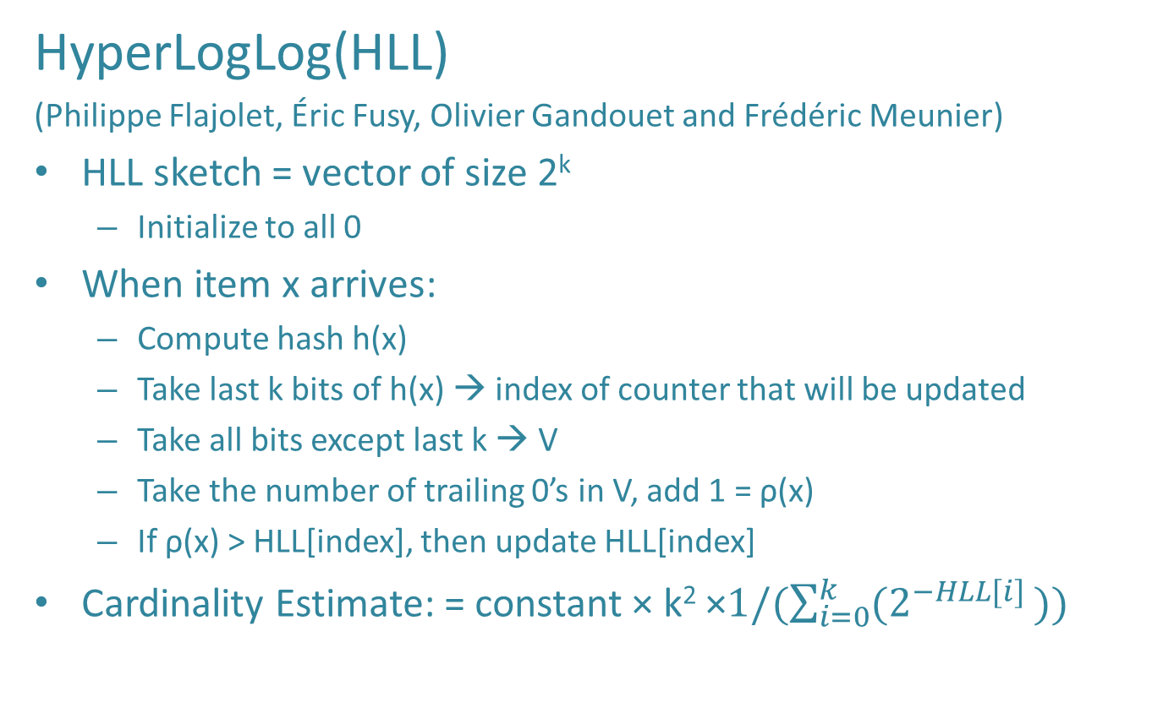
Approx Set
HyperLogLog(HLL)
(Philippe Flajolet, Éric Fusy, Olivier Gandouet and Frédéric Meunier)
HLL sketch = vector of size 2^{k}
Initialize to all 0
When item x arrives:
Compute hash h(x)
Take last k bits of h(x) → index of counter that will be updated
Take all bits except last k → V
Take the number of trailing 0’s in V, add 1 = ρ(x)
If ρ(x) > HLL[index], then update HLL[index]
Cardinality Estimate: = constant × k² ×$1/(\sum_{i=0}^{k}{(2^{−HLL[i] }))}$
Error : ~ 1.04 / √ k
Notes:
based on principle that having z trailing zeros has a probability of 2^{z+1} as estimate )

Slide 15
One Catch!
How to support merge in a window:
Merge:
For All (x, t’ ) ∈ S (v)
If (t – t’ ) < ω
Add (S(u), (x, t’ ))

Slide 16
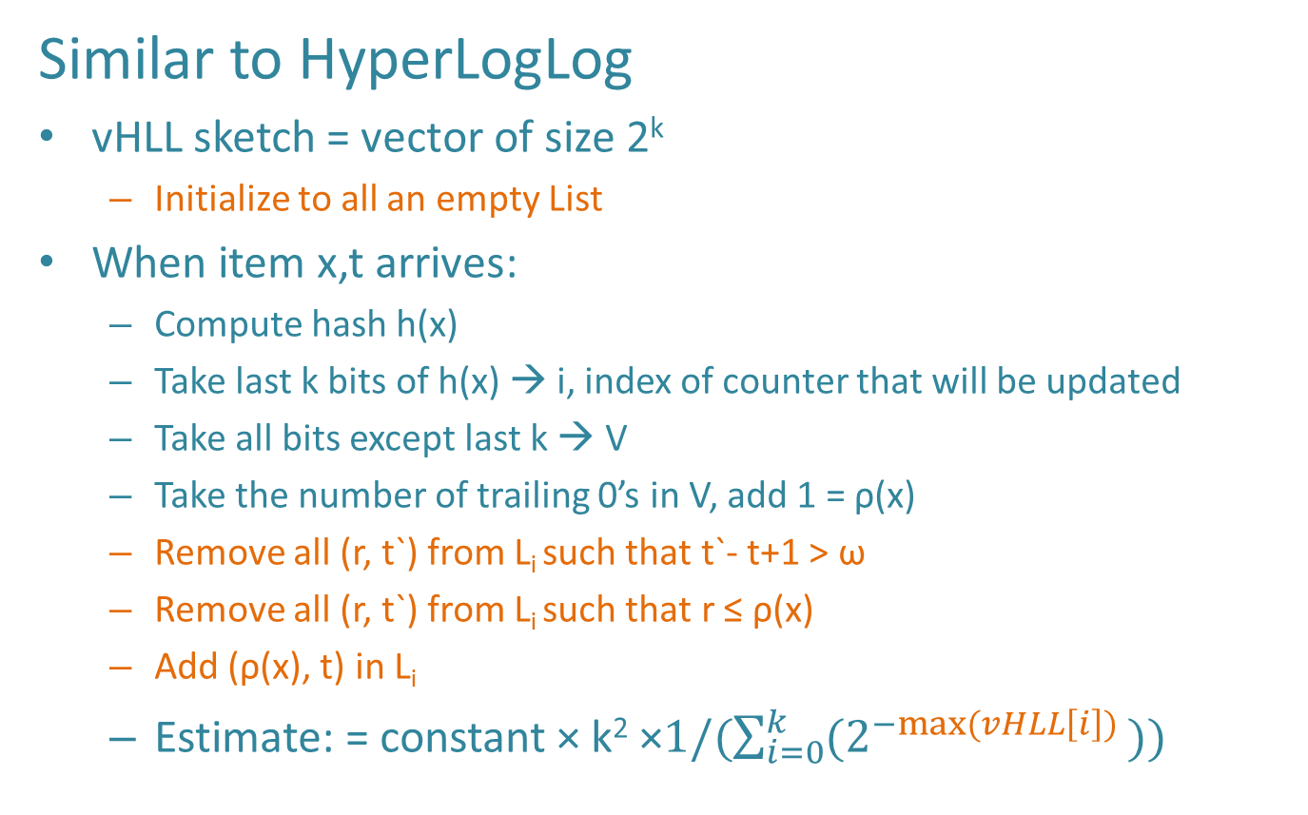
Versioned HLL
Similar to HyperLogLog
vHLL sketch = vector of size 2^{k}
Initialize to all an empty List
When item x,t arrives:
Compute hash h(x)
Take last k bits of h(x) → i, index of counter that will be updated
Take all bits except last k → V
Take the number of trailing 0’s in V, add 1 = ρ(x)
Remove all (r, t`) from L_{i} such that t`- t+1 > ω
Remove all (r, t`) from L_{i} such that r ≤ ρ(x)
Add (ρ(x), t) in L_{i}
Estimate: = constant × k² ×$1/(\sum_{i=0}^{k}{(2^{−max⁡(vHLL\left[i\right]) }))}$
Notes:
The rationale behind the update procedure is as follows: at any point in time t we need to be able to estimate the number of elements x that arrived within the time interval (t,t+w-1) .Therefore it is essential to know the maximal rho(x) of all x that arrived within this interval. We keep those pairs (r,t) in L_i such that r may, at some point, become the maximal value as we shift the window further back in time. It is easy to see that any pair (r,t) such that r <= rho(x) for a newly arrived x at t will always be dominated by (rho(x),t). On the other hand, if rho(x)<r we still do have to store (rho(x),t) as (r,t) will leave the window before (rho(x),t) will.

Slide 17
Complexity Analysis
n nodes and m interactions
Time Complexity :
О (mn)
Memory Complexity:
О (n²)
After Approximate the summary set φ
Time Complexity : О (m2^{k}log(ω)²)
Memory Complexity: О (n2^{k}log(ω)²)
k=6 , ω<<n

Slide 18
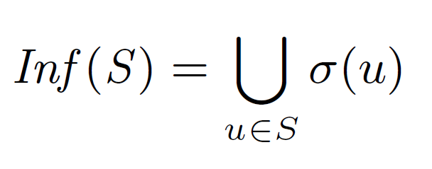
Influence Maximization
Find top k nodes such that the combined influence is maximum for a given ω.
The Influence function is Monotone and submodular, hence a greedy approach gives a good guarantee.

Slide 19
Efficiency Results
45 Million interactions in ~9 min in this laptop!!

Slide 20
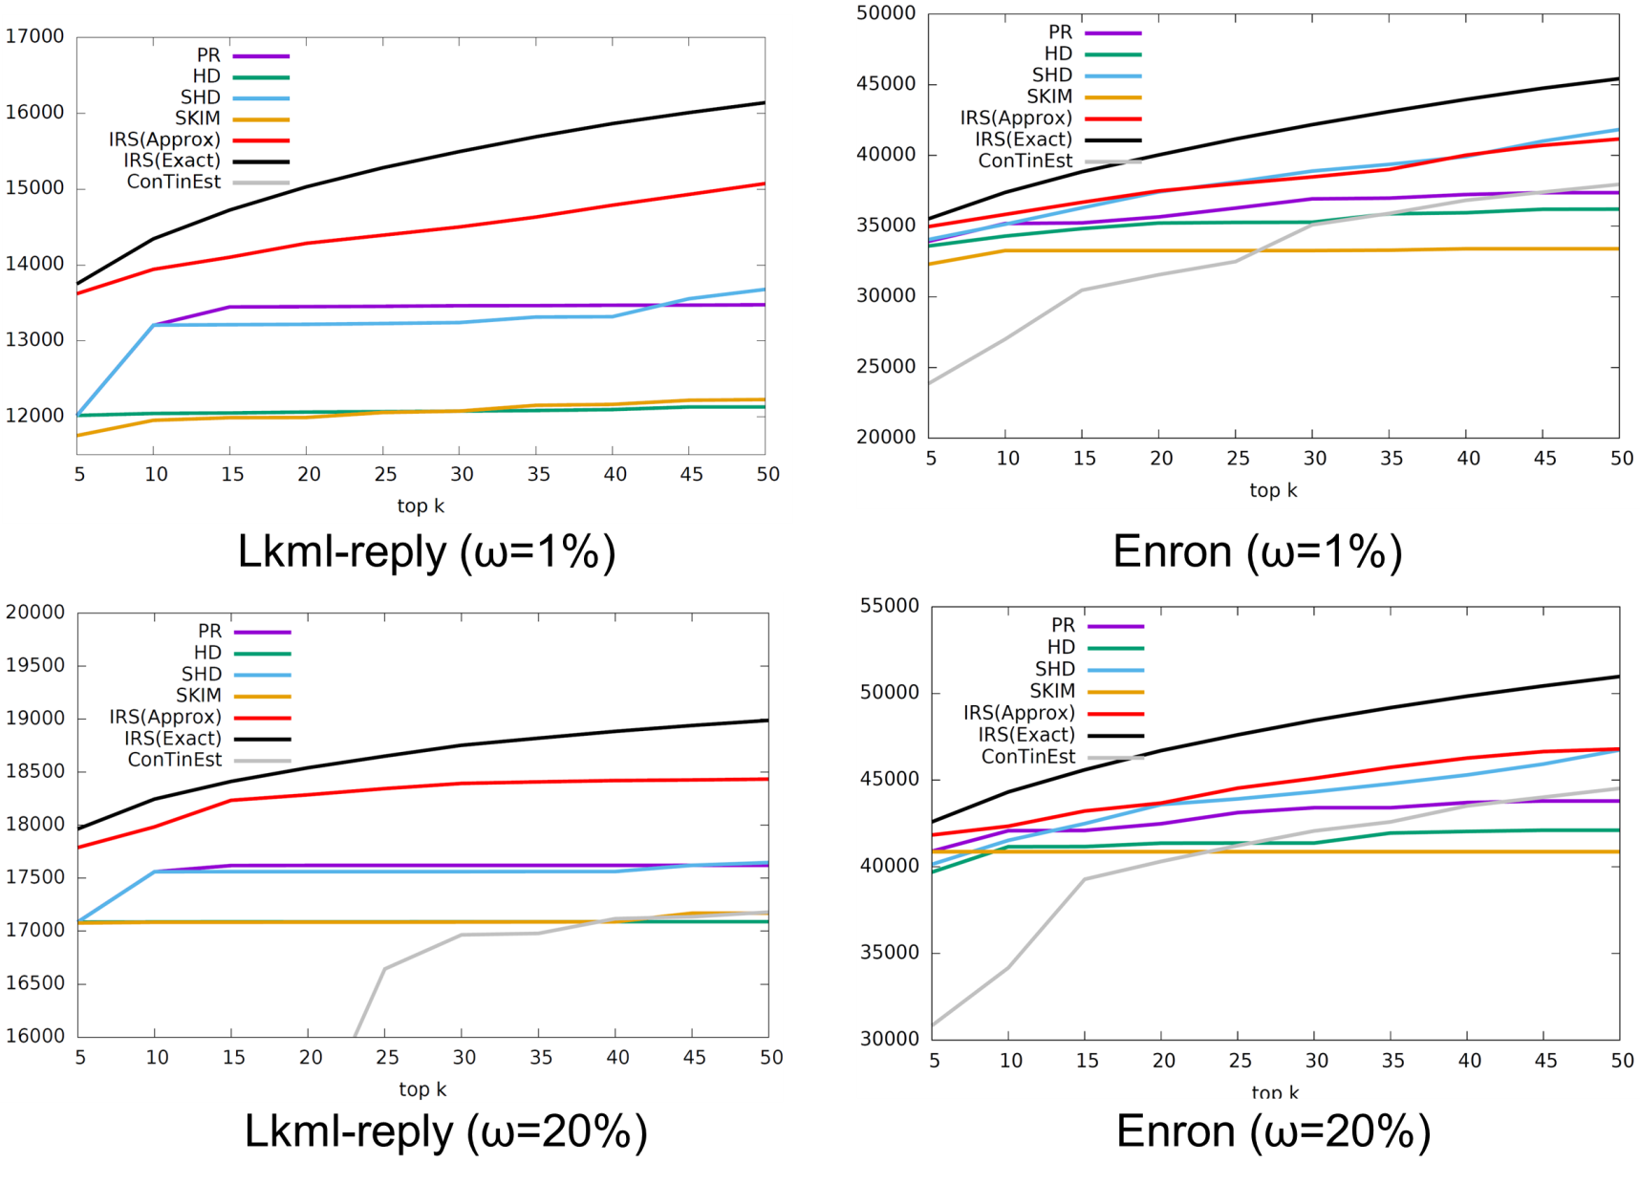
Effectiveness Results

Slide 21
Conclusion
Smaller window lengths have higher impact on information propagation in the network.
IRS offers an efficient model-independent approach to influence maximization using only the interactions.

Slide 22
Thank You

Slide 23
Additional slides

Slide 24
Versioned HLL
k=3
5,t₁
3,t₂
1,t₂
3,t₃
4,t₅
2,t₁
2,t₃
…
…
…
…
11100010 , t₁
→ i=2, ρ=2
Notes:
The rationale behind the update procedure is as follows: at any point in time t we need to be able to estimate the number of elements x that arrived within the time interval (t,t+w-1) .Therefore it is essential to know the maximal rho(x) of all x that arrived within this interval. We keep those pairs (r,t) in L_i such that r may, at some point, become the maximal value as we shift the window further back in time. It is easy to see that any pair (r,t) such that r <= rho(x) for a newly arrived x at t will always be dominated by (rho(x),t). On the other hand, if rho(x)<r we still do have to store (rho(x),t) as (r,t) will leave the window before (rho(x),t) will.

Slide 25
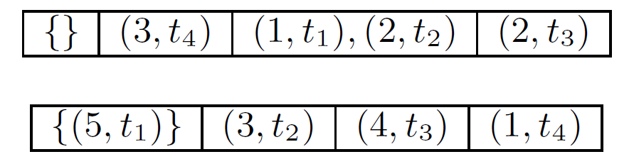
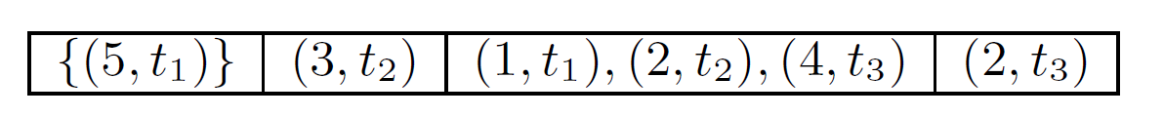
vHLL union
For each cell i , take the union of the respective lists L_{i} and L`_{i} and remove all pairs (r,t) in the result that are dominated by a pair (r`,t`) that came from the other list with t` < t and r`≥ r.
Notes:
If the lists are stored in order of time, this merge operation can be executed in time linear in the length of the lists.

