Slide 1



2SCENT: An Efficient Algorithm for Enumerating All Simple Temporal Cycles
Toon Calders – UAntwerpen
Joint work with Rohit Kumar (ULB)

Slide 2
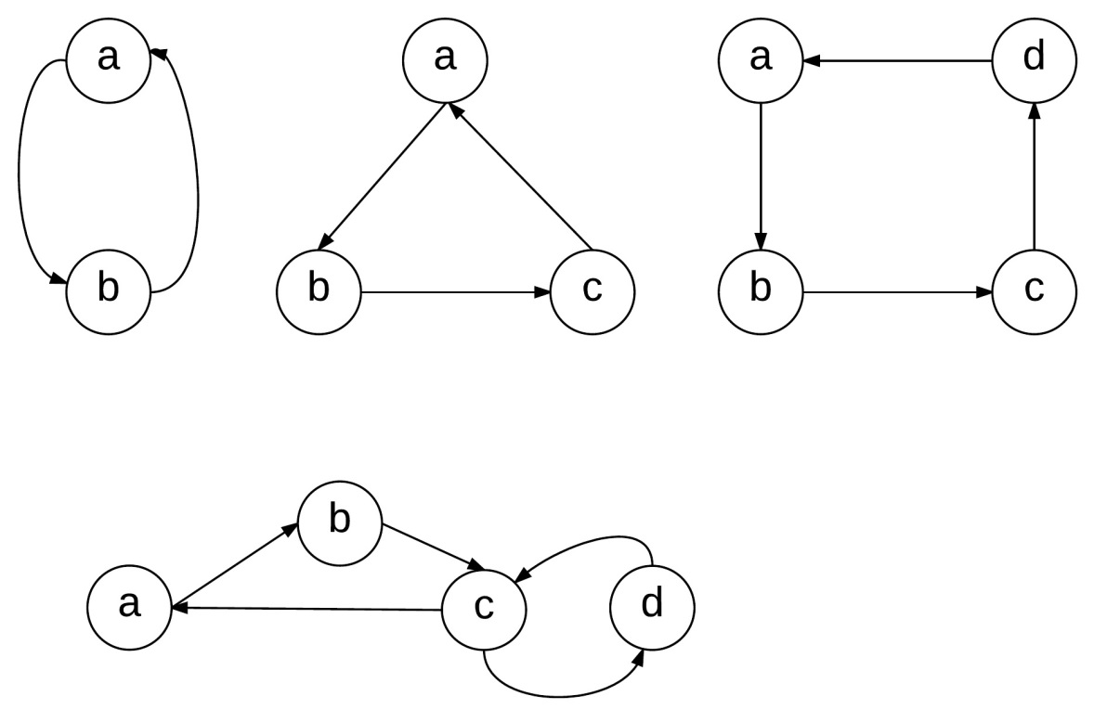
Simple Cycle
“A simple cycle is a closed path/walk with no repetitions of vertices or edges allowed, other than the repetition of starting and end vertex.”

Slide 3



Simple Temporal Cycle
d
e
5
5
2,7
4
a
8
3,6
b
c
5
7
8
a
d
c
a
5
4
8
a
e
c
a

Slide 4
Perspective
Simple Cycle in Retweet network
Discussion among peers
Group of fake account to promote advertisement messages.
Financial transaction network
Indicator for fraud or tax invasion.
In biological neural net
Simple Temporal cycles could indicate feedback loops
Network Characterization using pattern frequency

Slide 5
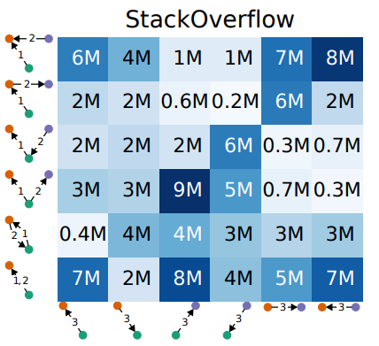
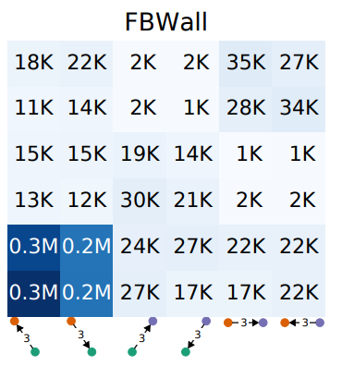
Main Inspiration
Interaction networks: many interesting patterns.
Patterns capture differences in use of networks
Paranjape, A., Benson, A. R., & Leskovec, J. (2017). Motifs in temporal networks. In Proceedings of the Tenth ACM International Conference on Web Search and Data Mining (pp. 601-610). ACM.

Slide 6
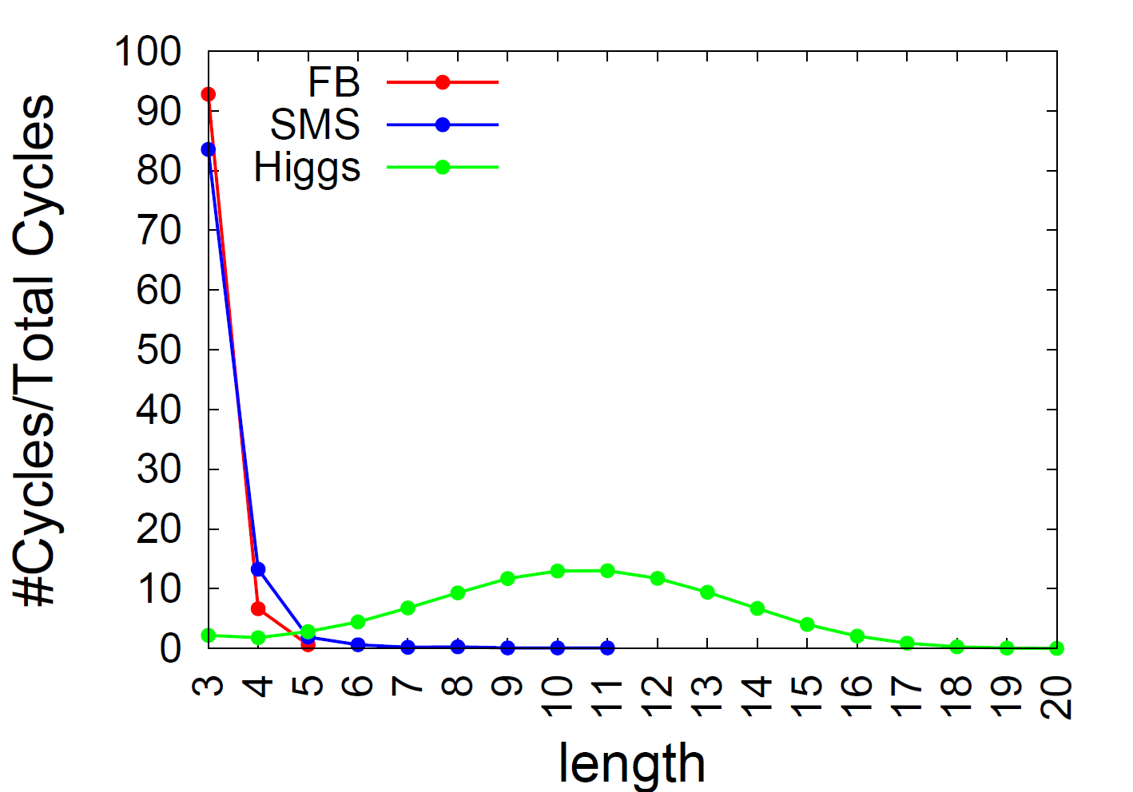
Our Observation
Close social network vs Open Social network have different cycle distributions.

Slide 7
Problem
No existing algorithm to directly find all simple cycles in a temporal network.
Using naïve approach of enumerating all temporal paths and reporting cycles is not very efficient*.
*Kumar, R., & Calders, T. (2017). Finding simple temporal cycles in an interaction network. The European Conference on Machine Learning and Knowledge Discovery in Databases (TGLSD- ECML/PKDD)

Slide 8
2SCENT
Source Detection Phase: Find root node, candidate nodes set, start time and end time of every Cycle.
Constrained Depth First Search: Run on the subgraph containing edges between the start time and end time and consisting of nodes in the candidates set.

Slide 9

Source Detection Phase
Extension of Influence reachability algorithm
If a node could reach itself then there is a cycle.
All the nodes in the reachability summary of the node are candidates for the cycle.
Result: set of triples ( root node, candidates, [start, end] ) (b, {a,d,e,c},t₁,t₅)
Challenge: keep summaries small; evade out-of-window information; use Bloom filters
c
t₁
a
t₅
t₂
b
d
t₄
{ (c,t₁), (d,t₂), (e,t₄),
(b,t₁) }
S(b) + {(a,t₅ ), (c,t₁), (d,t₂), (e,t₃),
(b,t₁)}
t₁
b
e

Slide 10
2nd Phase
Given a seed, find all cycles for that seed
Exact solution, worst case delay O(m), runtime O(cm) c: #cycles, m: #interactions
Avoid following the same fruitless path multiple times
Extension of:
D. B. Johnson (1975). Finding all the elementary circuits of a directed graph. SIAM Journal on Computing, 4(1):77-84

Slide 11
Further optimizations
Repeated edges cause a lot of problems
Solution based on path bundles

Slide 12
Results
n = #Nodes; m = #Interactions
Dataset | Window | Naïve Time | 2SCENT Time
Facebook (n=46k, m= 877k) | 1 hour | 6.5 seconds | 12.2 seconds
 | 10 hours | 9.3 seconds | 18.2 seconds
SMS (n=44k, m=545k) | 1 hour | 21.1 seconds | 34.8 seconds
 | 10 hours | 15.7 hours | 2.1 mins
Higgs (n=304k, m=526k) | 1 hour | 10.6 mins | 10.7 seconds
 | 10 hours | Crashed | 3.6 mins
For networks with few temporal paths in the window the Naïve algorithm is best but as the number of temporal paths increase 2SCENT becomes incredibly efficient.

Slide 13
Future Work
Significance of cycles
How many cycles a→b→c→d→e can we expect?
Null model: respect frequency and T1 + T2 + … + T5
At any timepoint one of the interactions takes place
T1
a
b
T2
b
c
T3
c
d
T4
d
e
T5
e
a

