Slide 1
Test Management Office (TMO)
Automation
May 2017

Slide 2
Automation Tools
NEXTGEN core(R2 - Residential, R3 - Commercial, R4 - Video)
SAT
eCommerce
T3
DeviceManagement

Slide 3
Applications Automated/Under automation with java framework
NEXTGEN core(R2 - Residential, R3 - Commercial, R4 - Video)
SAT
eCommerce
T3
DeviceManagement

Slide 4
Java Automation Framework – Key Components
Java – Open source programming language of choice for automation
Selenium Web driver – used for driving browser automation for web applications.
Webservice – used for executing webservices via Java.
JDBC – used for executing SQL against Oracle tables via Java.
Maven – used for dependency management with third party/external software along with compiling the source code into executable.
Oracle – centralized tables for storing test cases, objects, components, exec parms
Excel – used as user interface through which user can configure/update the test data
Bitbucket/GitHub – Used as source code repository for automation code
ARA/Jenkins – Used as CI engine to drive/schedule the automation jobs
ALM, Log4j – Used for standard logging mechanism across the framework

Slide 5
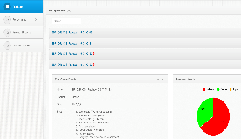









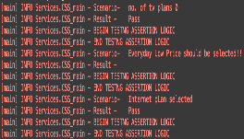
Common Testing Platform
Solution Overview
Test Framework & Scripts
Continuous Integration
Test Reporting
Automation Framework and Script
Creation
Source
Control
Test
Scheduling
Executive
Reporting
Detailed
Reporting
Code Execution
Common
Logging
Common
Logging
Executive
Reporting
Framework Creation
Test Script Creation
Source
Control
Test
Scheduling
Automated Test Execution
Common
Logging
Detailed
Reporting
Executive
Reporting
Create New Framework & Evaluate existing automation harness
Create New Test Scripts with Selenium Web Driver and Java (Open Source)
Load sources into source control for use in continuous build
Configure Test Jobs for ingestion by a Continuous Integration solution
Define and implement auto-build process that incorporates dependencies
Define and implement logging standards
Continuous Integration-based reporting modules and visualizations
Define common classes for integration with HP ALM and Jenkins Reporting

Slide 6
Java Automation Framework – Test Process
Identify mature applications ready to be automated (application rationalization complete)
Automation team works with dev/functional QA to identify the regression suite
Automation team produces a schedule for automating the full regression suite
Once the suite is completed it is included in the CI/CD framework for scheduling/reporting
Review smoke tests with teams for signoff
Automation team completes the automated smoke tests for the application
Test automation engineer who worked on the suite will be part of the functional QA
Onshore test auto. lead will manage an offshore team to maintain continuous automation for new releases

Slide 7
Java Automation Framework – Data and Keyword Driven
Test Automation Suite
Execution
(Test Cases to Execute, Env)
ALM, Global
Object
(Object Definition)
Component
(Common Functionality)
Test Cases
(Events, Objects, Test Data )
Environment
(Env, URLs, Credentials)
Data Driven framework is test data is separate from code, allowing end users ability to modify test data outside of code making test data easy to maintain.
Keyword Driven framework allows end users to initiate any event they want without coding. This configuration based scripting removes users from code providing ability to develop and maintain test suites quickly.
Hybrid framework uses both data driven and keyword driven frameworks.
In our hybrid framework,
Happy Path Scenario (Application remains stable) - Users only require updates to test data.
Rainy Day Scenario (Application changes impacting automation) - Users required to update Object thus allowing flexibility to quickly adopt to application changes.

Slide 8
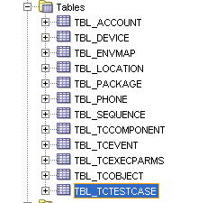
Java Automation Framework – Oracle Tables
Test entities managed via Oracle tables.

Slide 9
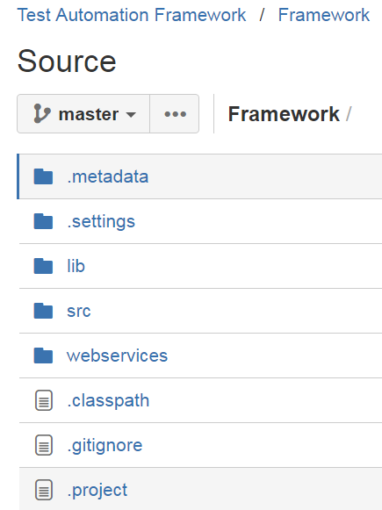


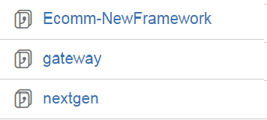
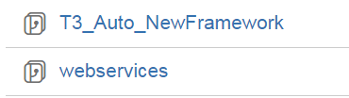
Java Automation Framework – BitBucket
Source Code
All Java Automation source code in BitBucket
https://git.corp.chartercom.com:8443/projects
One Framework repository for common code shared by all applications
One repository per application

Slide 10
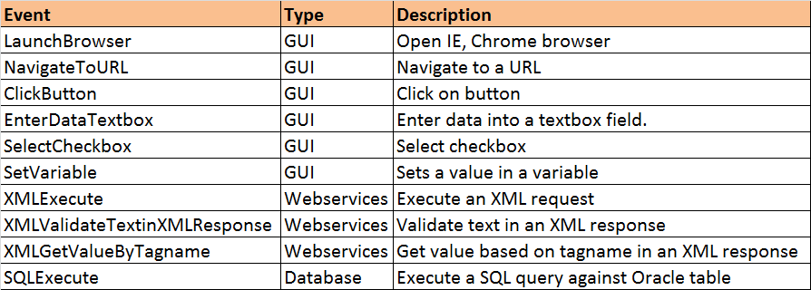
Java Automation Framework - Event
The Framework repository contains about 50 common Java functions/events.
An EVENT is the basic building block used by a manual tester or automation developer to automate test cases. Below are examples.

Slide 11
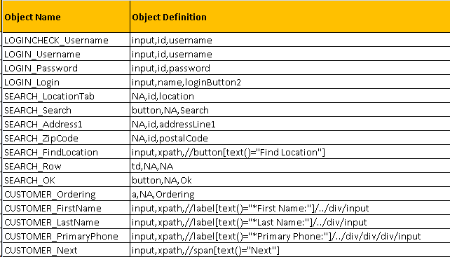
Java Automation Framework – Object
One object repository definition list per application as shown below. Each row defines one object, Object Name and Object Definition.

Slide 12
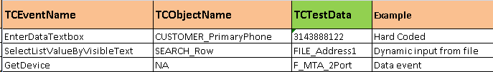
Java Automation Framework – Test Data
Data Events
GetDevice, GetTN, GetLocation - Events specifically for getting next entity available
Dynamic Values
Output from previous step in test case used as input
Hard Values
Hard coded in test case or component
101 ECOMMERCE DR

Slide 13
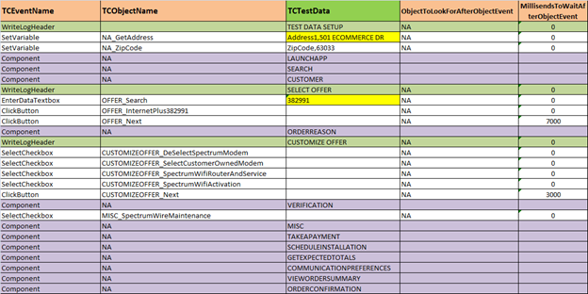
Java Automation Framework – Test Case
To automate a test case, there is one view per test case (as shown below) with 5 columns for any manual tester or automation developer to use. Purple rows are calls to Components.

Slide 14
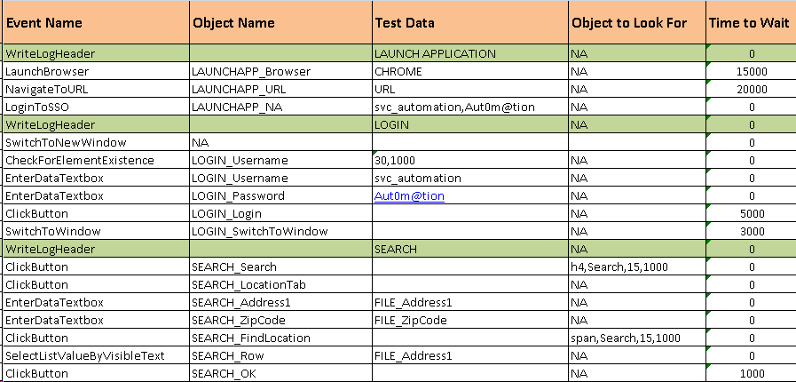
Java Automation Framework – Component
To re-use functionality, you can create many Components for test cases to re-use, below example shows 3 components. The format of the Component is shown below.

Slide 15
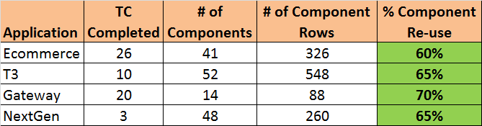
Java Automation Framework - Component Reuse

Slide 16
Java Automation Framework – Upcoming
NextGen
TPSI
Webservices
SAT/FireAxe
Device Management

Slide 17
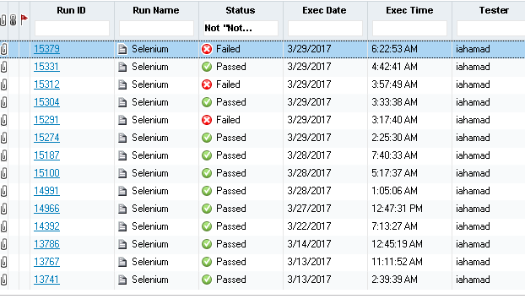
Java Automation Framework – ALM
Test Results
Test status (Passed, Failed)
Log file attachments

Slide 18
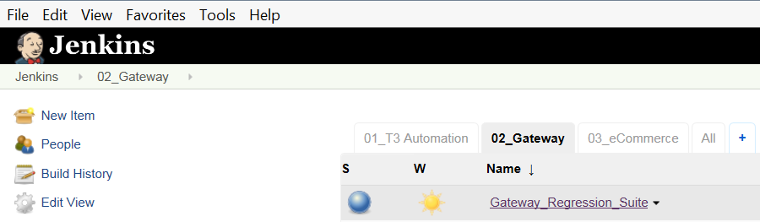
Java Automation Framework – Jenkins
Schedule Test Automation Jobs
Schedule automated smoke or regression jobs
Easy to refer release teams or manual testers to kick off

Slide 19
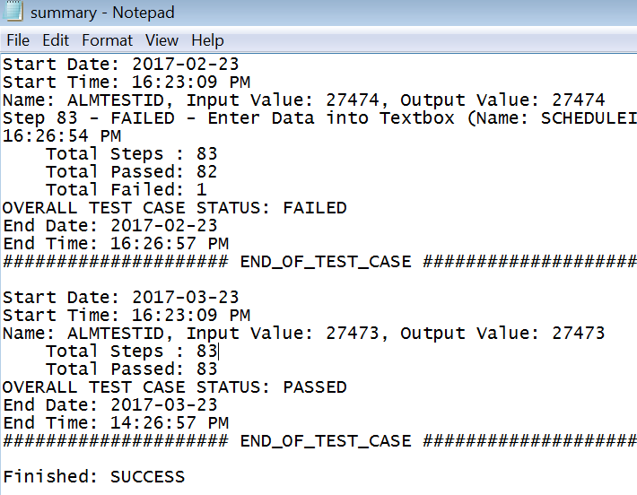
Java Automation Framework – ARA
Schedule Deployments & Test Automation Together
Tool automating scheduling, execution and reporting of deployments, smoke tests & regression suites

Slide 20
Java Automation Framework – Benefits
Centralized Test Data Setup
Enterprise wide, centralized test data management
Eliminate manual setup of test data
10-15% time savings in development and execution
Ease of Automating Tests
User friendly, easy to train newcomers
Plug n Play any web based or webservice based app
Easy configuration for objects
Easy configuration for Dynamic wait versus Hard waits
Component Re-use
Keyword Driven, centralized
50% savings in Development/Maintenance time
50% savings in Maintenance

Slide 21
Java Automation Framework – Benefits (con’t)
Less Dependence on Developer Skill
Less dependence on technical SME developers to build/maintain automation suites
More attractive to projects due to budget constraints
Ease of Porting Between Technical Platforms
Moving from one technical platform to another would require only conversion/mapping of primarily Framework based libraries
Integration
ALM Integration
Jenkins – jobs scheduled to kick off tests
ARA – packages to kick off Jenkins jobs – tool for linking automated deployments with automated smoke test/regression (CICD)

Slide 22
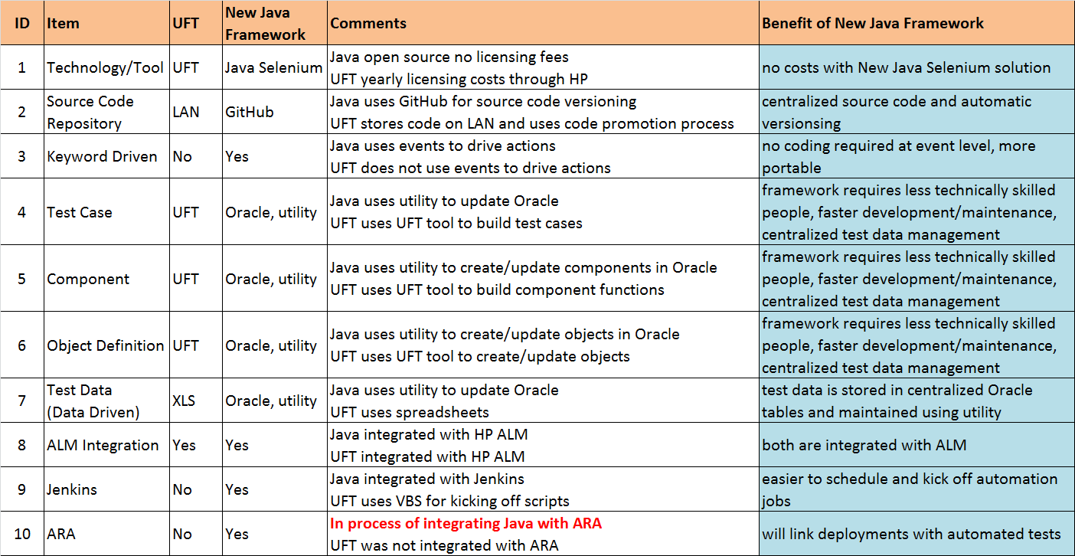
UFT vs New Java/Selenium Framework - Benefits

Slide 23
Java Automation Framework – Q&A
Questions?

