Slide 1

Accessibility Testing

Slide 2
What is Accessibility Testing?
Why Accessibility Testing?
Special/Key Term of Accessibility
Requirements
Browser with SR Compatibility
WCAG 2.0 at a Glance
Accessibility Examples
A and AA level conformance
Sample Bug Template
Questions?

Slide 3

…..
What is accessibility Testing?
“Accessibility testing is subset of Usability testing and trying to make the application/feature accessible for the different type of person with disability”
Disabled person may be in different type like
Visually impaired person
Low vision user
Deaf or hard of hearing
Physical disability etc.

Slide 4

…..
Why Accessibility Testing?
Reason 1: Cater to market for Disabled People
About 20% of the population has disability issues.
1 in 10 people have a sever disability
1 in 2 people over 65 have reduced capabilities
Disabilities include blindness, deaf, handicapped,
or any disorders in the body.

Slide 5
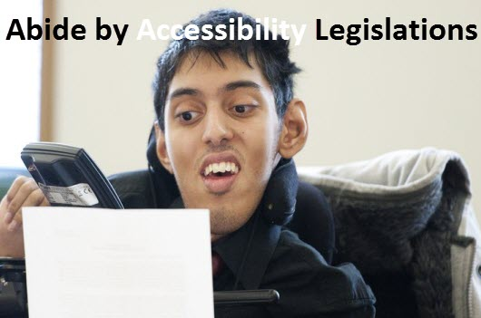
…..
Why Accessibility Testing?
Reason 2: Abide by Accessibility Legislations
Government agencies all over the world have come
out with legalizations, which requires that IT products
to be accessible by disabled people.
Following are the legal acts by various governments -
United States: Americans with Disabilities Act - 1990
United Kingdom: Disability Discrimination Act - 1995
Australia: Disability Discrimination Act - 1992
Ireland : Disability Act of 2005
Accessibility Testing is important to ensure legal compliance.

Slide 6
…..
Key Term
WAI- Web Accessibility Initiative.
WCAG 2.0: WCAG stands for Web content Accessibility Guideline and provided by WAI Team of W3C organization.
WAI-ARIA: ARIA stands for Accessibility of Rich Internet Applications, is a W3C protocol for enhancing and supporting accessibility of scripted and dynamic content.
Screen Reader: Screen readers convert digital text into synthesized speech. They empower users to hear content and navigate with the keyboard. The technology helps people who are blind or who have low vision to use information technology with the same level of independence and privacy as anyone else.

Slide 7
…..
Requirements
Accessibility Automation Tool/Software:
WAT (Web Accessibility Toolbar)- IE Toolbar
Achecker- Web App
PowerMapper- Desktop App
GAT (Google Accessibility Toolbar)- Chrome Extension
Wave Toolbar- Chrome Extension
Screen Readers:
JAWS - Desktop App (Win only)
NVDA - Desktop App (Win only)
Narrator- Desktop App (Win only)
Other Software:
1. CCA (Color Contrast Analyzer)

Slide 8
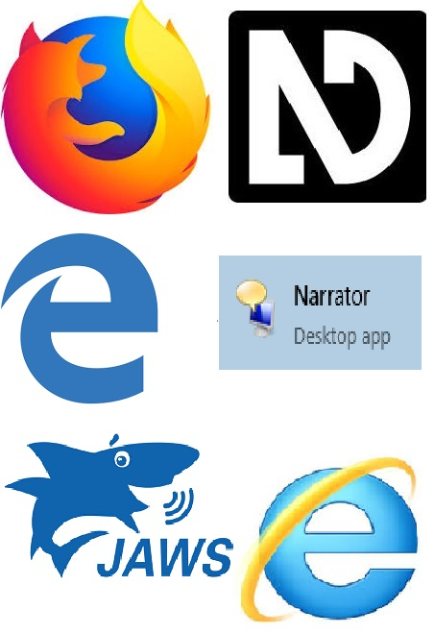
…..
Compatibility Issue
BROWSERS COMPATIBILITY WITH SCREEN READERS
S.N. | Screen Reader | Browser
1 | JAWS | Microsoft Internet Explorer.
2 | NVDA | Mozilla Firefox.
3 | Windows 10 Narrator | Microsoft Edge
4 | VoiceOver (iOS) | Safari (iOS)
5 | Android TalkBack | Google Chrome(Android)
Note: The behavior of application may differ in different environments, like if we have to do the accessibility testing on IE + Jaws and in other Firefox + JAWS then the behavior might be change due to dependency of screen reader with browsers.

Slide 9
…..
WCAG 2.0 at a Glance
A set of Rules/Guideline is implemented by W3C organization, so we need to follow those rules while doing the testing.
1. Perceivable:-
  Provide text alternatives for non-text content.
  Provide captions and other alternatives for multimedia.
  Create content that can be presented in different ways, including by assistive technologies, without losing meaning.
  Make it easier for users to see and hear content.
2. Operable:-
  Make all functionality available from a keyboard.
  Give users enough time to read and use content.
  Help users navigate and find content.

Slide 10
…..
WCAG 2.0 at a Glance
3. Understandable:-
Make text readable and understandable.
Make content appear and operate in predictable ways.
Help users avoid and correct mistakes.
4. Robust:-
Maximize compatibility with current and future user tools.

Slide 11
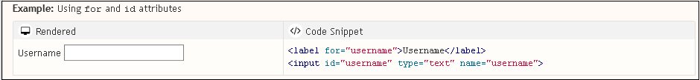
…..
Accessibility Examples
Associate a label with every form control
Use a for attribute on the <label> element linked to the id attribute of the form element, or using WAI-ARIA attributes. In specific situations it may be acceptable to hide <label> elements visually, but in most cases labels are needed to help all readers understand the required input.

Slide 12
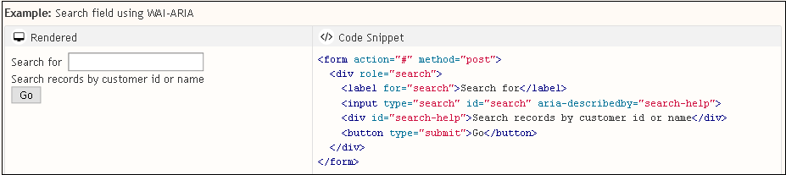
…..
Accessibility Examples
2. Use mark-up to convey meaning and structure
Use appropriate mark-up for headings, lists, tables, etc. HTML5 provides additional elements, such as <nav> and <aside>, to better structure your content. WAI-ARIA roles can provide additional meaning, for example, using role="search" to identify search functionality. Work with designers and content writers to agree on meanings and then use them consistently.

Slide 13
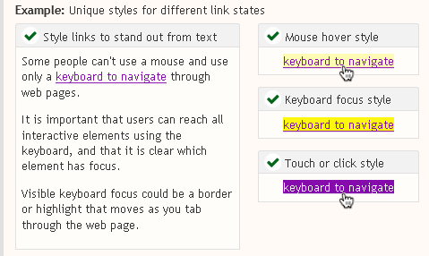
…..
Accessibility Examples
3. Ensure that interactive elements are easy to identify
Provide distinct styles for interactive elements, such as links and buttons, to make them easy to identify.

Slide 14
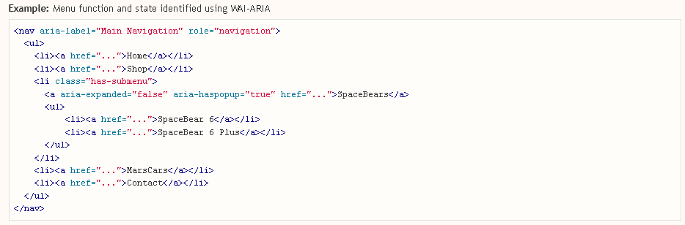
…..
Accessibility Examples
4. Provide meaning for non-standard interactive elements
Use WAI-ARIA to provide information on function and state for custom widgets, such as accordions and custom-made buttons. For example, role="navigation" and aria-expanded="true". Additional code is required to implement the behavior of such widgets, such as expanding and collapsing content or how the widget responds to keyboard events.

Slide 15
…..
Sample Bug Template
Title/Summary | [Accessibility - Perceivable] Alt text is not defined for 'Charter logo' image
Labels | Accessibility, Xavient, WCAG1.1.1, CheckedStage and other label we can also add for different level of environment.
Repro Steps | Step 1: Launch the Browser and enter the URL https://www.spectrum.com/ Step 2: Navigate to 'Charter logo' image on top of the screen and try to find it's alt text. Step 3: Check and verify, If alt text is defined for 'Charter logo' image.
Actual Result | Alt text is not defined for 'Charter logo' image.
Expected Result | Alt text should be define for 'Charter logo' image as 'Charter logo' and Jaws should also read this alt text when focus appears on this logo image.
Guideline Reference | http://www.w3.org/TR/UNDERSTANDING-WCAG20/text-equiv-all.html
System Information | OS: Windows 10, version 10.0 ( Build 10240) Screen Reader: Jaws 18 Browser: IE, Version- 11.010240.17354
Environment Details | Stage, Prod, QA

Slide 16
Thank You

