Slide 1
DevOps Starter Kit

Slide 2
Agenda
1 | Introduction to DevOps and Starter Kit
DevOps Starter kit Features
2 | Introduction to DevOps
DevOps
DevOps tools
3 | Setup using DevOps Starter Kit

Slide 3
Introduction to DevOps Starter Kit

Slide 4
DevOps Starter kit Features:
Effortless setup.
Infrastructure with containers of tools, such as:
Jenkins : CI/CD & build tool
Artifctory : Binary Repository
Sonar : Code Quality tool
The Devops Starter kit is simple and more efficient way to start with DevOps journey. With basic DevOps tools packed as immutable containers that are automatically installed to server and are ready to be used to configure continuous Integrations and fast, reliable and continuous deployments with zero-downtime and ability to roll-back.

Slide 5
Introduction to DevOps

Slide 6
DevOps
DevOps focuses heavily on establishing a collaborative culture and improving efficiency through automation with DevOps tools. While some organizations and people tend to value one more than the other, the reality is it takes a combination of both culture and tools to be successful. Here’s what you need to know about these two DevOps values.

Slide 7
CI/CD
Continuous Integration
Continuous integration is the practice of quickly integrating newly developed code with the main body of code that is to be released. Continuous integration saves a lot of time when the team is ready to release the code.
Continuous Deployment
Continuous deployment is the practice of deploying all the way into production without any human intervention. The code release typically only goes to a small percentage of users and there’s an automated feedback loop that monitors quality and usage before the code is propagated further.

Slide 8
DevOps Tools
DevOps tools consist of configuration management, code quality, test and build systems, version control , binary repositories, monitoring tools, continuous integration, continuous deployment, continuous monitoring and continuous delivery require different tools.
The Startup kit we will be setting up following tools :-
Jenkins : Build , Continuous integration/deployment/delivery tool
Artifactory : Binary repository to store the artifacts such as .war and .ear files.
SonarQube : Code Quality dashboard.

Slide 9
Setup using DevOps Starter Kit

Slide 10
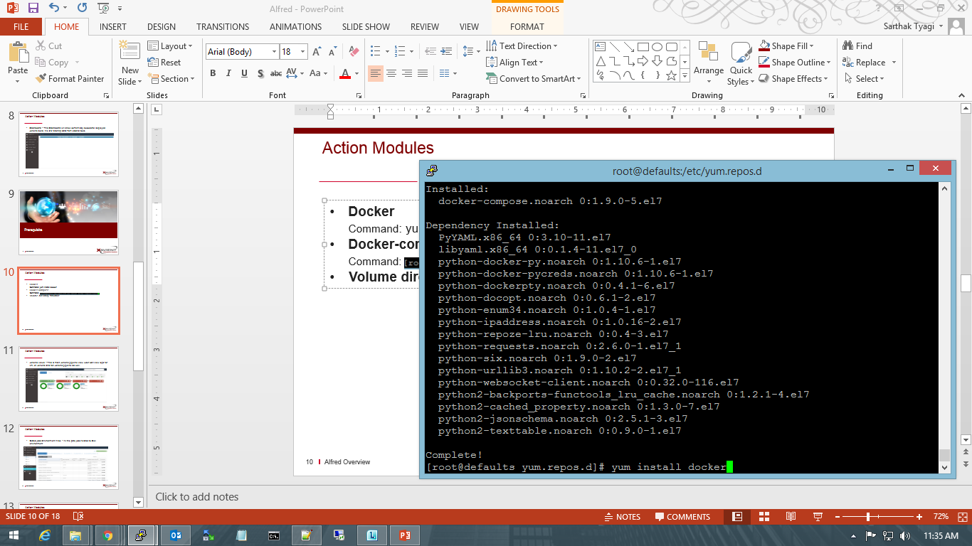
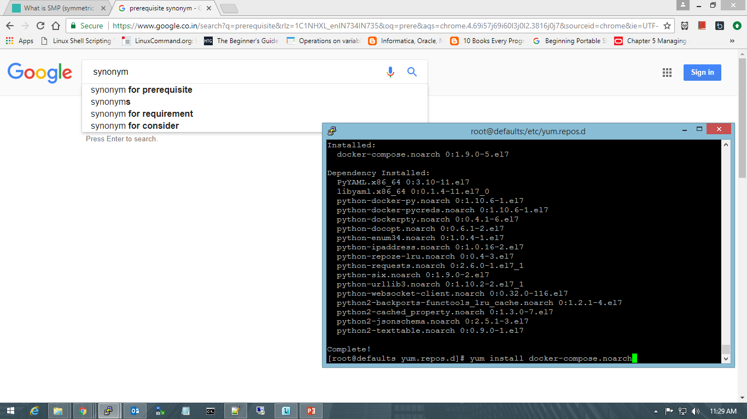
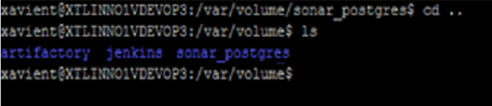
Prerequisite
Install Docker
Command:
Install Docker-compose
Command:
Setup Volume directory structure
cd /var ; mkdir volume;
cd volume
mkdir jenkins; mkdir artifactory;
mkdir sonar_postgres;
cd sonar_postgres;
mkdir data;

Slide 11
Quick Setup :
Git checkout: Checkout the toolkit .
Command: git checkout http://git.xavient.com/DevOps/Docker_CI.git .
2. Select Jenkins + SonarQube + Artifactory toolkit
Command: cd CI_ToolKit_Artifactory_v.5.4.4
3. Setting up Starter kit :
Command: docker-compose up -d
And Done…

Slide 12
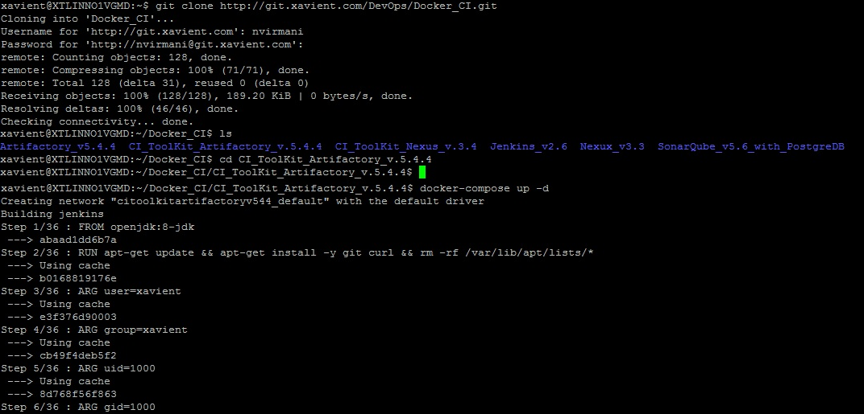

Slide 13
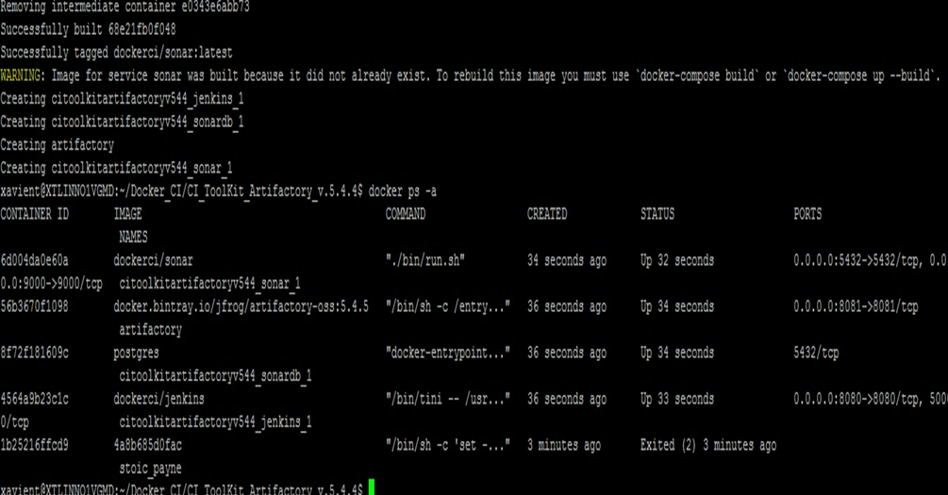

Slide 14
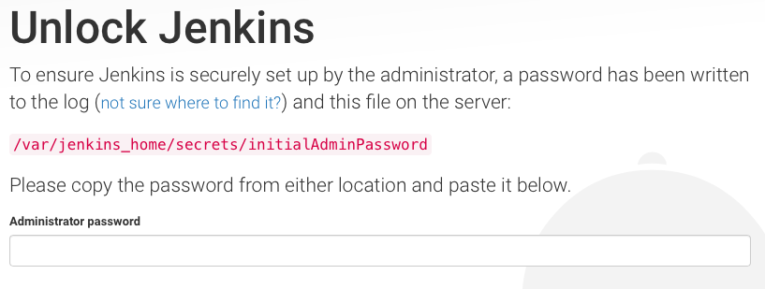
Jenkins: Dashboard
Jenkins URL -: http://<hostname>:8080
Unlock Jenkins using the administrator password mentioned in the file on the path mentioned.
Command : docker exec ${image_name} cat /var/jenkins_home/secrets/initialAdminPassword

Slide 15
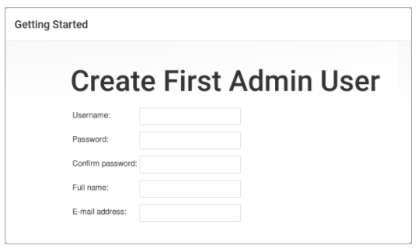
Jenkins: Dashboard
Create first Admin user on Jenkins

Slide 16
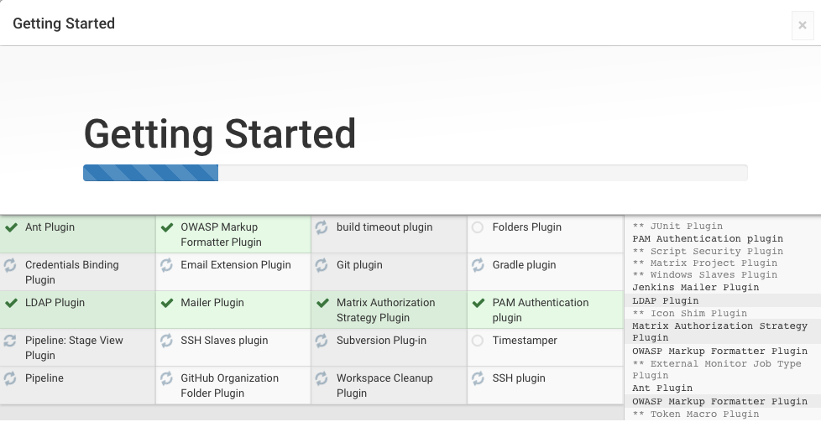
Jenkins: Dashboard
Default Plugins installation.

Slide 17
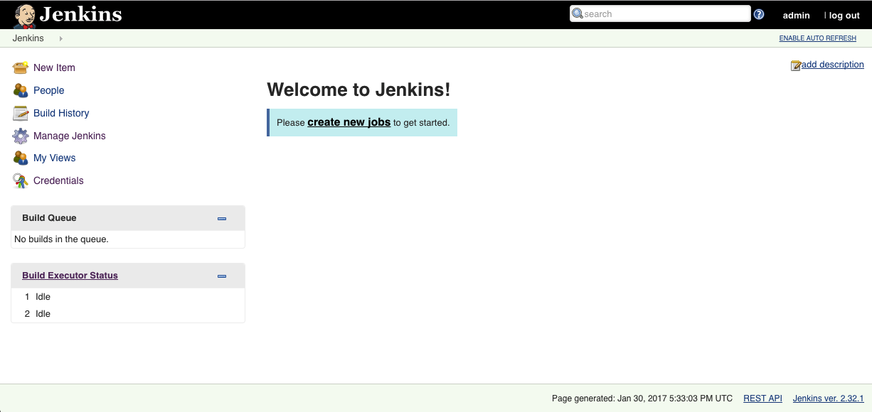
Jenkins: Dashboard

Slide 18
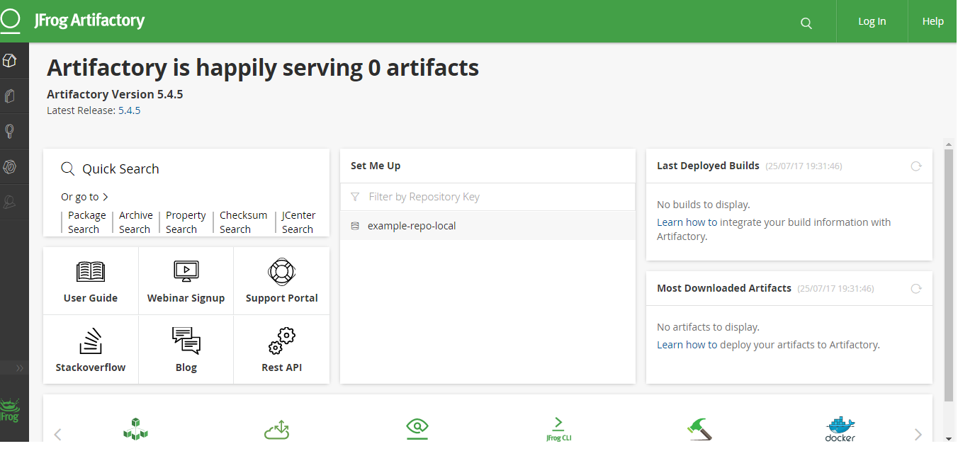
Artifactory: Dashboard
Nexus URL -: http://<hostname>:8081
Username/Password -: admin/password

Slide 19
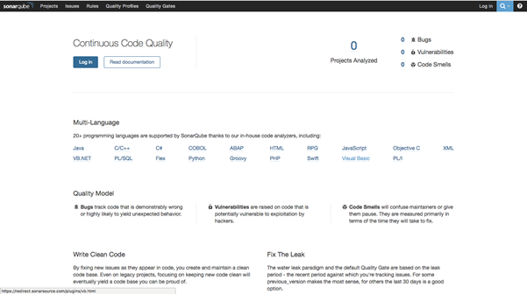
SonarQube: Dashboard
SonarQube URL -: http://<hostname>:9000
Username/Password -: admin/admin

Slide 20
Thank You
Neeraj Virmani

