Slide 1


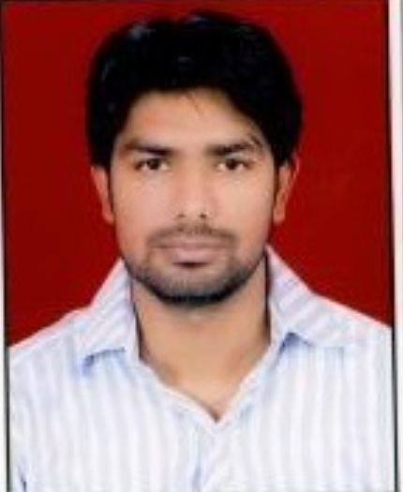
You deserve the Pat On The Back for:
Chirag Singh
Chirag is a valuable part of charter automation team.
His problem solving skills and thinking out of box approach is highly appreciable
You are well equipped with latest technology and always eager to help and share knowledge to your team members.
Even failure can’t be disappointing when it has to be shared with hard working team members like you. Thanks for giving it your best shot
Sr. s/w test engineer

