Slide 1
Python Calculator using Tkinter library
Project Submission - NextHikes IT Solutions

Slide 2
Introduction
This project shows how to create a basic level calculator using Python.
We use the Tkinter library to build a GUI application.
The calculator performs basic arithmetic operations such as addition, subtraction, multiplication, and division.

Slide 3
Project Overview
Features of the Calculator:
1. Equation display area to show input and results.
2. Buttons for numbers and operators.
3. Operations: +, -, ×, ÷
4. Ability to clear input (C) and compute result (=)

Slide 4
Code Explanation
Key Functions:
1.press(num): It is the function that builds the mathematical expression as it get clicked on the number and operator buttons.
2. global expression: we use global variable named expression. It acts as a computer’s memory. It’s a string that stores the sequence of buttons pressed.
3. equalpress(): This function is called when “=” sign is pressed.
4. eval(expression): This eval() function takes a string and evaluates it as a Python expression, and returns the result.
5. clear(): Clears the input screen
6. Tkinter is the standard built-in Graphical User Interface (GUI) library for Python. It's the easiest way to create windows, buttons, text boxes.

Slide 5
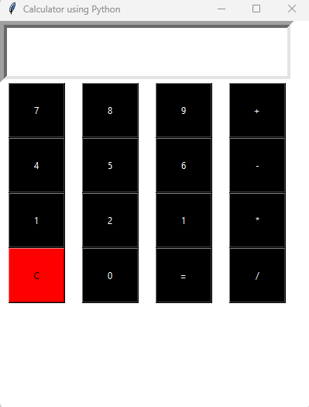
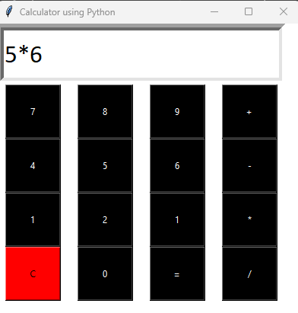
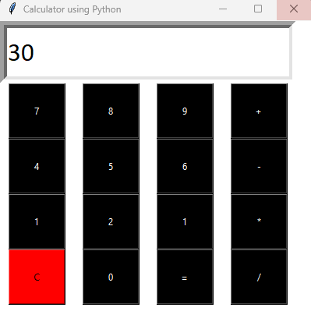
Output
The application launches a GUI window with buttons and an input field.
Users can perform calculations just like a basic calculator.

