Slide 1
Current Scenario
The mail operations right from booking to delivery works in an offline mode. The nodes communicate with the central server through a client for exchange of data.
This leads to :
Loads of paperwork
Unorganized record keeping
Loss of data & consignment
Inefficient tracking of consignment
Also in rural areas internet connectivity is very low due to which people are not able to track their consignment. Moreover, at the post-office the internet connectivity fluctuates very frequently due to which offline maintenance of data is mandatory.

Slide 2
Proposed Solution
A comprehensive framework to integrate the entire mail operations right from booking to delivery into an online system which can handle connectivity disturbances:
A web application and an android mobile application enabling the customers to get the status of their consignment.
A USSD application enabling the customers to track their consignment in case of no internet connection.
A desktop application for managing and administrating the various operations in the post-office which works in an offline mode.
A web application for various post office server operations where there is no internet fluctuation.

Slide 3
Technology Stack
Web Application
Frontend : CSS, HTML, Bootstrap
Backend : Node JS, Java
Mobile Application : Java, Android
Database : MySQL (Central DB)
USSD
Desktop Application using electron

Slide 4
Web application
We have developed a web application hosted live on heroku for client as well as server side.
Web application is developed on Express JS framework which offers a variety of features such as asynchronous request handling , consistent routing to modules and consistent middleware interface.
Web application for client offers a variety of features such as track consignment , locate post office , find pincode and calculate postage.
Web Application for server is used for updating the central database as and when a post/parcel is received at the post office/national sorting hub. This requires active internet connection to update the consignment details on the server side.

Slide 5
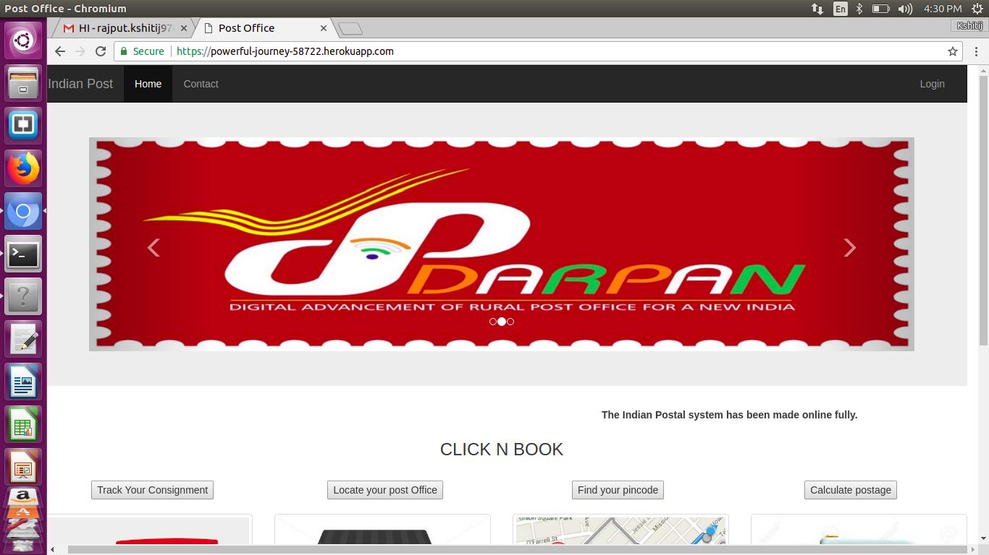
Web Application

Slide 6
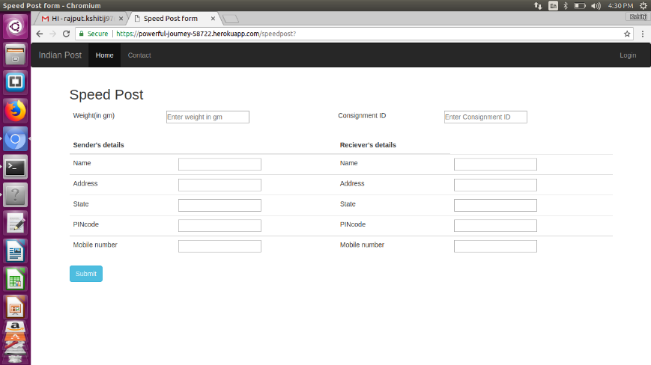
Web Application

Slide 7
ANDROID APPLICATION
Android Application is for the client and has various functionalities like track your consignment, find your pincode, calculate your postage and find the nearest post offices.
The android app on low internet connectivity runs the USSD code to display the status of consignment.
Android app is built on Android studio.

Slide 8
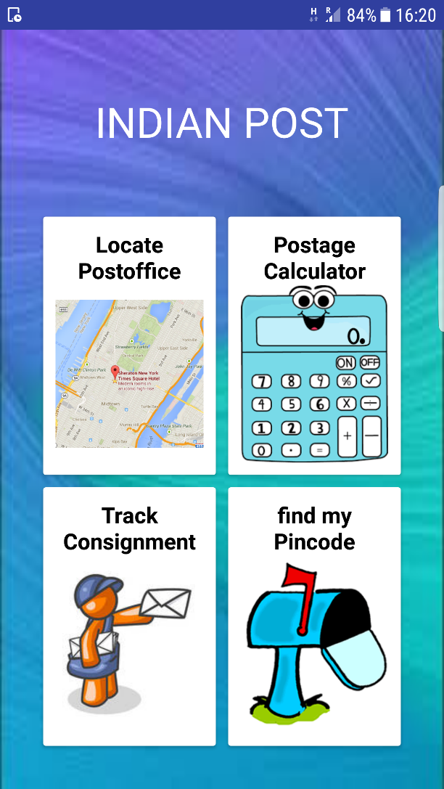
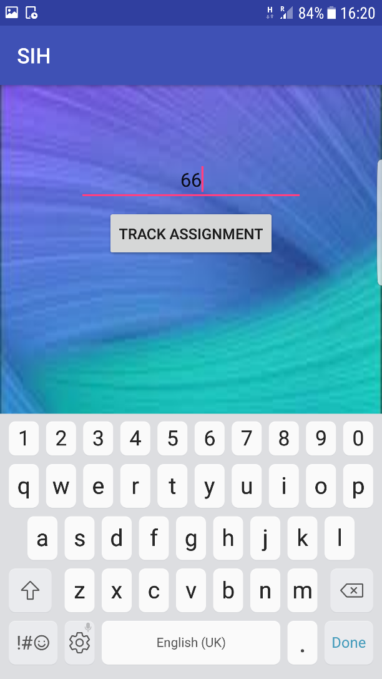
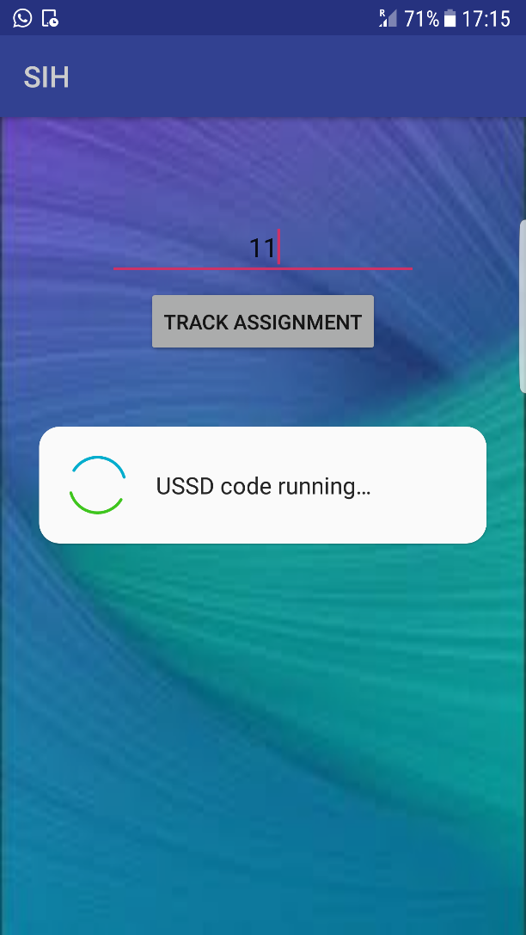
ANDROID APPLICATION

Slide 9
DESKTOP APPLICATION
A desktop application is an offline application that can handle internet fluctuation at the post office.
It will be used for managing and administrating the various operations in the post-office which works in an offline mode.
It is build on ElectonJs which is an efficient framework for developing the desktop applications.
The desktop app pushes the consignment details in a local database on no internet connectivity. When the connectivity resumes the data is synced from local database to the central database.
The desktop app can be of great use in rural areas where there is a constant issue of internet connectivity.

Slide 10
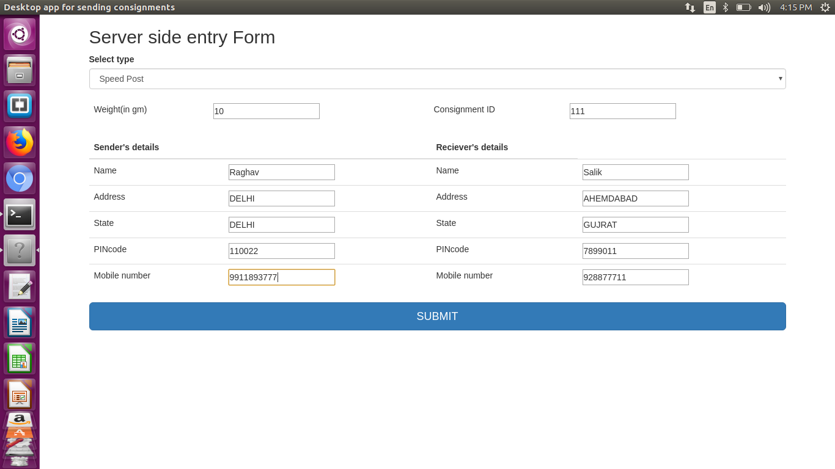
DESKTOP APPLICATION
Changes are pushed to a Local Database when there is no connectivity.

Slide 11
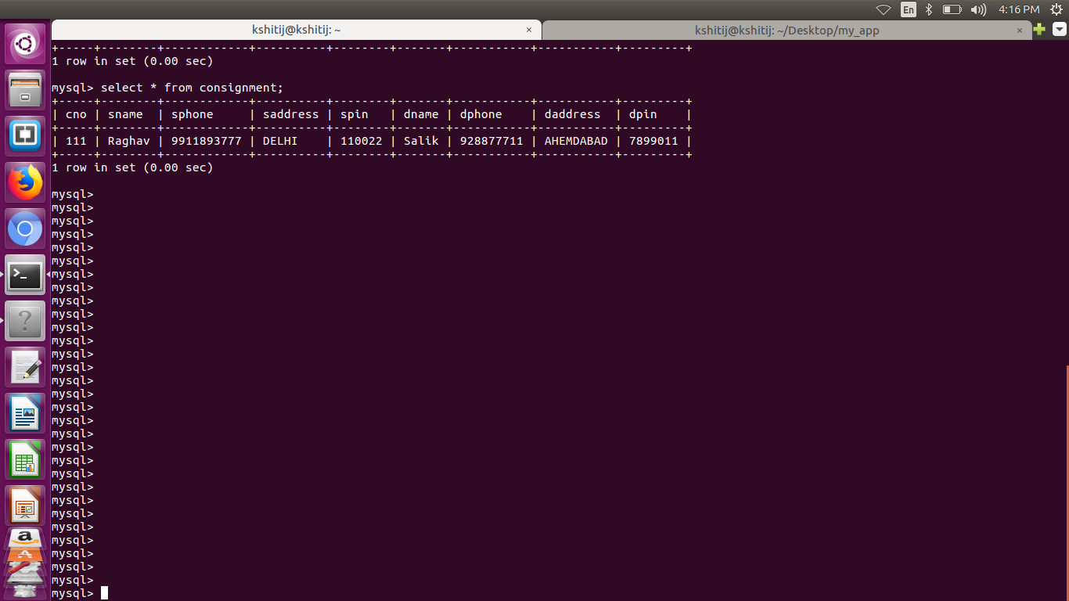
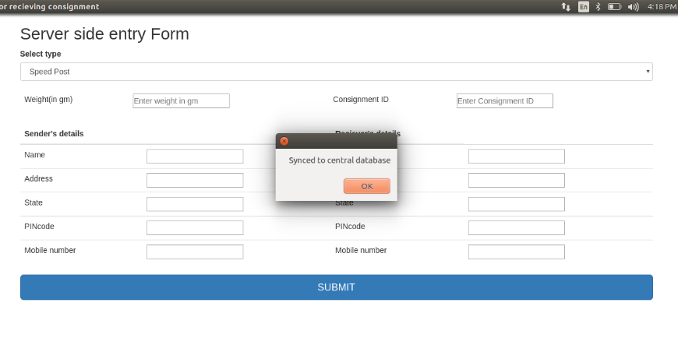
DESKTOP APPLICATION
Local Database at the remote post-office machine.
Main Server/Central Database is updated when Internet connectivity resumes.

Slide 12
USSD
Unstructured Supplementary Service Data

Slide 13
Introduction
USSD is a protocol used by GSM cellular telephones to communicate with the service provider’s computers.
USSD can be used for WAP browsing, prepaid call back service, mobile-money services, location based content services, menu-based information services, and as a part of configuring the phone on the network.
USSD messages are upto 182 alphanumeric characters in length.
USSD can be of great use in rural areas where internet connectivity is an issue and where people are not having smart phones as it can be operated without internet connection.
USSD is also used to update the status of consignment at the NSH and the destination post office.

Slide 14
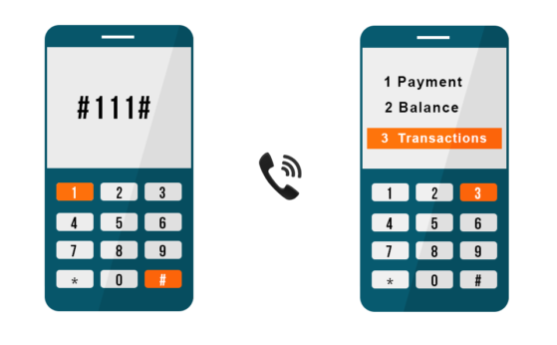
Typical USSD application

Slide 15
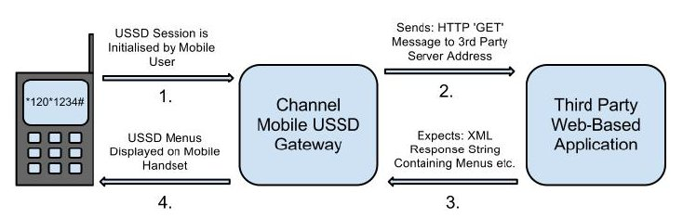
HOW USSD WORKS
It is a GSM technology used to send texts between a mobile and applications in a network.
Enables session based communication between the application server at the network side and the mobile user.
USSD messages create a real time connection during a USSD session. This connection between the application and the user remains open, allowing a two-way exchange of a sequence of data.

Slide 16
ADVANTAGES OF USSD AND WHY USSD OVER SMS?
USSD has no dependency on handset and OS types.
Easy to navigate and no need to remember long keywords or urls.
Real time and INSTANT messaging service capability – up to seven to eight times faster than SMS for two-way transactions.
Supports menu based applications facilitating more user interactions.
No internet connectivity required.
Unlike SMS, there are no charges for this.

Slide 17
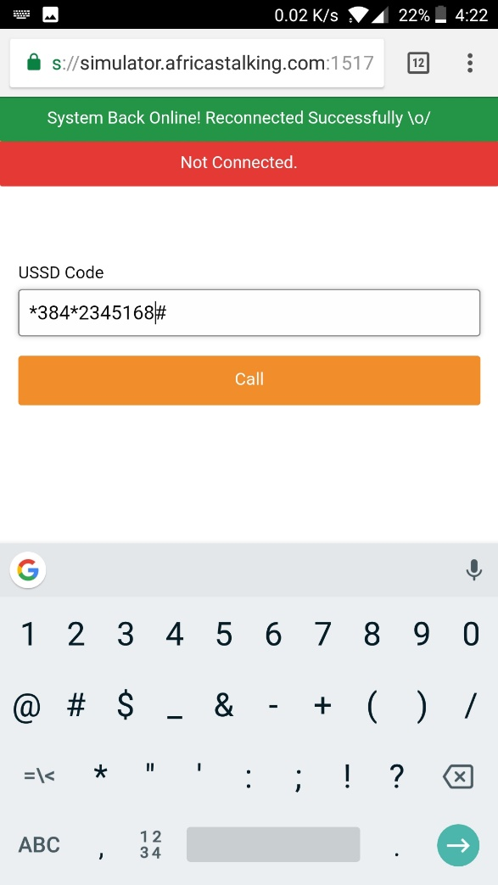
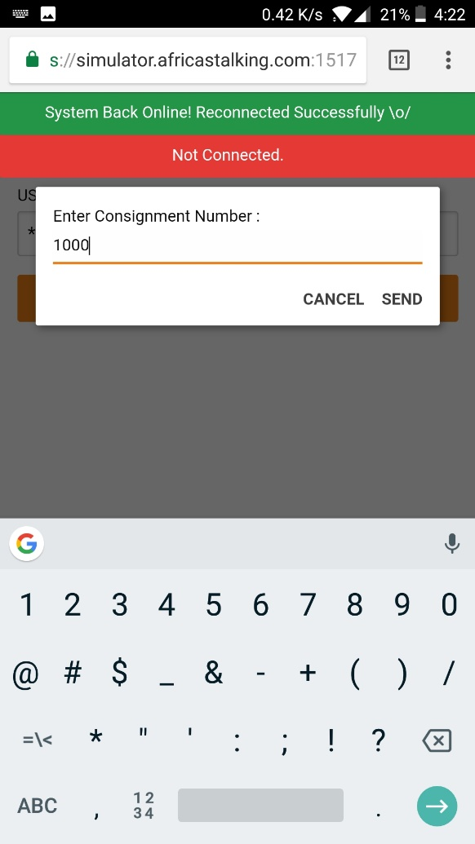
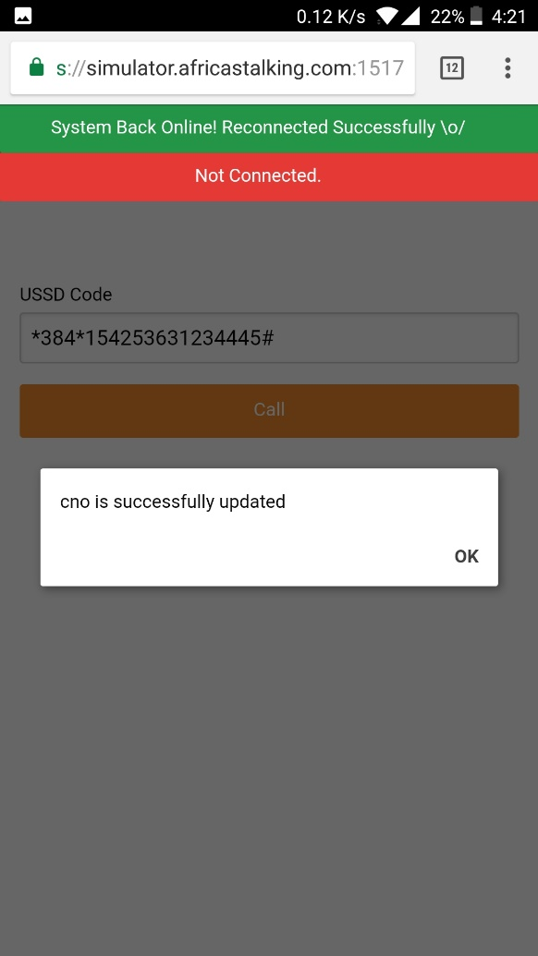
USSD APPLICATION FOR POST OFFICE OPERATION

Slide 18
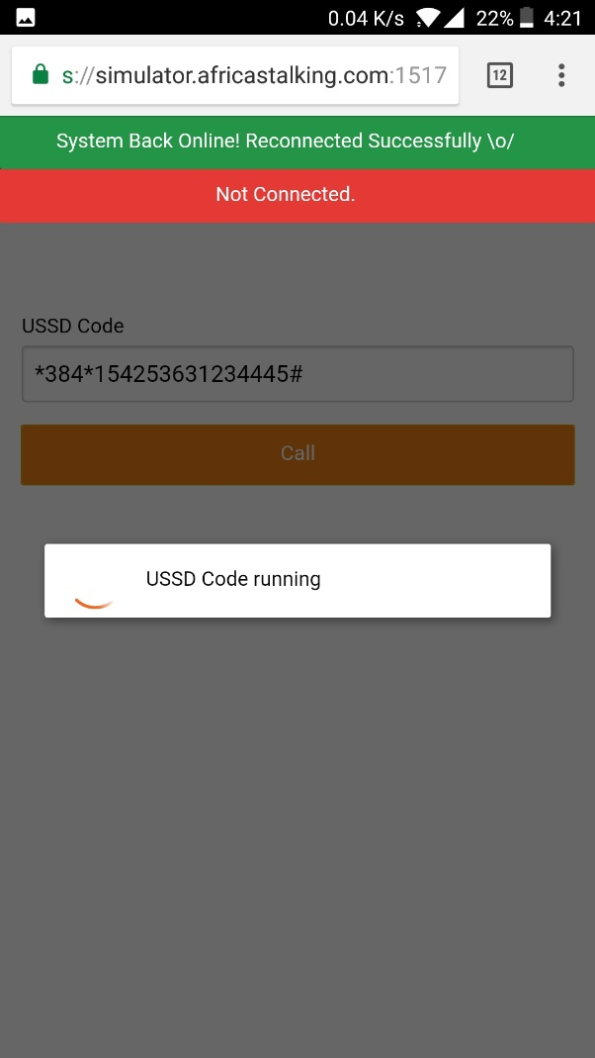
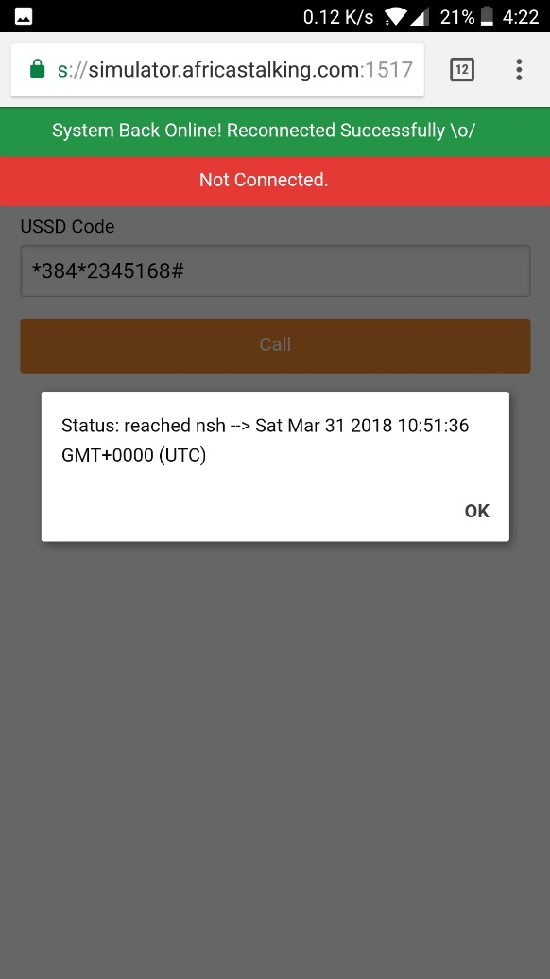
USSD APPLICATION FOR CLIENTS FOR TRACKING CONSIGNMENTS

Slide 19
SHOW STOPPER
USSD is also used to update the status of consignment at the NSH and the destination post office. Also it is used to track the consignment in no internet connectivity
We used a cache database for ongoing transaction(consignments not delivered) to ensure minimal load on central database ensuring fastest possible query time.

Slide 20
CONCLUSION
Besides capturing the data in an offline mode using the desktop application and updating when minimum required bandwidth is available, we also aim to provide a framework to digitalize and automate the entire mail operations in India.
Post with different intermediate operations synchronized through a central database.
The main highlight of our project is the USSD Application on both the client side and the server side which uses zero internet connectivity and minimum cellular network to update status and track consignment easily and efficiently.

