Slide 1
Spring Data JPA
Presented by: Dadaram Jadhav
Authored by: Dadaram Jadhav

Slide 2
Agenda
Spring Data JPA
Repository
Query creation
Named Query
Named Native Query
@Query
Sorting
Pagination
Collection mapping
Relationship mapping
Inheritance mapping

Slide 3
Software setup
JDK 1.8 or above
STS
MySQL

Slide 4
Spring data
Spring data is umbrella project containing many subprojects specific to database
Mission is to provide familiar and consistent, Spring-based programming for data access
It makes it easy to use data access technologies
Works with relational and non-relational databases, map-reduce frameworks
Projects are developed by working together with many of companies and developers

Slide 5
Spring data features
Powerful repository and custom object-mapping abstractions
Dynamic query derivation from repository method names
Support for transparent auditing (created, last changed)
Possibility to integrate custom repository code
Advanced integration with Spring MVC controllers
Experimental support for cross-store persistence

Slide 6
Spring Data modules
Spring Data Commons
Spring Data JDBC
Spring Data JPA
Spring Data MongoDB
Spring Data Redis
Spring Data REST
Spring Data LDAP
Spring Data for Apache Cassandra

Slide 7
Spring Data JPA
Spring Data JPA is part of Spring Data
Simplifies implementation of JPA based repositories
JPA is standard API for object-relational mapping
Makes easy to build Spring-powered applications that use data access
Earlier, for simple queries, pagination, and auditing we need to write lots of boilerplate code
Aims to improve implementation of data access by reducing efforts
We write repository interface and spring will provide implementation

Slide 8
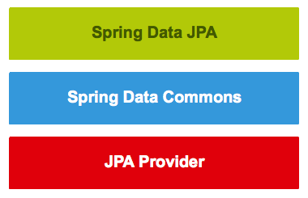
Spring Data JPA
Spring Data JPA is not a JPA provider
Adds an extra layer of abstraction on JPA provider like Hibernate
With Spring Data JPA, repository layer contains three layers

Slide 9
Spring Data JPA
Provides support for creating JPA repositories by extending repository
Spring Data Commons provides infrastructure shared by specific Spring Data projects
JPA Provider (like hibernate) implements Java Persistence API

Slide 10
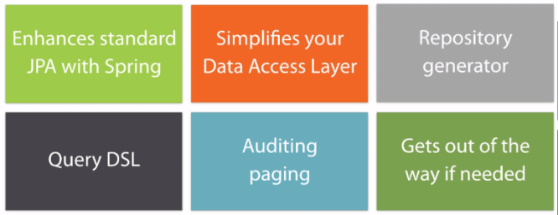
Spring data JPA Features

Slide 11
Features
Sophisticated support to build repositories based on Spring and JPA
Support for Querydsl predicates and thus type-safe JPA queries
Transparent auditing of a domain class
Pagination support, dynamic query execution, ability to integrate custom data access code
Validation of @Query annotated queries at a bootstrap time
JavaConfig based repository configuration with @EnableJpaRepositories
Support for batch loading, sorting, dynamical queries
Reduce code size for generic CRUD operations by using CrudRepository

Slide 12
First application
Create new spring boot application
Add required dependency like spring-boot-starter-data-jpa, h2 database
Create model class, annotate with @Entity
Annotate id with @Id
Create JPA repository and extend with JpaRepository
Insert records with save method
Fetch record with findById() or findAll()

Slide 13
application.properties
spring.jpa.generate-ddl=false
spring.jpa.hibernate.ddl-auto=none
spring.datasource.url=jdbc:mysql://localhost:3306/cybage
spring.datasource.username=root
spring.datasource.password=admin123
spring.jpa.properties.hibernate.dialect = org.hibernate.dialect.MySQL5Dialect

Slide 14
Interfaces
Repository
CrudRepository
PagingAndSortingRepository
JpaRepository

Slide 15
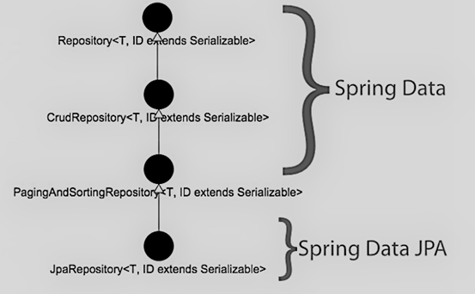
Repository interfaces
Repository<T, ID extends Serializable> interface is marker interface
It captures type of managed entity and type of entity’s id
It helps container to discover concrete repository during classpath scanning

Slide 16
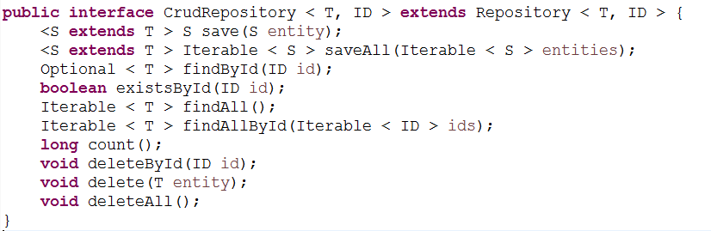
CrudRepository
CrudRepository<T, ID extends Serializable> provides CRUD operations for managed entity

Slide 17
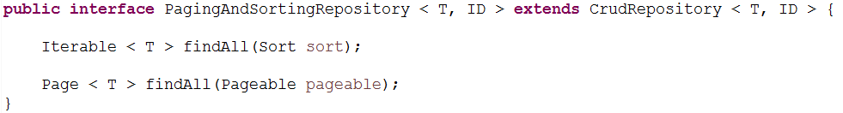
PagingAndSortingRepository
PagingAndSortingRepository<T, ID> is an extension of CrudRepository
Provides methods to retrieve entities using pagination and sorting

Slide 18
JpaRepository
Module deals with enhanced support for JPA based data access layers
Spring Data JPA project provides following interfaces
JpaRepository<T, ID extends Serializable> interface
JpaSpecificationExecutor interface

Slide 19
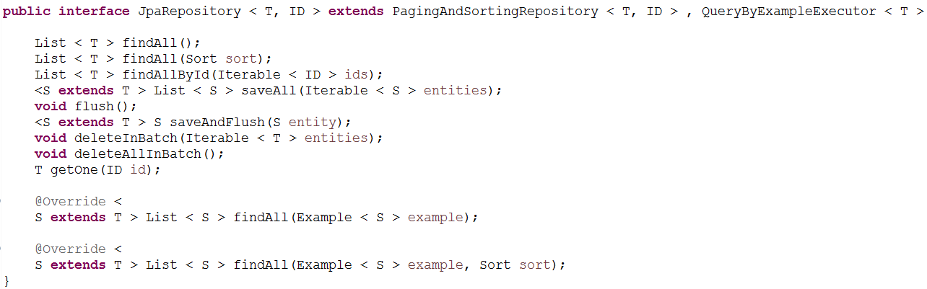
JpaRepository
JpaRepository<T, ID> is a JPA specific repository that combines methods declared by common repository behind a single interface

Slide 20
Query creation
Spring data jpa offer various ways to create queries
Types | Explanation
Automatic | Offered by spring data JPA
Query using method name | Create query using method name
@NamedQuery | Static query using JPQL
@NamedNativeQuery | Defines query in native SQL
@Query | Create query using JPQL and SQL

Slide 21
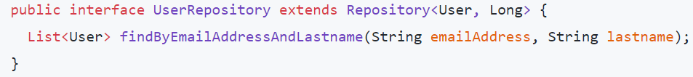
Query creation from method name
Spring Data JPA offers various ways to create a query
We will focus on how to generate a query using method name
Spring Data JPA creates a query using JPA criteria API from this
This translates into following query
select u from User u where u.emailAddress = ?1 and u.lastname = ?2

Slide 22
Keyword inside method name
Keyword | Sample | JPQL snippet
And | findByLastnameAndFirstname | … where x.lastname = ?1 and x.firstname = ?2
Or | findByLastnameOrFirstname | … where x.lastname = ?1 or x.firstname = ?2
Is, Equals | findByFirstname, findByFirstnameIs, findByFirstnameEquals | … where x.firstname = ?1
Between | findByStartDateBetween | … where x.startDate between ?1 and ?2
LessThan | findByAgeLessThan | … where x.age < ?1
LessThanEqual | findByAgeLessThanEqual | … where x.age <= ?1
GreaterThan | findByAgeGreaterThan | … where x.age > ?1
GreaterThanEqual | findByAgeGreaterThanEqual | … where x.age >= ?1
After | findByStartDateAfter | … where x.startDate > ?1
Before | findByStartDateBefore | … where x.startDate < ?1
IsNull, Null | findByAge(Is)Null | … where x.age is null
IsNotNull, NotNull | findByAge(Is)NotNull | … where x.age not null
Like | findByFirstnameLike | … where x.firstname like ?1

Slide 23
Keyword inside method name
Keyword | Sample | JPQL snippet
NotLike | findByFirstnameNotLike | … where x.firstname not like ?1
StartingWith | findByFirstnameStartingWith | … where x.firstname like ?1 (parameter bound with appended %)
EndingWith | findByFirstnameEndingWith | … where x.firstname like ?1 (parameter bound with prepended %)
Containing | findByFirstnameContaining | … where x.firstname like ?1 (parameter bound wrapped in %)
OrderBy | findByAgeOrderByLastnameDesc | … where x.age = ?1 order by x.lastname desc
Not | findByLastnameNot | … where x.lastname <> ?1
In | findByAgeIn(Collection<Age> ages) | … where x.age in ?1
NotIn | findByAgeNotIn(Collection<Age> ages) | … where x.age not in ?1
True | findByActiveTrue() | … where x.active = true
False | findByActiveFalse() | … where x.active = false
IgnoreCase | findByFirstnameIgnoreCase | … where UPPER(x.firstame) = UPPER(?1)

Slide 24
Rules for Creating Query Methods
Invoked query is derived from name of query method
Need to follow following rules
Query must start with: find…By, read…By, query…By, count…By,
To limit number of returned results, add First or Top before first By
If we want to get more than one result, we have to append optional numeric value to First and Top keywords
For example, findTopBy, findTop1By, findFirstBy, and findFirst1By
for unique, add Distinct before first By word (findDistinctTitleBy)

Slide 25
Named Query
Specifies static, named query in Java Persistence query language
Query names are scoped to persistence unit
@NamedQuery applied to an entity
@Entity
@NamedQuery(name = "User.findByEmail", query = "select u from User u where u.emailAddress = ?1")
public class User { ……. }
Naming query is important. Entity.methodName
Add method in repository
Use method whenever required

Slide 26
Named Queries
@NamedQueries
Specifies multiple named Java Persistence query language queries
Query names are scoped to persistence unit
@NamedQueries annotation can be applied to entity
@Entity
@Table(name = "users")
@NamedQueries(value = {
@NamedQuery(name = "User.findByLastname", query = "select u from User u where u.lastname = ?1") })
public class User {
}

Slide 27
Named Native Query
It defines query in native SQL
@NamedNativeQuery and @NamedNativeQueries are used
@Entity
@Table(name = "users")
@NamedNativeQuery(name = "User.findByEmailAddress", query = "select * from users where email_address = ?1", resultClass = User.class)
@NamedNativeQueries(value = {
@NamedNativeQuery(name = "User.findByLastname", query = "select * from users where lastname = ?1", resultClass = User.class) })
public class User {
}

Slide 28
@Query
Method names query generation strategy has following weaknesses:
Method name parser determine what kind of queries we can create
If method doesn’t support keyword, we cannot use this strategy
Method names of complex query methods are long and ugly
There is no support for dynamic queries
Using named queries to declare queries for entities is a valid
As queries themselves are tied to Java method that executes them, you can actually bind them directly by using Spring Data JPA @Query

Slide 29
@Query
Creating Query Methods using @Query
Configure by annotating query method with @Query
It supports both JPQL and SQL queries
Query that is specified by using @Query precedes all other query generation strategies

Slide 30
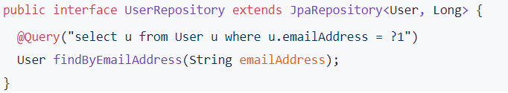
@Query using JPQL Queries
We can create a JPQL query with @Query
Add query method to our repository interface
Annotate query method with @Query annotation

Slide 31
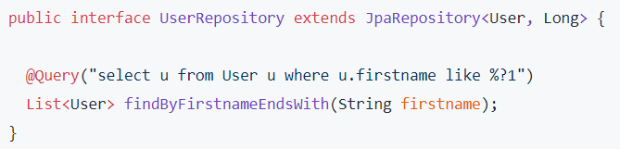
Like expression
Queries created with @Query allows definition of LIKE expressions
List<Movie> findByTitleContaining(String title);
List<Movie> findByTitleContains(String title);
List<Movie> findByTitleIsContaining(String title);
List<Movie> findByRatingStartsWith(String rating);

Slide 32
Like expression
List<Movie> findByDirectorEndsWith(String director);
List<Movie> findByTitleContainingIgnoreCase(String title);
List<Movie> findByRatingNotContaining(String rating);
@Query("SELECT m FROM Movie m WHERE m.title LIKE %:title%")
List<Movie> searchByTitleLike(@Param("title") String title);
@Query("SELECT m FROM Movie m WHERE m.rating LIKE ?1%")
List<Movie> searchByRatingStartsWith(String rating);

Slide 33
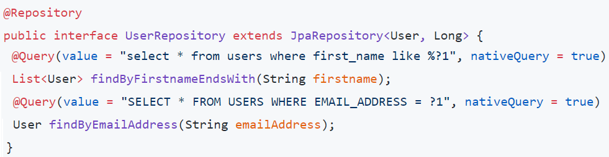
@Query with SQL Queries
@Query allows for running native queries by setting nativeQuery flag
Add query method to our repository and annotate using @Query

Slide 34


Sorting
Queries from method name strategy are sorted using OrderBy
Finding title by ascending order of title
Finding title by ascending order of title and descending order of description

Slide 35
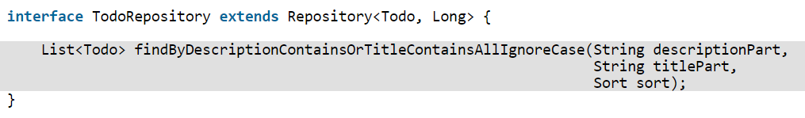
Sorting
Sorting result of queries generated from method name strategy
Possible with sort object

Slide 36
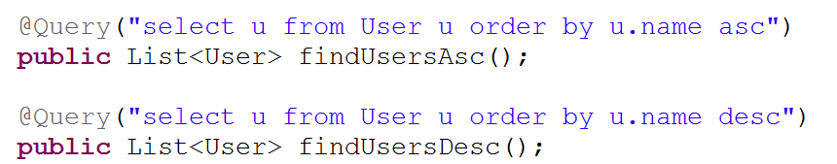
Sorting With Query Strings
For queries using named queries or @Query, sorting added in string

Slide 37
Sorting With Sort Class
Sort class can be used for query with @Query
Sort object obtained manually or using Spring Data Web Support
Sort query results in ascending order by using title
private Sort orderBy() {
return new Sort(Sort.Direction.ASC, "title");
}

Slide 38
Sorting All Entities
PagingAndSortingRepository can be used to sort all entities
interface TodoRepository extends PagingAndSortingRepository<Todo, Long> {
}
Iterable<T> findAll(Sort sort) method returns all entities found from database and sorts them by using sort specified by Sort object

Slide 39
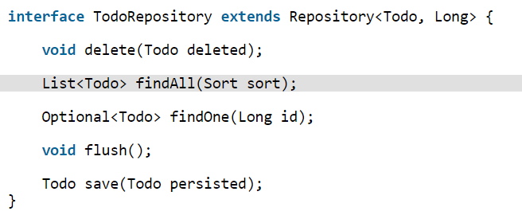
Sorting in Repository
If we created our repository by extending Repository, we can declare findAll(Sort sort) method in our repository

Slide 40
Which Sorting Method Should We Use?
For named/native queries with @Query, add sorting logic into query
For JPA Criteria API, sort using Sort class
Always try to put our query generation logic and sorting logic to same place
For queries using SQL or JPQL, add sorting logic into query
For query generation from method name, use same method for sorting
If method name is too long then rewrite query using @Query
If pagination required then sort using sort class

Slide 41
Pagination
We can paginate query results by following these steps:
Obtain Pageable object that specifies information of requested page
Pass Pageable object to correct repository method as parameter
Obtaining Pageable Object
We can obtain Pageable object by using these two methods:
We can create it manually
We can use Spring Data web support (@EnableSpringDataWebSupport)
We can paginate query results of query methods, JPA criteria queries, and Querydsl queries
We cannot paginate query results of SQL queries

Slide 42
Pagination
Creating Pageable Object Manually
If we want create Pageable object manually, service class that wants to paginate query results, must create Pageable object
private Pageable createPageRequest() {
return new PageRequest(1, 10, Sort.Direction.ASC, "title", "description");
}

Slide 43
Pagination
Paginating All Entities
Using PagingAndSortingRepository
interface TodoRepository extends PagingAndSortingRepository<Todo, Long> { }
Page<T> findAll(Pageable pageRequest) returns page of entities

Slide 44
Pagination
If we created our repository interface by extending Repository, add Page<T> findAll(Pageable pageRequest)
interface TodoRepository extends Repository<Todo, Long> {
Page<Todo> findAll(Pageable pageRequest);
}

Slide 45
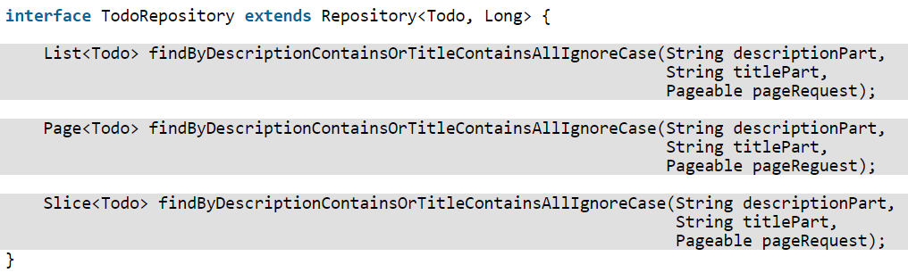
Pagination
Paginating Query Results of Queries that Use Query Generation From Method Name Strategy
Add new method parameter (Pageable object) to query method

Slide 46
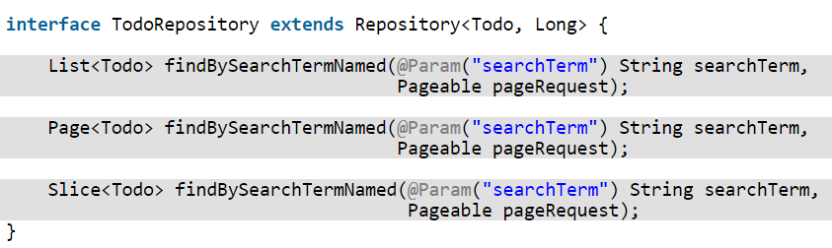
Pagination
Paginating Query Results of Named Queries That Use JPQL
Add new method parameter (Pageable object) to query method

Slide 47
Pagination
Difference between Page and Slice
findAll(Pageable pageable) method by default returns a Page object
A Page object provides lots of useful information
It has total pages, number of current page and whether current page is first page or last page
Slice is very much similar to Page, except it does not provide number of total pages in database
It helps in improving performance when we do not need to display total number pages in UI
Generally, Slice is used in case navigation is consist of Next page and Previous page links.

Slide 48
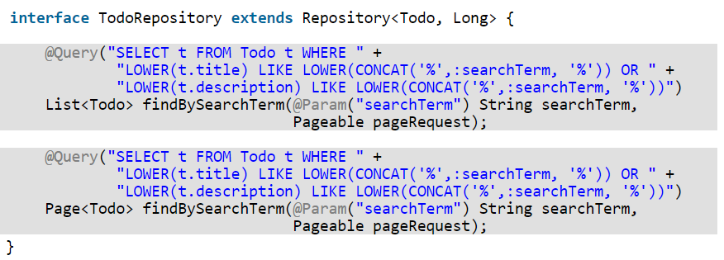
Pagination
Paginating JPQL Queries That Use @Query Annotation
Remove sorting logic from the JPQL query
Add new method parameter (Pageable object) to query method

Slide 49
Inheritance mapping
Inheritance can mapped with Single table, Table per class, Joined table, Mappedsuperclass
Single table: inheritance is mapped to one table
An object is stored in one row in table and discriminator value stored in discriminator column
Table per class: Every concrete entity class in hierarchy is mapped to a separate table
Table contains column for all fields of concrete class, including inherited fields
Joined table: Every class in hierarchy is represented as a separate table, causing no field duplication to occur
An object is stored spread out over multiple tables; one row in each of tables that make up its class inheritance hierarchy
is-a relation between a subclass and its superclass is represented as a foreign key relation

Slide 50
Collection mapping
Collection mapping possible for basic as well as embeddable types
Basic type includes collection of basic types like string
Define embedding class and annotate with @Embeddable
Use @ElementCollection to declare an element-collection mapping
All records of collection are stored in separate table
Configuration for this table is specified using @CollectionTable
JoinColumn refers to primary table

Slide 51
Relationships
It defines relationship between entities
Relationship
Onetoone
Onetomany/Manytoone
Manytomany
Annotations used are @OneToOne, @OneToMany, @ManyToOne, @ManyToMany
In one-to-one, primary key of one table exists as foreign key on another table
In a one-to-many, primary key of one table exists as a foreign key on another table
In many-to-many, association between two entities is tracked by cross-reference table

