Slide 1
CLUSTERING TECHNIQUES – ML BASED UNSUPERVISED HIERARCHICAL CLUSTERING
GROUP MEMBERS
Namburu Veera Venkata Vimal Aditya(20CE30019)
Rohit Raj (20CE30022)
Sagar Meena (20CE30023)

Slide 2
What is clustering?
Clustering is the process of grouping similar entities together. The goal of this unsupervised machine learning technique is to find similarities in the data points and group similar data points together.

Slide 3
Why to use clustering?
Grouping similar entities together help profile the attributes of different groups.
In other words, this will give us insight into underlying patterns of different groups.
Clustering is also used to reduce the dimensionality of the data when you are dealing with copious number of variables.

Slide 4
HIERARCHICAL CLUSTERING
Hierarchical Clustering starts by assigning all data points as their own clusters. As the name suggests, it builds the hierarchy and in the next step, it combines the two nearest data point and merges is together to one cluster and repeats this step till all data is exhausted. It is shown using a tree-like diagram (called Dendogram) which shows the sequence of merges or splits.

Slide 5
Types of hierarchical clustering
AGGLOMERATIVE CLUSTERING
DIVISIVE CLUSTERING
In this, each data is treated as a separate cluster and merges two pairs of clusters which are maximum comparable and it repeats this step till all data is exhausted.
It is a bottom-up algorithm as small parts are merged together to form a big cluster.
It is just the opposite of agglomerative clustering. In this, the whole data is considered as a single cluster. It spilts the cluster into two which are very much distinct and repeats this step till no further splitting occurs.
It is a top down-algorithm as a big chunk of data is split into small clusters.

Slide 6
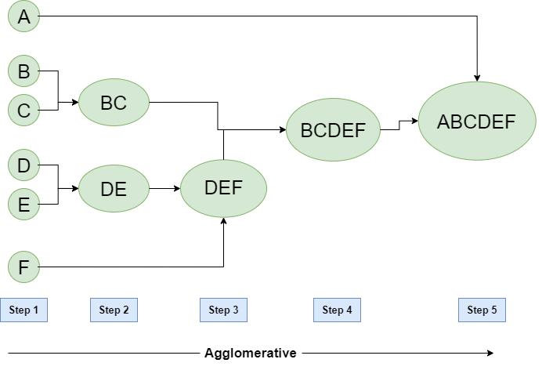
Fig. Agglomerative clustering

Slide 7
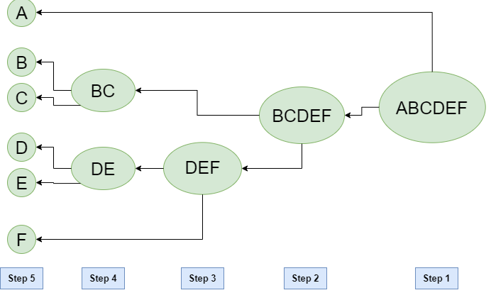
Fig. Divisive Clustering

Slide 8
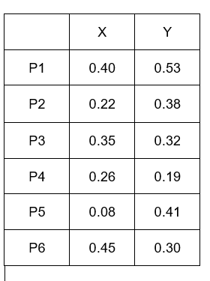
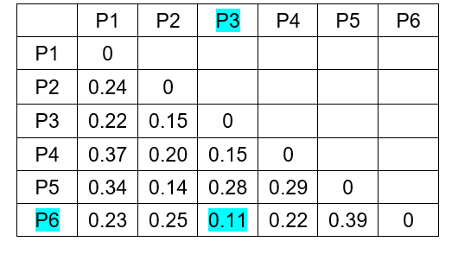
HOW DOES IT WORK?
Consider 6 points/clusters P1, P2, P3, P4, P5, P6 having x and y co-ordinates as shown here. Now, distance of each point with every other point is calculated and filled it into a distance matrix.

Slide 9
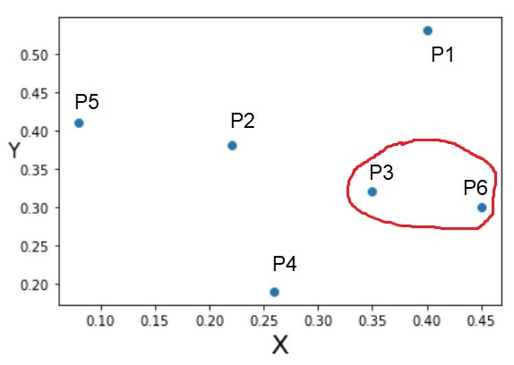
Now, we will find the element which has the least distance. Here, the distance between P3 and P6 is the least, so (P3, P6) will be considered as one cluster.
We have to find the distance between the cluster (P3,P6) and the other clusters P1, P2, P4, P5.
Distance between (P3, P6) and P1
= Min. of distance between P3 and P1 and between P6 and P1.
= 0.22

Slide 10
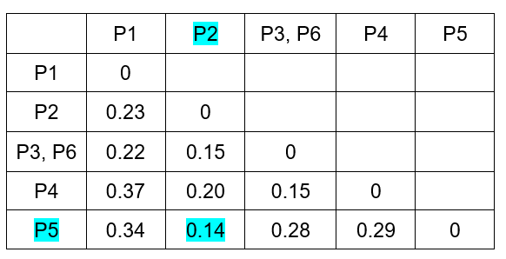
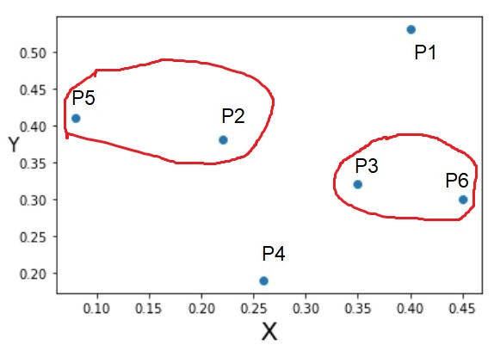
Similarly, Distance between (P3, P6) and P2 = 0.15 Distance between (P3, P6) and P4 = 0.15 Distance between (P3, P6) and P5 = 0.28 So, now the new distance matrix is updated as shown and we have to find the least distance in this matrix. Here, distance between P2 and P5 is the least and combined into one cluster.

Slide 11
We again find the distance between (P2, P5) cluster and other clusters to update the distance matrix.
Dist. between (P2, P5) and P1 = Min of dist. Between P2 and P1 and between P5 and P1 = 0.23
Similarly, Dist. Between (P2, P5) and (P3, P6) = 0.15
Dist. Between (P2, P5) and P4 = 0.20

Slide 12
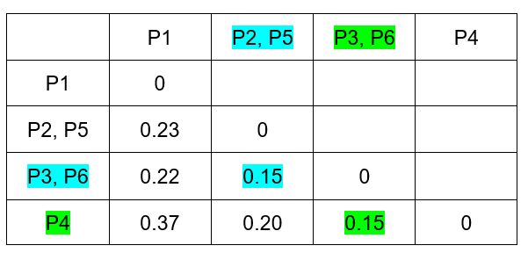
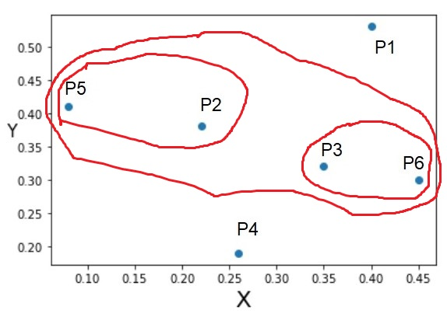
So, the distance matrix is updated as shown and we again find the least distance in this matrix.
Here, there are two values, one b/w (P2, P5) cluster and (P3, P6) cluster and the other b/w (P3, P6) cluster and P4 cluster. But we will take the one which comes first in this matrix. Therefore, (P2, P5) and (P3, P6) can be considered as a single cluster as shown.

Slide 13
Now, we have to find the distance between (P2, P3, P5, P6) cluster and the remaining clusters to update the distance matrix.
Dist. b/w (P2, P3, P5, P6) and P1 = Min. dist b/w (P2, P5) and P1 and b/w (P3, P6) and P1 = 0.22
Similarly, Dist. b/w (P2, P3, P5, P6) and P4 = 0.15

Slide 14
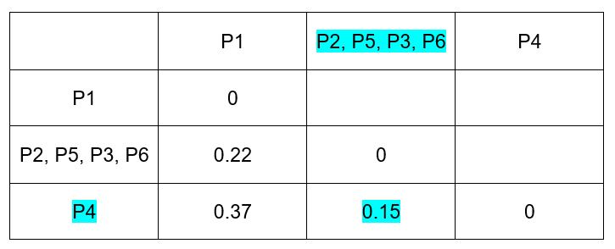
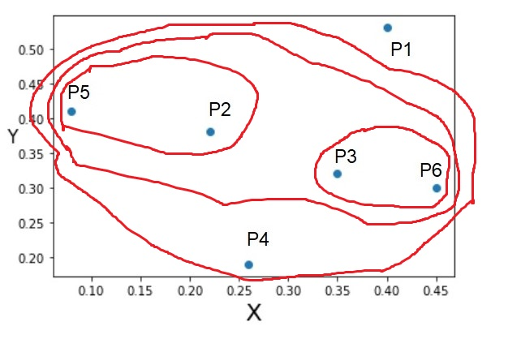
The distance matrix is updated as shown here.
As we can se here, the distance between (P2, P3, P5, P6) and P4 is the least, so these can combined into one single cluster as shown. Now there are only two clusters i.e. (P2, P5, P3, P6, P4) and P1 left.
Dist. b/w (P2, P5, P3, P6, P4) cluster and P1 cluster
= Min. dist b/w (P2, P5, P3, P6) and P1 and b/w P4 and P1
= 0.22

Slide 15
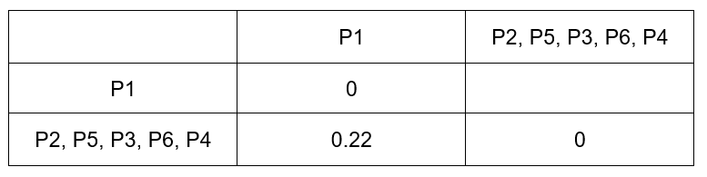
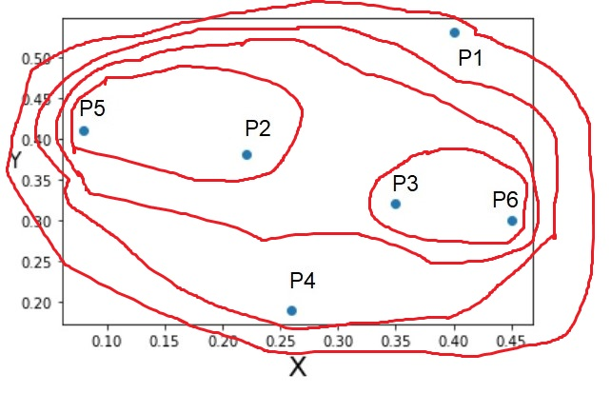
Again, we update the distance matrix as shown here.
We have only one value left, i.e. distance b/w (P2, P5, P3, P6, P4) and P1. Therefore these will be combined and so the whole data will become a single cluster as shown in the graph.

Slide 16
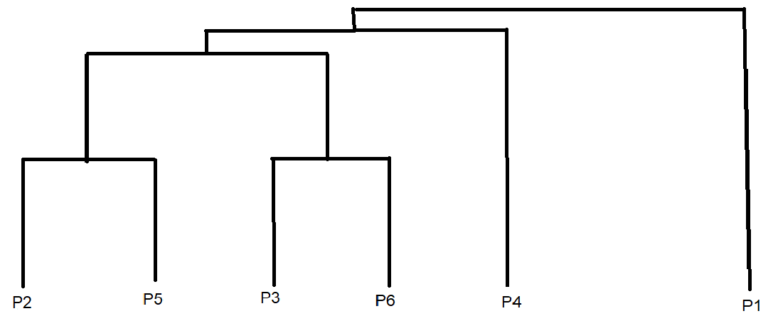
The dendrogram for this example is shown here:

Slide 17
THANK YOU

