Slide 1






NALANETRA FLOODGRID
AI-DRIVEN HYPER-LOCAL SEVERE WEATHER & URBAN FLOOD EARLY WARNING SYSTEM
Team: Dropwise
PROBLEM STATEMENT 05: AI-Driven Hyper-Local Early Warning System for Severe Weather Nowcasting (Cloudbursts & Flash Floods)
Coupling Dual-Pol Doppler Radar Nowcasting (2–6h Lead Time), High-Res DEM Hydrodynamics & Proof-Gated Municipal Closure
[01] SEVERE WEATHER NOWCASTING
• 2–6 Hours Actionable Lead Time before cloudburst/flash-flood impact
• Dual-Pol Doppler Radar QPE + Integrated Water Vapor (IWV) ingestion
• Spatiotemporal Deep Learning recognizes pre-event atmospheric signatures
• Multi-task Neural Network outputs simultaneous storm & flash-flood risk maps
[02] HYDRAULIC DRAINAGE COUPLING
• High-Res DEM Topography & Watershed Delineation mapping
• Graph-based Drainage Network: Manhole nodes & stormwater pipe edges
• Kinematic-Wave Runoff Simulation (Manning’s Equation hydrodynamics)
• Predictive Street Inundation & Vulnerable Underpass Depth Triage
[03] GROUND-TRUTH & ACCOUNTABLE ACTION
• 1-Tap Bilingual Citizen Reporting (GPS, Depth & Photo Verification)
• P-Score Algorithm: P = 0.30S + 0.20R + 0.15W + 0.15D + 0.10E + 0.10A
• 150m Spatial Clustering & Dynamic Rerouting via OSRM Flood Nav API
• Proof-Gated Municipal Closure: Mandatory Before/After Tamper-Evident Photos
EVENT: KAYA'26 (Organized by AZMTH) | TRACK: Software Hackathon (AI & Autonomous) | TEAM: Dropwise | PS-05: Hyper-Local Severe Weather Nowcasting
KAYA • कृतिम • अभियान • युवा • अन्वेषण | KRITRIM · ABHIGYAN · YUVA · ANVESHAN

Slide 2
NALANETRA FLOODGRID
Team: Dropwise
URBAN FLOOD INTELLIGENCE & ACCOUNTABLE MUNICIPAL RESPONSE ECOSYSTEM
PROBLEM OVERVIEW & GROUND REALITY
• Economic Impact: ₹15,000+ Cr annual damage across Indian urban centres.
• Critical Delays: 12-18 hours severe gridlock & submerged highway underpasses.
• Blind Forecasts: Macro weather forecasts miss hyper-local street waterlogging.
• Ghost Closures: 40-60% citizen drainage complaints closed prematurely.
• Emergency Hazard: Commuters & ambulances trapped with zero flood routing.
PROPOSED SOLUTION (NALANETRA ECOSYSTEM)
• Predictive Layer (Doppler + DEM): Target: 3-hr hyper-local flood-risk nowcast.
• Ground Truth Validation: 1-Tap citizen reporting with GPS & depth tags.
• Dynamic Conflict Resolution: Visual evidence upgrades priority (Moderate -> Critical).
• Proof-Gated Closure Loop: Field crews submit before/after photo proof.
• Graph Drainage Hydraulics: Manholes (nodes) & stormwater pipes (edges) modeled.
• Flood-Aware Navigation API: Waterlogged road status API for flood-aware routing.
HIERARCHICAL SYSTEM ARCHITECTURE
TIER 1: ADMINISTRATION & COMMAND ➔ MCG OFFICER COMMAND CENTRE
• Interactive GIS Heatmap & Hotspot Feeds
• Explainable Priority Queue with Officer Verification & 150m Clustering
• Crew Assignment Workflow, Response Dispatch & SLA Analytics
▼
TIER 2: CORE INTELLIGENCE ENGINE ➔ NALANETRA AI & HYDRAULIC CORE
• Doppler Radar (IMD) + DEM Inundation Simulation
• Graph-based Drainage Hydraulic Model (Nodes & Edges)
• Priority Formula: P = 0.30S + 0.20R + 0.15W + 0.15D + 0.10E + 0.10A
• Flood-Safe Routing: OSRM + OSM with Dynamic Flooded Edge Penalization
▼
TIER 3: END-USER & FIELD RESPONSE ➔ CITIZEN & FIELD CREW APP
• Citizen App: 1-Tap Hindi/English Reporting, Live 5-Stage Stepper
• Field Crew App: GPS Navigation, Turn-by-Turn Flood-Safe Routing
• Proof Gate: Evidence-Linked Before/After Photo Closure Workflow

Slide 3
TECHNICAL APPROACH
Team: Dropwise
COUPLING FORECAST INTELLIGENCE WITH GROUND TRUTH & PROOF-GATED CLOSURE
METHODOLOGY (8-STAGE PIPELINE)
INCIDENT LIFECYCLE FLOW CHART & PRIORITY FORMULA
1. Hydrological Analysis
Gurugram hotspots & MCG drainage SOPs
5. Multi-Portal System Dev
Citizen, MCG Officer & Field Crew App
PHASE A: DETECTION & TRIAGE
PHASE B: ACTION & VERIFICATION
1. Rain Nowcast / Citizen Report
4. Flood-Safe Crew Navigation
▼
▼
2. DEM & Network Modeling
Topographic elevation & manhole graph nodes
6. Safe Navigation API
OSRM + OSM dynamically rerouting around submerged road segments
2. AI Priority & 150m Clustering
5. Choke Cleared & Photo Proof
▼
▼
3. Officer Crew Dispatch
6. Proof-Gated Verified Close
3. Doppler Radar Ingestion
IMD nowcast data & live weather feeds
7. Pilot Ward Deployment
Single-ward deployment in Ward 14 Gurugram
SCIENTIFIC PRIORITY FORMULA (MATHEMATICAL MODEL):
P = 0.30(S) + 0.20(R) + 0.15(W) + 0.15(D) + 0.10(E) + 0.10(A)
S: Severity Depth (Ankle to Submerged) • R: Doppler Radar Nowcast
W: Ward Criticality Index • D: Drainage Hydraulic Pipe Capacity
E: Emergency / Hospital Route (1.5x Multiplier) • A: SLA Aging & Accumulation
P-Score provides explainable prioritization; weights will be calibrated using pilot incident and response data.
4. Priority Engine Algorithm
Formula P-Score & dynamic severity upgrade
8. City-Wide Scaling
Multi-ward rollout & repeatable municipal model
TECHNOLOGY ARCHITECTURE — FULL-STACK OVERVIEW
LAYER | TECHNOLOGY | ROLE IN NALANETRA | KEY CAPABILITY
Frontend (Maps & UI) | Flutter (Dart) + Material 3 flutter_map + Mapbox / Maptiler GL | Interactive Flood Dashboard Vector map rendering with smooth zoom & rotation. | Zero-Lag Rendering High-FPS flood heatmaps without "tile loading" errors.
AI & Intelligence | FastAPI (Python) + OpenCV YOLOv8 / MobileNet (On-Device) | Real-time Severity Triage Validates user photos locally before upload. | Junk Filtering Rejects fake/blurry reports instantly (saves server cost).
Data & Routing | PostgreSQL + PostGIS OSRM + Dynamic Weights | Spatial Graph DB & Safe Routing Stores road networks & flooded polygons. | Dynamic Rerouting OSRM graph updates live to mark flooded roads as "Blocked".
Security & Services | SHA-256 + Secure Storage Firebase FCM (Notifications Only) | Evidence Integrity & Alerts Encrypts proofs locally; Push alerts via FCM. | Tamper-Proof Audit Raw evidence secure even on rooted devices.

Slide 4
FEASIBILITY AND VIABILITY
Team: Dropwise
MVP VALIDATION PATH • WARD 14 PILOT ➔ GROUND TRUTH ➔ PROOF-GATED CLOSURE ➔ SCALE
1. TECHNICAL
Doppler radar, DEM rasters, graph hydraulics & GPS APIs are proven technologies.
2. ECONOMICAL
Zero sensor capex; mobile & open APIs. Pilot estimate: <₹1.2L/mo vs ₹35L+ hardware.
3. SOCIAL
Bilingual UI (Hindi/English) with 1-tap workflows empowers all citizens.
4. LEGAL & COMPLIANCE
Aligned with NDMA 2010 urban flood guidelines & MoES data standards.
5. OPERATIONAL
Human-in-the-loop: automated AI triage with full officer dispatch control.
6. SECURITY & AUDIT
Role-based access, SHA-256 evidence hashes & tamper-evident audit trails.
COMPETITIVE EDGE MATRIX (Why NalaNetra Beats Existing Systems)
POTENTIAL CHALLENGES & MITIGATION STRATEGIES
• Monsoon Connectivity Blackout: Offline storage (FlutterSecureStorage) queues photos; auto-syncs online.
• Fake / Spam Citizen Reports: AI photo-relevance screening with mandatory officer verification before dispatch.
• Duplicate Report Overhead: Auto-clusters reports within 150m and 6 hours into one incident ID.
• Weather API Rate Limits: Local caching of Doppler rasters with resilient heuristic fallback.
Key Capability | NalaNetra (Ours) | Municipal 1800 | Google FloodHub
Drainage-Rain Coupling | ✓ Dynamic Coupling | ✗ Manual | ✗ Basin Only
Hyper-Local Street Truth | ✓ 1-Tap GPS Truth | ✗ Voice Calls Only | ✗ None
Proof-Gated Photo Closure | ✓ Mandatory Proof | ✗ High Ghost Risk | ✗ None
Flood-Aware Safe Routing | ✓ Flood-Aware Routing | ✗ No Routing | ▲ Partial
Specialized Hardware Cost | ✓ ZERO (Mobile) | ✗ High Sensor Cost | ✗ High Sensor Cost

Slide 5
IMPACT AND BENEFITS
Team: Dropwise
CREATING ACCOUNTABLE, PROOF-BACKED AND RESILIENT URBAN DRAINAGE GOVERNANCE
TARGET: 80% FASTER
Rapid Response
Pilot goal: reduce response from 180 min baseline toward <35 min.
PROOF-LINKED
Proof-Linked Closures
Before/after evidence and location checks reduce unverifiable closures.
TARGET: -70%
Optimized Logistics
150m/time-window grouping designed to reduce redundant crew trips.
TARGET: 3 HOURS
Lead Time Goal
Lead time to be calibrated using weather, terrain and citizen inputs.
Enhanced Public Safety
Protects residents, commuters and emergency corridors in high-risk urban locations.
Hospital Route Protection
Designed to maintain clear transit corridors for ambulances and critical healthcare access.
Municipal Accountability
Evidence-linked and auditable workflow from complaint to verified sign-off.
Citizen Trust & Transparency
Live 5-stage status stepper eliminates public communication blackouts.
Resilient Urban Planning
Historical inundation analytics inform long-term municipal drain upgrades under AMRUT 2.0.
3-PHASE IMPLEMENTATION & NATIONWIDE SCALING ROADMAP
PHASE 1: PILOT WARD
Months 1–3 • Ward 14 & NH-48, Gurugram
• Coupled Doppler + DEM hyper-local nowcast engine
• Up to 25 response crews for coordinated field operations
• Bilingual Hindi/English citizen reporting app
• Real-time underpass flood depth triage
PHASE 2: CITY-WIDE EXPANSION
Months 4–8 • City-wide expansion after pilot validation
• Progressive ward-by-ward rollout based on pilot outcomes
• Dynamic OSRM flooded edge rerouting
• Live API link with Traffic Police feeds
• Automated contractor SLA enforcement
PHASE 3: NATIONAL SCALING
Months 9–18 • Replication to other cities after validation
• Inter-city expansion under AMRUT 2.0
• MoES / NCMRWF unified radar pipelines
• Standardized open APIs for NDMA framework
• Replicable smart-city resilience model

Slide 6
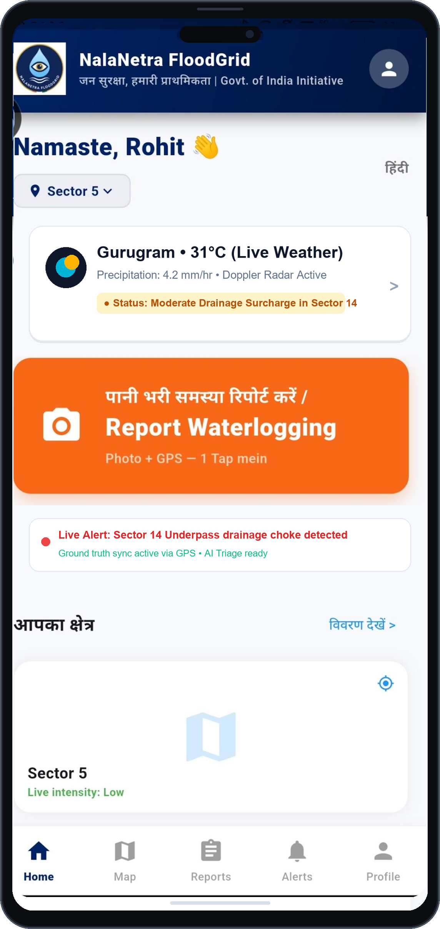
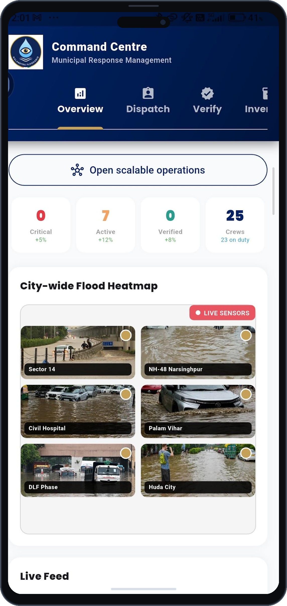
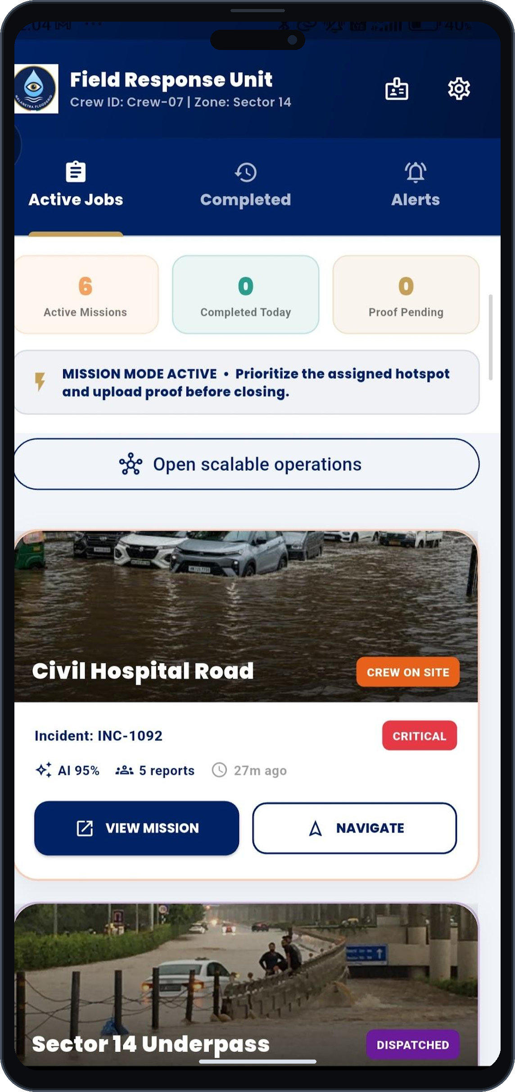
RESEARCH & REFERENCES
Team: Dropwise
WORKING SYSTEM IMPLEMENTATION & STATUTORY GOVERNANCE ALIGNMENT
OUR WORKING PROTOTYPE
SCIENTIFIC RESEARCH & METHODOLOGICAL FOUNDATIONS
1. Dual-Pol Doppler Radar Quantitative Precipitation Estimation (QPE)
• Method: Optical-flow vector tracking & Z-R calibration from Doppler radar. [NalaNetra Role: Sub-km rain volume feeds for nowcast engine.] [→ View Radar Research]
2. 1-D Kinematic-Wave Drainage Routing (Manning’s Equation)
• Method: Hydrodynamic stormwater pipe conveyance & manhole surcharge (EPA-SWMM). [NalaNetra Role: Couples surface rainfall with drainage capacity.] [→ View EPA-SWMM Model]
3. Monocular Computer Vision Severity Triage & Evidence Integrity
• Method: Automated waterlogging depth classification & SHA-256 upload integrity. [NalaNetra Role: Triages citizen reports & flags inconsistent evidence.] [→ View CV Research Paper]
STATUTORY GOVERNANCE & NATIONAL REFERENCES
• National Disaster Management Authority (NDMA): 2010 Urban Flood Guidelines — Stormwater drainage, early warning & municipal SOPs. [→ Open NDMA Guidelines]
• India Meteorological Department (IMD): Urban Nowcasting SOP — Standard operating doctrine for extreme heavy rainfall events. [→ Open IMD Nowcast]
• NCMRWF • MoES: Unified Model (UM) — High-resolution atmospheric nowcasts coupled with drainage networks. [→ Visit NCMRWF]
• National Institute of Disaster Management (NIDM): Urban Flood Management — Standard training doctrine for municipal drainage resilience. [→ Open NIDM Report]
Citizen Portal (Hindi UI)
1-Tap GPS Report, Live Weather
& 5-Stage Stepper
MCG Officer Portal
City Heatmap, P-Score Priority
Queue & Crew Dispatch
Field Response Unit
Turn-by-Turn Safe Navigation
& Mandatory Photo Proof

