Slide 1
Different Reconstruction Techniques on Sinogram Image of Solder Ball Grid
Rohit Das
Advised By – Prof. Chiou-Shann Fuh
61047086s@ntnu.edu.tw
+886-0905023713

Slide 2
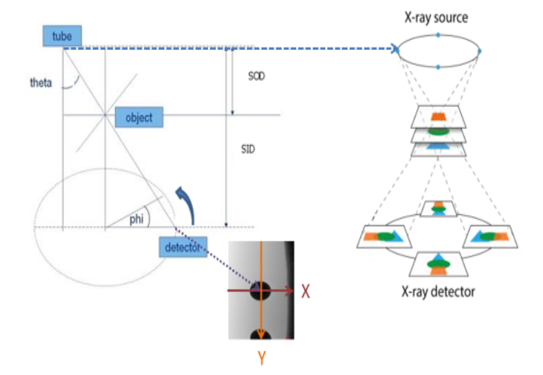
Introduction
SOD – Source to Object Distance
SID – Source to Image Distance

Slide 3
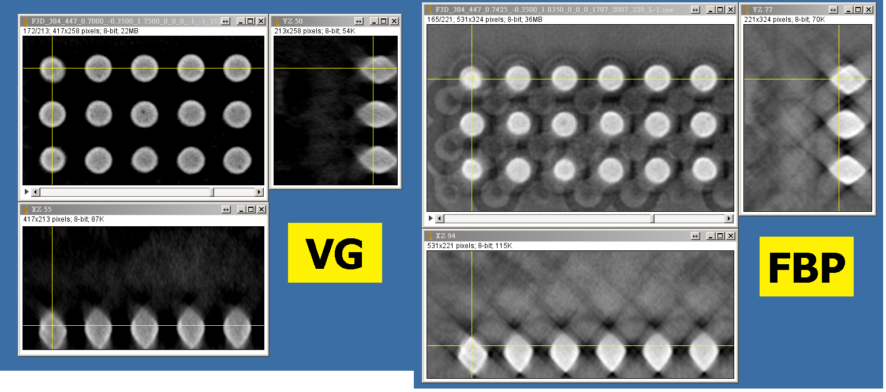
The Problem
VG: Volume Graphics
FBP: Filtered Back Projection
The solder balls are too rhombus
Image contrast not clear enough (voids are dark spots)

Slide 4

Experiment
In order to do potential research, we need to experiment on a base image so that we can apply the method post research.
This image has a lot of shapes and will be quite potential in solving the problem.
Ground Truth

Slide 5
Sinogram
The Radon Function (Sinogram) computes projections of an image matrix along specified directions.
Widely applicable in Computer Tomography
Gif source - https://en.wikipedia.org/wiki/File:Radon_transform_sinogram.gif
Notes:
CT never creates images. It throws beams to the dividing the measured photon counts by the incident photon counts and taking the negative logarithm yields samples of the Radon transform of the linear attenuation map. from measured projection or scattering data. object. And these beams are then reconstructed to images.

Slide 6
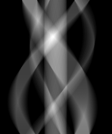
Sinogram
Two Methods
Inbuilt Function – skimage_transformation.radon()
Iterative Algorithm
Original Image
Expected Sinogram

Slide 7
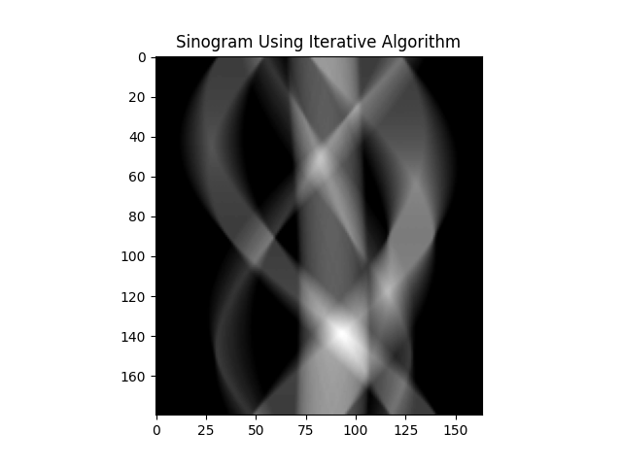

Sinogram Generation from Iterative Algorithm
Rotate the image and project the image at every angle (till 180$°$)
Go through each column by indexing over row of projected image
Sum each iteration and divide it by height
Add it to new image

Slide 8
Different Reconstruction Techniques
Filtered Back Projection(FBP)
Algebraic Reconstruction Technique(ART)
Simultaneous Algebraic Reconstruction Technique(SART)

Slide 9
Filtered Back Projection (FBP)
Most commonly used Reconstruction Technique
No need of any prior information
AS the name suggests, we apply a filter for removing halo noise and apply Backprojection algorithm
Since it is a linear method, we can also use the filter after implementing Backprojection

Slide 10
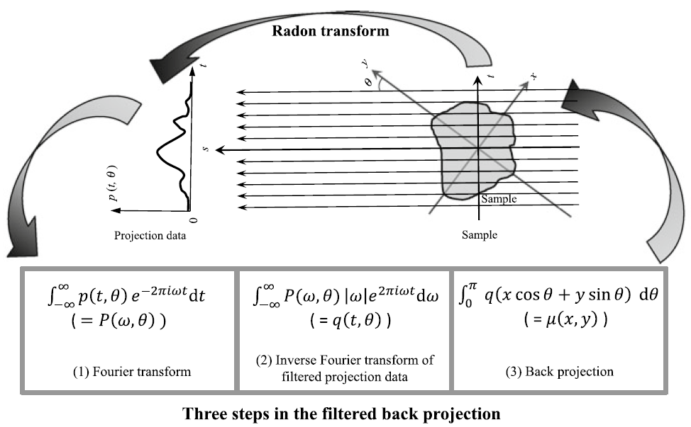
Filtered back projection (FBP)

Slide 11
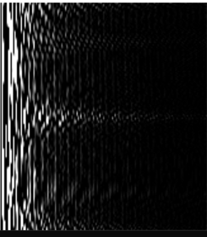
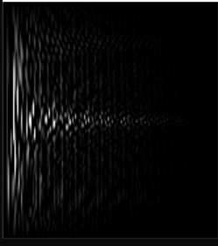
Filtered BackProjection (FBP)
Original Image
Sinogram
Forward Fourier Transform
After applying Hamming Filter

Slide 12
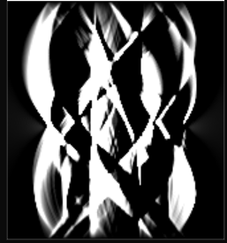
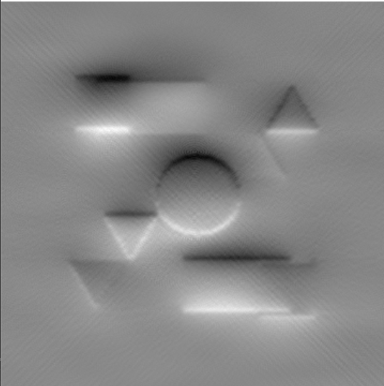
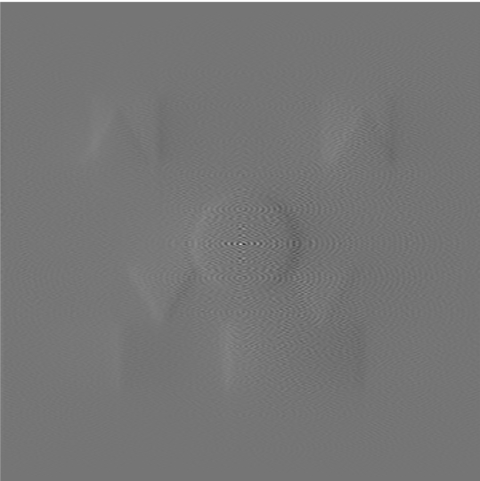
Filtered BackProjection (FBP)
Inverse Fourier Transform
Applying Hamming Filter after Sinogram Generation
Hamming Filter after BackProjection

Slide 13
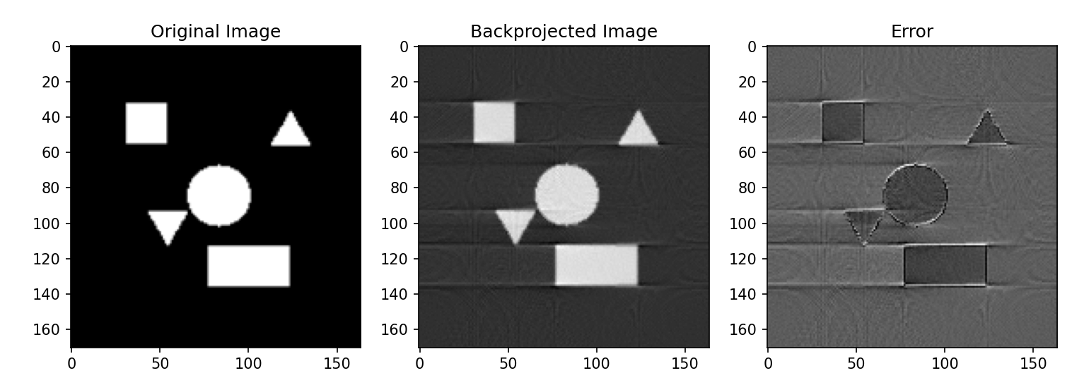
Filtered Backprojection (FBP)
Another Experiment in Python using Ramp Filter

Slide 14
Filtered Backprojection (FBP)
Like any problem, there is a challenge!
The challenge we face right now is implementing Backprojection algorithm.
The actual process of Backprojection is difficult to understand and an overview even less so.
Very Hard to trace the process
Since it is a linear operation and the process needs no prior information, there might be a chance of different results on different images.

Slide 15
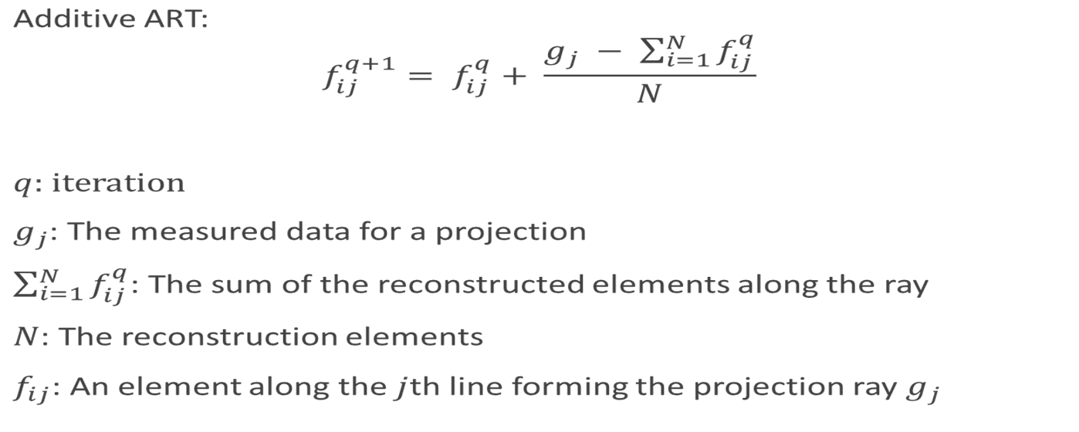
Algebraic Reconstruction Technique (ART)
A classic iterative reconstruction method (R. Gordon, "A tutorial on art (algebraic reconstruction techniques)," in IEEE Transactions on Nuclear Science, vol. 21, no. 3, pp. 78-93, June 1974, doi: 10.1109/TNS.1974.6499238.)

Slide 16
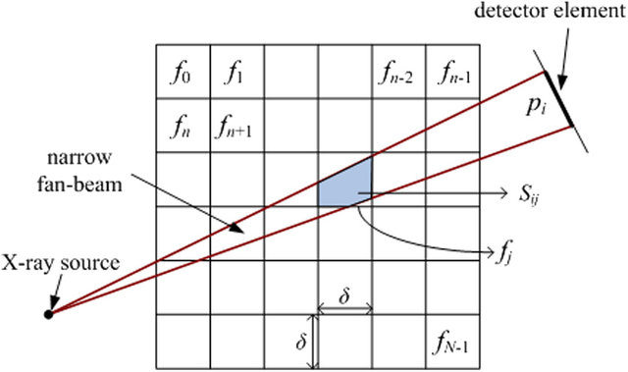
Algebraic Reconstruction Technique (ART)

Slide 17
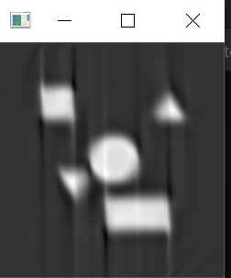
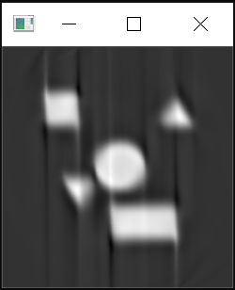
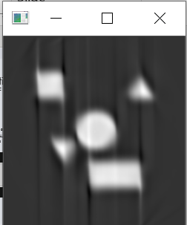
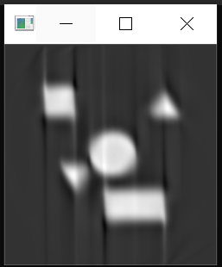

Algebraic Reconstruction Technique (ART)
Results
$32$ iterations
50 iterations
180 iterations
500 Iterations

Slide 18
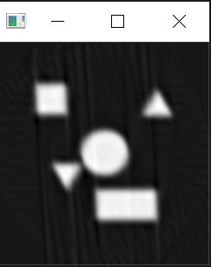
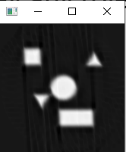
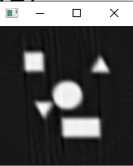

Remove Halo Noise
Can morphology play any role here?
300 Iteration at 4$°$
Erosion
Opening
Erosion minimizes the shape size(As it was supposed to do)
Opening did nothing as the noise is not grainy noise but Halo noise
Halo Noise seems very difficult to remove

Slide 19
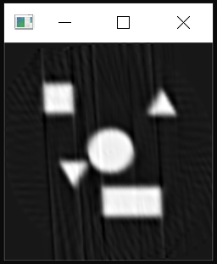
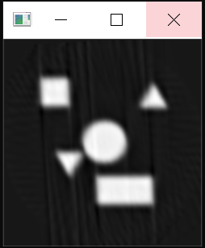
How about Sharpening?
300 Iteration at 4$°$
Using Sharpen Filter
Using Sharpen Filter at every iteration of ART

Slide 20
HOW TO REGAIN THE SHAPE AFTER RECONSTRUCTION?
Post processing might not solve the problem.
Halo Effect makes it difficult to regain the shape.

Slide 21
Simultaneous Algebraic Reconstruction Technique (SART)
A significant reduction in the noise can be achieved if we apply all error correction terms for rays in a particular projection simultaneously rather than in the conventional sequential fashion.
An inherently discrete approach in which all ray equations are corrected for simultaneously, regardless of the order.
The proposed technique is aimed at producing a smooth image estimate after the consideration of the subset of ray-sum projections associated with a particular scan direction; SIRT, on the contrary, aims at producing smooth image estimates after each full iteration, i.e., after all the ray-sum equations have been considered.

Slide 22
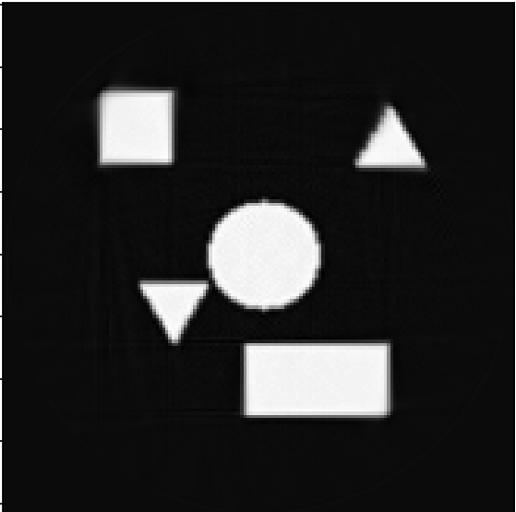
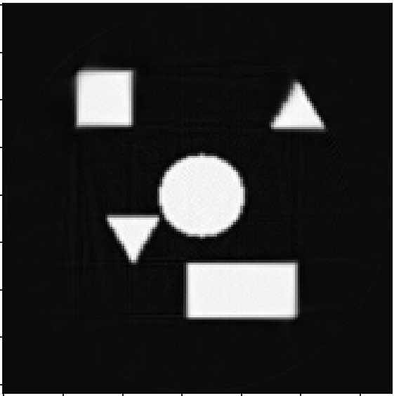

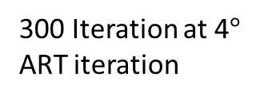
Simultaneous Algebraic Reconstruction Technique (SART)
300 Iteration at 4$°$
ART iteration
SART with 1 iteration
SART with 2 iterations
Original Image

Slide 23
Pipeline
Input Image
Back Projection
Normalization
Create Filter
Inverse Fourier Transform
Output
Fourier Transform
Filter

Slide 24
Thank You

