Slide 1
Different Reconstruction Techniques on Sinogram Image
Rohit Das
Advised By – Prof. Chiou-Shann Fuh
61047086s@ntnu.edu.tw
+886-0905023713

Slide 2
Research Progress
Pre-processing after ART
Is there any way to reduce some halo noise on after ART?
Simultaneous Algebraic Reconstruction Technique (SART)

Slide 3
Pre-processing after ART
One good advantage of ART over FBP is the shape retention.
Shape retention is our primary concern after reconstruction since the main problem lies with the solder ball shape.
So, to improve the quality and to reduce the halo noise in a general way, we used Fourier transform and apply hamming filter and after that used inverse Fourier transform.
We used the concept of FBP but instead of backprojection we used it on the ART image.

Slide 4
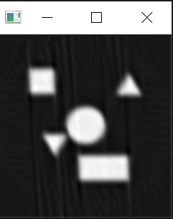
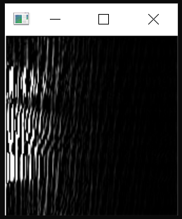
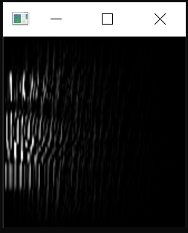
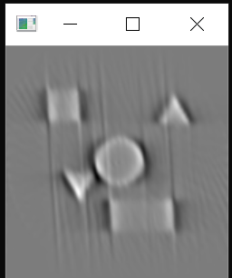

Not satisfactory Results(ART)
300 Iteration at 4$°$
Forward Fourier Transform
Hanning Filter
Inverse Fourier Transform
Same way for halo noise removal won’t work other than back projection(FBP).
Maybe a better filter can fix this?
More research is needed.

Slide 5
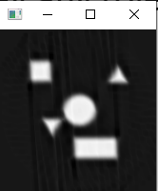
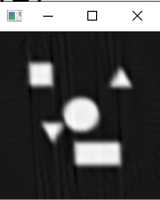

Remove Halo Noise
Can morphology play any role here?
300 Iteration at 4$°$
Erosion
Opening
Erosion minimizes the shape size(As it was supposed to do)
Opening did nothing as the noise is not grainy noise but Halo noise
Halo Noise seems very difficult to remove

Slide 6
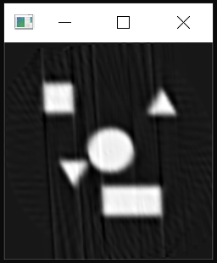
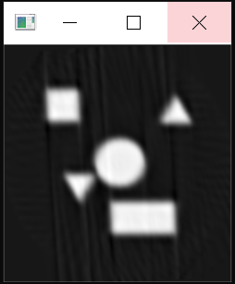
How about Sharpening?
300 Iteration at 4$°$
Using Sharpen Filter
Using Sharpen Filter at every iteration of ART

Slide 7
HOW TO REGAIN THE SHAPE AFTER RECONSTRUCTION?
Post processing might not solve the problem.
Halo Effect makes it difficult to regain the shape.

Slide 8
Simultaneous Algebraic Reconstruction Technique(SART)
A significant reduction in the noise can be achieved if we apply all error correction terms for rays in a particular projection simultaneously rather than in the conventional sequential fashion.
An inherently discrete approach in which all ray equations are corrected for simultaneously, regardless of the order.
The proposed technique is aimed at producing a smooth image estimate after the consideration of the subset of ray-sum projections associated with a particular scan direction; SIRT, on the contrary, aims at producing smooth image estimates after each full iteration, i.e., after all the ray-sum equations have been considered.

Slide 9
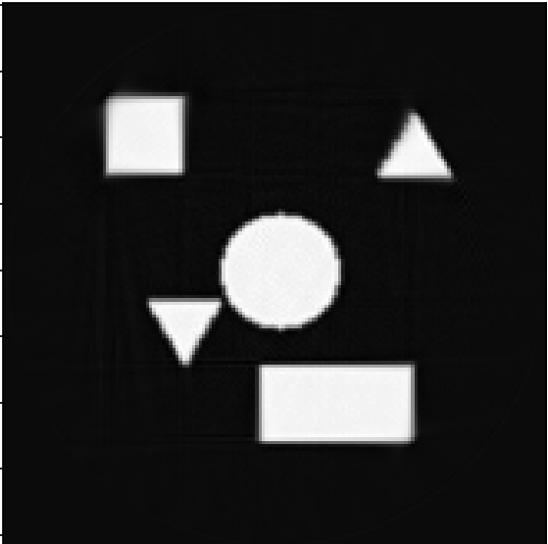
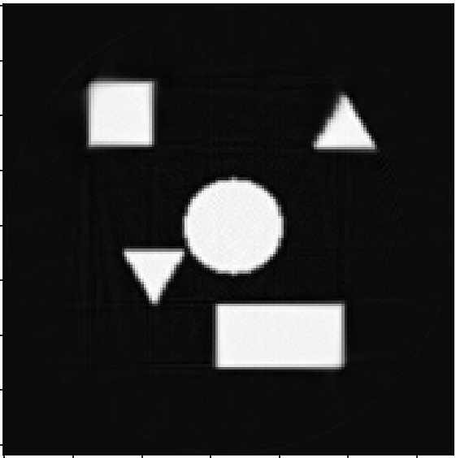

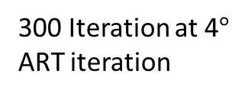
Simultaneous Algebraic Reconstruction Technique(SART)
300 Iteration at 4$°$
ART iteration
SART with 1 iteration
SART with 2 iteration
Original Image

Slide 10
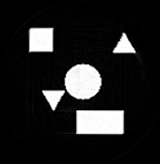
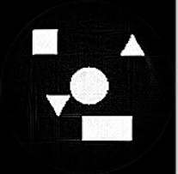
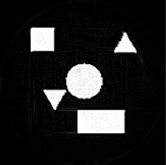
Simultaneous Algebraic Reconstruction Technique(SART)
After applying sharpening filter
SART with 2 iteration and sharpen kernel
SART with 2 iteration and self-made filter kernel
SART with 2 iteration and self-made filter kernel
Original Image
[[0, -1, 0], [-1, 5, -1],
[0, -1, 0]]
[[-1, -1, -1], [-1, 9, -1],
[-1, -1, -1]]
[[-1, -1, -1], [-1, 8, -1],
[-1, -1, 0]]

Slide 11
Thank You

