Slide 1
IndiaBites
An Explainable Hybrid Restaurant Recommendation System with Personalised Fusion Weights
MTech Integrated CSE (Business Analytics) · CSE4077 Recommender Systems · Slot A1+TA1
Presented by: <S ROHIT – 23MIA1175> · <MRIDULA S– 23MIA1004> · < FEDRICK ENGELS – 23MIA1082>
Faculty Mentor: Dr S Vigneshwari (54147) School of Computer Science and Engineering, VIT Chennai
12
19
9
7
2
Indian cities
Cuisine types
Models trained
Evaluation metrics
Datasets
Notes:
Introduce the project: a hybrid restaurant recommender for the Indian market. Two things make it different from a textbook hybrid - the fusion weights are learned per user, and every recommendation explains itself. Mention that the system is fully implemented and will be demonstrated.

Slide 2
Why single-signal recommenders fail here
1
Cold start
Constraints specific to India
A newly registered diner has no rating history, so the collaborative signal is not weak — it is mathematically undefined.
Dietary observance is a hard filter, not a preference — vegetarian, Jain, halal and vegan.
Price spans two orders of magnitude, from ₹150 street food to ₹2,000+ fine dining.
A single "Indian" label conflates Chettinad, Andhra, Kerala, Bengali, Punjabi, Gujarati, Rajasthani, Mughlai and Hyderabadi cuisines.
Locality matters more than city — a diner in T. Nagar will not cross Chennai for dinner.
2
Overspecialisation
Content-based filtering keeps proposing what has already been eaten, so genuine discovery is suppressed.
3
Hidden dissatisfaction
A four-star rating conceals review text describing inconsistent service; the star alone discards that signal.
Each signal fails differently — which is precisely why combining them works.
Notes:
Set up the motivation. The three numbered failures are the textbook weaknesses of each single signal. The card on the right is what makes the Indian market different - dietary rules are hard constraints, not soft preferences. Close on the line at the bottom: the failures are independent, so a hybrid is justified.

Slide 3
A five-layer hybrid framework
1
2
3
4
5
Filter
Score
Normalise
Fuse
Explain
Hard constraints applied conjunctively — city, diet, budget, cuisine
›
Three signals scored independently: TF-IDF, item–item CF, VADER
›
Min–max to [0,1] so no signal dominates by scale
›
Weighted sum using the user’s own NNLS weights
›
Dominant term mapped to a plain-English reason
Shybrid(u, i) = w₁(u)·Scontent + w₂(u)·Scollab + w₃(u)·Ssentiment
The weights carry the subscript (u) — they belong to the individual user, not to the system.
Cold start handled, not ignored
Why normalisation is not optional
With no history the collaborative term is undefined, so a popularity prior stands in and the explanation says so explicitly.
The three arms produce different natural ranges; without rescaling, the widest-spread arm would win for reasons unrelated to quality.
Notes:
Walk left to right through the five layers. Emphasise layer 4 - that is where the novelty sits, highlighted in green. The equation is the whole method in one line; point at the (u) subscripts. Mention that normalisation is a real engineering decision, not boilerplate.

Slide 4
What is new in this work
1
Personalised fusion weights
2
Explainability layer
w(u) = arg min ‖A(u) w − b(u)‖² subject to w ≥ 0
“Recommended because you prefer South Indian cuisine, and it’s highly rated in T. Nagar.”
Estimated separately for every user by Non-Negative Least Squares over that user’s own rating history.
Replaces the single fixed blend that every comparable hybrid applies to the whole population.
Non-negativity is essential: a negative coefficient would mean a better match lowers preference — uninterpretable, and it would invalidate the explanations.
The dominant term of the fusion equation is mapped to a plain-English reason.
Cold-start suggestions state openly that they rest on popularity, not on personalised evidence — the user is never misled about the basis.
Explanations improve trust independently of accuracy, so the facility is justified even where no metric moves.
The hybrid architecture itself follows prior work — these two extensions are the original contribution.
Notes:
Be explicit that the three-signal hybrid is not claimed as novel - it follows Asani et al. The two cards are what is actually new. On card one, stress why non-negativity is a real constraint and not decoration. On card two, note that the cold-start honesty is deliberate.

Slide 5
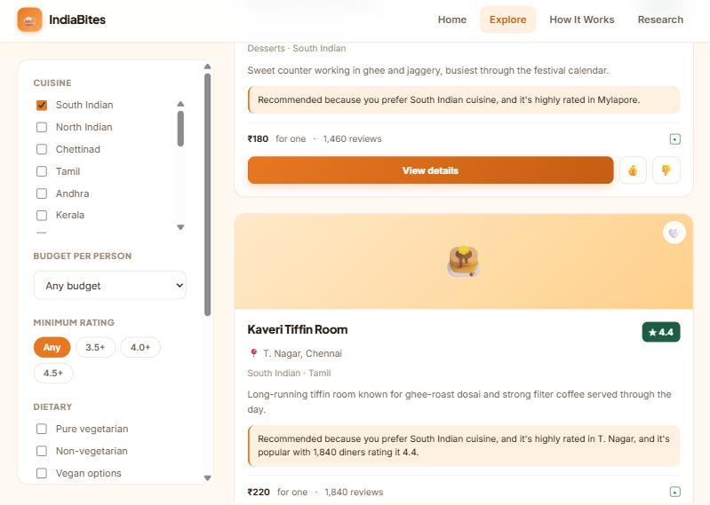
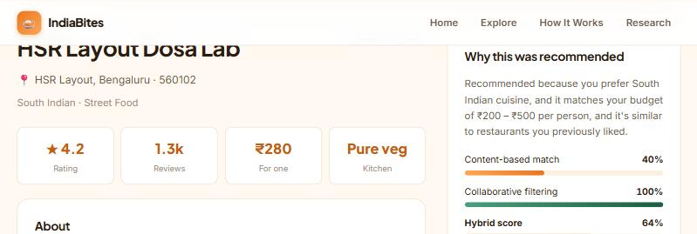
The working system
0.6 × 0.40 + 0.4 × 1.00 = 0.64
The hybrid arithmetic is exposed to the user, not hidden behind a single score
60 sample restaurants across 12 cities and 19 cuisines.
TF-IDF index and item–item similarity matrix computed live in the browser — no server required.
Listings are clearly labelled sample data; addresses, hours and contact details were deliberately not fabricated.
Filters narrow Chennai + South Indian to four results; every card carries its generated reason
Notes:
This is the demo slide - if the live site is available, show it instead and use these as backup. The key moment is the score breakdown on the right: content 40 percent, collaborative 100 percent, hybrid 64 percent, and the arithmetic checks out exactly. Mention the sample-data labelling as a deliberate integrity choice.

Slide 6
Evaluation protocol and what remains
9
7
2
Status: results pending
models trained
metrics
datasets
The pipeline and all nine models are implemented; the evaluation notebooks have yet to be executed, so no figures are quoted here rather than estimated.
Rating prediction: Global Mean and Popularity baselines vs. tuned SVD, NMF, item-based and user-based KNN.
Sentiment: VADER against Multinomial Naïve Bayes and Logistic Regression.
Known limitations
The per-user interaction layer is synthetic — public catalogues carry no rating history.
Evaluation is offline only; no user study was conducted.
Weight personalisation needs history, so it cannot help the cold-start users who need it most.
Metrics: RMSE and MAE alongside Precision@K, Recall@K, F1@K, NDCG@K and Coverage — error and ranking families reported together, because they are known to disagree.
Project deliverables
Future scope
Project report and research paper draft.
Two Colab notebooks — full pipeline and novel extensions.
A deployed, browser-based web interface.
Authentic interaction data to remove the principal threat to validity.
A fine-tuned transformer in place of the VADER lexicon.
Context-aware signals — time of day, occasion, group size.
Thank you · Questions welcome
Notes:
Close on the evaluation design rather than on numbers. Be upfront that results are pending - the protocol is defined and the models are built, but the notebooks have not been run, so nothing is quoted. State the limitations plainly; examiners respond better to candour than to overclaiming. End on future scope and invite questions.

