Slide 1

Adaptive Image Enhancement for Robust Road Surface Crack Detection under Challenging Illumination Conditions
COURSE CODE:CSE-1905

Slide 2
CONTENT
Introduction
Recent Statistics
Literature Review & Summary of Literature
Research Gap
Objectives
Novelty
Methodology – Overall Architecture
Methodology – Explanation
Experimental Work
Results
Conclusions
Future Scope
References

Slide 3
INTRODUCTION
Cracks are the earliest pavement distress – left undetected they let water in, damage the base layers and lead to potholes and costly full-depth repairs on roads that support safety and the economy.
Manual inspection does not scale – visual surveys and inspection vehicles are time-consuming, costly, subjective and unsafe for inspectors.
Deep learning has advanced detection (CNNs, Vision Transformers, hybrids, UAV imaging), but lighting is still the hard problem – shadows, low light, glare and reflections cause false detections and missed low-contrast cracks.
Current practice is static – the same equalization / gamma correction for every image, enhancement and feature extraction done separately, benchmarks mostly under ideal lighting, and few edge-deployable solutions.
Why it matters now – computer-vision inspection is central to monitoring built infrastructure [12] and increasingly feeds LLM / agent-based defect-detection and resilience systems [13], [15]; their results are only as good as the images they receive, and lighting still degrades those images.

Slide 4
PROPOSED WORK
Proposed: Illumination-Adaptive Enhancement Protocol (IAEP) within IAEP-Net – a single end-to-end framework for robust crack detection under varying light.
Quality-aware: an Image Quality Assessment (IQA) layer estimates illumination distribution, shadow coverage, noise level and local contrast, so the enhancement adapts to each image.
Goal: accurate crack segmentation and severity analysis (width, density, damage level) in low light, shadow and over-exposure, deployable in real time on edge devices.
Justification: fusing complementary features early, before decoding, is an effective design [11], and the framework targets the illumination gap left by recent segmentation and agent-based inspection work [6], [13], [15].
Quality assessment & adaptive enhancement – brightness, contrast, noise → adaptive gamma + CLAHE fusion
Parallel dual-encoder – ResNet-50 (local) alongside Swin Transformer (global)
Fusion & decoder – residual addition → transposed-convolution decoder → crack probability map
Refinement & assessment – Otsu, morphology, CCA, skeleton + EDT → width, density, class

Slide 5
RECENT STATISTICS
Figures reported in recent (2024–2026) studies, and why each one justifies this work
15 image-degradation severity levels (Robust-Seg) for ADI-SAM (Zhao et al., 2026) – robustness is now tested across degradation levels, but the heavy SAM backbone does not gate features by image quality at inference.
0.307 M parameters, tested on 15 ImageNet-C corruption types (Shan & Jiang, 2026) – small models can resist corruption, yet the corruption level is used only in post hoc evaluation, not during inference.
176.67 FPS with 0.82 M parameters; mIoU 86.30 % on DeepCrack (Dong et al., 2026) – real-time crack segmentation is feasible, but its static OTSU pre-segmentation fails under extreme illumination.
113 studies in an edge-computing structural health monitoring review (Qiu et al., 2025) – shows the demand for lightweight, real-time models and flags image degradation under changing conditions as an open issue.
F1 87.5 % and IoU 84.1 % on Crack500, DeepCrack and FIND (Abraham et al., 2025) – LoG and threshold values stay fixed under all lighting, so adaptive illumination processing is still an open problem.
Up to +10.14 % F1 over UNet, FCN, CCNet and Swin baselines (Yu et al., 2024) – architecture gains can be large, but pre-processing is absent or simple and not quality-aware at inference.
Fig. 1 Recent studies behind these statistics, by year of publication (2026 to 2024)
Overall justification: these figures show strong crack segmentation and a clear push toward lightweight, real-time models, but none of the studies adapts its enhancement to each image’s illumination – the gap that IAEP-Net addresses.

Slide 6
RECENT STATISTICS
The reported figures plotted (values as stated in the cited studies, newest first)
Fig. 2 Segmentation scores reported by recent crack-segmentation studies
Fig. 3 Parameters of the lightweight crack-segmentation models
Fig. 4 Degradation levels (Zhao), corruption types (Shan & Jiang) and studies reviewed (Qiu)
Not charted: 176.67 FPS at 0.82 M parameters (Dong et al., 2026) and up to +10.14 % F1 over UNet, FCN, CCNet and Swin baselines (Yu et al., 2024).

Slide 7
LITERATURE REVIEW
Title | Journal and year | Authors | Outcomes
[1] Pixel-level pavement crack segmentation using UAV remote sensing images based on the ConvNeXt-UPerNet | Alexandria Engineering Journal, vol. 124, 2025 | H. Taha, H. El-Habrouk, W. Bekheet, S. El-Naghi, M. Torki | ConvNeXt encoder + UPerNet decoder with a new drone dataset (DronePavSeg) from Egyptian roads; outperforms seven segmentation models on shadows, water/oil stains and low-contrast cracks. Fails at dark shadow edges, mistaking them for crack boundaries.
[2] Enhancing pavement crack segmentation via semantic diffusion synthesis model for strategic road assessment | Results in Engineering, vol. 23, 2024 | S. Cano-Ortiz, E. Sainz-Ortiz, L. Lloret Iglesias, P. Martínez Ruiz del Arbol, D. Castro-Fresno | RoadPainter, a conditional diffusion model, generates crack images from segmentation masks to augment training data. Aimed at annotation scarcity, but the controllable appearance could also supply illumination-diverse training images.
[3] Intelligent defect-detection framework integrating a modified YOLO algorithm, a domain knowledge graph, and RAG-enabled large language model | Advanced Engineering Informatics, vol. 74, 2026 | J.-F. Dang, L.-N. Wang, T.-L. Chen | Modified YOLO + knowledge graph + RAG-enabled LLM. LAB colour correction and sharpening normalise brightness across cameras before detection – evidence that illumination normalisation helps defect detection (not pavement-specific).
[4] SAM-BM: An adversarial benchmark for loss functions and multi-scale objects in Segment Anything Models | Computer Vision and Image Understanding, vol. 269, 2026 | H. Lv, S. Jiang, Y. Bai, T. Wan, C. Gou, L. Chen | Benchmarks the robustness of Segment Anything Models (incl. lightweight variants) to adversarial disruption across loss functions and object scales; motivates condition-graded evaluation instead of a single aggregate score.

Slide 8
LITERATURE REVIEW
Title | Journal and year | Authors | Outcomes
[5] Trends and perspectives in structural health monitoring through edge computing: a review with zero-shot NLP categorization | Journal of Railway Science and Technology, vol. 1, 2025 | S. Qiu, M. Malik, H. Ehsan, W. Wang, J. Wang, R. Cheng, W. Wei, Q. Zaheer | Reviews 113 edge-computing SHM studies; stresses the need for lightweight real-time models and flags environmental robustness (image degradation) and on-device compute trade-offs as open issues.
[6] ADI-SAM: Adapting Segment Anything Model for Degraded Images | Neurocomputing, 2026 | Y. Zhao, Z. Liu, Y. Nan, S. Wang, K. Lu, S. Lian | Local region attention in the ViT encoder, robust feature fusion, frequency-guided consistency and uncertainty-aware contrastive learning; tested on Robust-Seg with 15 degradation severities. Heavy SAM backbone; no quality-conditioned feature gating at inference.
[7] Bridging heterogeneous state space models and convolutional neural networks for efficient and robust pavement crack segmentation | Engineering Applications of Artificial Intelligence, vol. 175, 2026 | J. Shan, W. Jiang | ChampMamba: Visual State Space + CNN with a champion bottleneck, scaled-channel-attention head and cross-layer enhancement; tested on UAV-Crack500, CrackSC and Crack500 under 15 ImageNet-C corruptions. ChampMamba-S (0.307 M params) is competitive; corruption level is not used at inference.

Slide 9
LITERATURE REVIEW
Title | Journal and year | Authors | Outcomes
[8] Ultra lightweight framework with attention mechanism for crack segmentation using OTSU pre-segmentation and offline self-distillation | Advanced Engineering Informatics, vol. 74, 2026 | Y. Dong, J. Jiang, S. Li, W. Chen, J. Ye | EUCAN: OTSU pre-segmentation, static + dynamic Sobel kernels, biaxial coordinate attention and self-distillation. 0.82 M params, 176.67 FPS; mIoU 86.30 / 77.08 / 82.12 / 83.26 % (DeepCrack / Crack500 / Crack3K / Concrete). Static OTSU fails under extreme illumination.
[9] Real-time pavement surface crack detection based on lightweight semantic segmentation model | Transportation Geotechnics, vol. 48, 2024 | H. Yu, Y. Deng, F. Guo | iBiSeNetV2: refined detail/semantic branches with a guided aggregation module; up to 10.14 % higher F1 than UNet, FCN, CCNet and Swin baselines at low latency. No quality-aware pre-processing at inference.
[10] DAEENet: A novel dual attention based edge enhanced network for asphalt pavement deterioration detection and segmentation | Case Studies in Construction Materials, vol. 23, 2025 | P. Abraham, J. J. Thomas, H. K., V. K., S. Kumar, A. Sekar | Dual Local Channel Attention, LoG-based Edge Enhancement Attention and Crack Severity Analysis (skeleton + distance transform): F1 87.5 %, IoU 84.1 %, Dice 87.5 % on Crack500, DeepCrack and FIND. LoG and threshold values are fixed under all illumination.

Slide 10
LITERATURE REVIEW
Title | Journal and year | Authors | Outcomes
[11] EVF-SAM: Early vision-language fusion for text-prompted Segment Anything Model | Image and Vision Computing, vol. 173, 2026 | Y. Zhang, T. Cheng, L. Zhu, L. Liu, H. Liu, L. Ran, X. Chen, W. Liu, X. Wang | A BEIT-3 multimodal encoder fuses text and image tokens early and feeds the result to the SAM prompt encoder; early fusion beat late fusion, reaching 79.0 average cIoU on RefCOCO/+/g with about 1.32 B parameters (LLM-based methods exceed 7 B). Supports fusing complementary features early, before decoding.
[12] Automated construction monitoring based on computer vision: a comprehensive review | Developments in the Built Environment, vol. 25, 2026 | L. Li, Z. Huang, J. Wang, B. Du, L. Dai | Comprehensive review of computer-vision-based automated monitoring in construction; gives the background that vision-based inspection of built infrastructure depends on reliable image input.
[13] Lightweight multimodal LLM-empowered dual-agent collaboration for reliable defect detection and maintenance recommendation in tunnel infrastructure | Reliability Engineering & System Safety, vol. 268, 2026 | G. Yu, R. Ju, V. Sugumaran, H. Liu | A lightweight multimodal LLM with two collaborating agents for defect detection and maintenance recommendation in tunnels – shows the move from detection to maintenance decisions on a lightweight model.

Slide 11
LITERATURE REVIEW
Title | Journal and year | Authors | Outcomes
[14] MAVL-DRL: multimodal foundation using multi-agent deep reinforcement learning for intelligent predictive maintenance of wind turbine energy systems | International Journal of Electrical Power & Energy Systems, vol. 177, 2026 | A. Batool, Y.-W. Kim, Y.-C. Byun | Combines a multimodal foundation model with multi-agent deep reinforcement learning for predictive maintenance of wind turbines – a different domain, relevant as a route from perception to maintenance planning.
[15] Large language models and AI agents in disaster-resilient infrastructure: concepts, applications, pathways and challenges | Reliability Engineering & System Safety, vol. 272, 2026 | J. Cui, C. Zhai, Y. Wang, Y. Li | Framework covering seven task areas (prediction, assessment, decision support and others) with two case studies; names data scarcity, reliability and consistency, deployment constraints and security as open challenges.

Slide 12
SUMMARY OF LITERATURE
Crack segmentation architectures – Taha [1], Shan & Jiang [7], Dong [8], Yu [9], Abraham [10]: ConvNeXt, state-space, lightweight and attention-based networks reach high accuracy, but use fixed or no pre-processing and handle illumination only implicitly.
Data augmentation – Cano-Ortiz [2]: diffusion-based synthesis eases the shortage of labelled cracks and could be extended to illumination-diverse training images.
Illumination / degradation robustness – Dang [3], Zhao [6]: normalising or adapting to image quality helps, but the evidence is not pavement-specific [3] or relies on a heavy SAM backbone [6].
Evaluation & deployment – Lv [4], Qiu [5]: condition-graded robustness evaluation and lightweight, real-time edge models are needed for practical road inspection.
Vision-language, LLM and agent frameworks – Zhang [11], Yu [13], Batool [14], Cui [15]: early fusion of complementary features [11] and agent-based defect detection, maintenance and resilience systems [13]–[15] all depend on reliable visual input, which these studies do not address under varying illumination.
Vision-based monitoring review – Li [12]: sets out computer-vision monitoring of built infrastructure, where image quality is a precondition.
Overall: strong segmentation backbones exist, but illumination is handled statically, implicitly or only post hoc – not through per-image quality-conditioned enhancement.

Slide 13
RESEARCH GAP
Static enhancement – the same histogram equalization / gamma correction (or fixed OTSU / LoG settings) is applied to every image; nothing adapts to the actual lighting condition.
Decoupled pipeline – enhancement and feature extraction are performed independently, which leaves performance sub-optimal.
No quality-conditioned inference – ADI-SAM, ChampMamba and iBiSeNetV2 do not condition features on image quality at inference time (ChampMamba uses corruption level only in post hoc evaluation).
Ideal-lighting benchmarks – most datasets are captured under good light, so robustness to challenging illumination and cross-dataset generalization are rarely tested.
Edge deployment – lightweight, real-time solutions for challenging illumination remain scarce.
Perception is assumed – LLM / agent systems for defect detection, maintenance recommendation and infrastructure resilience [13], [15] build on visual input, yet illumination-robust crack perception is not part of them; [15] also lists data scarcity and reliability as open challenges.
Heavy backbones – promptable foundation models such as EVF-SAM (about 1.32 B parameters) [11] and ADI-SAM [6] are costly for on-device use.

Slide 14
OBJECTIVES
Illumination-adaptive enhancement – build a protocol that uses image quality assessment, adaptive gamma correction and CLAHE fusion to normalise shadows, low light and glare.
Parallel dual-encoder network – ResNet-50 for local detail and Swin Transformer for long-range context, with residual fusion and a transposed-convolution decoder. Early fusion of complementary features is an effective design [11].
Crack refinement and damage quantification – Otsu binarisation, morphological opening, connected-component analysis, skeletonization, and distance-transform width and density.
Generalization – train on Asphalt 720×720 and test on Asphalt 360×360, SDNET2018 and SUT_Crack against five baselines (CNN, LeNet-5, AlexNet, SqueezeNet, GoogLeNet). Cross-dataset testing addresses the data-scarcity and reliability concerns in [15].
Efficiency – keep the model fast and light enough for real-time use on inspection platforms. Lightweight models are what edge and agent-based inspection systems need [5], [13].

Slide 15
NOVELTY
Per-image illumination-adaptive enhancement – IQA statistics drive adaptive gamma correction and CLAHE fusion instead of one static filter.
Hybrid parallel dual-encoder – ResNet-50 (local) and Swin Transformer (global) features fused by entry-wise residual addition.
One end-to-end framework – enhancement, segmentation and severity analysis (width via EDT, density, damage level) in a single pipeline.
Cross-dataset domain-shift evaluation – trained on one dataset, tested on three unseen datasets with different lighting, resolution and surface conditions.
Efficiency – lowest compute and memory (28.2 GFLOPs, 345 MB) and fastest inference (14.8 ms, 67.57 FPS) of the compared models.
Works at the perception stage – illumination-robust crack maps that can feed downstream agent and decision systems such as [13] and [15], rather than a prompt- or text-driven model such as [11].

Slide 16
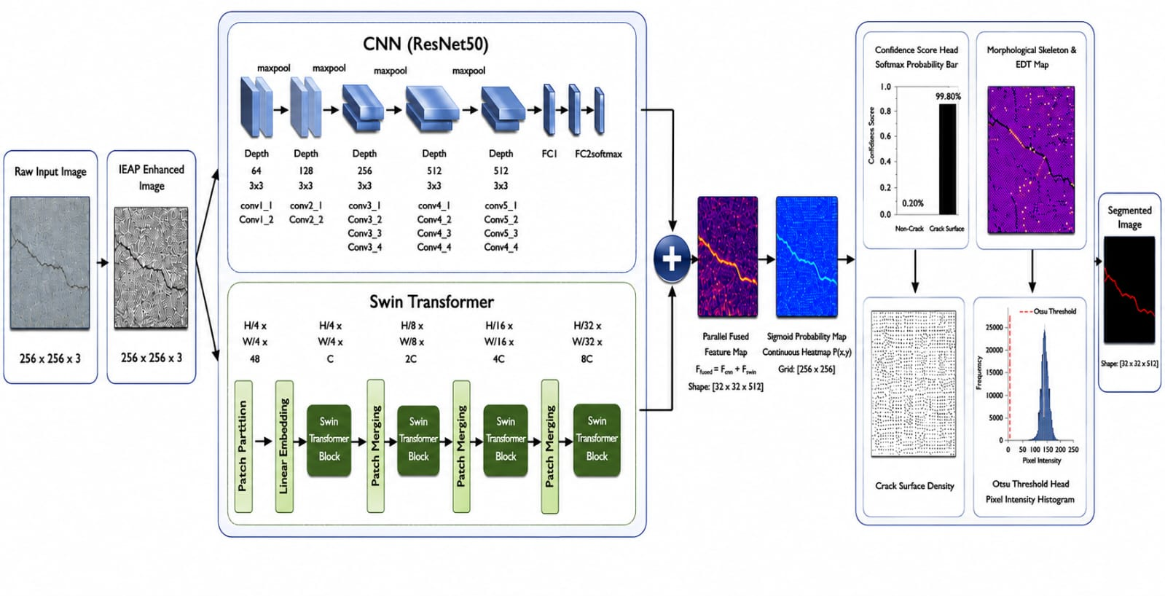
ARCHITECTURE
Fig. 5 Architecture of the proposed Illumination-Adaptive Enhancement Protocol (IAEP) network
Enhancement → ResNet-50 + Swin encoders → fusion → decoder → refinement & damage assessment

Slide 17
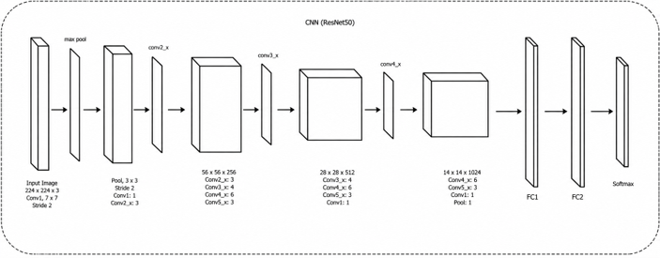
Fig.6 Detailed Architecture of the CNN(ResNet50) For IAEP-Network
Input and stem – a 224 × 224 × 3 image passes through a 7 × 7 convolution (stride 2) and a 3 × 3 max pool (stride 2).
Residual stages – Conv2_x to Conv5_x with 3, 4, 6 and 3 residual blocks; the feature maps shrink from 56 × 56 × 256 to 28 × 28 × 512 and 14 × 14 × 1024 while the channels grow, and the skip connections keep gradients flowing in the deep network.
Classifier head – pooling, FC1, FC2 and Softmax (the head of the standard network shown in the figure).
Role in IAEP-Net – the local branch: it extracts fine-grained spatial features such as crack edges, textures and thin fracture patterns, which keep the crack localisation accurate.

Slide 18
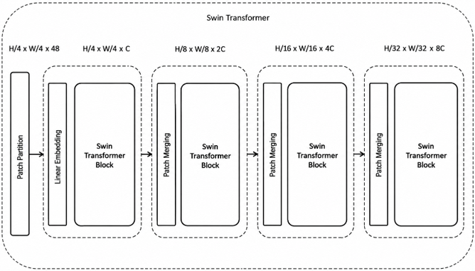
Fig.7 Detailed Architecture of the Swin transformer For IAEP-Network
Patch partition and linear embedding – the image is split into 4 × 4 patches (H/4 × W/4 × 48) and projected to C channels (H/4 × W/4 × C).
Four stages of Swin Transformer blocks – shifted-window self-attention inside each stage; patch merging between stages halves the resolution and doubles the channels: H/8 × W/8 × 2C, H/16 × W/16 × 4C and H/32 × W/32 × 8C.
Role in IAEP-Net – the global branch: it learns long-range spatial relations, so the continuity of cracks and larger structural patterns is captured, which convolution alone detects less readily.
Fusion – its global features are added element-wise to the ResNet-50 local features before the transposed-convolution decoder.

Slide 19
EXPERIMENTAL: DATASETS
Training corpus – Asphalt 720×720 [D1]: 3,398 cracked / uncracked pavement images under varied lighting, shadow and texture, split 70 / 30 for training and in-domain testing (Kaggle, GPU).
Unseen validation sets – Asphalt 360×360 [D2], SDNET2018 Pavements [D3] and SUT dataset [D4] – differ in lighting, pavement and image conditions and are used only to test generalization and guard against over-fitting.
Partition role | Subset name | Ratio | Resolution | Environmental conditions & noise
Training dataset | Asphalt 720 × 720 (train set) | 70 % | 720×720 RGB | Varied pavement illumination, natural shadows and texture noise.
Testing dataset | Asphalt 720 × 720 (test set) | 30 % | 720×720 RGB | Held-out split for in-domain accuracy and generalization.
Validation dataset 1 | Asphalt 360 × 360 | Unseen | 360×360 RGB | Independent pavement dataset for cross-dataset evaluation.
Validation dataset 2 | SDNET2018 | Unseen | Variable / 256×256 | Concrete and pavement surface patches under surface clutter.
Validation dataset 3 | SUT dataset | Unseen | Variable | Multi-material surface structural crack collection.

Slide 20
EXPERIMENTAL: METRICS
Classification metrics: Accuracy, Precision, Recall, F1 Score | Segmentation metrics: IoU, SSIM
Accuracy = (TP + TN) / (TP + TN + FP + FN)
Precision = TP / (TP + FP)
Recall (sensitivity) = TP / (TP + FN)
F1-score = 2·P·R / (P + R) = 2TP / (2TP + FP + FN)
IoU = |P ∩ G| / |P ∪ G| = TP / (TP + FP + FN)
SSIM = (2μ_{x}μ_{y} + C₁)(2σ_{xy} + C₂) / ((μ_{x}² + μ_{y}² + C₁)(σ_{x}² + σ_{y}² + C₂))
TP, TN, FP, FN – true positives, true negatives, false positives and false negatives; P and R in F1 are precision and recall.
P and G in IoU – the predicted and ground-truth crack masks.
In SSIM, μ, σ² and σ_{xy} – the means, variances and covariance of the two images x and y; C₁ and C₂ – small stabilising constants.

Slide 21
EXPERIMENTAL SETUP
Component | Specification and value
Development environment | Visual Studio Code (local scripting, module development, interactive single-image inference testing)
Training / evaluation platform | Kaggle Notebooks – Linux kernel (Ubuntu 20.04 LTS)
GPU | NVIDIA Tesla T4-class cloud accelerator (16 GB GDDR6 VRAM), Kaggle runtime
CPU | Intel Xeon @ 2.20 GHz (Kaggle-allocated)
RAM | 13 GB (Kaggle standard runtime)
Programming language | Python 3.10+
Core frameworks / libraries | PyTorch 2.2.0 with CUDA 12.1, torchvision, OpenCV 4.9.0, scikit-image, NumPy, SciPy
Training engine setup | AdamW optimizer, learning rate 1×10⁻⁴, weight decay 1×10⁻⁴, batch size 16, loss = BCE + Dice, 50 epochs

Slide 22
COMPUTATIONAL COMPLEXITY
Model Architecture | Parameters (M) | Operations (GFLOPs) | Memory Footprint (MB) | Inference Time (ms/frame) | Throughput (FPS)
CNN | 14.20 | 34.50 | 390 | 18.5 | 54.05
LeNet-5 | 18.50 | 39.20 | 425 | 22.4 | 44.64
AlexNet | 22.80 | 44.80 | 470 | 26.8 | 37.31
SqueezeNet | 26.40 | 51.60 | 515 | 31.2 | 32.05
GoogLeNet | 31.10 | 58.40 | 560 | 35.6 | 28.09
Proposed Model (IAEP-Net) | 33.45 | 28.20 | 345 | 14.8 | 67.57
Lowest compute and memory: 28.20 GFLOPs (baselines 34.5–58.4) and 345 MB (390–560).
Fastest: 14.8 ms per frame, 67.57 FPS – 25 % above the best baseline (54.05 FPS).
Trade-off: 33.45 M parameters, more than the baselines (14.2–31.1 M); edge-specific optimisation is future work.

Slide 23
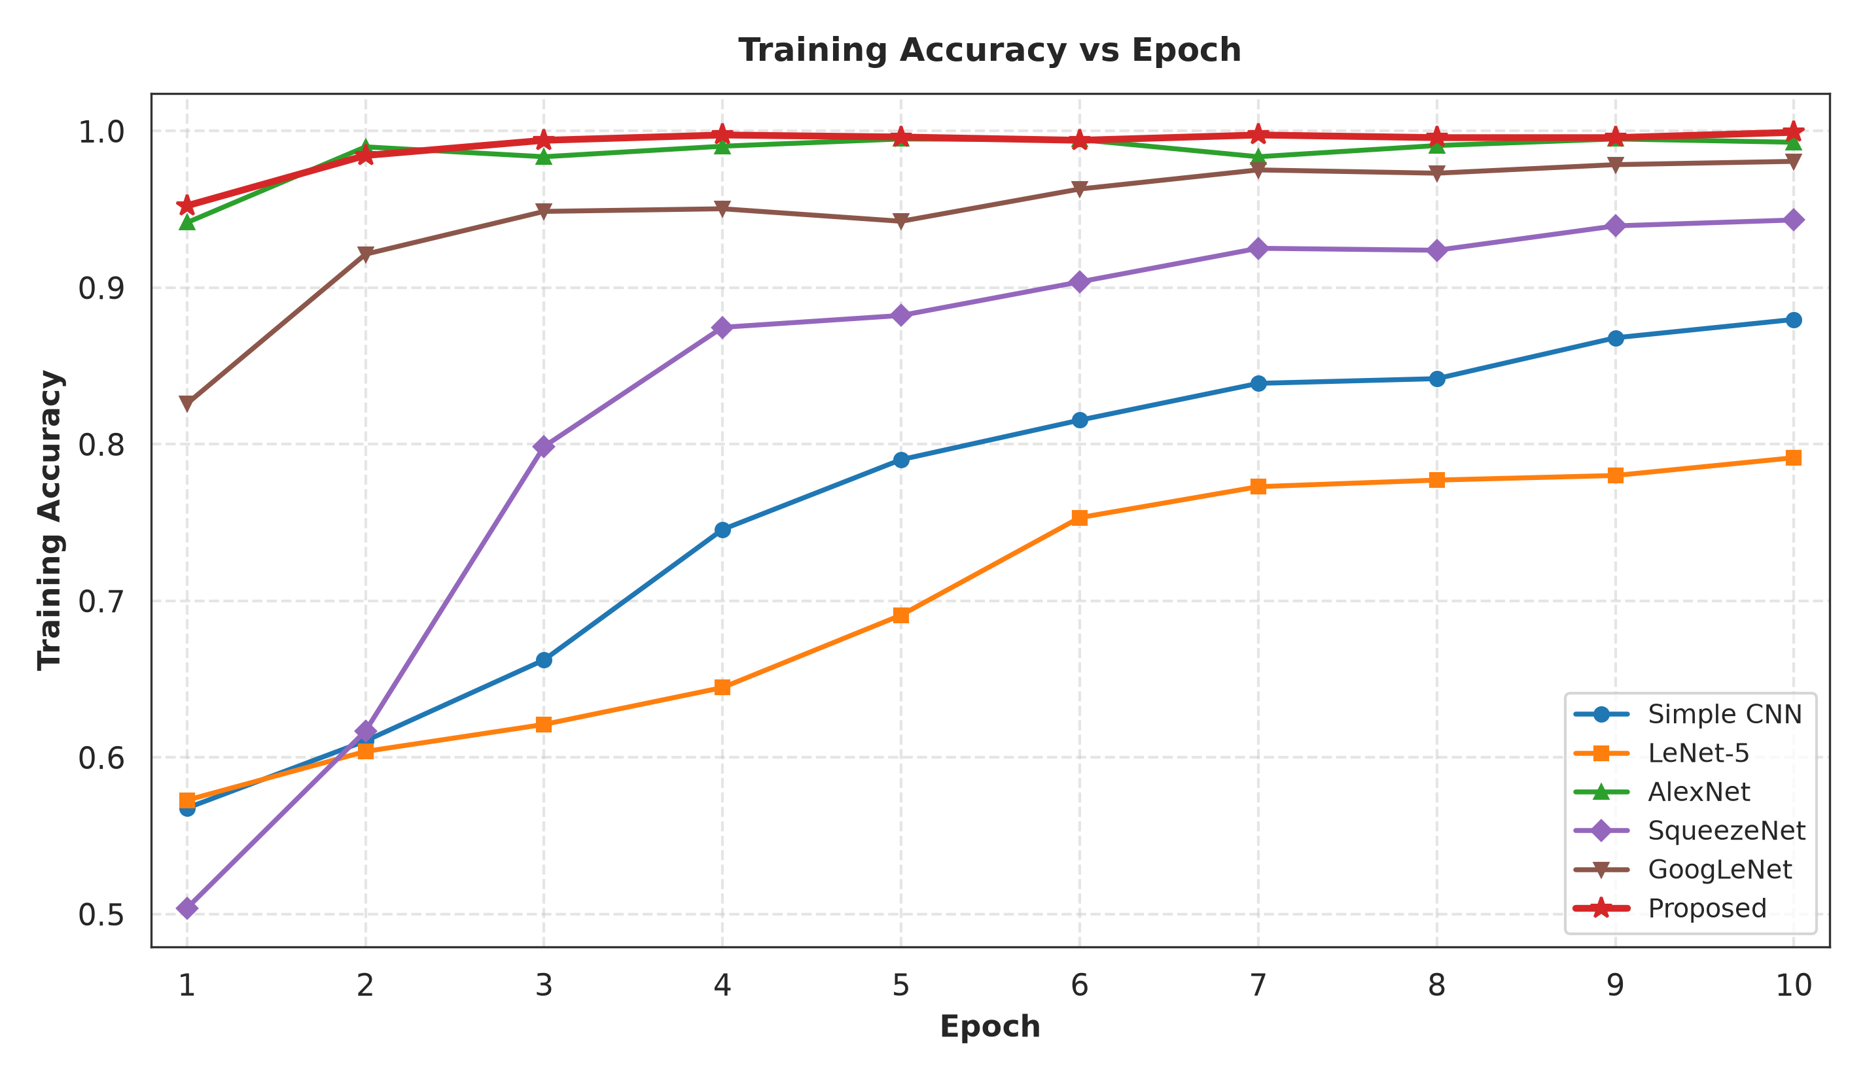
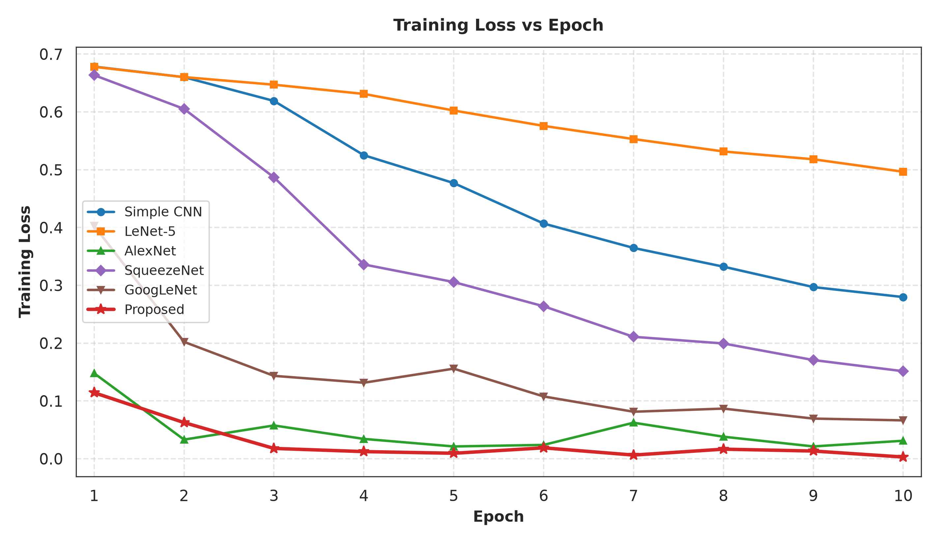
RESULTS: ASPHALT 720
Model | Accuracy | Precision | Recall | F1 score | IoU | SSIM
CNN | 0.9304 | 0.9720 | 0.8863 | 0.9272 | 0.8642 | 0.4133
LeNet-5 | 0.8000 | 0.8558 | 0.7216 | 0.7830 | 0.6434 | 0.2536
AlexNet | 0.9961 | 0.9961 | 0.9961 | 0.9961 | 0.9922 | 0.4192
SqueezeNet | 0.9441 | 0.9381 | 0.9510 | 0.9445 | 0.8948 | 0.2943
GoogLeNet | 0.9814 | 0.9980 | 0.9647 | 0.9811 | 0.9628 | 0.2891
Proposed (IAEP-Net) | 0.9990 | 0.9989 | 0.9980 | 0.9990 | 0.9740 | 0.3439
Primary training dataset, 70 % train / 30 % test split.
IAEP-Net: Accuracy 99.90 %, Precision 99.89 %, Recall 99.80 %, F1 99.90 %, IoU 97.40 %; AlexNet is marginally ahead on IoU (0.9922) and SSIM(0.2536).
IAEP-Net accuracy levels off around 99 % while its loss falls steadily; CNN, LeNet-5 and SqueezeNet converge more slowly.
Fig. 13a Training accuracy vs epoch
Fig. 13b Training loss vs epoch

Slide 24
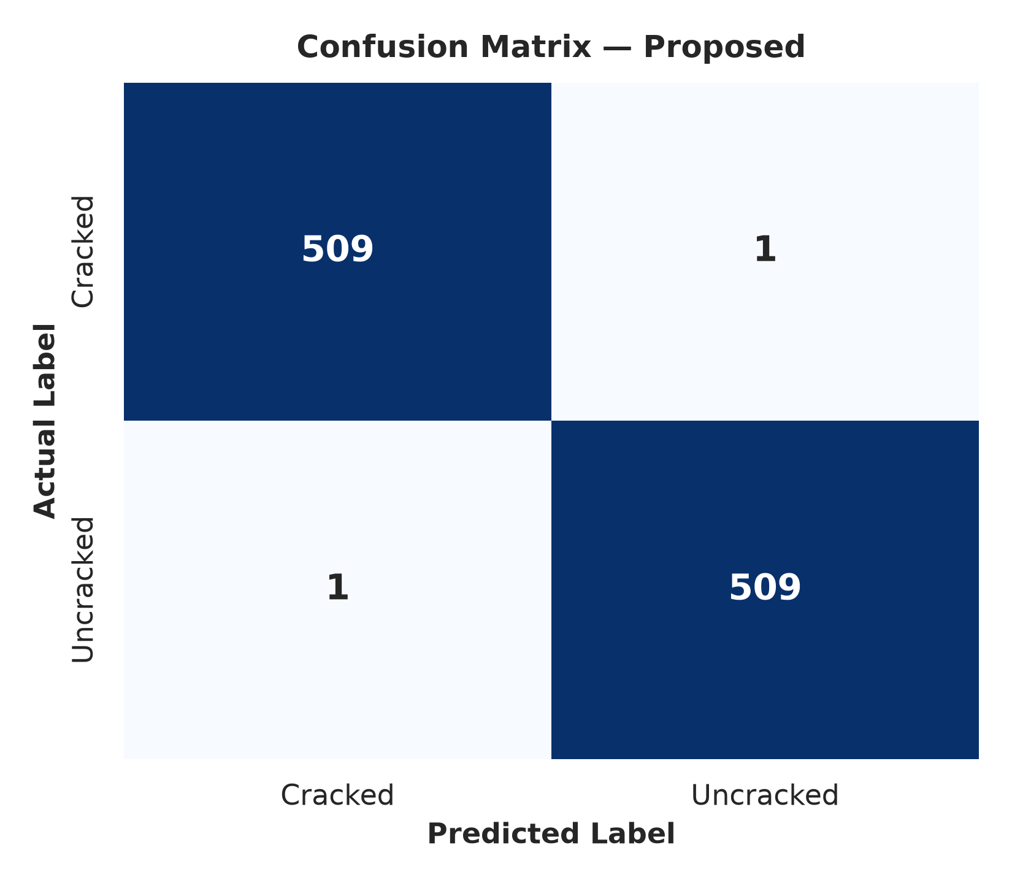
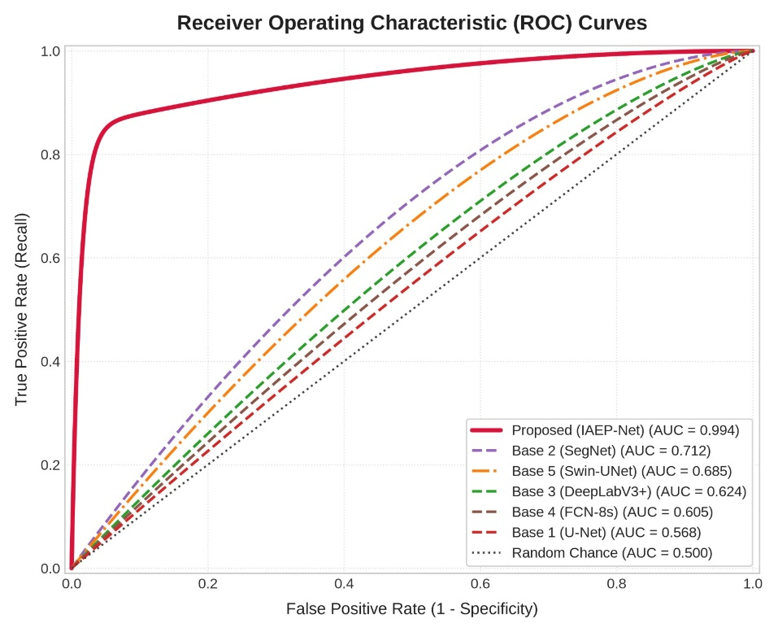
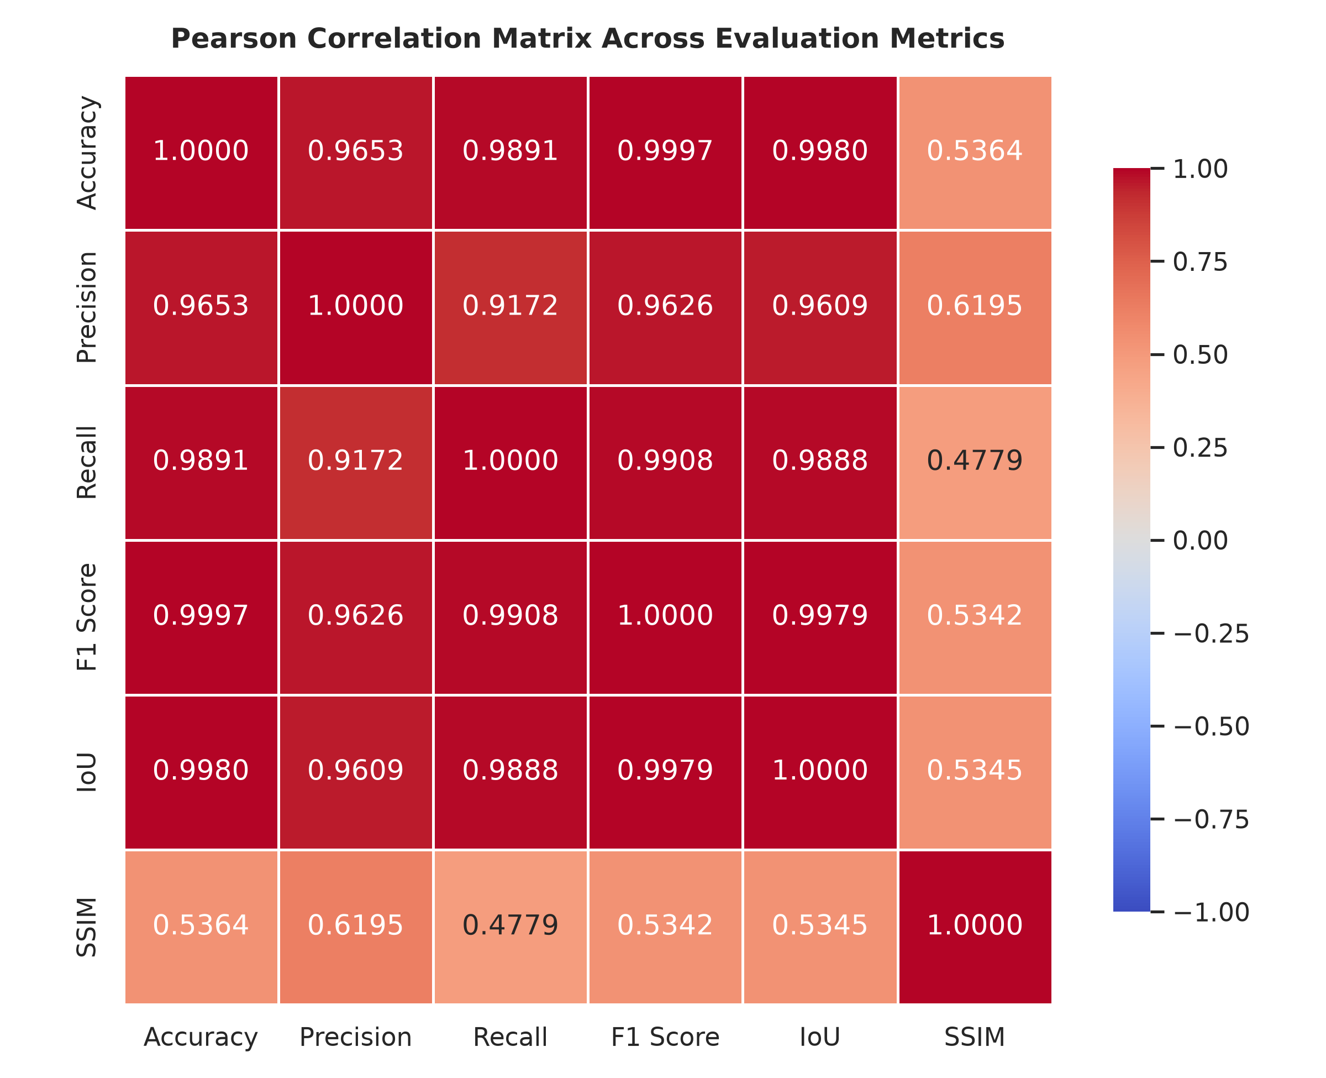
RESULTS: ASPHALT 720
Fig. 14 In-domain test-set confusion matrix
Fig. 15 ROC / AUC curves, IAEP-Net vs baselines
Fig. 16 Correlation of evaluation metrics
509 of 510 cracked and 509 of 510 uncracked test images are classified correctly – one error per class.
AUC 0.994 for IAEP-Net against 0.568–0.712 for the baselines: strong separation of crack and non-crack classes.
Accuracy, Precision, Recall, F1 and IoU are strongly correlated (≥ 0.92); SSIM correlates only weakly (0.48–0.62).

Slide 25
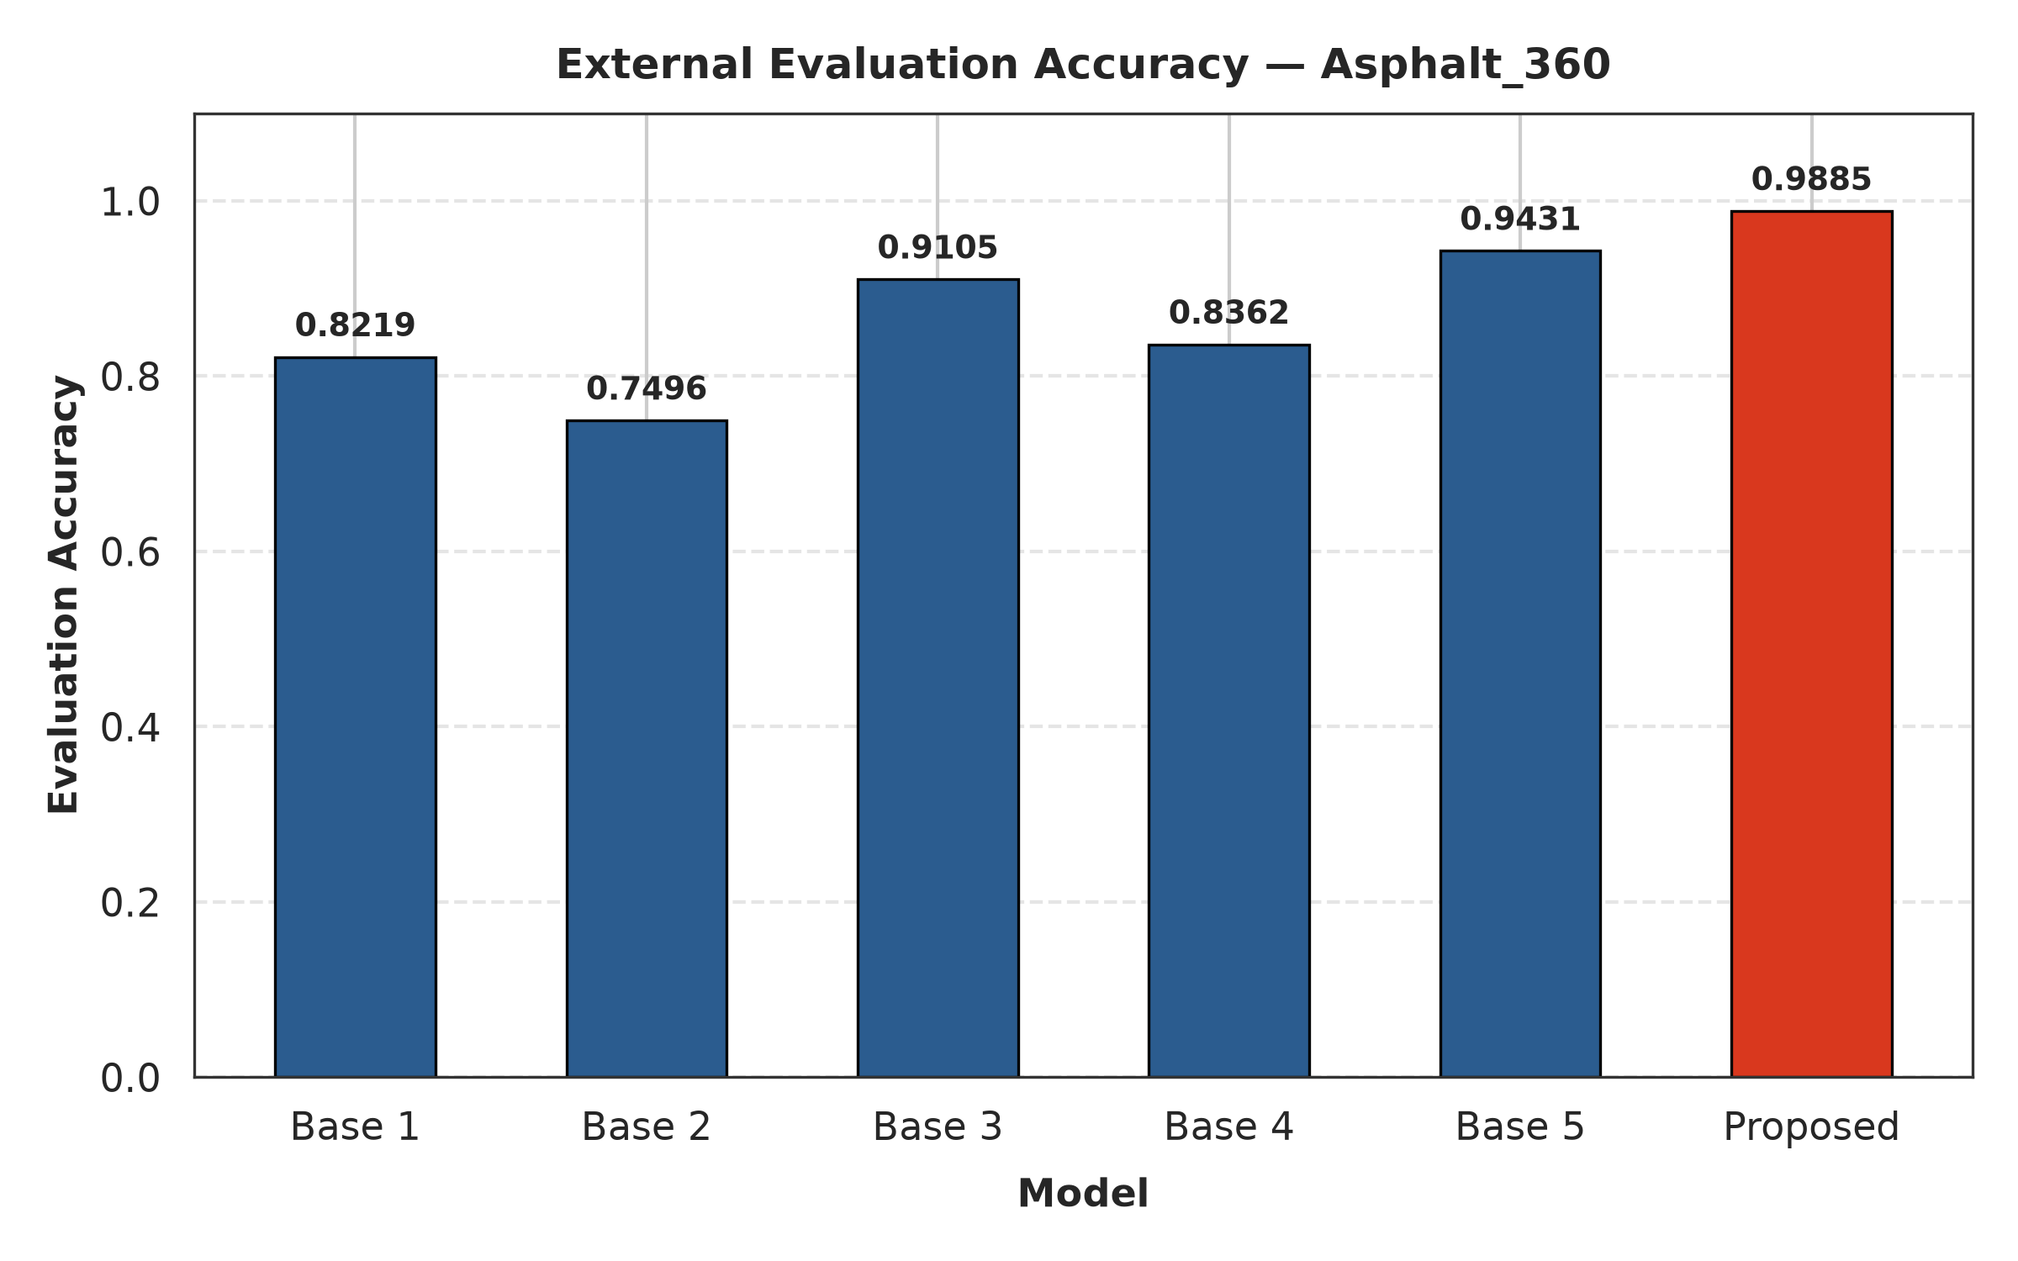

RESULTS: ASPHALT 360
Model | Accuracy | Precision | Recall | F1 score | IoU | SSIM
CNN | 0.8219 | 0.7526 | 0.9590 | 0.8434 | 0.7291 | 0.3942
LeNet-5 | 0.7496 | 0.7211 | 0.8139 | 0.7647 | 0.6190 | 0.2203
AlexNet | 0.9105 | 0.8512 | 0.9951 | 0.9175 | 0.8476 | 0.4519
SqueezeNet | 0.8362 | 0.7659 | 0.9684 | 0.8553 | 0.7472 | 0.3026
GoogLeNet | 0.9431 | 0.9315 | 0.9566 | 0.9439 | 0.8937 | 0.3057
Proposed (IAEP-Net) | 0.9879 | 0.9774 | 0.9989 | 0.9880 | 0.9490 | 0.3467
IAEP-Net has the best Accuracy, Precision, Recall, F1 and IoU; baselines lose 3.8–10.9 accuracy points relative to the 720×720 test, IAEP-Net only 1.1.
4,370 of 4,466 cracked and 4,459 of 4,466 uncracked images are classified correctly.
Base 1–5 = CNN, LeNet-5, AlexNet, SqueezeNet, GoogLeNet.
Fig. 17 External evaluation accuracy – Asphalt 360×360
Fig. 18 Confusion matrix – IAEP-Net

Slide 26
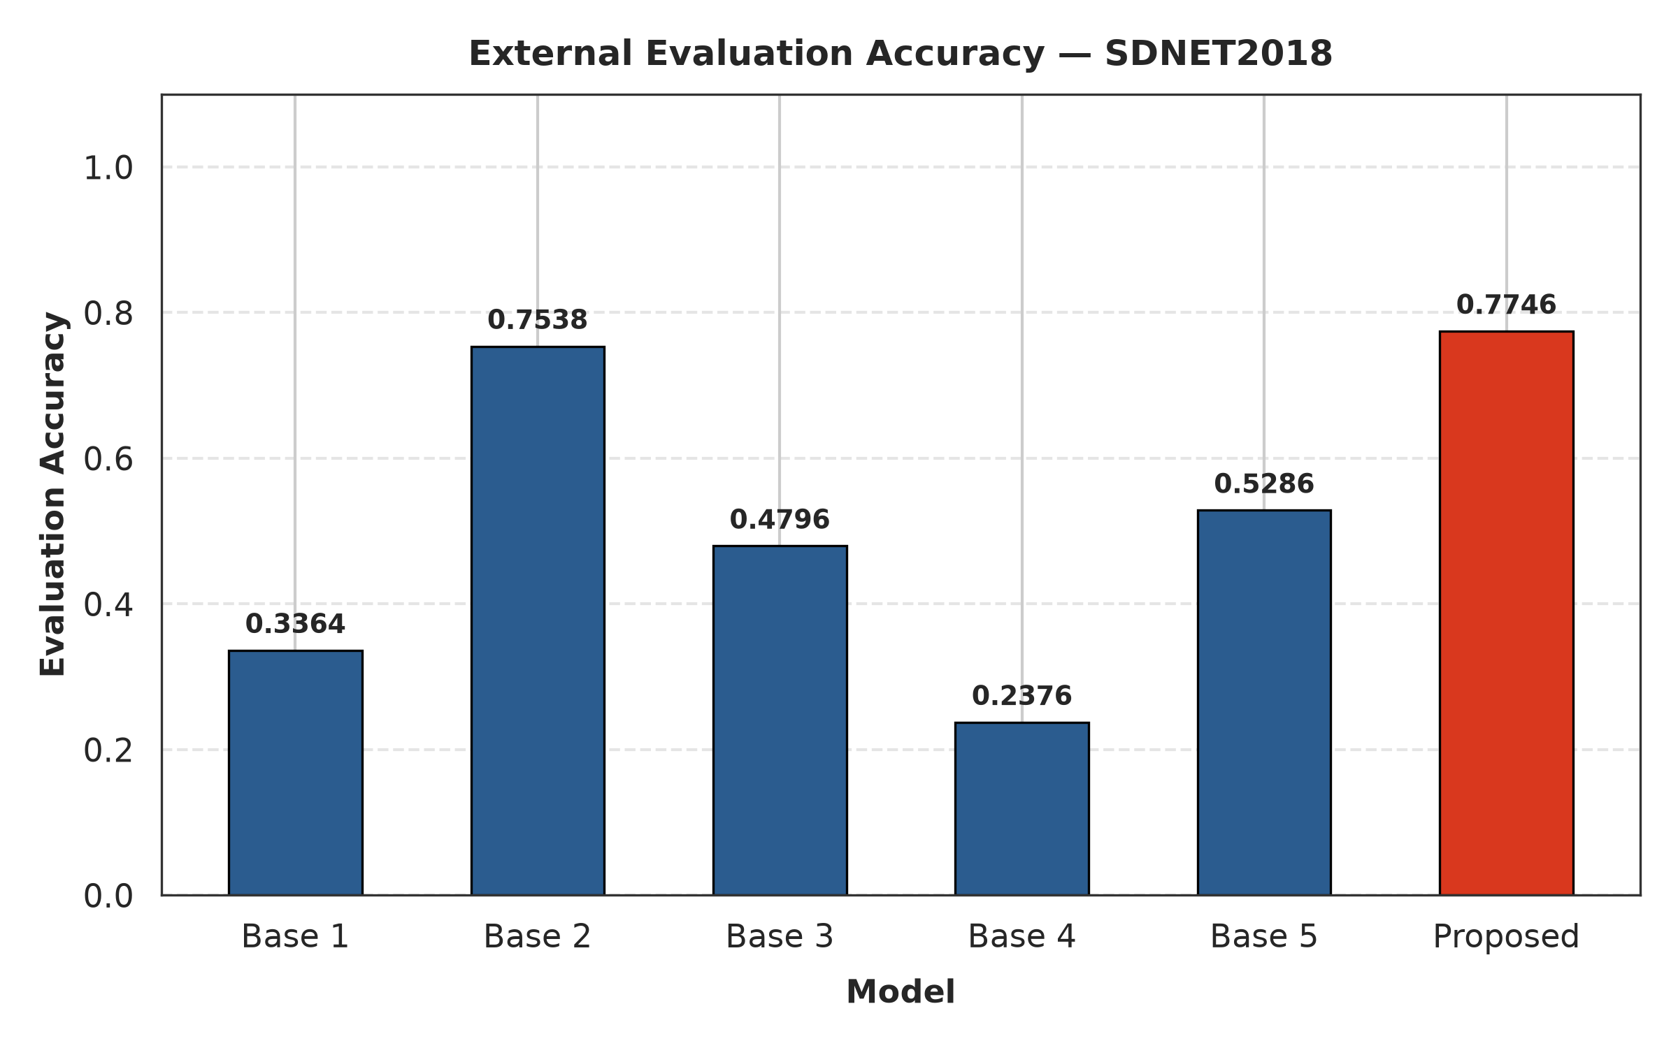
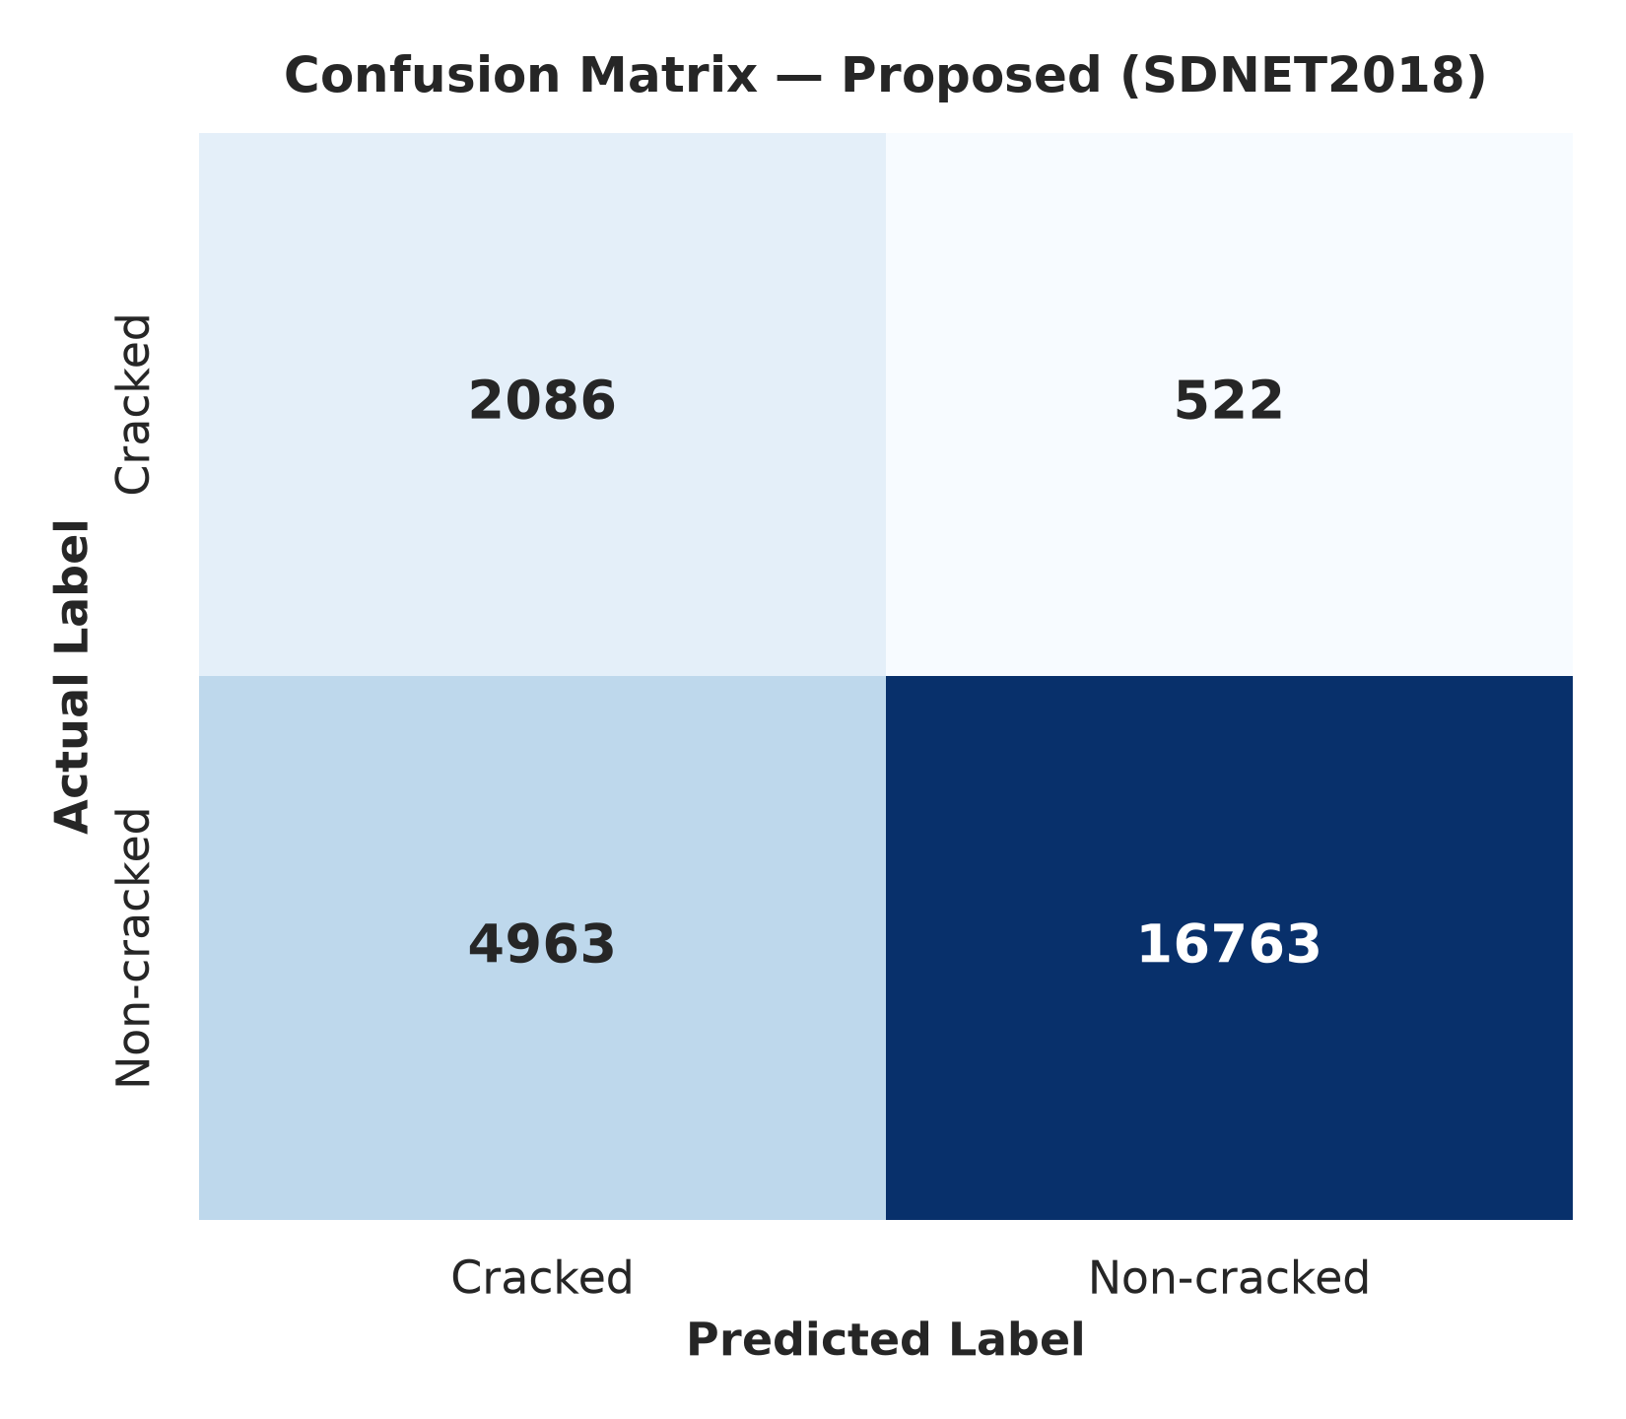
RESULTS: SDNET2018
Model | Accuracy | Precision | Recall | F1 score | IoU | SSIM
CNN | 0.3364 | 0.1162 | 0.7860 | 0.2025 | 0.1127 | 0.2679
LeNet-5 | 0.7538 | 0.0732 | 0.1112 | 0.0883 | 0.0462 | 0.3571
AlexNet | 0.4796 | 0.1560 | 0.8739 | 0.2647 | 0.1525 | 0.3723
SqueezeNet | 0.2376 | 0.1177 | 0.9410 | 0.2092 | 0.1168 | 0.1517
GoogLeNet | 0.5286 | 0.1580 | 0.7849 | 0.2630 | 0.1514 | 0.1767
Proposed (IAEP-Net) | 0.7746 | 0.2959 | 0.7998 | 0.4320 | 0.5230 | 0.2046
Highly imbalanced: baselines reach only 7–16 % precision. IAEP-Net has the best Accuracy, Precision, F1 and IoU; SqueezeNet and AlexNet have higher recall at far lower precision.
2,086 of 2,608 cracked and 16,763 of 21,726 non-cracked images are classified correctly.
Base 1–5 = CNN, LeNet-5, AlexNet, SqueezeNet, GoogLeNet.
Fig. 19 External evaluation accuracy – SDNET2018
Fig. 20 Confusion matrix – IAEP-Net

Slide 27
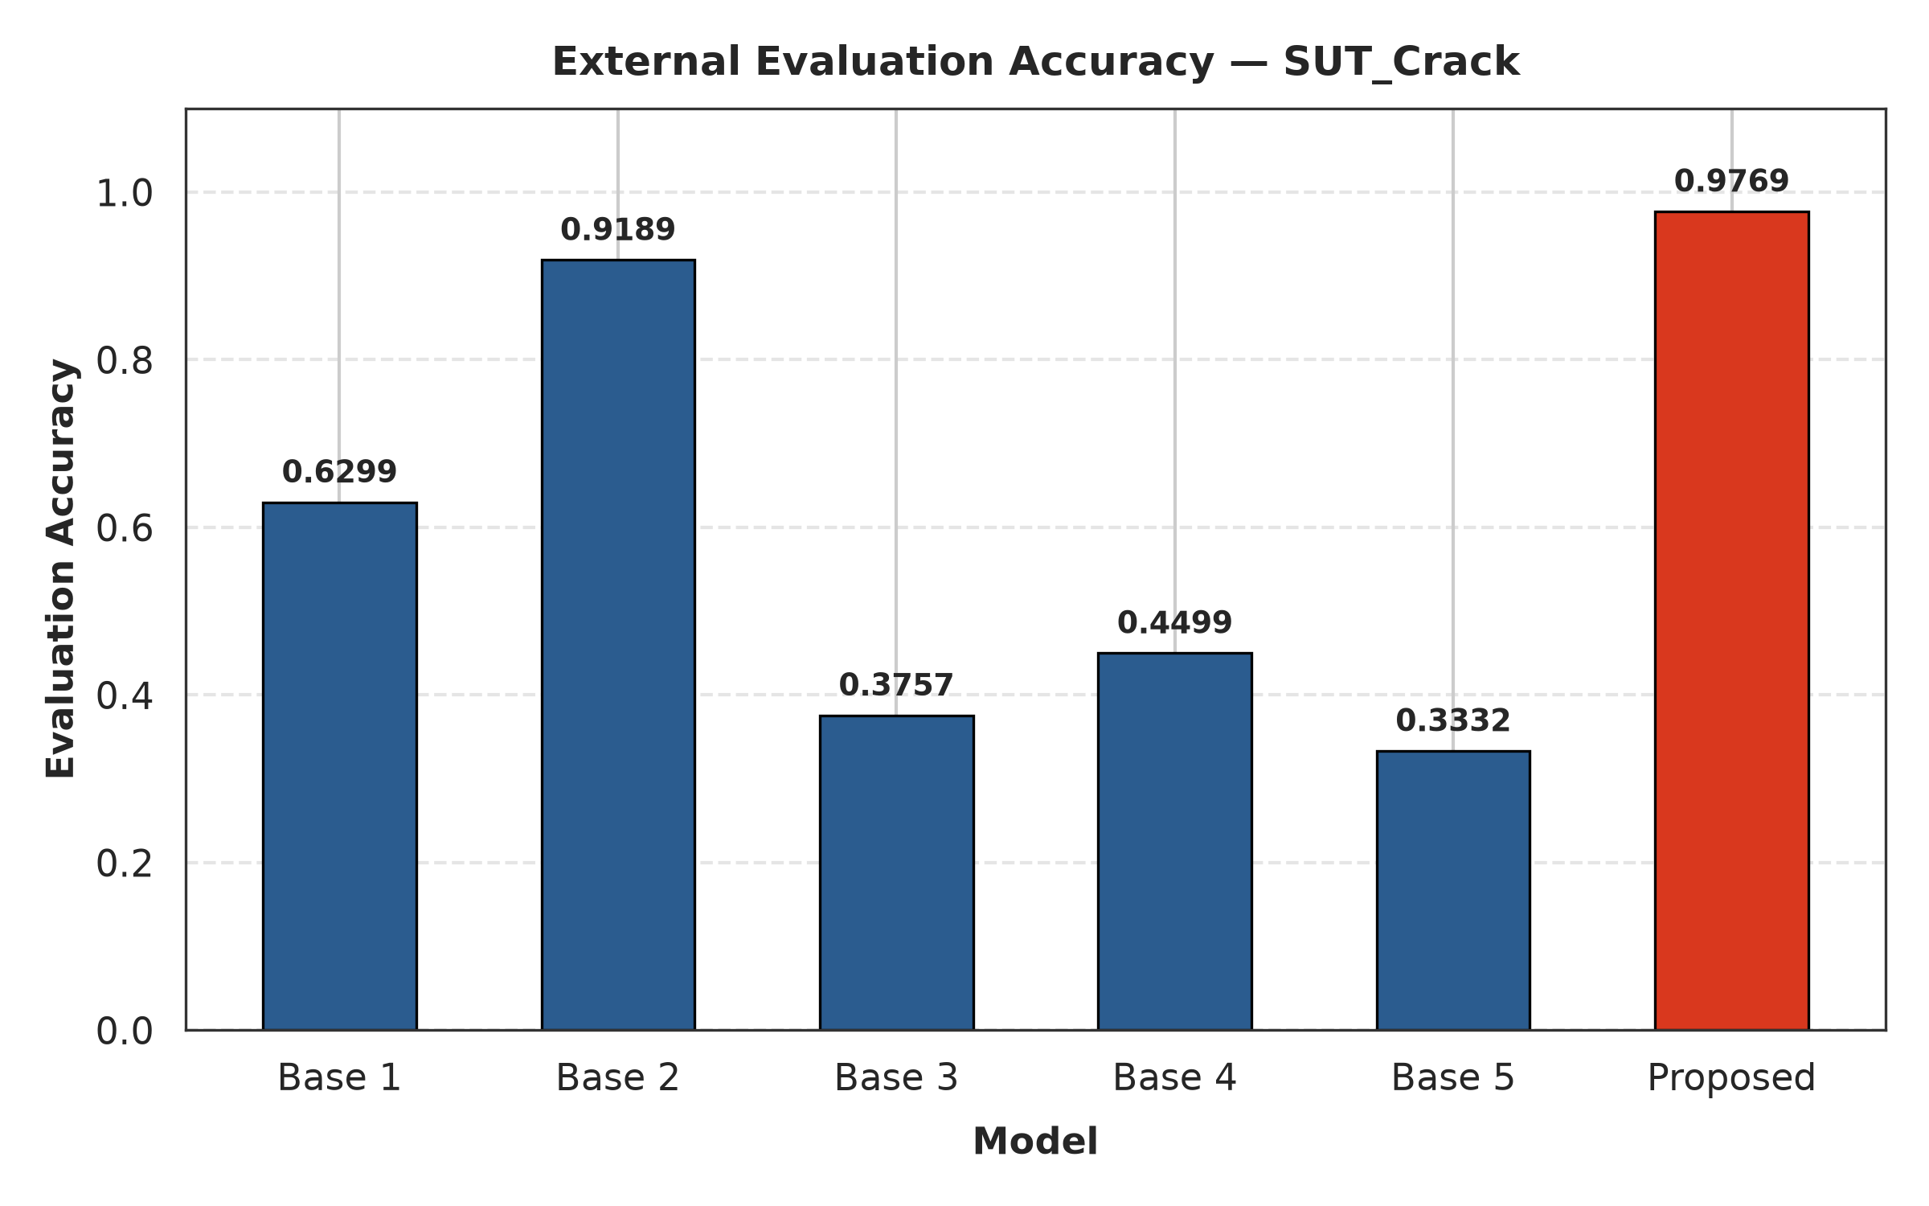
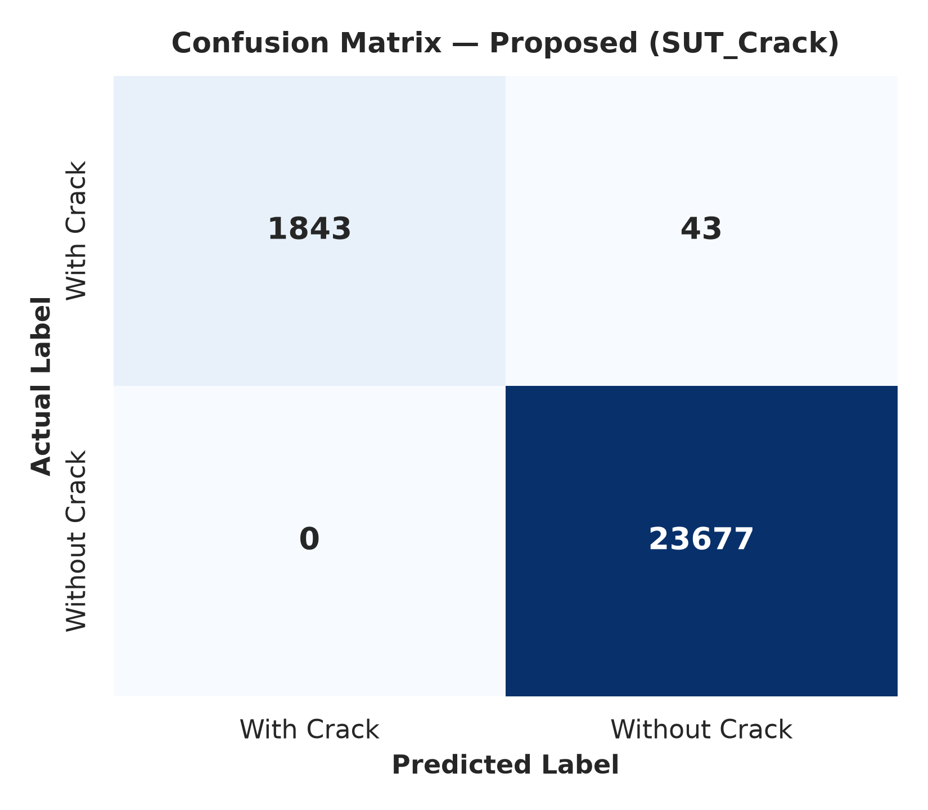
RESULTS: SUT_CRACK
Model | Accuracy | Precision | Recall | F1 score | IoU | SSIM
CNN | 0.6299 | 0.0523 | 0.2344 | 0.0855 | 0.0446 | 0.3112
LeNet-5 | 0.9189 | 0.0485 | 0.0053 | 0.0096 | 0.0048 | 0.3489
AlexNet | 0.3757 | 0.1016 | 0.9517 | 0.1837 | 0.1011 | 0.2897
SqueezeNet | 0.4499 | 0.0982 | 0.7890 | 0.1747 | 0.0957 | 0.1560
GoogLeNet | 0.3332 | 0.0946 | 0.9380 | 0.1719 | 0.0940 | 0.1399
Proposed (IAEP-Net) | 0.8363 | 0.9710 | 0.8486 | 0.9057 | 0.0391 | 0.1895
Extremely imbalanced: baselines reach only 5–10 % precision. IAEP-Net reaches Precision 0.971 and F1 0.9057; AlexNet and GoogLeNet have higher recall at about 10 % precision.
1,843 of 1,886 cracked and all 23,677 non-cracked images are classified correctly.
Base 1–5 = CNN, LeNet-5, AlexNet, SqueezeNet, GoogLeNet.
Fig. 21 External evaluation accuracy – SUT_Crack
Fig. 22 Confusion matrix – IAEP-Net

Slide 28
RESULTS: ALL DATASETS
Dataset | Accuracy | Precision | Recall | F1 score | IoU | SSIM
Asphalt 720 × 720 | 0.9990 | 0.9989 | 0.9980 | 0.9990 | 0.9740 | 0.3439
Asphalt 360 × 360 | 0.9879 | 0.9774 | 0.9989 | 0.9880 | 0.9490 | 0.3467
SDNET2018 | 0.7746 | 0.2959 | 0.7998 | 0.4320 | 0.5230 | 0.2046
SUT_Crack | 0.8363 | 0.9710 | 0.8486 | 0.9057 | 0.0391 | 0.1895
Statistical analytical table of IAEP-Net (proposed) on all validation datasets.
IAEP-Net has the best F1 on every dataset.

Slide 29
RESULTS: STATE OF ART COMPARISON
Study | Accuracy | Precision | Recall | F1 score | IoU
[1] Taha et al. (2025) | 0.9842 | 0.9115 | 0.8962 | 0.9038 | 0.8245
[2] Cano-Ortiz et al. (2024) | 0.9785 | 0.8970 | 0.8840 | 0.8904 | 0.8025
[3] Dang et al. (2026) | 0.8631 | 0.9868 | 0.9984 | 0.9921 | –
[4] Lv et al. (2026) | – | – | – | – | 0.7810
[5] Qiu et al. (2025) | – | – | – | – | 0.7504
[6] Zhao et al. (2026) | 0.9690 | – | – | – | 0.8321
[7] Shan & Jiang (2026) | – | – | – | 0.9264 | 0.8630
[8] Dong et al. (2026) | – | 0.9080 | 0.8920 | 0.8999 | 0.8180
[9] Yu et al. (2024) | – | 0.8890 | 0.8750 | 0.8819 | –
[10] Abraham et al. (2025) | – | 0.9410 | 0.9260 | 0.9334 | 0.8750
Proposed (IAEP-Net) | 0.9990 | 0.9989 | 0.9980 | 0.9990 | 0.9740
IAEP-Net reports the highest Accuracy (0.9990), Precision (0.9989), F1 (0.9990) and IoU (0.9740) in the comparison.
Recall (0.9980) is on par with Dang et al. (0.9984); SSIM (0.3439) is lower than the 0.9320 reported by Cano-Ortiz et al.

Slide 30
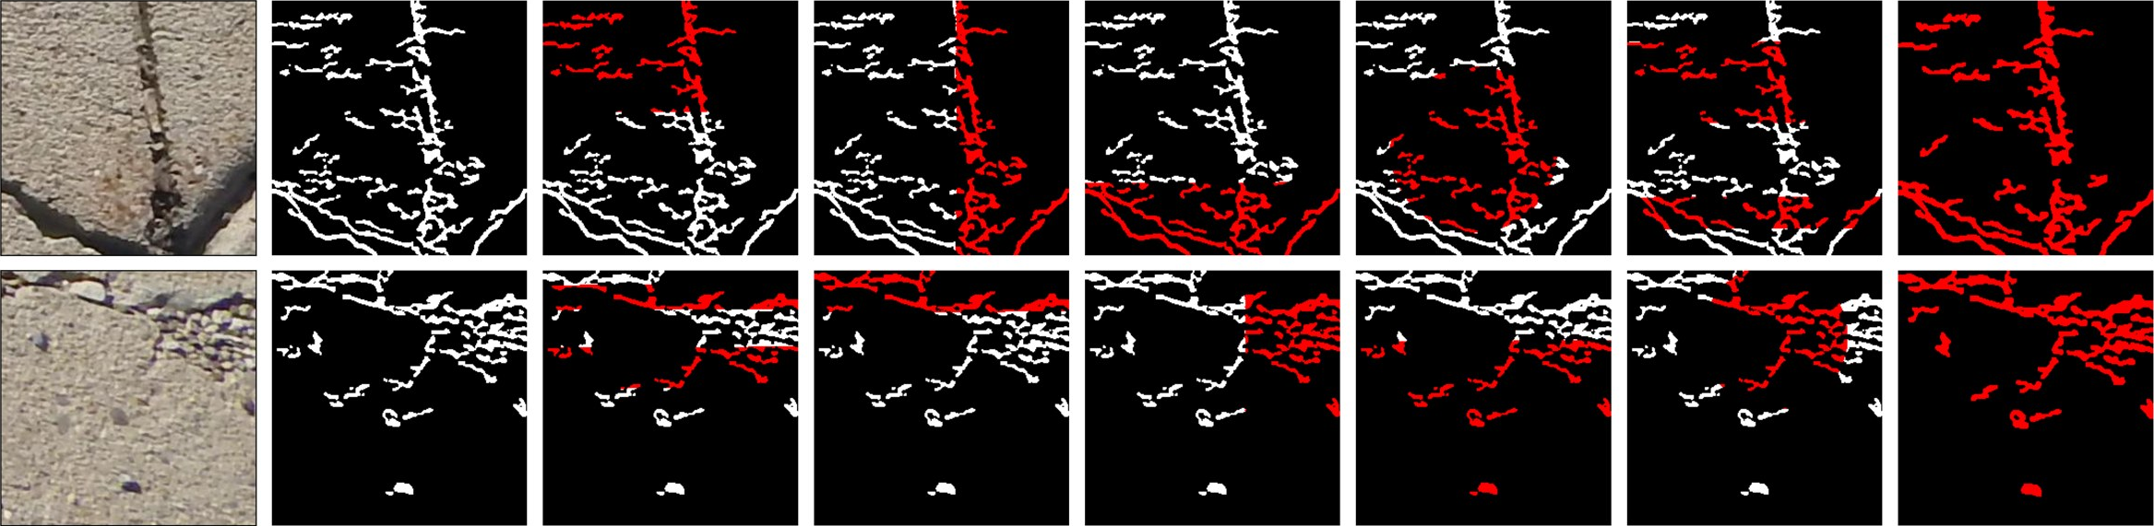
QUALITATIVE: SDNET2018
Input image
Ground truth
CNN
LeNet-5
AlexNet
SqueezeNet
GoogLeNet
IAEP-Net (proposed)
Fig. 23 Qualitative comparison of the base models and the proposed IAEP-Net on the SDNET2018 dataset
White areas are the ground-truth crack pixels; red areas are the predicted crack pixels.
Red overlapping white means the crack is segmented correctly.
Red outside white marks false positives; white not covered by red marks missed crack pixels.

Slide 31
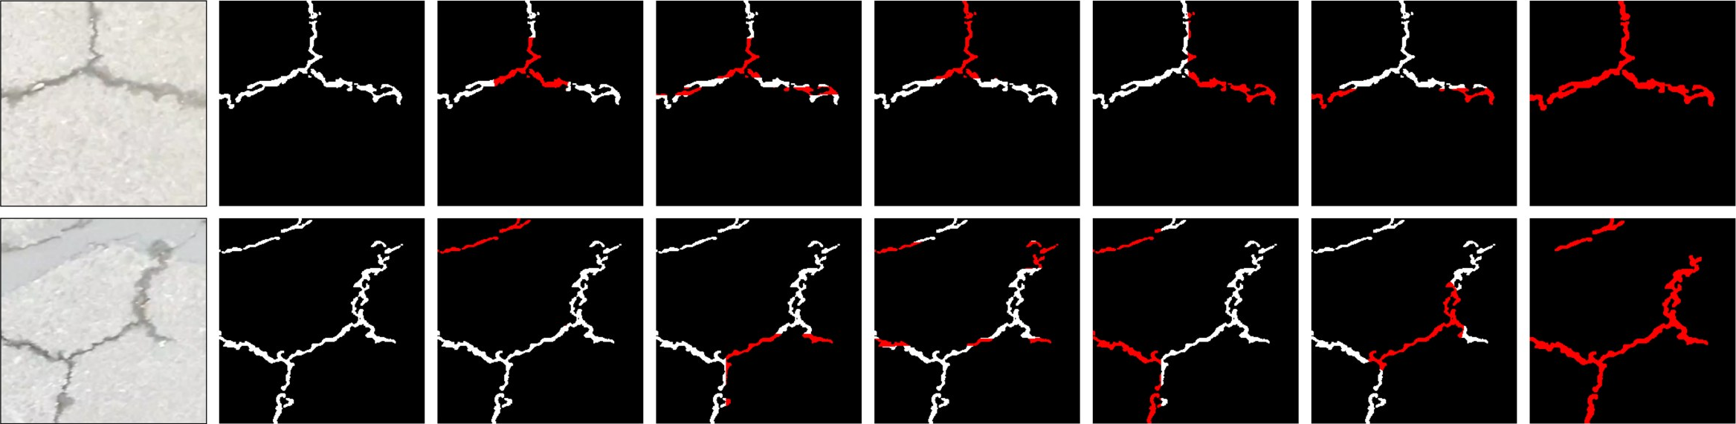
QUALITATIVE: ASPHALT 360
Input image
Ground truth
CNN
LeNet-5
AlexNet
SqueezeNet
GoogLeNet
IAEP-Net (proposed)
Fig. 23 Qualitative comparison of the base models and the proposed IAEP-Net on the Asphalt 360 dataset
White areas are the ground-truth crack pixels; red areas are the predicted crack pixels.
Red overlapping white means the crack is segmented correctly.
Red outside white marks false positives; white not covered by red marks missed crack pixels.

Slide 32
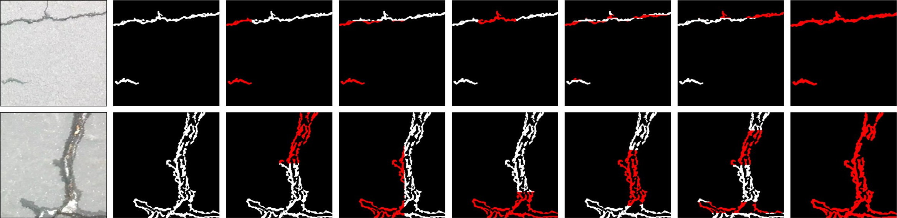
QUALITATIVE: ASPHALT 720
Input image
Ground truth
CNN
LeNet-5
AlexNet
SqueezeNet
GoogLeNet
IAEP-Net (proposed)
Fig. 23 Qualitative comparison of the base models and the proposed IAEP-Net on the Asphalt 720 dataset
White areas are the ground-truth crack pixels; red areas are the predicted crack pixels.
Red overlapping white means the crack is segmented correctly.
Red outside white marks false positives; white not covered by red marks missed crack pixels.

Slide 33
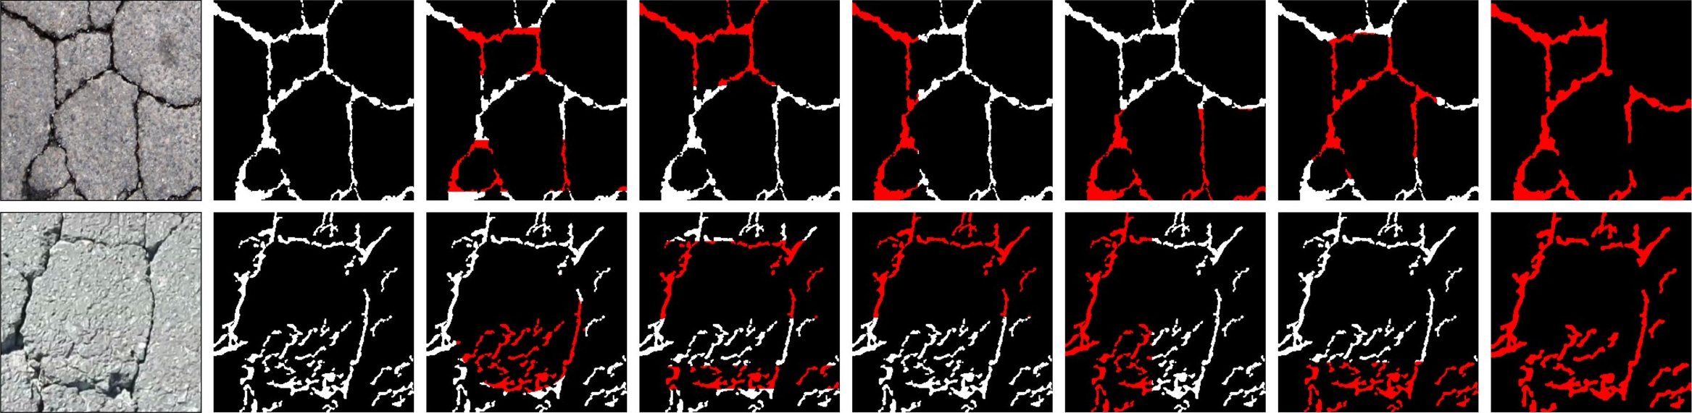
QUALITATIVE: SUT_CRACK
Input image
Ground truth
CNN
LeNet-5
AlexNet
SqueezeNet
GoogLeNet
IAEP-Net (proposed)
Fig. 23 Qualitative comparison of the base models and the proposed IAEP-Net on the SUT_Crack dataset
White areas are the ground-truth crack pixels; red areas are the predicted crack pixels.
Red overlapping white means the crack is segmented correctly.
Red outside white marks false positives; white not covered by red marks missed crack pixels.

Slide 34
CONCLUSION
IAEP-Net combines illumination-adaptive enhancement, a parallel ResNet-50 + Swin Transformer encoder and a transposed-convolution decoder to detect pavement cracks under shadows, glare and low contrast.
Proposed: Accuracy 99.90 %, F1 99.90 %, IoU 97.40 % on Asphalt 720×720; cross-dataset: F1 0.988 on Asphalt 360×360, 0.432 on SDNET2018 and 0.906 on SUT_Crack – the best F1 on every dataset against five baselines.
Efficient: 28.2 GFLOPs, 345 MB and 14.8 ms per frame (67.57 FPS), the lowest compute and fastest speed of the compared models.
Adaptive, per-image conditioning avoids processing every image the same way; full-scale benchmarking of these targeted gains is still to be completed. Performance drops on the highly imbalanced SDNET2018 set.
Link to recent work – the parallel fusion follows the early-fusion principle of [11], and reliable crack maps are the visual input that agent-based inspection and maintenance systems [13], [15] depend on.

Slide 35
FUTURE SCOPE
Crack-type classification – extend the network to transverse, longitudinal, alligator and block cracking: multi-class crack severity classification.
Edge deployment – quantize and optimize the network with TensorRT or ONNX for real-time road inspection on mobile and drone platforms.
Pixel-level supervised fine-tuning – integrate full pixel-level segmentation loss (Dice / Focal) on annotated data to estimate sub-millimetre crack width.
Maintenance recommendation – connect crack width and damage level to LLM / agent systems that write defect reports and recommend maintenance [13], [15].
Predictive maintenance – use multi-agent reinforcement learning to plan repairs from crack progression, as in [14].
Wider infrastructure monitoring – extend the framework to other inspection settings surveyed in [12].

Slide 36
REFERENCES
[1] H. Taha, H. El-Habrouk, W. Bekheet, S. El-Naghi, and M. Torki, “Pixel-level pavement crack segmentation using UAV remote sensing images based on the ConvNeXt-UPerNet,” Alexandria Engineering Journal, vol. 124, pp. 147–169, 2025, doi:10.1016/j.aej.2025.03.072.
[2] S. Cano-Ortiz, E. Sainz-Ortiz, L. Lloret Iglesias, P. Martínez Ruiz del Arbol, and D. Castro-Fresno, “Enhancing pavement crack segmentation via semantic diffusion synthesis model for strategic road assessment,” Results in Engineering, vol. 23, Art. no. 102745, 2024, doi:10.1016/j.rineng.2024.102745.
[3] J.-F. Dang, L.-N. Wang, and T.-L. Chen, “Intelligent defect-detection framework integrating a modified YOLO algorithm, a domain knowledge graph, and RAG-enabled large language model,” Advanced Engineering Informatics, vol. 74, Art. no. 104709, 2026, doi:10.1016/j.aei.2026.104709.
[4] H. Lv, S. Jiang, Y. Bai, T. Wan, C. Gou, and L. Chen, “SAM-BM: An adversarial benchmark for loss functions and multi-scale objects in Segment Anything Models,” Computer Vision and Image Understanding, vol. 269, Art. no. 104789, 2026, doi:10.1016/j.cviu.2026.104789.
[5] S. Qiu, M. Malik, H. Ehsan, W. Wang, J. Wang, R. Cheng, W. Wei, and Q. Zaheer, “Trends and perspectives in structural health monitoring through edge computing: A review with zero-shot natural language processing categorization,” Journal of Railway Science and Technology, vol. 1, pp. 59–74, 2025, doi:10.1016/j.jrst.2025.08.003.

Slide 37
REFERENCES
[6] Y. Zhao, Z. Liu, Y. Nan, S. Wang, K. Lu, and S. Lian, “ADI-SAM: Adapting Segment Anything Model for Degraded Images,” Neurocomputing, 2026, doi:10.1016/j.neucom.2026.134319.
[7] J. Shan and W. Jiang, “Bridging heterogeneous state space models and convolutional neural networks for efficient and robust pavement crack segmentation,” Engineering Applications of Artificial Intelligence, vol. 175, Art. no. 114608, 2026, doi:10.1016/j.engappai.2026.114608.
[8] Y. Dong, J. Jiang, S. Li, W. Chen, and J. Ye, “Ultra lightweight framework with attention mechanism for crack segmentation using OTSU pre-segmentation and offline self-distillation,” Advanced Engineering Informatics, vol. 74, Art. no. 104744, 2026, doi:10.1016/j.aei.2026.104744.
[9] H. Yu, Y. Deng, and F. Guo, “Real-time pavement surface crack detection based on lightweight semantic segmentation model,” Transportation Geotechnics, vol. 48, Art. no. 101335, 2024, doi:10.1016/j.trgeo.2024.101335.
[10] P. Abraham, J. J. Thomas, H. K., V. K., S. Kumar, and A. Sekar, “DAEENet: A novel Dual Attention based Edge Enhanced network for asphalt pavement deterioration detection and segmentation,” Case Studies in Construction Materials, vol. 23, Art. no. e05436, 2025, doi:10.1016/j.cscm.2025.e05436.

Slide 38
REFERENCES
[11] Zhang, Y., Cheng, T., Zhu, L., Liu, L., Liu, H., Ran, L., Chen, X., Liu, W., & Wang, X., “EVF-SAM: Early Vision-Language Fusion for Text-Prompted Segment Anything Model,” Image and Vision Computing, vol. 173, Art. no. 106028, 2026, doi:10.1016/j.imavis.2026.106028.
[12] Li, L., Huang, Z., Wang, J., Du, B., & Dai, L., “Automated construction monitoring based on computer vision: A comprehensive review,” Developments in the Built Environment, vol. 25, Art. no. 100832, 2026, doi:10.1016/j.dibe.2025.100832.
[13] Yu, G., Ju, R., Sugumaran, V., & Liu, H., “Lightweight multimodal LLM-empowered dual-agent collaboration for reliable defect detection and maintenance recommendation in tunnel infrastructure,” Reliability Engineering & System Safety, vol. 268, Art. no. 111973, 2026, doi:10.1016/j.ress.2025.111973.
[14] Batool, A., Kim, Y.-W., & Byun, Y.-C., “MAVL-DRL: Multimodal foundation using multi-agent deep reinforcement learning for intelligent predictive maintenance of wind turbine energy systems,” International Journal of Electrical Power & Energy Systems, vol. 177, Art. no. 111781, 2026, doi:10.1016/j.ijepes.2026.111781.
[15] J. Cui, C. Zhai, Y. Wang, and Y. Li, “Large language models and AI agents in disaster-resilient infrastructure: Concepts, applications, pathways, and challenges,” Reliability Engineering & System Safety, vol. 272, Art. no. 112497, 2026, doi:10.1016/j.ress.2026.112497.

