Slide 1
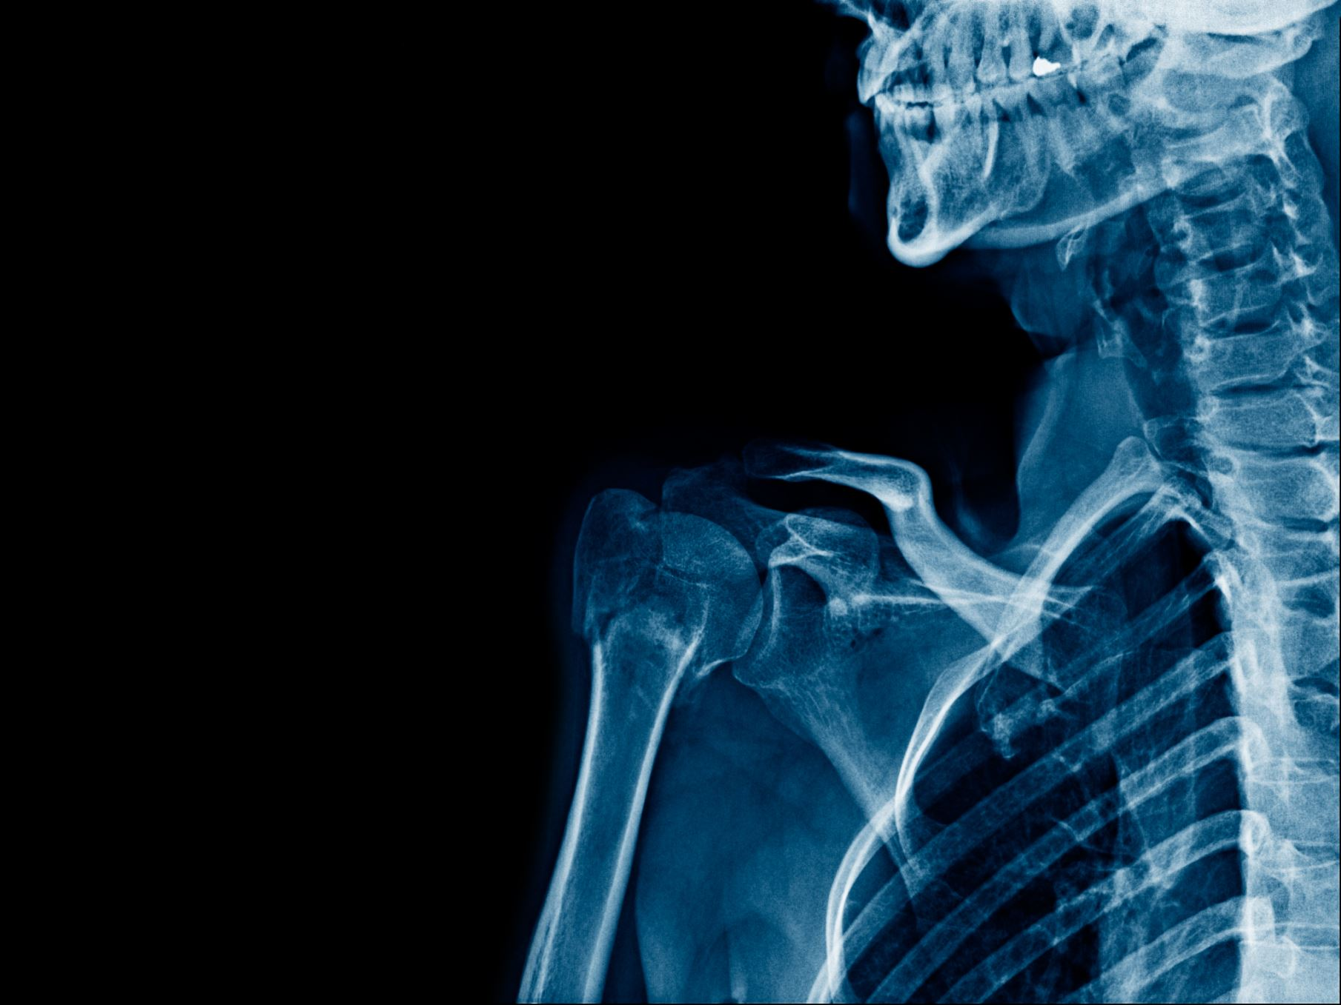
Pneumonia Detection from Chest X-rays using Azure Custom Vision
Rohit Prasad
B.Tech ECE, BPPIMT
EDUNET Foundation – Microsoft Azure AI Internship (June 2025)

Slide 2
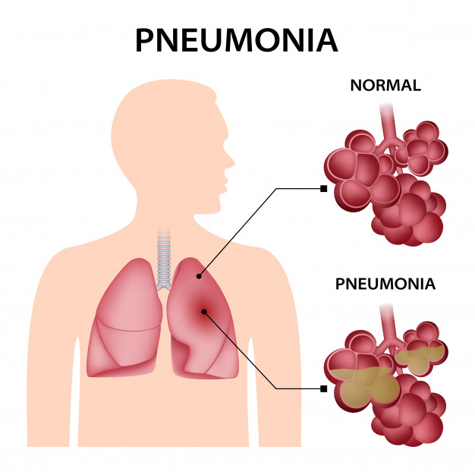
Problem Statement
Pneumonia is a potentially life-threatening lung infection.
Early diagnosis is critical but challenging in low-resource settings.
Manual diagnosis from X-rays is time-consuming and prone to human error.
AI can assist in detecting pneumonia from chest X-rays efficiently.

Slide 3
Project Objective
To develop an AI model that can detect signs of pneumonia in chest X-rays.
Use Azure Custom Vision to train an image classification model.
Build a simple, accessible tool for assisting medical diagnosis.

Slide 4
Dataset Overview
Dataset Source: Kaggle - Chest X-ray Images (Pneumonia)
Classes: 'Normal' and 'Pneumonia'
Used ~139 images (50 Normal + 50 Pneumonia) for training
Preprocessed and uploaded to Azure Custom Vision for classification

Slide 5
Model Training
Platform: Azure Custom Vision
Project Type: Classification (Multiclass)
Domain: General (compact)
Trained model on labeled dataset with 'Normal' and 'Pneumonia' tags
Quick Training option used for fast results

Slide 6
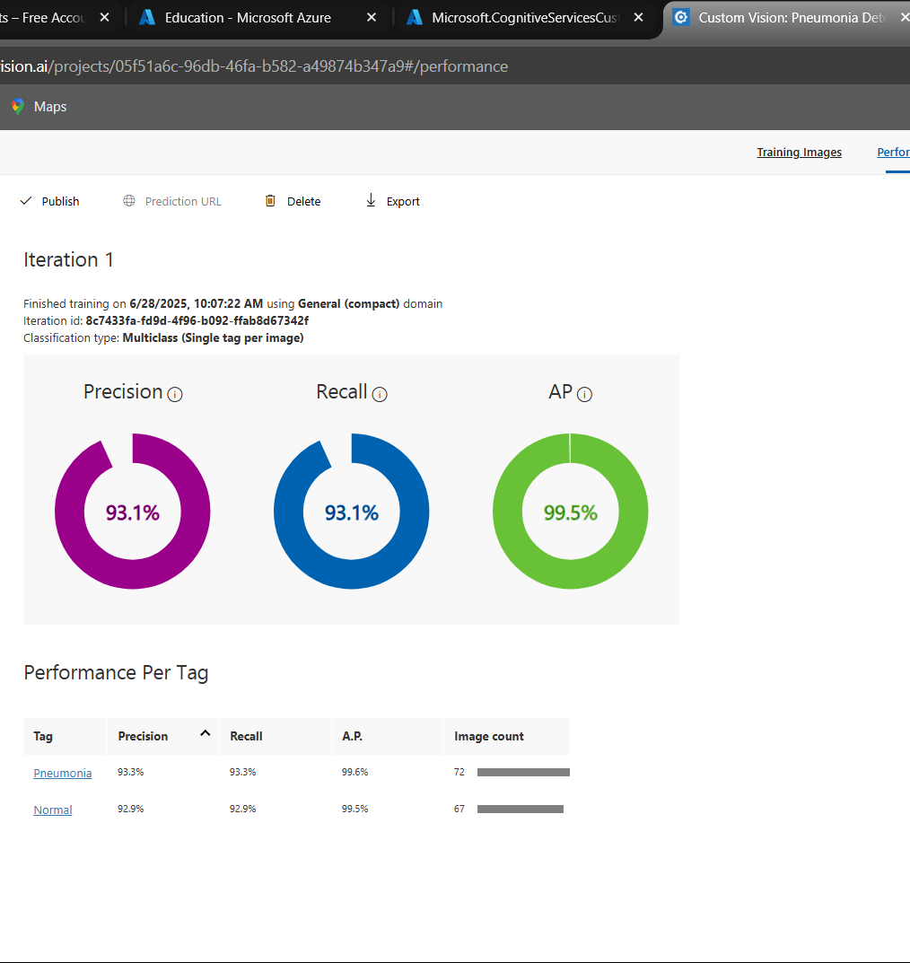
Model Performance
High Precision and Recall achieved after training
Confusion matrix available in Azure portal
Screenshot of model metrics included in GitHub repository

Slide 7
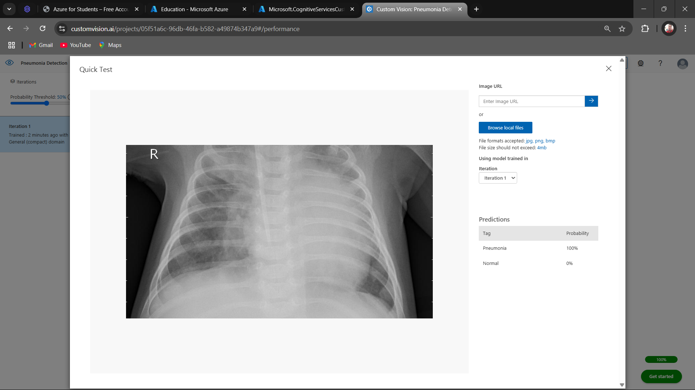
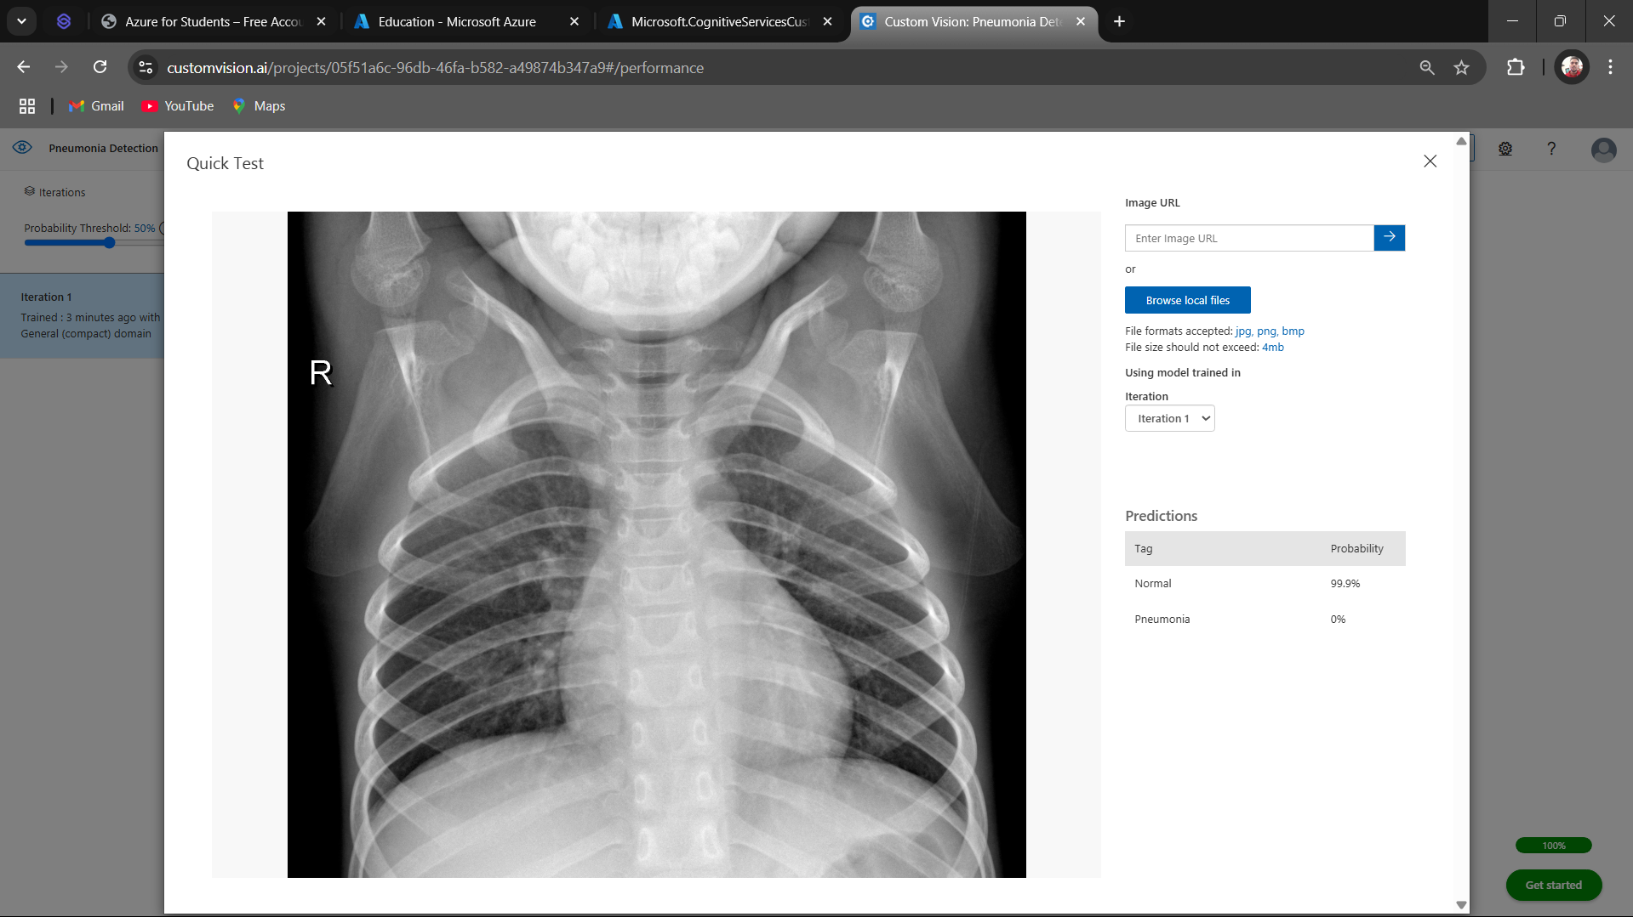
Quick Test Result
Uploaded new chest X-ray image in Azure Quick Test
Model correctly predicted the class (Normal or Pneumonia)
Confidence score shown for prediction
Screenshot available in GitHub repo

Slide 8
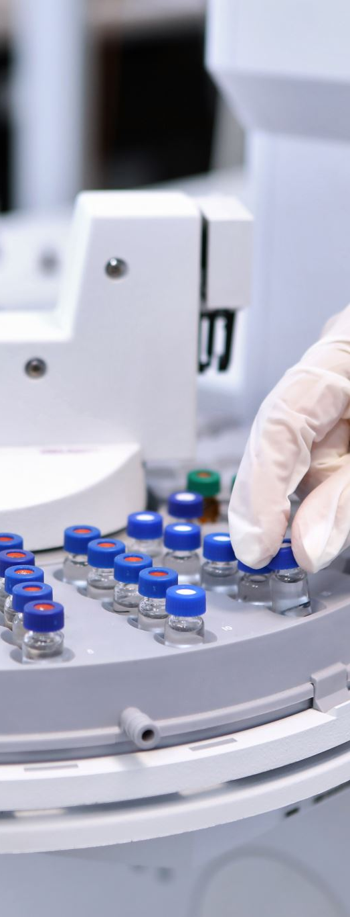
Conclusion & Tools Used
Successfully built pneumonia detection model using Azure Custom Vision.
AI-based diagnosis can support medical professionals in real-time.
Tools Used:
- Azure Custom Vision
- Kaggle Dataset
- GitHub
- PowerPoint

