Slide 1

CAPSTONEPROJECT PNEUMONIA DETECTION FROM CHEST X-RAYS USING AZURE CUSTOM VISION
Presented By
Student Name: Rohit Prasad
College Name: B.P. Poddar Institute of Management and Technology , VIP ,Kolkata
Department: ECE
Email ID: rohitprasad9232@gmail.com
AICTE Student ID: 221150110188

Slide 2
OUTLINE
Problem Statement (Should not include solution)
Proposed System/Solution
System Development Approach (Technology Used)
Algorithm & Deployment
Result (Output Image)
Conclusion
Future Scope
References

Slide 3
Problem Statement
Pneumonia is a life-threatening lung infection that requires rapid and accurate diagnosis. In many areas, access to expert radiologists is limited, which delays diagnosis and treatment. Manual diagnosis through chest X-rays is time-consuming and subject to human error.

Slide 4
Proposed Solution
Labeled into two classes: Pneumonia and Normal.
Labeled into two classes: Pneumonia and Normal.
Labeled into two classes: Pneumonia and Normal.
Interface supports image upload for real-time classification.
Data Collection & preprocessing:
Sourced X-ray images from public datasets (e.g., NIH, Kaggle).
Labelled into two classes : Pneumonia and Normal.
Images resized and cleaned for uniform input.
Custom Vision Model Training:
Used Azure Custom Vision Classification(General) project type.
Uploaded labeled images into separate tags.
Azure automatically extracted features and applied transfer learning.
Model Evaluation :
Training progress visualized via metrics:
Precision
Recall
MAP (Mean Average Precision)
Iteratively trained for higher accuracy.
Prediction Workflow :
Model predicts class (Pneumonia or Normal) with confidence percentage.
Interface supports image upload for real-time classification.
Evaluation:
Trained model published as a REST API.
Usable in mobile/web apps for health screening.
Predictions accessible via a simple HTTP POST request with the image payload.

Slide 5
System Approach
Tools & Technologies Used: - Azure Custom Vision Service - Python for dataset preparation - Labelling using Azure Portal Steps: 1. Collected and labelled dataset (Pneumonia/Normal) 2. Uploaded to Azure Custom Vision 3. Trained and tested classification model 4. Evaluated metrics and deployed API endpoint

Slide 6
Algorithm & Deployment
Algorithm: - Image Classification using Azure Custom Vision (Transfer Learning)
Deployment: - Trained model published on Azure - Prediction endpoint created for REST API access - Tested with real chest X-ray samples via web request or interface
Input: Chest X-ray image Output: Pneumonia / Normal with confidence score

Slide 7
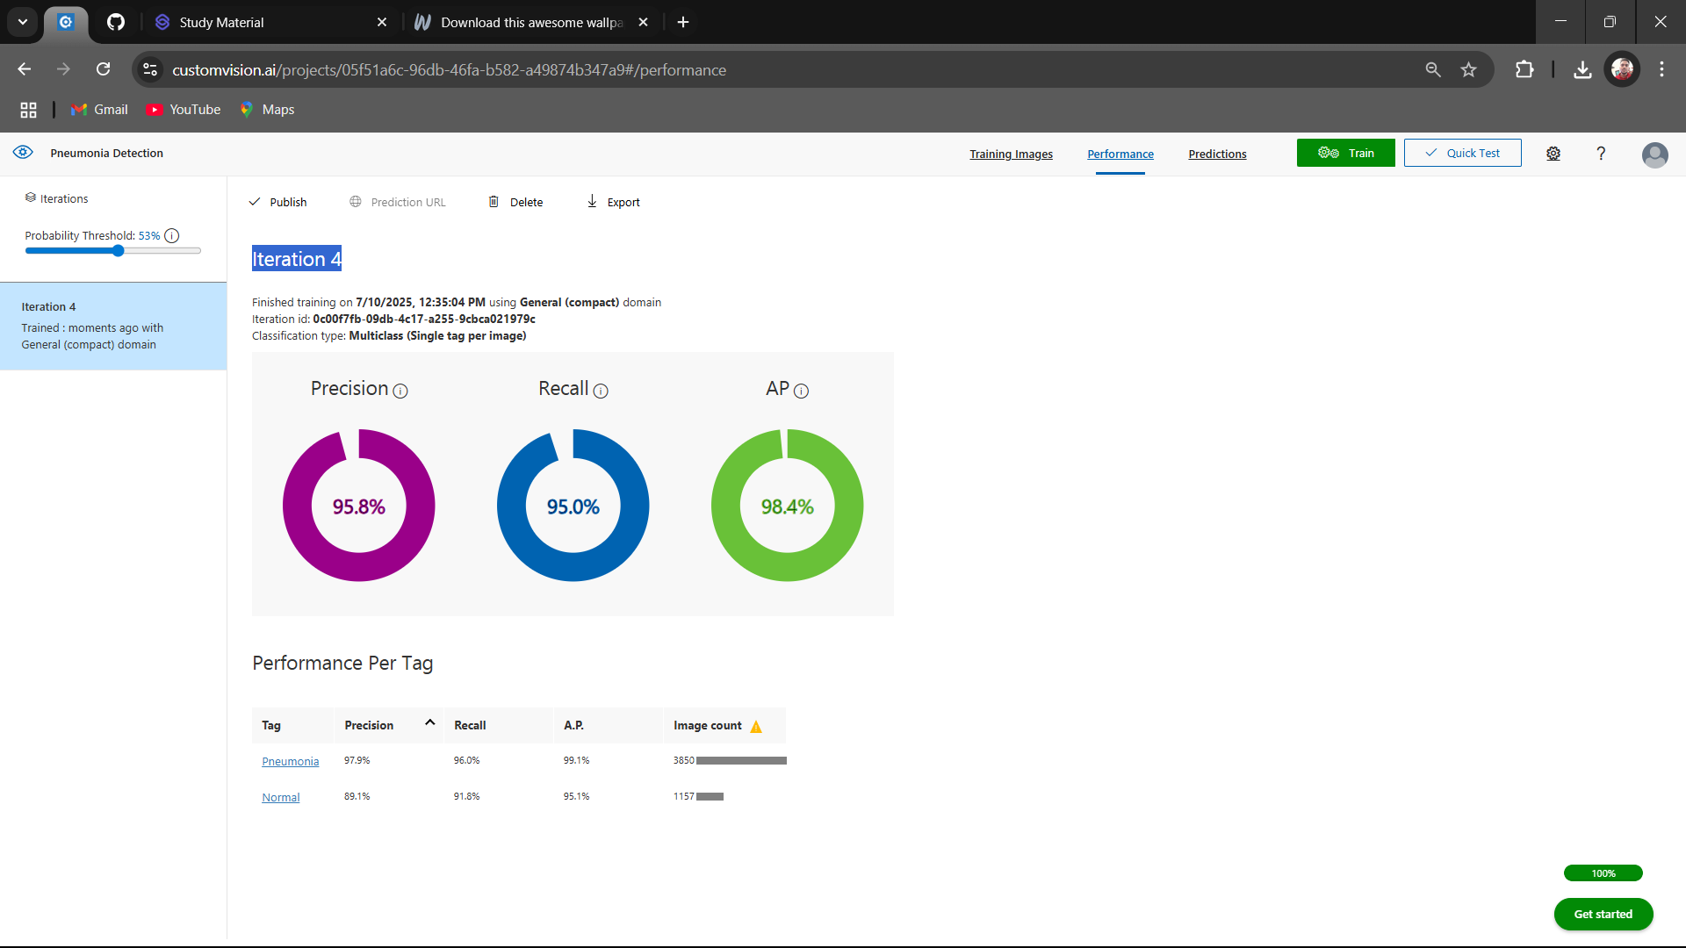
Result
Azure Custom Vision performance metrics

Slide 8
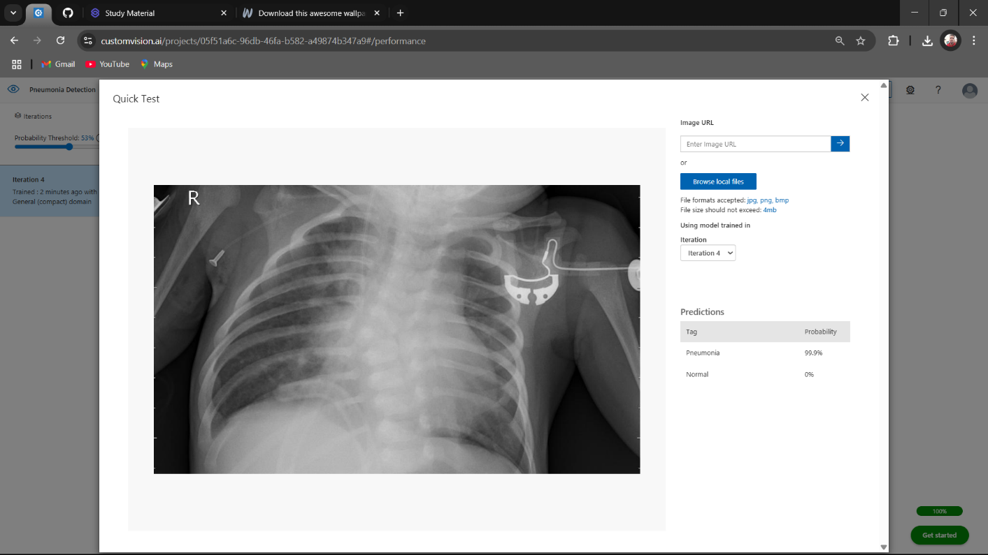
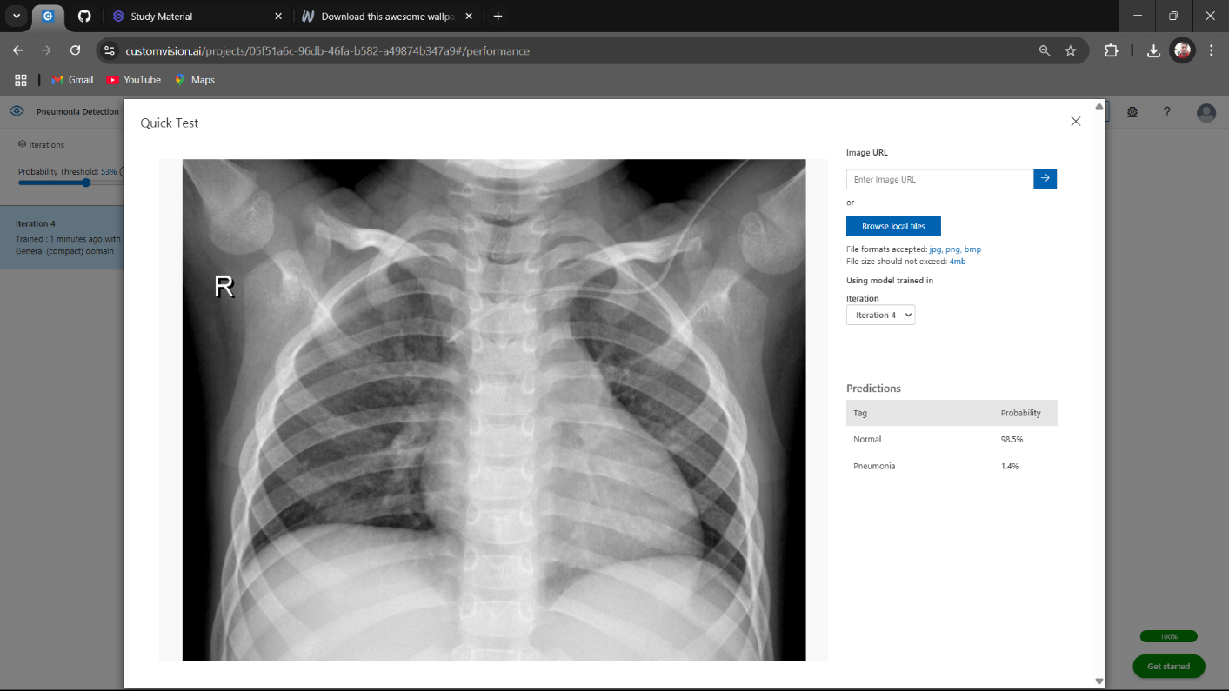
Result
RESULT(OUTPUT IMAGE)
Prediction: Pneumonia (Confidence: 99.9%)
Prediction: Normal (Confidence: 98.5%)

Slide 9
Conclusion
This project serves as a prototype for AI-assisted diagnosis in medical imaging. With larger datasets and integration of explainable AI (XAI) methods, this system can evolve into a clinical tool that supports radiologists and improves early pneumonia detection in underserved regions. Benefits: - Reduces diagnostic time - Works in remote or resource-limited settings - Integrates with healthcare systems via API Challenges: - Image quality variation - Dataset bias

Slide 10
Future scope
1. Deploy as a full-stack web/mobile app. 2. Use larger, more diverse datasets. 3. Integrate with hospital systems (EMR). 4. Extend to detect other diseases (e.g., Tuberculosis). 5. Add explainability using Grad-CAM visualizations.

Slide 11
References
Microsoft Azure Custom Vision Documentation NIH Chest X-ray Dataset https://en.wikipedia.org/wiki/Pneumonia
Related AI/ML research articles on pneumonia detection
https://www.nature.com/articles/s41598-024-52703-2
Github Link- https://github.com/rohit9232/Pneumonia-Detection-AzureAI

Slide 12
Thank you

