Slide 1
UE22CS320B – Capstone Project Phase-2 ESA
Project Title : Intelligent Concept Acquisition System - An AI-Driven Platform for Concept Mastery and Personalized Knowledge Enhancement
Project ID : 170
Project Guide : Prof. Sheela Devi
Project Team : Naveen Radhakrishnan - PES2UG22CS344
Nitish Kumar - PES2UG22CS374
Rohit Yakkundi - PES2UG23CS819
Sharan Surpur - PES2UG23CS821

Slide 2
Outline
Abstract
Suggestions from Review – 1
Suggestions from Review – 2
Analysis and Critique of Research/Relevance -Application in Real world
High Level Design
Design Methodology
Project Progress (Minimum 20% implementation)
Data Preprocessing and Base Model Implementation
Individual Contribution
References

Slide 3
Abstract
Introduction
An AI-driven adaptive learning platform where users upload educational content in the form of documents or videos. The system analyzes the content, generates tailored question papers, evaluates student performance, and identifies learning gaps. Based on performance, the platform dynamically constructs a personalized syllabus and iteratively teaches and tests until mastery is achieved.

Slide 4
Suggestions from Review – 1
Concern 1: Overlap with existing LLMs (ChatGPT, Gemini, Deepseek)
🔹 What differentiates your system from general-purpose LLMs?
Response:
Focused on education-specific content, not generalized knowledge.
Uses user-uploaded study materials for contextual question generation.
Provides personalized, concept-level feedback.
Tracks learning over time, creating a progressive mastery path.
Concern 2: Feasibility of adaptive learning and personalized generation
🔹 Can adaptive mechanisms be realistically implemented?
Response:
Built in modular phases (starting with core features like question generation).
Uses customized AI models (NLP, recommendation systems) for the educational context.
Tested on limited datasets to ensure scalability and reliability before full-scale launch

Slide 5
Analysis and Critique of Research/Relevance -Application in Real world
Analysis and Critique of Research:
Evaluates the strengths and weaknesses of existing research.
Identifies gaps, inconsistencies, or potential improvements.
Relevance:
Examines whether the research aligns with current challenges and industry needs.
Assesses how impactful the research is within its domain.
Application in the Real World:
Determines how the research findings can be implemented practically.
Explores use cases, scalability, and feasibility in real-world scenarios.

Slide 6
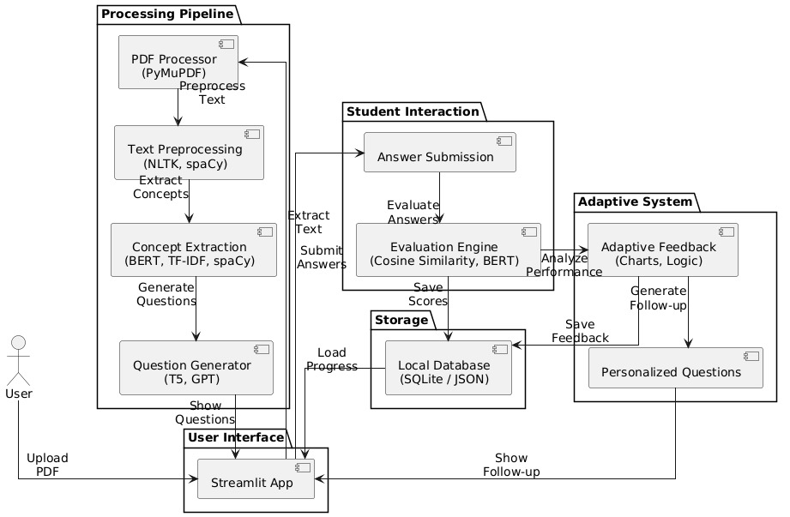
high-level design

Slide 7
Design methodology
Tech Stack:
Python (Flask backend)
scikit-learn, NLTK, spaCy for NLP
SQLite for DB
HTML/CSS + Bootstrap for UI
Approach:
NLP to analyze documents
Rule-based + ML-based question generation
Evaluation by comparing student answers with key concepts

Slide 8
Project Progress-DataPreprocessing and Base model implementation
3.1 User Authentication
Basic user registration and login system implemented.
3.2 Document Upload System
Users can upload various file formats (PDFs, DOCs, videos).
Files are stored and preprocessed for content extraction (currently for text-based documents).
3.3 Content Understanding
NLP pipeline processes uploaded documents to extract key concepts and topics.
Utilizes summarization and keyword extraction models (e.g., spaCy, BERT-based models).

Slide 9
3.4 Question Generation
Implemented question generation based on extracted topics using pre-trained transformer models (like T5 or GPT-based).
Supports MCQs.
3.5 Test Interface
Users can take generated tests via a simple frontend.
Test responses stored for evaluation.
3.6 Automatic Evaluation
answers evaluated automatically.

Slide 10
Individual Contribution
Team Member | Tasks/Modules Assigned | Development (Lines of Code)
Rohit Yakkundi | Module 1 - User interaction portal and communication flow | 620
Naveen Radhakrishnan | Module 4 - Assessment evaluation and adaptation | 650
Sharan Surpur | Module 3 - MCQ Generation | 700
Nitish Kumar | Module 2 - Text extraction and concept identification | 800

Slide 11
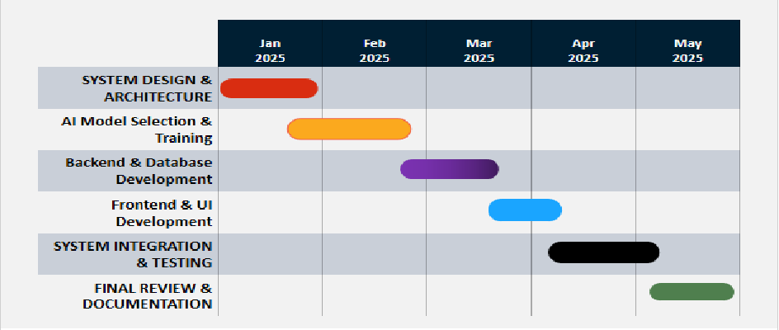
Capstone (Phase-I Phase-II and Phase III) Project Timeline

Slide 12
Conclusion
📘 Project Title: Intelligent Concept Acquisition System – AI-powered adaptive learning platform.
📥 Input: Student-uploaded PDFs/documents as learning material.
🧠 Core Features:
Concept extraction using NLP (spaCy, NLTK, BERT)
AI-based question generation (MCQs, short answers)
Personalized feedback and progress tracking
⚙️ Tech Stack: Python, Flask, scikit-learn, NLTK, spaCy, SQLite.
📈 Implementation Progress:
User login & document upload functional
NLP pipeline & concept extraction working
Question generation using transformer models
Auto-evaluation and basic test interface ready
📅 Next Phase Plan: Enhanced feedback loop, broader dataset testing, and full system integration

Slide 13
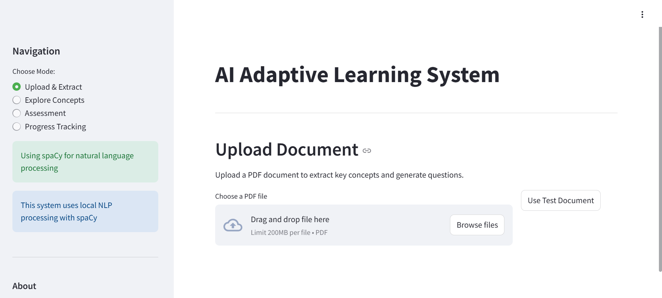
USER INTERFACE

Slide 14
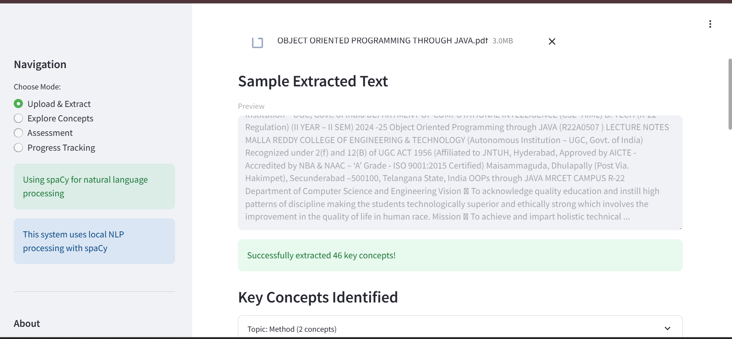
USER INTERFACE

Slide 15
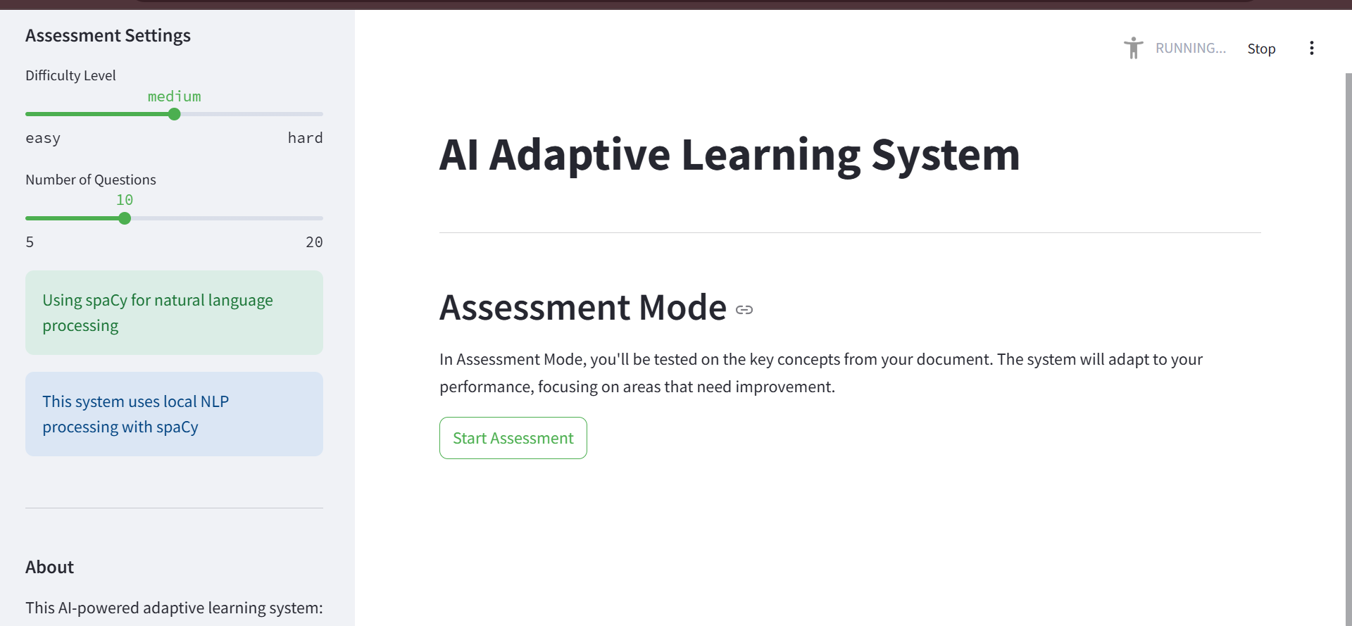
USER INTERFACE

Slide 16
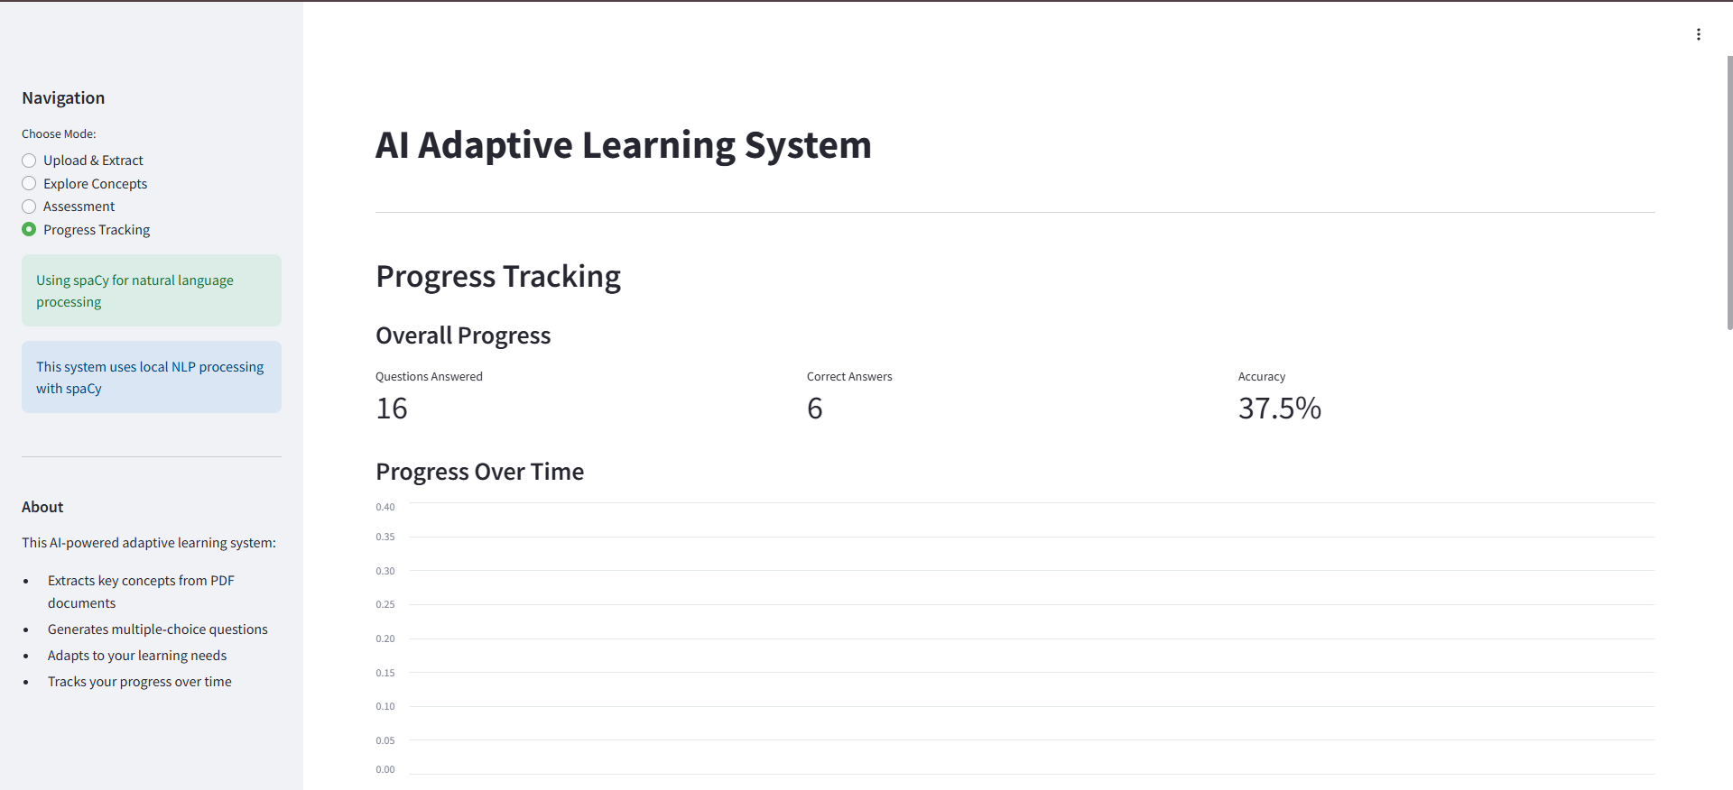
USER INTERFACE

Slide 17
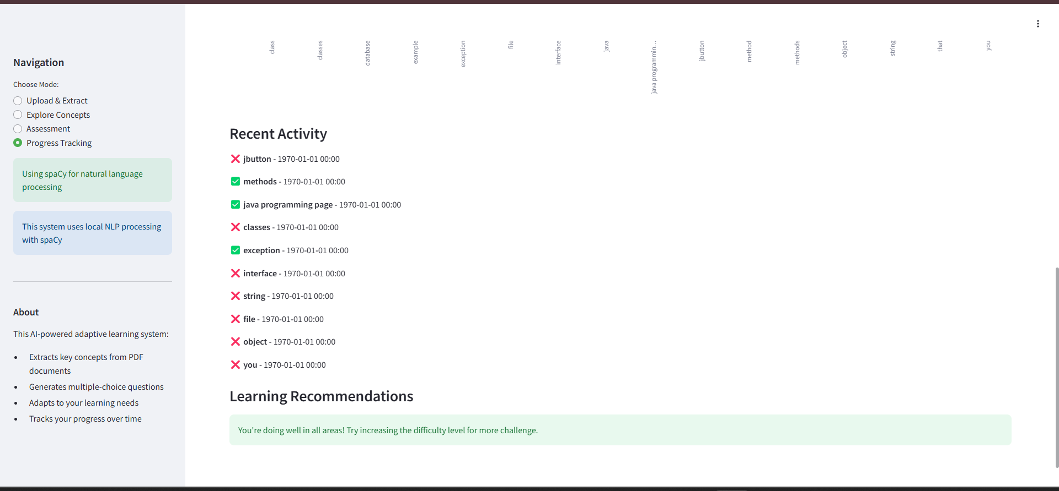
USER INTERFACE

Slide 18
References
[1]S. -C. Kong and Y. Yang, "A Human-Centered Learning and Teaching Framework Using Generative Artificial Intelligence for Self-Regulated Learning Development Through Domain Knowledge Learning in K–12 Settings," in IEEE Transactions on Learning Technologies, vol. 17, pp. 1588-1599, 2024, doi: 10.1109/TLT.2024.3392830.
[2]M. Zafari, J. S. Bazargani, A. Sadeghi-Niaraki and S. -M. Choi, "Artificial Intelligence Applications in K-12 Education: A Systematic Literature Review," in IEEE Access, vol. 10, pp. 61905-61921, 2022, doi: 10.1109/ACCESS.2022.3179356.
[3]I. Gligorea, M. Cioca, R. Oancea, A.-T. Gorski, H. Gorski, and P. Tudorache, “Adaptive Learning Using Artificial Intelligence in e-Learning: A Literature Review,” Education Sciences, vol. 13, no. 12, pp. 1216–1216, Dec. 2023, doi: https://doi.org/10.3390/educsci13121216.

Slide 19
References
[4]S. Chen, Z. Wang, and M. Zhang, "Supporting Teachers’ Professional Development WithGenerative AI: The Effects on Higher Order Thinkinearning Technologies, vol. 17, no. 1, pp. 1-12, Feb. 2024. doi: 10.1109/TLT.2024.3369690
[5]A. M. Turing, "Computing Machinery and Intelligence," Mind, vol. 59, no. 236, pp. 433-460, 1950. [Online]. Available: https://www.sciencedirect.com/science/article/pii/S2666920X22000650. Accessed: Feb. 12, 2025.
[6]Effects of AI-Based Personalized Adaptive Learning System in Higher Education
Y. Cho, "Effects of AI-Based Personalized Adaptive Learning System in Higher Education," International Journal of Artificial Intelligence in Education, vol. 31, no. 2, pp. 1-12, 2021.

Slide 20
Thank You

