Slide 1

Compiler Design
Preet Kanwal
Department of Computer Science & Engineering
Teaching Assistant : Kavya P K

Slide 2

Compiler Design
Unit 3: Static
Single-Assignment(SSA)
Preet Kanwal
Department of Computer Science & Engineering

Slide 3

Compiler Design Lecture Overview
In this lecture, you will learn about -
Static Single-Assignment (SSA) Form
ɸ-function
ɸ-function Examples

Slide 4
Compiler Design
Static Single Assignment (SSA) Form
Each variable is assigned exactly once but may be used multiple times.
Existing variables in the original IR are split into versions:
New version of variable is typically indicated by the original name with a subscript, so that every definition gets its own version.
SSA is an intermediate form widely used by modern optimizing compilers.

Slide 5
Compiler Design
ɸ-function
Control flow can’t be predicted in advance, so we can’t always know which definition of a variable reached a particular use.
To handle this uncertainty, we create ɸ functions.
Notation represents natural “meet points” where values are combined.
No. of arguments to ɸ(a1, a2 ....) is the number of incoming flow edges.
Return value of the function corresponds to the control-flow path taken to get to the statement.

Slide 6
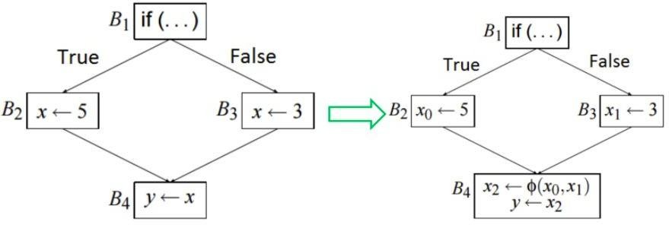
Compiler Design
ɸ-function - Example 1

Slide 7
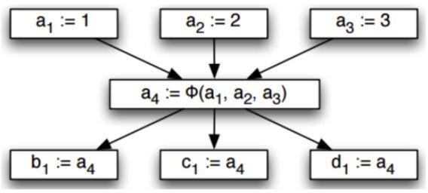
Compiler Design
ɸ-function - Example 2
case (...) of 0: a := 1;
1: a := 2;
2: a := 3;
end
case (...) of 0: b := a;
1: c := a;
2: d := a;
end

Slide 8
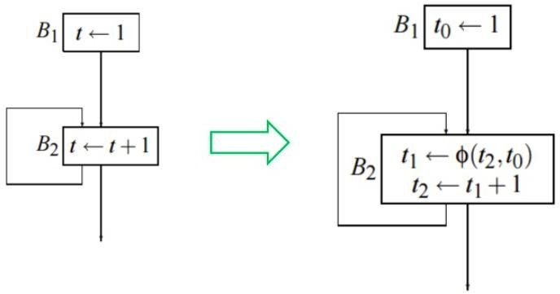
Compiler Design
ɸ-function - Example 3

Slide 9
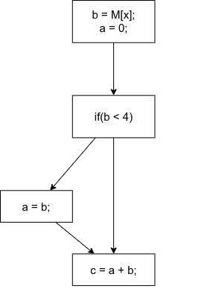
Compiler Design
ɸ-function - Example 4

Slide 10
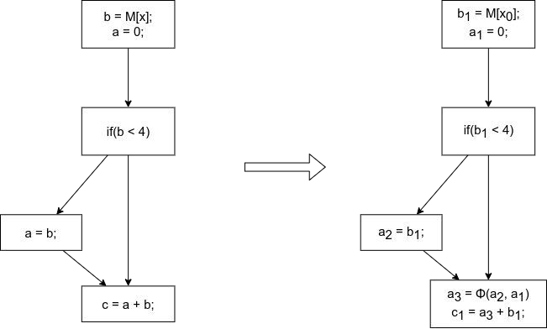
Compiler Design
ɸ-function - Example 4

Slide 11
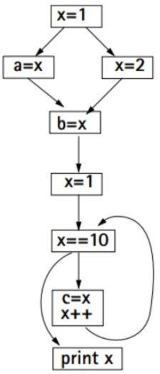
Compiler Design
ɸ-function - Example 5

Slide 12
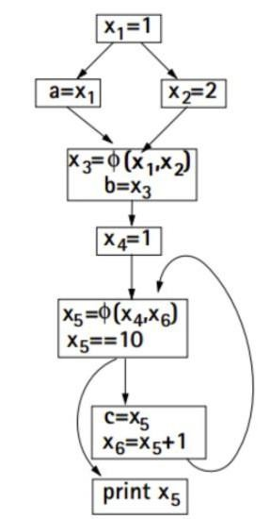
Compiler Design
ɸ-function - Example 5

Slide 13
Compiler Design
ɸ-function - Example 6
Example (contd.)
i = 1
j = 1
k = 0
if k < 100
if j < 20
return j
j = i
k = k + 1
j = k
k = k + 2

Slide 14
Compiler Design
ɸ-function - Example 6
Example (contd.)
SSA
i1 = 1
j1 = 1
k1 = 0
j2 = ɸ (j1,j3,j4) k2 = ɸ (k1,k3,k4) if k2 < 100
if j2 < 20
return j2
j3 = i1 k3 = k2 + 1
j4 = k2 k4 = k2 + 2

Slide 15
Compiler Design
ɸ-function - Example 7
Example
x = 0;
y = 0;
while (x<10){
y = y+x;
x = x+1;
}
print(y);

Slide 16
Compiler Design
ɸ-function - Example 7
Example
x_1 = 0
y_1 = 0
x = 0;
y = 0;
while (x<10){
x_2 = ɸ (x_1,x_3) y_2 = ɸ (y_1,y_3) (x_2 < 10)?
y = y+x;
x = x+1;
}
print(y);
y_3 = y_2 + x_2 x_3 = x_2 + 1
print(y_2)

Slide 17
Compiler Design Note -
Most modern production compilers use SSA form (eg. gcc, suif, llvm, hotspot etc.)
Popular compiler optimizations (eg. constant propagation) become easier to write (and in some cases, algorithmically faster) when applied to programs in SSA form.
Conversion to SSA form introduces a lot of assignments - compilers that do this need to have good register allocators that can eliminate most of them again (not a concern these days).

Slide 18
THANK YOU
Preet Kanwal
Department of Computer Science & Engineering
preetkanwal@pes.edu

