Slide 1

Compiler Design Introduction to the Course
Divyaprabha K N
Assistant Professor,
Department of Computer Science & Engineering

Slide 2

COMPILER DESIGN: UE21CS341B
INTRODUCTION
Divyaprabha K N
Department of Computer Science & Engineering

Slide 3
COMPILER DESIGN
Syllabus
Unit 1 : Compilers The Language Processing System, The Phases of a Compiler, The Grouping of Phases into passes. Lexical Analysis: The Role of the Lexical Analyzer, Input Buffering, Specification of Tokens, Recognition of Tokens, Design of a Lexical Analyzer Generator. Syntax Analysis The role of the parser, Syntax Error Handling, Error-Recovery Strategies. Top-down parsing: Recursive Descent Parser (RDP) with Backtracking, LL(1) Parser. - 22 Slots
Unit 2 : Bottom-up parsing: Shift-Reduce Parsing, LR (0), SLR, viable prefixes, CLR, LALR. Syntax-Directed Translation Syntax-directed definitions, Evaluation orders for SDD’s, Applications of Syntax-Directed Translation, and Syntax-directed Translation Schemes – Postfix Translation Schemes. – 20 Slots

Slide 4
COMPILER DESIGN
Syllabus
Unit 3 : Parser Stack Implementation: Parser Stack Implementation of Postfix SDT's, SDT's with actions inside Productions, SDT's for L-Attributed Definitions. Implementing L-Attributed SDD’s: Bottom-Up Parsing. Intermediate-Code Generation Variants of Syntax Trees – Directed Acyclic Graphs for Expressions, Three-Address Code – Addresses and Instructions, Quadruples, Triples, Indirect Triples, SSA Form, Control Flow Graph. – 22 Slots
Unit 4 : Machine Independent Optimization: Different Optimizations, Optimization of Basic Blocks. Data Flow Analysis: Live-variable analysis, Next-use algorithm. Run-Time Environments Storage Organization, Different Allocation Strategies, Stack Allocation of space, Access to Non local Data on the stack. Code Generation: Issues in the design of a code generator, the target language, addresses in the target code, static allocation, stack allocation, run-time addresses for names. A Simple Code generator - The Code generation algorithm. - 22 Slots
Desirable Knowledge:
UE19CS202- Data Structures and its Application,
UE19CS205- Automata Formal Languages & Logic.

Slide 5
COMPILER DESIGN
Introduction - Overview
Course Contents Compiler Design : UE21CS341B
Unit 1 – Basics of Compiler & Lexical Analysis
Unit 2 – Syntax Analysis
Unit 3 – Syntax Directed Translation
Unit 4 – Intermediate Code Generation, Run-Time Environments

Slide 6

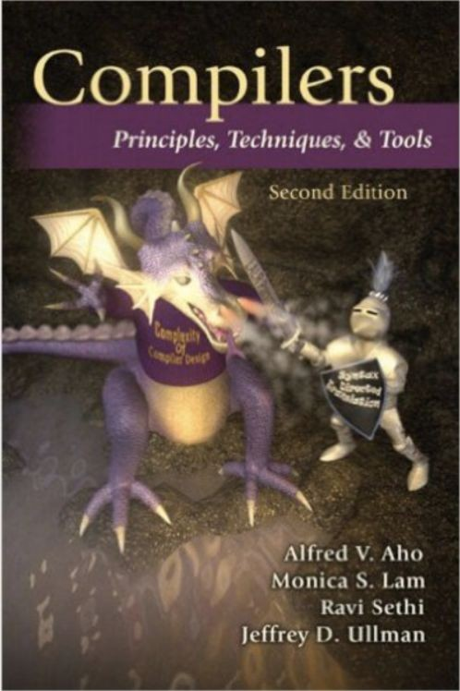
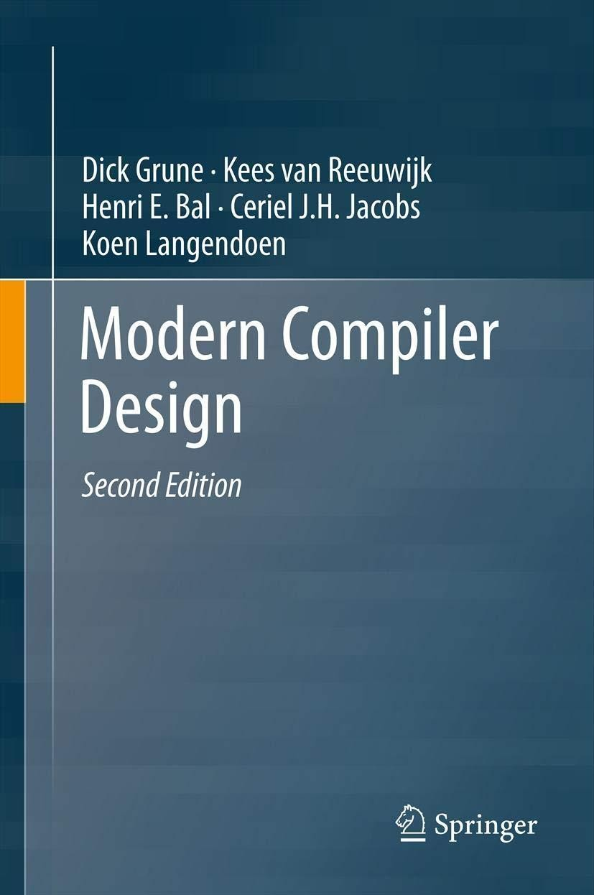
Compiler Design Tools, Text Book and Reference Book
T1 -
“Compilers–Principles, Techniques and Tools” Alfred V. Aho, Monica S. Lam, Ravi Sethi, Jeffery D. Ullman; 2nd Edition
R1 –
“Modern Compiler Design”, Dick Grune, Kees van Reeuwijk, Henri E. Bal, Ceriel J.H. Jacobs, Koen Langendoen; 2nd Edition
Tools/Languages: Lex and Yaac.
T1
R1

Slide 7
COMPILER DESIGN
Course Objectives
Introduce the major concept areas of language translation and compiler design.
Develop a greater understanding of the issues involved in programming language design and implementation.
Provide practical programming skills necessary for constructing a compiler.
Develop an awareness of the function and complexity of modern compilers.
Provide an understanding on the importance and techniques of optimizing a code from compiler's perspective.

Slide 8
COMPILER DESIGN
Course Outcome
At the end of this course, the student will be able to:
Use the knowledge of patterns, tokens and regex for solving the problems in the field of data mining.
Analyze and design the semantic behavior of a compiler.
Choose the appropriate compiler internal representation for different kinds of compiler tasks.
Translate a source-level language into a low-level compiler internal representation.
Optimize the performance of a program in terms of speed and space using new code optimization techniques.

Slide 9
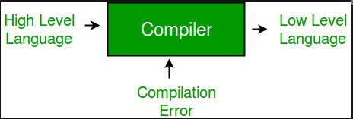
COMPILER DESIGN
Introduction
Compiler Input and Output

Slide 10
Compiler Design
Why study compilers?
Build a large, ambitious software system. See theory come to life.
Learn how to build programming languages.
Learn how programming languages work.
Learn tradeoffs in language design.
A short history of compilers:-
First, there was nothing.
Then, there was machine code.
Then, there were assembly languages.
Programming expensive; 50% of costs for machines went into programming.

Slide 11

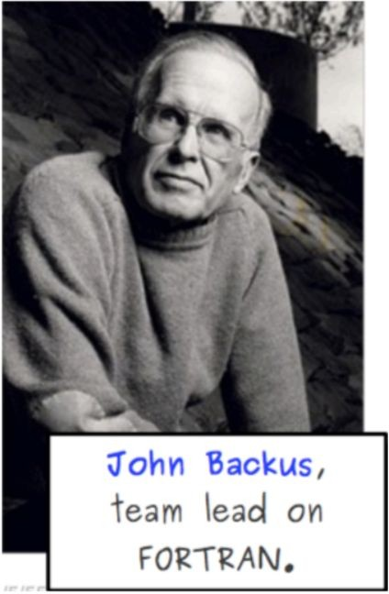
Compiler Design Introduction: Compiler
Rear Admiral Grace Hopper:
Inventor of A-0(1952), COBOL(1959), and the term “compiler.”
FORTRAN (Formula Translation) : first widely used high level programming language. First unambiguously complete compiler. (1954-57)

Slide 12
Compiler Design First C Compiler
First C Compiler (Modified B Compiler : Written in B)
TMG (TransMoGrifier) was the compiler definition tool used by Ken Thompson to write the compiler for the B language on his PDP-7 (an assembler) in 1970.
B was the immediate ancestor of C.

Slide 13
Compiler Design
Self-hosting Compiler
Self-hosting Compiler : Compiler that can compile its own source code.
Example : C, C++ , C#, Java, Pascal, Python, VisualBasic etc
In some of these cases, the initial implementation was not self-hosted, but rather, written in another language (or even in machine language); in other cases, the initial implementation was developed using bootstrapping.

Slide 14
Compiler Design Bootstrapping (Compilers)
Bootstrapping is the technique for producing a self- compiling compiler.
An initial core version of the compiler - the bootstrap compiler - is generated in a different language (which could be assembly language); successive expanded versions of the compiler are developed using this minimal subset of the language.
Example : BASIC, ALGOL, C, D, Pascal, Lisp, Java, Rust, Python.
https://www.geeksforgeeks.org/bootstrapping-in-compiler-design/
Assemblers were the first language tools to bootstrap themselves!

Slide 15
Compiler Design Cross Compiler
Native Compiler
Generates code for the same Platform on which it runs. high language into computer’s native language.
Example: Turbo C or GCC compiler
Converts
A cross compiler is for cross-platform software development of binary code
Cross compiler
A cross compiler is a compiler capable of creating executable code for a platform other than the one on which the compiler is running.
For example, a compiler that runs on a Windows 7 PC but generates code that runs on Android smartphone is a cross compiler. USE : Embedded Computers (Microwave oven, Washing Machine)

Slide 16
Compiler Design
Other Variants - Compiler-compiler (Compiler generator)
A programming tool that creates a parser, interpreter, or compiler from some form of formal description of a programming language and machine.
The most common type of compiler-compiler is more precisely called a parser generator, and only handles syntactic analysis:
its input is a grammar, typically written in Backus–Naur form (BNF) or extended Backus–Naur form (EBNF) that defines the syntax of a programming language
and its output is source code of a parser for the programming language.
Parser generators do not handle the semantics of the programming language, or the generation of machine code for the target machine

Slide 17
COMPILER DESIGN
Introduction
Application of Compiler
Compiler design helps full implementation Of High-Level Programming Languages
Support optimization for Computer Architecture Parallelism
Design of New Memory Hierarchies of Machines
Widely used for Translating Programs
Used with other Software Productivity Tools

Slide 18
THANK YOU
Divyaprabha K N
Department of Computer Science & Engineering
divyaprabha@pes.edu

