Slide 1

Compiler Design
Preet Kanwal
Department of Computer Science & Engineering
Teaching Assistant : Kavya P K

Slide 2

Compiler Design
Unit 2: Syntax Directed Definitions
Preet Kanwal
Department of Computer Science & Engineering

Slide 3
Compiler Design Lecture Overview
In this lecture, you will learn about -
Dependency graphs
Topological Sort
Evaluating SDDs - Example - Simple Desk Calculator
S–Attributed SDD Examples :
Counting Binary bits
Binary to Decimal conversion
Counting parentheses
Identifying the type of an expression - int or float
Identifying the sign of the evaluated expression - positive or negative

Slide 4
Compiler Design
Recap - Evaluating SDDs - Parse tree method
Evaluating an SDD over a given input consists of the following steps -
Construct Parse Tree for given input.
Construct Dependency graph.
Topologically sort the nodes of Dependency graph.
Produce as output Annotated Parse Tree.

Slide 5
Compiler Design Dependency Graphs
Dependency Graphs are the most general technique used to evaluate syntax directed definitions with both synthesized and inherited attributes.
A Dependency Graph shows the interdependencies among the attributes of the various nodes of a parse tree.
There is a node for each attribute.
If attribute b depends on an attribute c there is a link from the node for c to the node for b ( b ← c).
Dependency Rule - If an attribute b depends on attribute c, then we need to fire the semantic rule for c first and then the semantic rule for b.

Slide 6
Compiler Design
Dependency Graphs - Example
Production | Semantic Rule
D → T L | { L.in = T.type;}
T → int | { T.type = integer; }
T → real | { T.type = float; }
L → L , id 1 | { L₁.in= L.in; addType(id.entry, L.in); }
L → id | { addType(id.entry, L.in); }
Consider the earlier example of Syntax Directed Definition for Type Declarations.
This SDD has both inherited and synthesised attributes.
Construct the Annotated parse tree with dependency graph for the input real id1, id2, id3

Slide 7
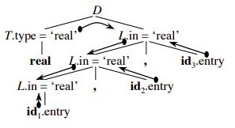
Compiler Design
Dependency Graphs - Example
The figure illustrates the annotated parse tree with the dependencies between attributes.

Slide 8
Compiler Design Topological Sort
The evaluation order of semantic rules depends from a Topological Sort derived from the dependency graph.
Topological Sort - Any ordering m , m , . . . , m such that if m → m is a link in
1 2 k i j
the dependency graph then m_{i} < m_{j} .
Any topological sort of a dependency graph gives a valid order to evaluate the semantic rules.

Slide 9
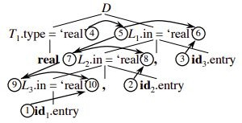
Compiler Design Topological Sort - Example
Consider the previous example of SDD for Type declarations
The topological sort of the parse tree is as follows -
Get id1.entry
Get id2.entry
Get id3.entry
T₁.type=‘real’
L₁.in=T₁.type
addtype(id3.entry, L₁.in)
L₂.in=L₁.in
addtype(id2.entry, L₂.in)
L₃.in=L₂.in
addtype(id1.entry, L₃.in)

Slide 10
Compiler Design
Example - Evaluating SDD to implement a Simple Desk Calculator
Evaluate the following SDD for the input 3 + 4 * 5
Production | Semantic Rule
E → E + T 1 | { E.val = E₁.val + T.val }
E → T | { E.val = T.val }
T→ T * F 1 | { T.val = T₁.val * F.val }
T → F | { T.val = F.val }
F → num | { F.val = num.lexval }

Slide 11
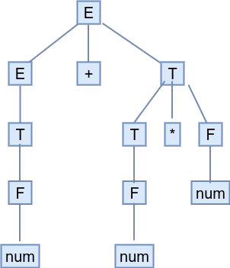
Compiler Design
Example - Evaluating SDD to implement a Simple Desk Calculator
Evaluate the following SDD for the input 3 + 4 * 5 Solution -
Construct Parse tree
Nodes are Terminals or Non-Terminals

Slide 12
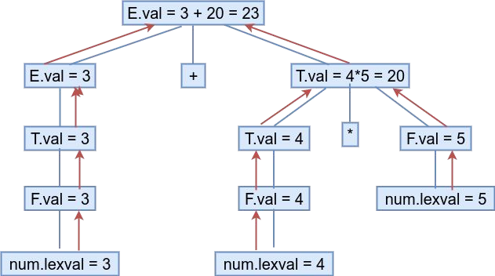
Compiler Design
Example - Evaluating SDD to implement a Simple Desk Calculator
Evaluate the following SDD for the input 3 + 4 * 5 Solution -
Construct dependency graph
Nodes are attributes

Slide 13
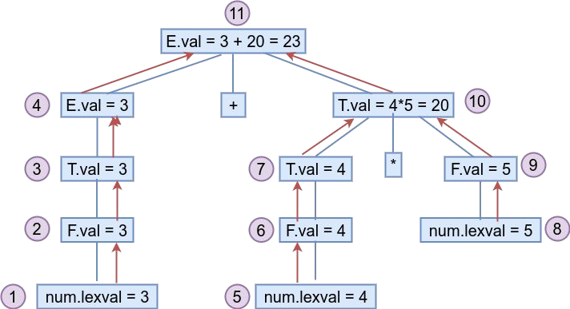
Compiler Design
Example - Evaluating SDD to implement a Simple Desk Calculator
Evaluate the following SDD for the input 3 + 4 * 5
Solution -
3. Decide Evaluation order nodes in Dependency graph
1,5,8,2,3,6,7,9,4,10,11
of the
Output -Annotated Parse tree carrying out the input.

Slide 14
Compiler Design
Evaluating SDDs - General Remarks
Attributes can be evaluated by building a dependency graph at compile-time and then finding a topological sort.
Disadvantages
This method fails if the dependency graph has a cycle - We need a test for non-circularity.
This method is time consuming due to the construction of the dependency graph.
Alternative Approach
Design the syntax directed definition in such a way that attributes can be
evaluated with a fixed order avoiding the need to graph - for example, S attributed definitions.
This method is followed by many compilers.
build the dependency

Slide 15
Compiler Design
Evaluating S-Attributed Definitions
Synthesized Attributes can be evaluated by a bottom-up parser as the input is being analyzed avoiding the construction of a dependency graph.
The parser keeps the values of the synthesized attributes in its stack.
Whenever a reduction A → α is made, the attribute for A is computed from the attributes of α which appear on the stack.
Thus, a translator for an S-Attributed Definition can be simply implemented by extending the stack of an LR-Parser.

Slide 16
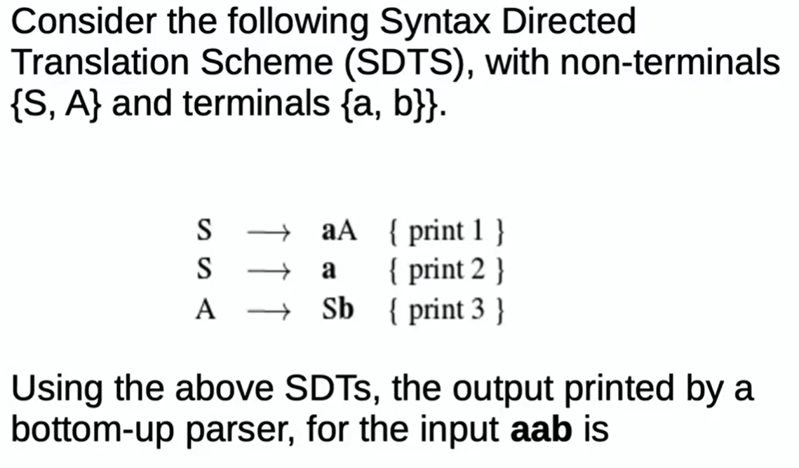
Compiler Design
Example

Slide 17
S-attributed SDDs - Examples

Slide 18
Compiler Design
Example 1 - SDD to count no. of 1s in a Binary Number
Production | Semantic Rule
L → L B 1 | { L.count = L₁.count + B.count; }
L → B | { L.count = B.count; }
B → 0 | { B.count = 0; }
B → 1 | { B.count = 1; }

Slide 19
Compiler Design
Example 2 - SDD to count no. of 0s in a Binary Number
Production | Semantic Rule
L → L B 1 | { L.count = L₁.count + B.count; }
L → B | { L.count = B.count; }
B → 0 | { B.count = 1; }
B → 1 | { B.count = 0; }

Slide 20
Compiler Design
Example 3 - SDD to count no. of bits in a Binary Number
Production | Semantic Rule
L → L B 1 | { L.count = L₁.count + B.count; }
L → B | { L.count = B.count; }
B → 0 | { B.count = 1; }
B → 1 | { B.count = 1; }

Slide 21
Compiler Design
Example 4 - SDD to convert Binary to Decimal
Production | Semantic Rule
L → L B 1 | { L.val = 2 * L₁.val + B.val; }
L → B | { L.val = B.val; }
B → 0 | { B.val = 0; }
B → 1 | { B.val = 1; }
https://gateoverflow.in/1738/Gate-cse-1998-question-23

Slide 22
Compiler Design
Example 5 - SDD to convert Binary Fraction to Decimal
Production | Semantic Rule
S → L .L 1 2 | L2.count { S.val = L₁.val + L₂.val / 2 ; }
L → L B 1 | { L.val = 2 * L₁.val + B.val; L.count = L₁.count + B.count;}
L → B | { L.val = B.val; L.count = B.count; }
B→ 0 | { B.val = 0; B.count = 1; }
B→ 1 | { B.val = 1; B.count = 1;}

Slide 23
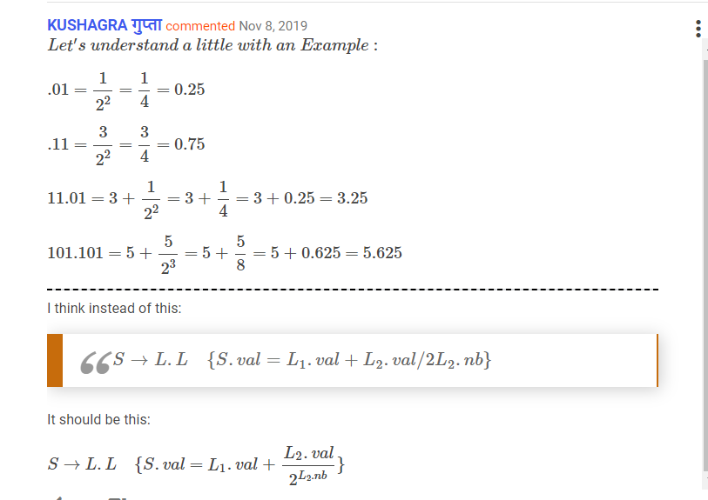
Compiler Design
Example 5 - SDD to convert Binary Fraction to Decimal

Slide 24
Compiler Design
Example 6 - SDD to count no. of balanced Parentheses
Production | Semantic Rule
S → (S ) 1 | { S.count = S₁.count + 1; }
S → a | { S.count = 0; }

Slide 25
Compiler Design
Example 7- SDD to convert infix to postfix
Production | Semantic Rule
E → E + T 1 | { printf(“+”); }
E → T
T→ T * F 1 | { printf(“*”); }
T → F
F → num | { printf(“%d”,num.lexval); }
https://cs.nyu.edu/~gottlieb/courses/2000s/2006-07-spring/compilers/lectures/lecture-02.html#:~:text=Definition%3A%20A%20syntax%2Ddirected%20translation,adds%20something%20at%20the%20end.

Slide 26
Compiler Design
Example 8 - SDD to determine type of each Term and Expression
The given grammar is for expressions involving operator + and integer or floating-point operands.
Floating-point numbers are distinguished by having a decimal point.
E -> E + T | T
T -> num . num | num
Write an SDD to determine the type of each term T and expression.

Slide 27
Compiler Design
Example 8 - SDD to determine type of each Term and Expression
Production |  | Semantic Rule
E → | E₁+ T | { } | if( E₁.type == float || T.type == float) { E.type = float; } else { E.type = integer; }
E → | T | { E.type = T.type }
T → | num . num | { T.type = float ; }
T → | num | { T.type = integer ; }

Slide 28
Compiler Design
Example 9 - SDD to Identify the sign of the evaluated expression
Given - an attribute grammar G for arithmetic expressions using multiplication, unary -, and unary +.
Complete the SDD -
Add semantic actions to compute an attribute E.sign for non-terminal E to record whether the arithmetic value of E is positive or negative.
The attribute sign can have two values,either POS or NEG.
Also, show the parse tree for input 2 * - 3
Production |  | Semantic Rule
S → | E | { if( E.sign == POS) print(“Result is positive”); else print(“Result is negative”); }
E → | num
E → | + E₁
E → | - E₁
E → | E₁* E₂

Slide 29
Compiler Design
Example 9 - SDD to Identify the sign of the evaluated expression
Production |  | Semantic Rule
S → | E | { if( E.sign == POS) print(“Result is positive”); else print(“Result is negative”); }
E → | num | { E.sign = POS; }
E → | + E₁ | { E.sign = E₁.sign}
E → | - E₁ | { if ( E1.sign == POS) E.sign = NEG; else E.sign = POS; }
E → | E₁* E₂ | { if ( E₁.sign == E₂.sign E.sign = POS; else E.sign = NEG; }

Slide 30
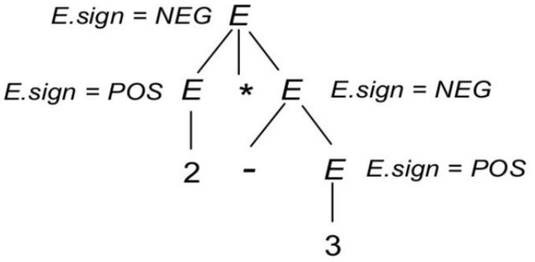
Compiler Design
Example 9 - SDD to Identify the sign of the evaluated expression (cont.)
Show the parse tree for input 2 * - 3 (where 2 and 3 are “unsigned_ints”). Indicate at each node what the values of associated attributes are.
Solution -

Slide 31
THANK YOU
Preet Kanwal
Department of Computer Science & Engineering
preetkanwal@pes.edu

