Slide 1

Compiler Design
Preet Kanwal
Department of Computer Science & Engineering
Teaching Assistant : Sree Pranavi G

Slide 2

Compiler Design
Unit 3: L-Attributed SDD - Intermediate Code Generation
Preet Kanwal
Department of Computer Science & Engineering

Slide 3
Compiler Design Lecture Overview
In this lecture, you will learn about -
L–Attributed SDD to generate intermediate code for -
Expressions
Condition statement
If statement
If-else statement
While statement
Do - while statement
For statement
Boolean expressions

Slide 4
Compiler Design Recap
There are 2 kinds of attributes - Synthesized and Inherited.
An SDD with only synthesized attributes is an S-attributed definition.
An SDD is L-attributed if all its attributes are either -
Synthesized
Extended synthesized dependent on children as well as inherited attributes.
Inherited but dependent only on inherited attributes at parent and any siblings at left.
Every S-attributed SDD is also L-attributed.

Slide 5
Compiler Design
SDD to generate Intermediate Code - Arithmetic Expressions
Write the SDD to generate intermediate code.
The given example indicates the code and its corresponding intermediate code for an expression a = b + - c .
Input | Output
a = b + - c | t1 = minus c t2 = b + t1 a = t2

Slide 6
Compiler Design
SDD to generate Intermediate Code - Arithmetic Expressions
Assigning appropriate semantic rules to each production -
Production | Semantic Rule
S -> id = E; | S.code = E.code || gen(top.get(id.lexval) ‘=’ E.addr)
E -> E1 + E2 | E.addr = new Temp(); E.code = E1.code || E2.code || gen(E.addr '=' E1.addr '+' E2.addr)
E -> -E1 | E.addr = new Temp(); E.code = E1.code || gen(E.addr '=' 'minus' E1.addr)
E -> (E1) | E.addr = E1.addr E.code = E1.code
E -> id | E.addr = top.get(id.lexval) E.code = ' '

Slide 7
Compiler Design
SDD to generate Intermediate Code - Arithmetic Expressions
Assigning appropriate semantic rules to each production - Explaination
The syntax-directed definition in the above slide builds up the three-address code for an assignment statement S using attribute code for S and attributes addr and
code for an expression E.
Attributes S.code and E.code denote the three-address code for S and E, respectively.
Attribute E.addr denotes the address that will hold the value of E.
NOTE: An address can be a name, a constant, or a compiler-generated temporary.
E -> id E.addr = top.get(id.lexval)
E.code = ' ‘
When an expression is a single identifier, say x, then x itself holds the value of the expression. The semantic rules for this production define E.addr to point to the symbol-table entry for this instance of id. Let top denote the current symbol table. Function top. get retrieves the entry when it is applied to the string representation id.lexval of this instance of id. E.code is set to the empty string.

Slide 8
Compiler Design
SDD to generate Intermediate Code - Arithmetic Expressions
Assigning appropriate semantic rules to each production – Explaination
E -> (E1) E.addr = E1.addr
E.code = E1.code
When E —> (E1), the translation of E is the same as that of the subexpression
E1. Hence, E.addr equals E1.addr, and E.code equals E1.code.
S -> id = E; S.code = E.code || gen(top.get(id.lexval) ‘=’ E.addr)
generates instructions that assign the value of expression E to the identifier id. The semantic rule for this production uses function top.get to determine the address of the identifier represented by id, as in the rules for E —> id.
S.code consists of the instructions to compute the value of E into an address given by E.addr, followed by an assignment to the address top.get(id.lexval) for this instance of id.

Slide 9
Compiler Design
SDD to generate Intermediate Code - Arithmetic Expressions
Assigning appropriate semantic rules to each production – Explaination
E -> E1 + E2 E.addr = new Temp();
E.code = E1.code || E2.code || gen(E.addr '=' E1.addr '+' E2.addr)
The operators + and unary are representative of the operators in a typical language. The semantic rules for E —> E1 + E2, generate code to compute the value of E from the values of E1 and E2. Values are computed into newly generated temporary names. If E1 is computed into E1.addr and E2 into E2. addr, then E1 + E2 translates into t = E1. addr + E2. addr, where t is a new temporary name. E.addr is set to t.
A sequence of distinct temporary names t1,t2,... is created by successively executing new Temp().
we use the notation gen(x '=' y '+' z) to represent the three-address instruction x = y + z. Expressions appearing in place of variables like x, y, and z are evaluated when passed to gen, and quoted strings like are taken literally. Other three-address instructions will be built up similarly by applying gen to a combination of expressions and strings.
When we translate the production E -> E1+E2, the semantic rules build up from E.code by concatenating E1.code, E2.code, and an instruction that adds the values of E1 and E2. The instruction puts the result of the addition into a new temporary name for E, denoted by E.addr.

Slide 10
SDD for ICG of unambiguous grammar
Production | Semantic Rule
E-> E1 + T
E -> T
T->T1 * F
T-> F
F -> id

Slide 11
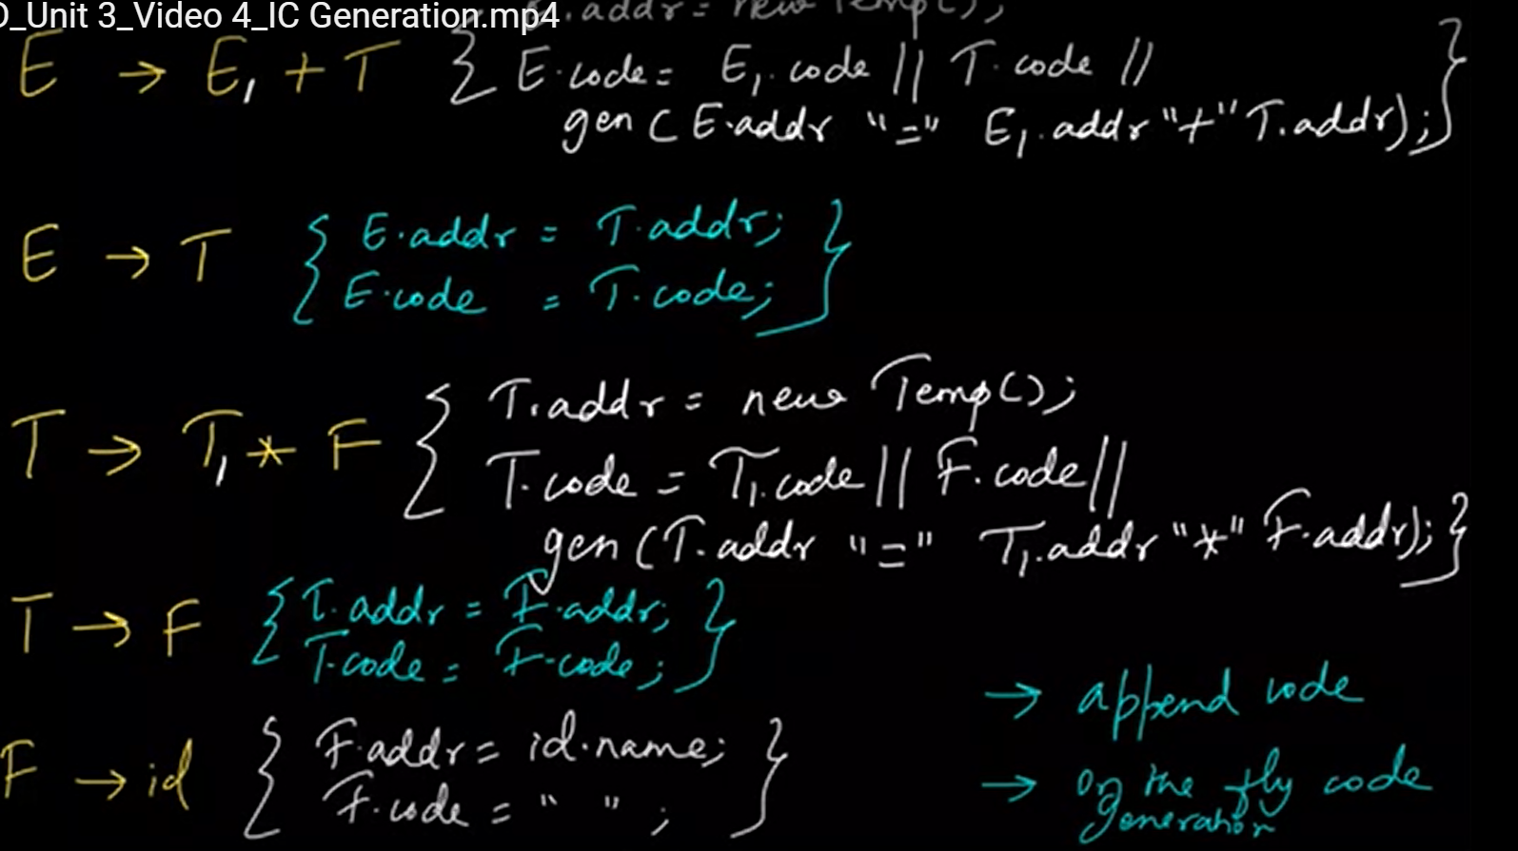
SDD for ICG of unambiguous grammar

Slide 12
Consider the syntax directed definition shown below.
S → id : = E {gen (id.place = E.place;);}
E → E1 + E2 {t = newtemp ( ); gen (t = El.place + E2.place;); E.place = t}
E → id {E.place = id.place;}
Here, gen is a function that generates the output code, and newtemp is a function that returns the name of a new temporary variable on every call.
For the statement 'X: = Y + Z', the 3-address code sequence generated by this definition is
X = Y + Z
t1 = Y + Z; X = t1
t1= Y; t2 = t1 + Z; X = t2
t1 = Y; t2 = Z; t3 = t1 + t2; X = t3
Answer :?

Slide 13
Compiler Design
SDD to generate Intermediate Code - Conditions
Production | Semantic Rule
C -> id1 rel id2 | C.code = gen('if' id1.lexval rel.op id2.lexval 'goto' C.true) || gen('goto' C.false)
rel -> > | rel.op = “>”
rel -> < | rel.op = “<”
rel -> >= | rel.op = “>=”
rel -> <= | rel.op = “<=”

Slide 14
Compiler Design
SDD to generate Intermediate Code - If Statement
Production | Semantic Rule
S -> if (C) S1 | L1 = new Label(); C.true = L1; or C.true = new Label() C.false = S.next; S1.next = S.next; (optional) S.code = C.code || label(L1) || S1.code

Slide 15
Compiler Design
SDD to generate Intermediate Code - If statement
to C.true
C.code
to C.false
C.true :
S1.code
Production | Semantic Rule
S -> if (C) S1 | L1 = new Label(); C.true = L1; C.false = S.next; S1.next = S.next; S.code = C.code || label(L1) || S1.code
L1 = new Label()
C.false :
…

Slide 16
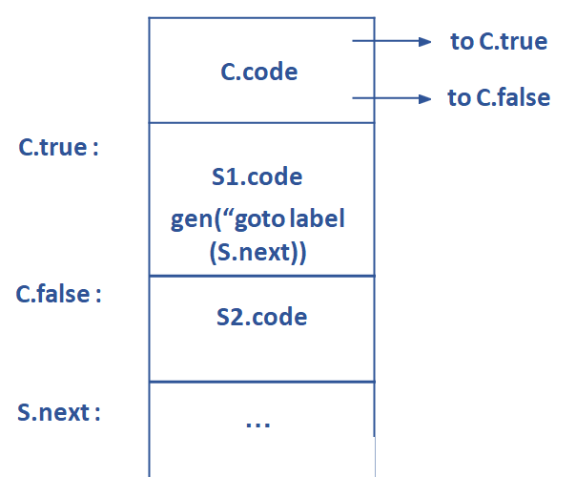
Compiler Design
SDD to generate Intermediate Code
If Else
S -> if ( C ) S1 else S2
C.true = new label(); C.false = new label(); S1.next = S.next;
S2.next = S.next;
S.code = C.code || label(C.true) || S1.code || gen(“goto” label(S.next)) || label(C.false) || S2.code

Slide 17
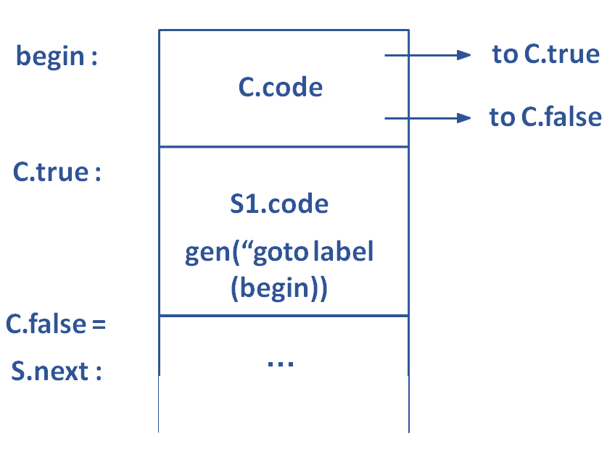
Compiler Design
SDD to generate Intermediate Code
While
S -> while ( C ) S1
begin = new label(); C.true = new label(); C.false = S.next; S1.next = begin;
S.code = label(begin) || C.code || label(C.true) || S1.code || gen(“goto” label(begin))

Slide 18
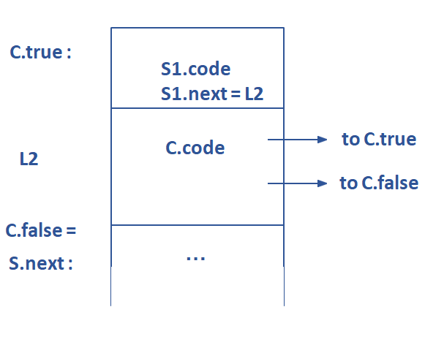
Compiler Design
SDD to generate Intermediate Code
Do - While
S -> do ( S1 ) while ( C )
C.true = new label(); C.false = S.next;
S.code = label(C.true) || S1.code ||C.code

Slide 19
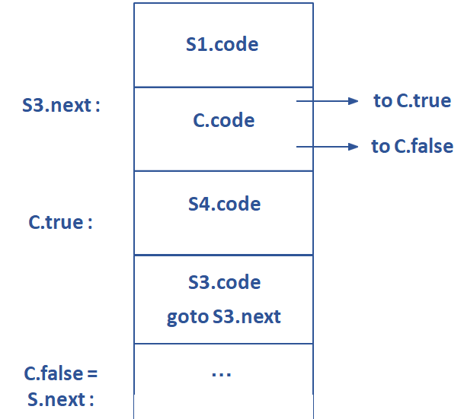
Compiler Design
SDD to generate Intermediate Code
For
S -> for (S1 ; C; S3) S4
C.true = new label(); C.false = S.next; S3.next = new label();
S.code = S1.code || label(S3.next) || C.code
||label(C.true)|| S4.code|| S3.code
|| gen(“goto S3.next);

Slide 20
Compiler Design
SDD to generate Intermediate Code
Boolean Expressions
B -> B1 || B2
B.true = B1.true B1.false = newl label(); B.true = B2.true B.false = B2.false
B.code = B1.code || label (B1.false) || B2.code
Suppose B is of the form B1 || B2 . If B1 is true then B is true. If B1 is false then B2 must be evaluated , so we make B1.false be the label of the first instruction in the code for B2.
The true and false exits of B2are same as the true and false exits of B respectively.

Slide 21
Compiler Design
SDD to generate Intermediate Code
Boolean Expressions
B -> B1 && B2
B.false = B1.false B1.true = newl label(); B.true = B2.true B.false = B2.false
B.code = B1.code || label (B1.true) || B2.code

Slide 22
Compiler Design
SDD to generate Intermediate Code
Boolean Expressions
B -> ! B1
B.true = B1.false B.false = B1.true B.code = B1.code

Slide 23
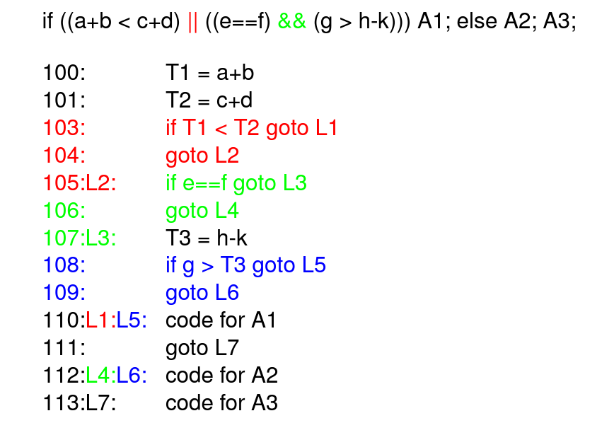
Compiler Design
SDD to generate Intermediate Code
Generate Intermediate Code for the following example :

Slide 24
Compiler Design
SDD to generate Intermediate Code
Generate Intermediate Code for the following example :
if ( x > 10)
{
x = x + 1
}
Grammar -
S -> if (B) { S1 }
B -> id1 > id2
S1 ->
E -> E1 + E2
E2 -> id
id = E;

Slide 25
THANK YOU
Preet Kanwal
Department of Computer Science & Engineering
preetkanwal@pes.edu

